Slide 1

5 Cuda Key Concept
Peter H. Chen

Slide 2
5 Cuda Key Concept
https://www.tutorialspoint.com/cuda/cuda_key_concepts.htm
Cuda Key Concept
We discuss key concept of Cuda
1. data parallelism,
2. program structure, and
3. execution

Slide 3
5.1 Data Parallelism

Slide 4
5.1 Data Parallelism
https://www.tutorialspoint.com/cuda/cuda_key_concepts.htm
Data Parallelism
The modern applications process large amounts of data that will result the significant execution time on sequential computers.
An example of such an application is rendering pixels.
For example, an application that converts RGB pixels to grayscale.
To process a 1920 x 1080 image, the application has to process 2073600 pixels.
To process all those pixels on a traditional uniprocessor CPU will take a very long time since the execution will be done sequentially.
The time taken will be proportional to the number of pixels in the image.
Further, it is very inefficient since the operation that is performed on each pixel is the same, but different on the data, i.e., SPMD (Single Program Multiple Data).
Since processing one pixel is independent of the processing of any other pixel, all the pixels can be processed in parallel.
If we use 2073600 threads (“workers”) and each thread processes one pixel, the task can be reduced to constant time.

Slide 5
5.1 Data Parallelism
https://www.tutorialspoint.com/cuda/cuda_key_concepts.htm
Data Parallelism
Millions of such threads can be launched on modern GPUs.
As has already been explained in the previous chapters, GPU is traditionally used for rendering graphics.
For example, per-pixel lighting is a highly parallel, and data-intensive task and a GPU is perfect for the job.
We can map each pixel with a thread and they all can be processed in O (1) constant time.
Image processing and computer graphics are not the only areas in which we harness data parallelism to our advantage.

Slide 6

5.1 Data Parallelism
https://www.tutorialspoint.com/cuda/cuda_key_concepts.htm
Data Parallelism
Many high-performance algebra libraries today such as CU-BLAS (Cuda-Basic Linear Algebra Subroutine) harness (string mount on horse, dog, and etc.) the processing power of the modern GPU to perform data intensive algebra operations.
One such operation, matrix multiplication has been explained in the later sections.
Harness (string mount on dog)

Slide 7
5.2 Program Structure of Cuda

Slide 8
5.2 Program Structure of Cuda
https://www.tutorialspoint.com/cuda/cuda_key_concepts.htm
Program Structure of Cuda
A typical CUDA program has code for both the GPU and the CPU.
By default, a traditional C program is a CUDA program with only the host code.
The CPU is referred to as the host, and the GPU is referred to as the device.
The host code can be compiled by a traditional C compiler, such as the GCC.
The device code needs a special compiler to understand the api functions that are used.
For NVIDIA GPUs, the compiler is called the NVCC (Nvidia C Compiler).
The host code runs on the CPU and the device code runs on the GPU.
The NVCC processes a CUDA program, and separates the host code from the device code.
To accomplish this, special CUDA keywords are looked for.
The code intended to run of the GPU (device code) is marked with special CUDA keywords for labelling data-parallel functions, called Cuda ‘Kernels’.

Slide 9
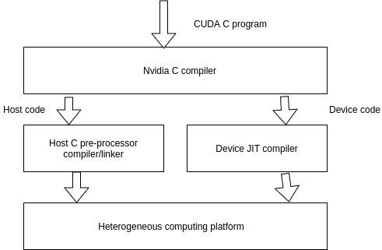
5.2 Program Structure of Cuda
https://www.tutorialspoint.com/cuda/cuda_key_concepts.htm
Program Structure of Cuda
The device code is further compiled by the NVCC and executed on the GPU.

Slide 10
5.3 Cuda Program Execution

Slide 11
5.3 Cuda Program Execution
https://www.tutorialspoint.com/cuda/cuda_key_concepts.htm
Cuda Program Execution
How does a CUDA program work?
While writing a CUDA program, the programmer has explicit control on the number of threads that he wants to launch (this is a carefully decided-upon number).
These threads collectively form a three-dimensional grid (threads are packed into blocks, and blocks are packed into grids).
Each thread is given a unique identifier, which can be used to identify what data it is to be acted upon.

Slide 12
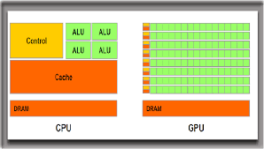
5.3 Cuda Program Execution
https://www.tutorialspoint.com/cuda/cuda_key_concepts.htm
Device Global Memory and Data Transfer
In previous discussion, a typical GPU comes with its own global memory, i.e., DRAM (Dynamic Random Access Memory).
For example, the NVIDIA GTX 480 has DRAM size equal to 4G.
From now on, we will call this memory the device memory.
To execute a kernel on the GPU, the programmer needs to allocate separate memory on the GPU by writing code.

Slide 13
5.3 Cuda Program Execution
https://www.tutorialspoint.com/cuda/cuda_key_concepts.htm
Device Global Memory and Data Transfer
The CUDA API provides specific functions for accomplishing this.
Here is the flow sequence −
After allocating memory on the device, data has to be transferred from the host memory to the device memory.
After the kernel is executed on the device, the result has to be transferred back from the device memory to the host memory.
The allocated memory on the device has to be freed-up. The host can access the device memory and transfer data to and from it, but not the other way round.
CUDA provides API functions to accomplish all these steps.

Slide 14
End

