Slide 1

01 Python Addition
Peter H. Chen

Slide 2
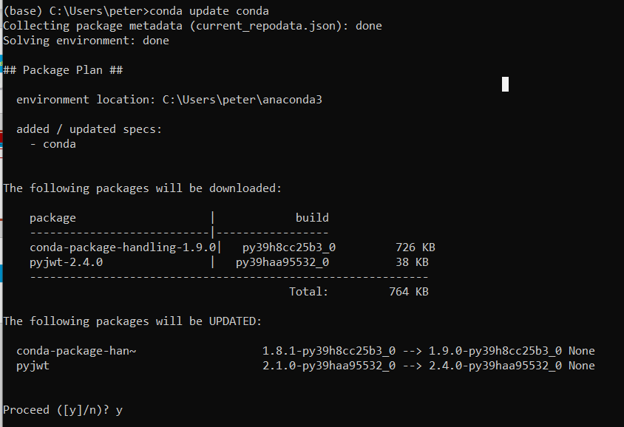
01 Python Addition
https://www.youtube.com/watch?v=vMZ7tK-RYYc&list=PL5B692fm6--vScfBaxgY89IRWFzDt0Khm&index=3
Python Addition
1. Download Anaconda.
2. Update anaconda: > conda update conda

Slide 3
01.1 Install Numba and cudatoolkit

Slide 4
01.1 Regular Python Code

Slide 5
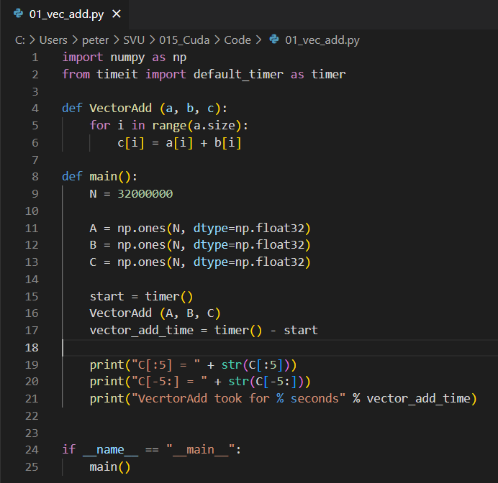
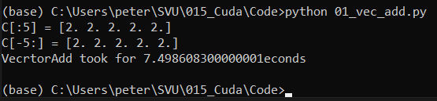
01.1 Regular Python Code
https://www.youtube.com/watch?v=vMZ7tK-RYYc&list=PL5B692fm6--vScfBaxgY89IRWFzDt0Khm&index=3
Python Code
> python 01_vec_add.py

Slide 6
End

