Slide 1

02 Cuda Python
Peter H. Chen

Slide 2
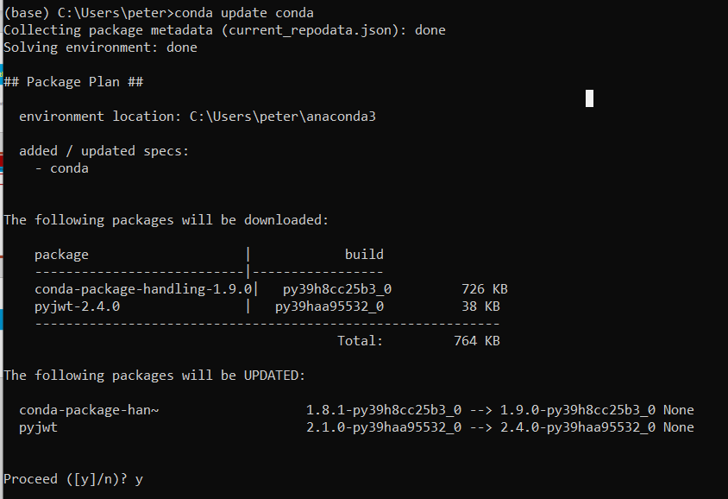
01 Cuda Python
https://www.youtube.com/watch?v=vMZ7tK-RYYc&list=PL5B692fm6--vScfBaxgY89IRWFzDt0Khm&index=3
Cuda Python
1. Download Anaconda.
2. Update anaconda: > conda update conda

Slide 3
01.1 Install Numba and cudatoolkit

Slide 4
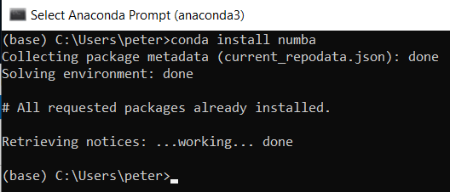
01.1 Install Numba and cudatoolkit
https://www.youtube.com/watch?v=vMZ7tK-RYYc&list=PL5B692fm6--vScfBaxgY89IRWFzDt0Khm&index=3
Install Numba
> conda install numba

Slide 5
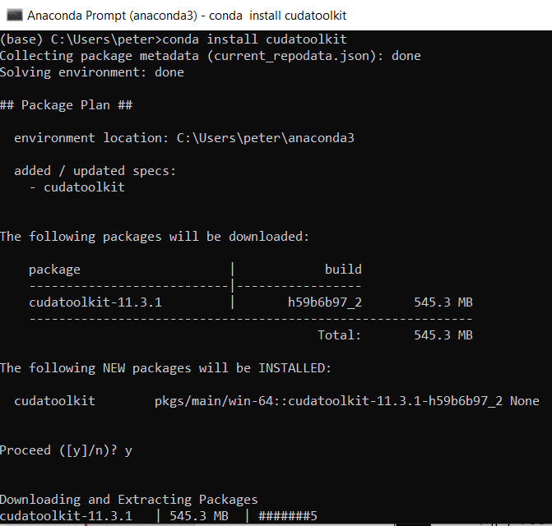
01.1 Install Numba and cudatoolkit
https://www.youtube.com/watch?v=vMZ7tK-RYYc&list=PL5B692fm6--vScfBaxgY89IRWFzDt0Khm&index=3
Install cudatoolkit
> conda install cudatoolkit

Slide 6
02.2 Parallel Python Code

Slide 7
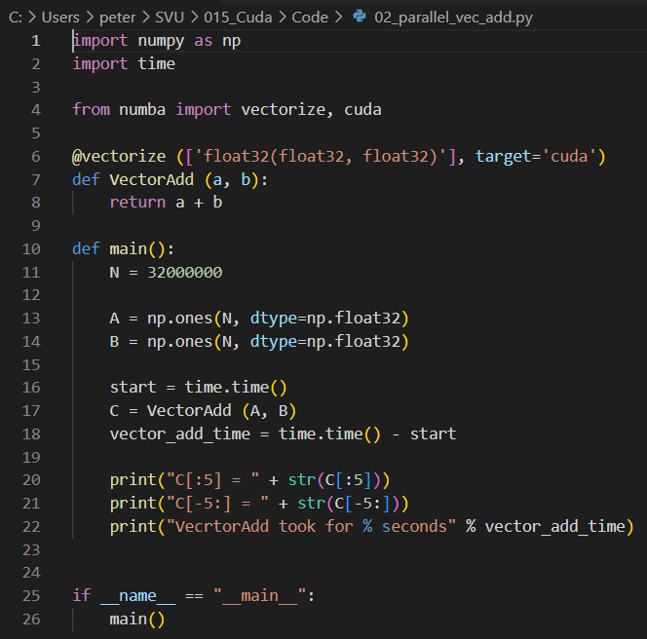
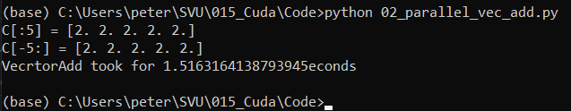
02.2 Parallel Python Code
https://www.youtube.com/watch?v=vMZ7tK-RYYc&list=PL5B692fm6--vScfBaxgY89IRWFzDt0Khm&index=3
Python Code
> python 02_parallel_vec_add.py

Slide 8
End

