Slide 1

007 Image View
Peter H. Chen

Slide 2
007 Image View
https://vulkan-tutorial.com/Drawing_a_triangle/Presentation/Image_views
Image View
We discuss image Pipeline:
1. Create image object.
2. Cleanup the Image object

Slide 3
007.1 Create Image Object

Slide 4
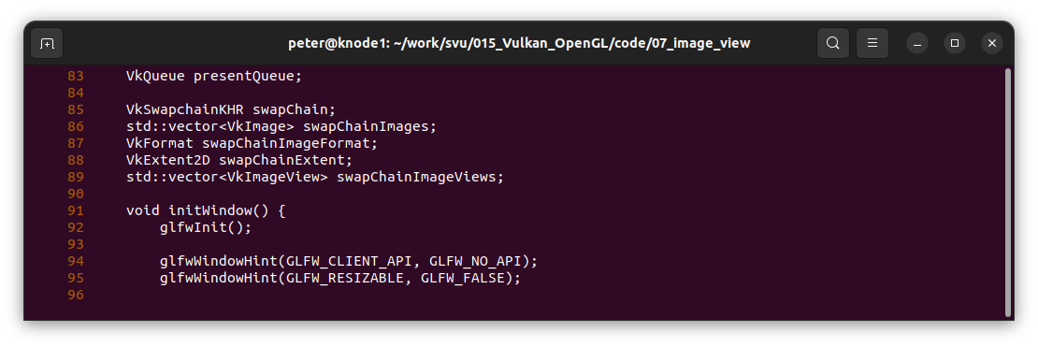
007.1 Create Image Object
https://vulkan-tutorial.com/Drawing_a_triangle/Presentation/Image_views
Create Image Object
Define structure of Pipeline Image.

Slide 5
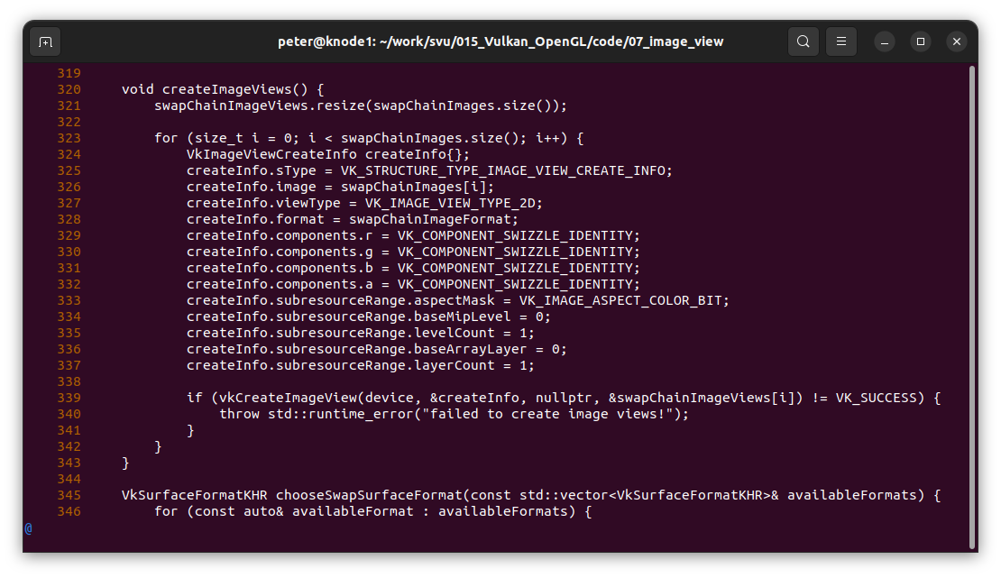
007.1 Create Image Object
https://vulkan-tutorial.com/Drawing_a_triangle/Presentation/Image_views
Create Image Object
Create Image View.

Slide 6
007.2 Cleanup Image Object

Slide 7
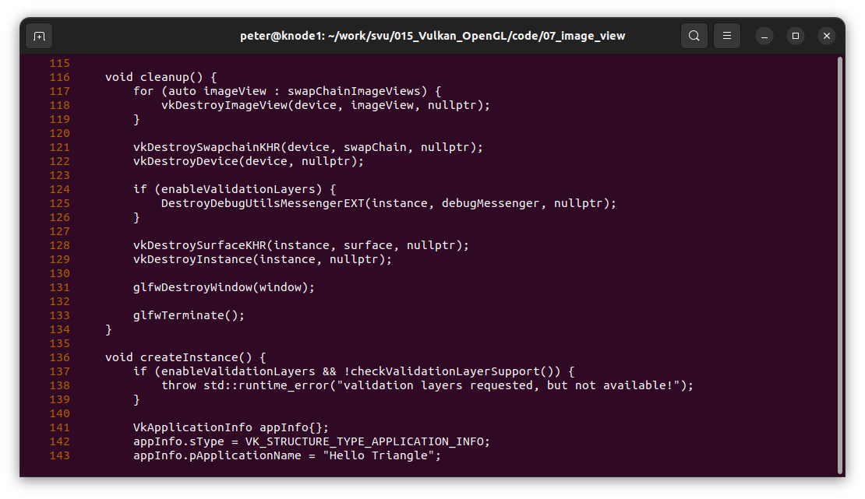
007.2 Cleanup Image Object
https://vulkan-tutorial.com/Drawing_a_triangle/Presentation/Image_views
Cleanup Image Object
Define structure of Pipeline Image.

Slide 8
End

