Slide 1

008 Graphics Pipeline
Peter H. Chen

Slide 2
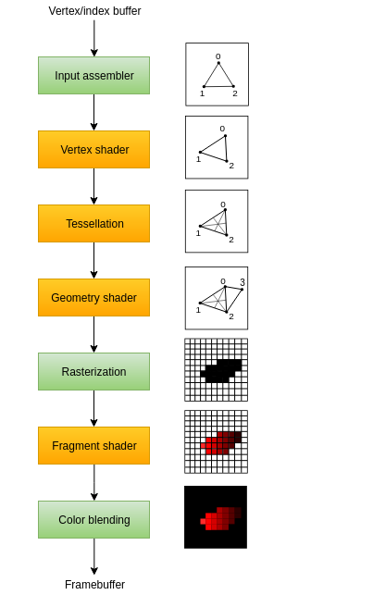
008 Graphics Pipeline
https://vulkan-tutorial.com/Drawing_a_triangle/Presentation/Image_views
Graphics Pipeline
We will setup the shader module for graphics pipeline.
On the right diagram is the graphics pipeline.
The graphic pipeline contains a sequence of operations which take the vertices and textures of meshes to the pixels for the target objects.
Tesselate/Tessellation: Decorate/Divide the big plane into smaller planes without gaps or overlapping.

Slide 3
008 Graphics Pipeline
https://vulkan-tutorial.com/Drawing_a_triangle/Presentation/Image_views
Graphics Pipeline
The input assembler collects the raw vertex data from the buffers you specify and may also use an index buffer to repeat certain elements without having to duplicate the vertex data itself.
The vertex shader is run for every vertex and generally applies transformations to turn vertex positions from model space to screen space. It also passes per-vertex data down the pipeline.

Slide 4
088.00 Graphics Pipeline
https://vulkan-tutorial.com/Drawing_a_triangle/Presentation/Image_views
Graphics Pipeline
The tessellation shaders allow you to subdivide geometry based on certain rules to increase the mesh quality. This is often used to make surfaces like brick walls and staircases look less flat when they are nearby.
The geometry shader is run on every primitive (triangle, line, point) and can discard it or output more primitives than came in. This is similar to the tessellation shader, but much more flexible. However, it is not used much in today's applications because the performance is not that good on most graphics cards except for Intel's integrated GPUs.

Slide 5
088.00Graphics Pipeline
https://vulkan-tutorial.com/Drawing_a_triangle/Presentation/Image_views
Graphics Pipeline
The rasterization stage discretizes the primitives into fragments. These are the pixel elements that they fill on the framebuffer. Any fragments that fall outside the screen are discarded and the attributes outputted by the vertex shader are interpolated across the fragments, as shown in the figure. Usually the fragments that are behind other primitive fragments are also discarded here because of depth testing.
The fragment shader is invoked for every fragment that survives and determines which framebuffer(s) the fragments are written to and with which color and depth values. It can do this using the interpolated data from the vertex shader, which can include things like texture coordinates and normals for lighting.

Slide 6
088.00 Graphics Pipeline
https://vulkan-tutorial.com/Drawing_a_triangle/Presentation/Image_views
Graphics Pipeline
The color blending stage applies operations to mix different fragments that map to the same pixel in the framebuffer. Fragments can simply overwrite each other, add up or be mixed based upon transparency.
Stages with a green color are known as fixed-function stages. These stages allow you to tweak their operations using parameters, but the way they work is predefined.

Slide 7
008 Graphics Pipeline
https://vulkan-tutorial.com/Drawing_a_triangle/Presentation/Image_views
Graphics Pipeline
Stages with an orange color on the other hand are programmable, which means that you can upload your own code to the graphics card to apply exactly the operations you want.
This allows you to use fragment shaders, for example, to implement anything from texturing and lighting to ray tracers.
These programs run on many GPU cores simultaneously to process many objects, like vertices and fragments in parallel.

Slide 8
008.01 Create Graphics Pipeline

Slide 9
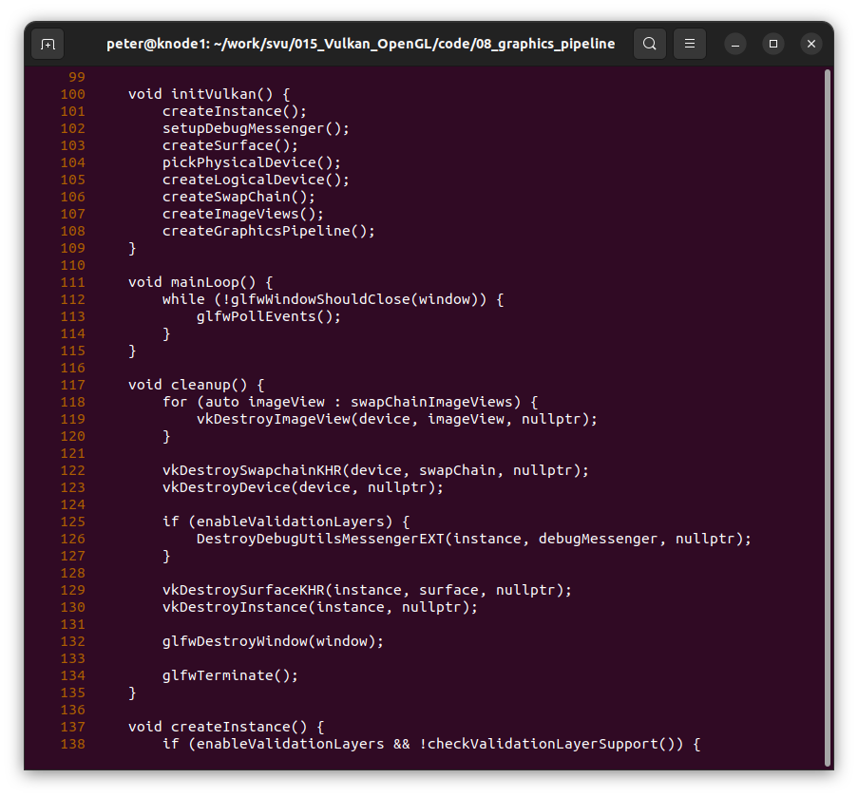
008.01 Create Graphics Pipeline
https://vulkan-tutorial.com/Drawing_a_triangle/Presentation/Image_views
Create Graphics Pipeline

Slide 10
End

