Slide 1

008 Shader Module
Peter H. Chen

Slide 2
008 Shader Module
https://vulkan-tutorial.com/Drawing_a_triangle/Presentation/Image_views
Shader Module
We discuss:
1. Vertex Shader
2. Fragment Shader
3. Per-Vertex Colors
4. Compile Shader
5. Load Shader
6. Create Shader Module
7. Create Shader Stage
The shader code in Vulkan has to be specified in a bytecode format as opposed to human-readable syntax like GLSL (OpenGL Shader Language) and HLSL.
This bytecode format is called SPIR-V and is designed to be used with both Vulkan and OpenCL (both Khronos APIs).
It is a format that can be used to write graphics and compute shaders, but we will focus on shaders used in Vulkan's graphics pipelines.

Slide 3
008 Shader Module
https://vulkan-tutorial.com/Drawing_a_triangle/Presentation/Image_views
Shader Module
The advantage of using a bytecode format is that the compilers written by GPU vendors to turn shader code into native code are significantly less complex.
The past has shown that with human-readable syntax like GLSL, some GPU vendors were rather flexible with their interpretation of the standard.

Slide 4
008.1 Vertex Shader

Slide 5
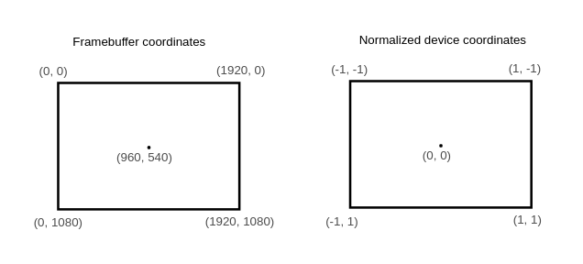
008.1 Vertex Shader
https://vulkan-tutorial.com/Drawing_a_triangle/Presentation/Image_views
Vertex Shader
A clip coordinate is a four dimensional vector from the vertex shader that is subsequently turned into a normalized device coordinate by dividing the whole vector by its last component.
These normalized device coordinates are homogeneous coordinates that map the framebuffer to a [-1, 1] by [-1, 1] coordinate system as below:

Slide 6
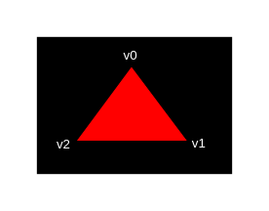
008.1 Vertex Shader
https://vulkan-tutorial.com/Drawing_a_triangle/Presentation/Image_views
Vertex Shader
For our first triangle we won't be applying any transformations.
We'll just specify the positions of the three vertices directly as normalized device coordinates to create the following shape:

Slide 7
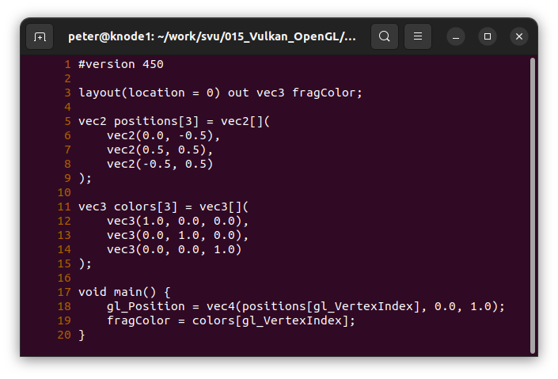
008.1 Vertex Shader
https://vulkan-tutorial.com/Drawing_a_triangle/Presentation/Image_views
Vertex Shader
For our first triangle we won't be applying any transformations.
We'll just specify the positions of the three vertices directly as normalized device coordinates to create the following shape:

Slide 8
008.1 Vertex Shader
https://vulkan-tutorial.com/Drawing_a_triangle/Presentation/Image_views
Vertex Shader
For our first triangle we won't be applying any transformations.
We'll just specify the positions of the three vertices directly as normalized device coordinates to create the following shape:

Slide 9
008.1 Vertex Shader
https://vulkan-tutorial.com/Drawing_a_triangle/Presentation/Image_views
Vertex Shader
For our first triangle we won't be applying any transformations.
We'll just specify the positions of the three vertices directly as normalized device coordinates to create the following shape:
(0.0, -0.5)
(0.0, 0.0)
(-0.5, 0.5)
(0.5, 0.5)

Slide 10
008.2 Fragment Shader

Slide 11
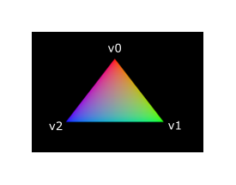
009.2 Fragment Shader
https://vulkan-tutorial.com/Drawing_a_triangle/Presentation/Image_views
Fragment Shader
Fragment shader specifies the color and depth of object for the framebuffer (09_shader_base.vert).
For each vertices, we specify the colors (1, 0, 0), (0, 1, 0), (0, 0, 1).

Slide 12
008.3 Per-Vertex Colors

Slide 13
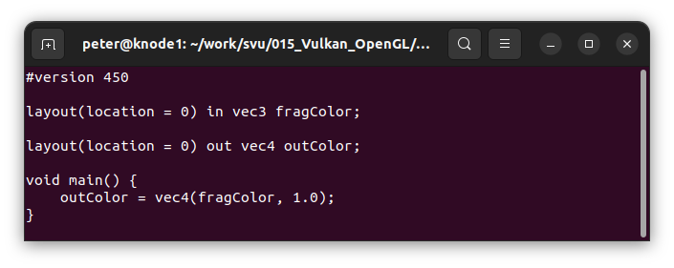
008.3 Per-Vertex Colors
https://vulkan-tutorial.com/Drawing_a_triangle/Presentation/Image_views
Per-Vertex Colors
We pass in the per-vertex colors to the fragment shader (09_shader_base.frag).
We match the colors vec3 with layout (location).

Slide 14
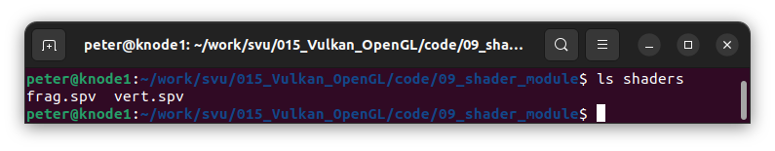
008.3 Per-Vertex Colors
https://vulkan-tutorial.com/Drawing_a_triangle/Presentation/Image_views
Compile Vert and Frag
After, we compiled, we have frag.spv and vert.spv (SPIR-V or Standard, Portable, Intermediate Representation Version V format) files.
They are in compiled bytecode format.

Slide 15
008.4 Load Shader

Slide 16
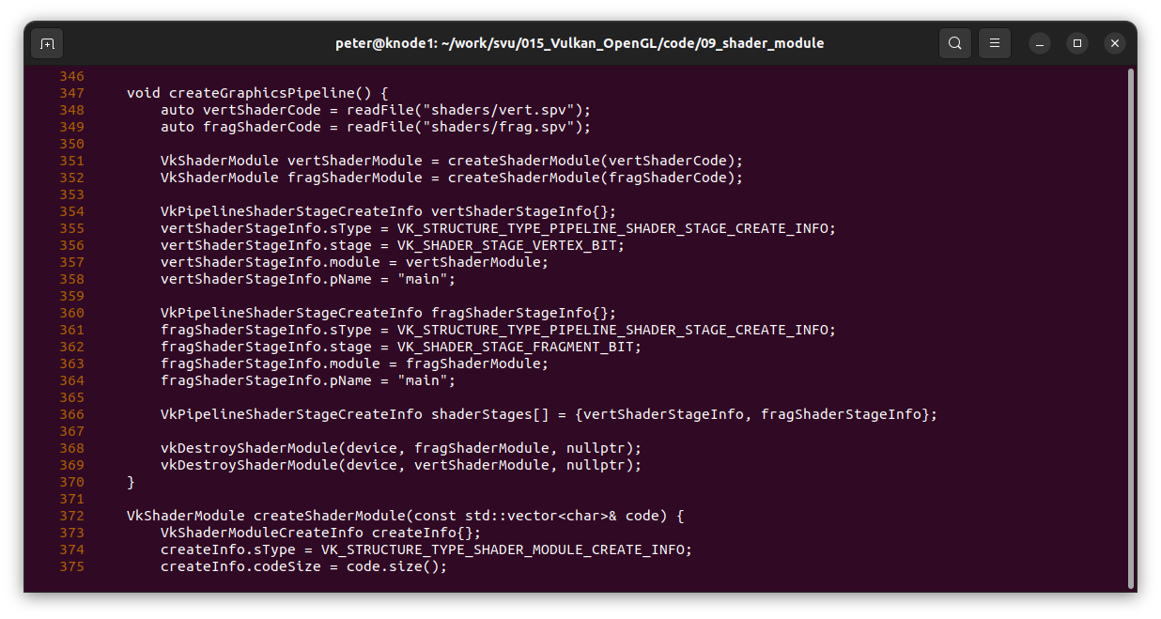
008.4 Load Shader
https://vulkan-tutorial.com/Drawing_a_triangle/Presentation/Image_views
Load Shader
Load Shader shaders/vert.spv and shaders/flag.spv.

Slide 17
008.5 Create Shader Module

Slide 18
008.5 Create Shader Module
https://vulkan-tutorial.com/Drawing_a_triangle/Presentation/Image_views
Create Shader Module

Slide 19
008.6 Create Shader Stage

Slide 20
008.6 Create Shader Stage
https://vulkan-tutorial.com/Drawing_a_triangle/Presentation/Image_views
Create Shader Stage

Slide 21
End

