Slide 1

005 Window Surface
Peter H. Chen

Slide 2
005 Window Surface
https://vulkan-tutorial.com/Drawing_a_triangle/Presentation/Window_surface
Logical Device and Queue Family
We discuss:
1. Create Window Surface
2. Query Presentation Support
3. Create Presentation Queue
Vulkan is a platform agnostic API, Vulkan cannot interface directly with window system.
Vulkan use WSI (Window System Integration) extension to present the result to the screen.

Slide 3
005.1 Window Surface Creation

Slide 4
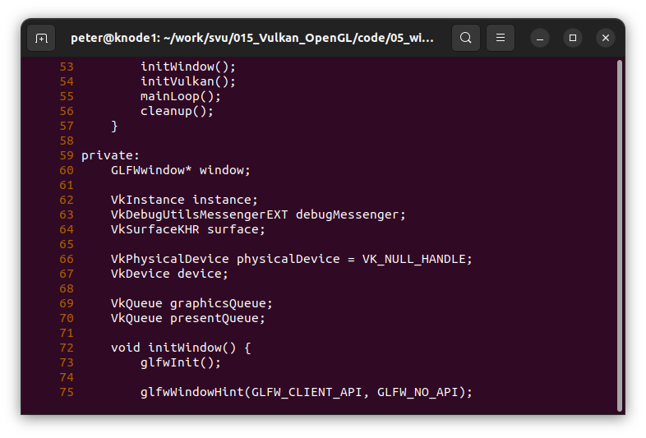
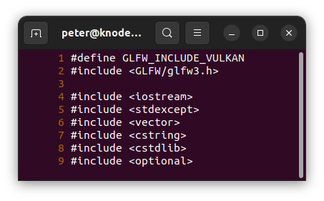
005.1 Window Surface Creation
https://vulkan-tutorial.com/Drawing_a_triangle/Presentation/Window_surface
Window Surface Creation
Add surface object, surface is a window object.

Slide 5
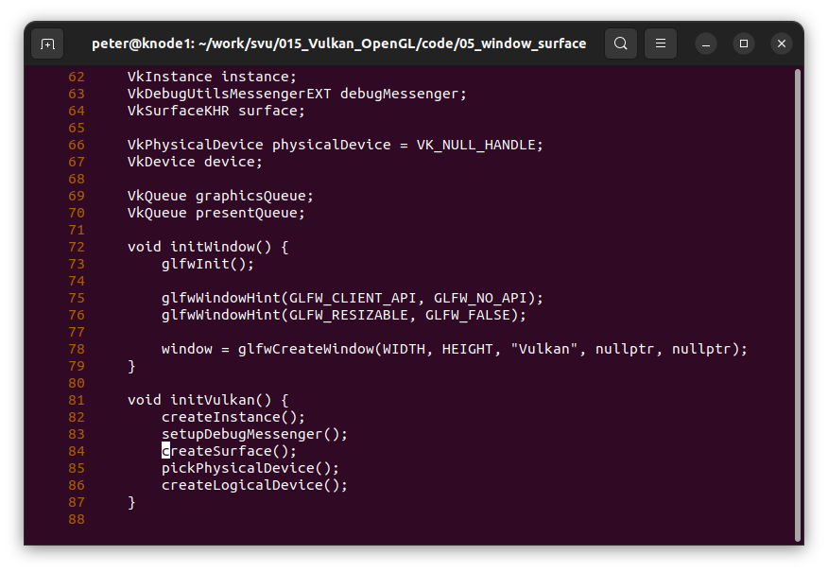
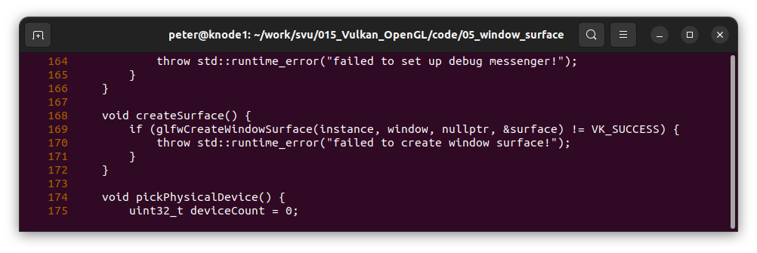
005.1 Window Surface Creation
https://vulkan-tutorial.com/Drawing_a_triangle/Presentation/Window_surface
Window Surface Creation
Add surface object, surface is a window object.

Slide 6
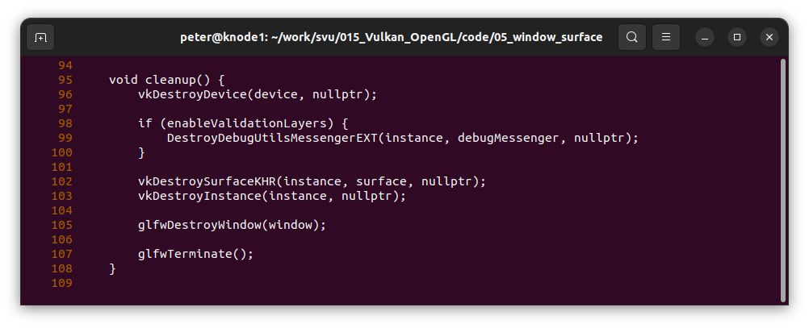
005.1 Window Surface Creation
https://vulkan-tutorial.com/Drawing_a_triangle/Presentation/Window_surface
Window Surface Creation
Destroy surface.

Slide 7
005.2 Query Presentation Support

Slide 8
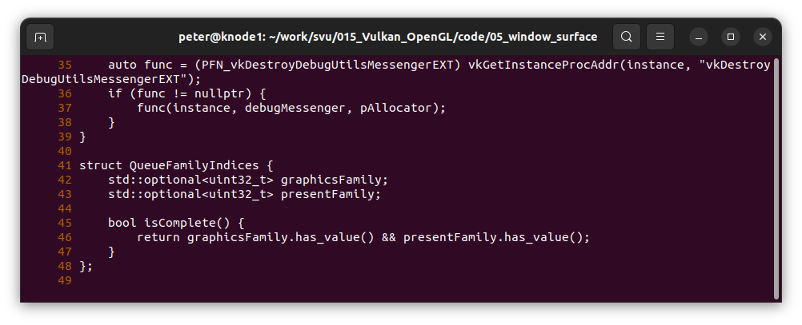
005.2 Query Presentation Support
https://vulkan-tutorial.com/Drawing_a_triangle/Presentation/Window_surface
Query Presentation Support
Every device in the system need to support the display.

Slide 9
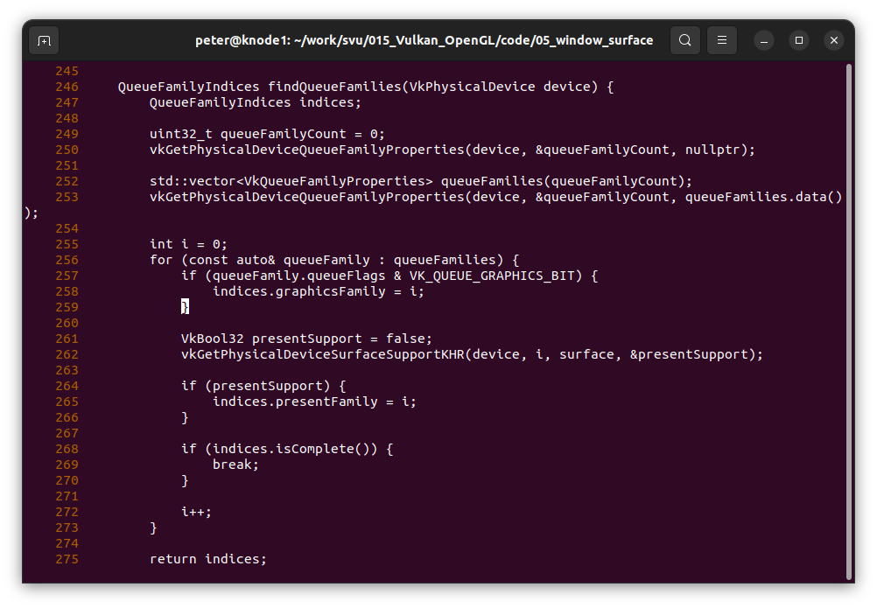
005.2 Query Presentation Support
https://vulkan-tutorial.com/Drawing_a_triangle/Presentation/Window_surface
Query Presentation Support
Get device surface support.

Slide 10
005.3 Create Presentation Queue

Slide 11
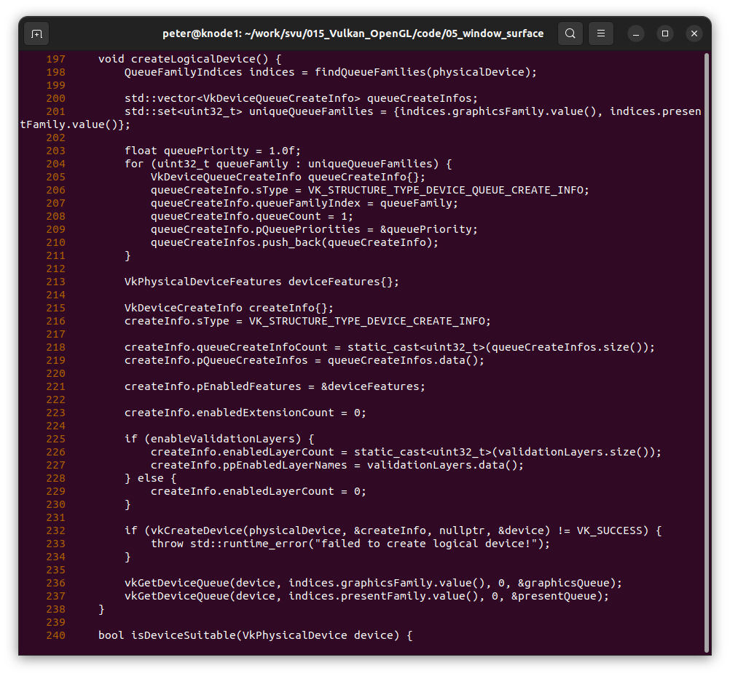
005.3 Create Presentation Queue
https://vulkan-tutorial.com/Drawing_a_triangle/Presentation/Window_surface
Create Presentation Queue
Create presentation queue, Queue Information Count.

Slide 12
005.3 Create Presentation Queue
https://vulkan-tutorial.com/Drawing_a_triangle/Presentation/Window_surface
Create Presentation Queue
Get device surface support.

Slide 13
End

