Slide 1

006 Swap Chain
Peter H. Chen

Slide 2
006 Swap Chain
https://vulkan-tutorial.com/Drawing_a_triangle/Presentation/Swap_chain
Swap Chain
We discuss:
1. Check Swap Chain Support
2. Enable Device Extension
3. Query Swap Chain Support
4. Setup Swap Chain
4.1 Surface Format
4.2 Presentation Mode
4.3 Swap Extent
5. Create Swap Chain
6. Retrieve Swap Chain Image
Swap chain is a queue of images that are waiting to be displayed on the screen.
The application acquire an image to draw it and return it to queue.

Slide 3
006.1 Check Swap Chain

Slide 4
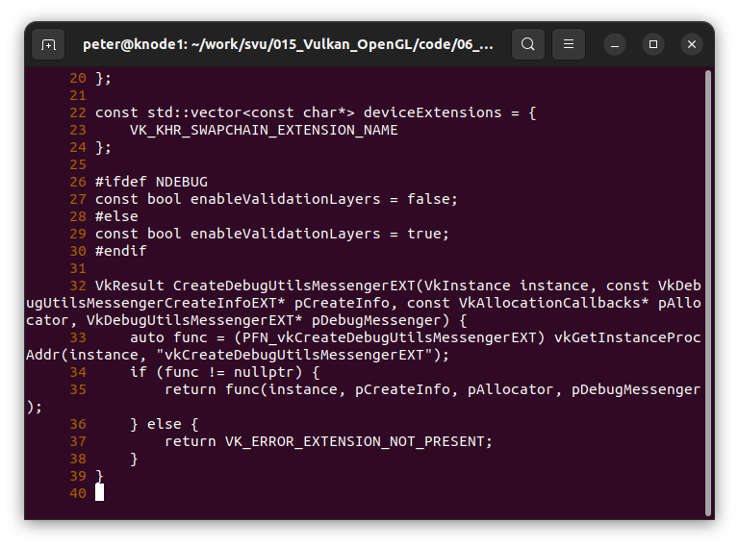
006.1 Check Swap Chain
https://vulkan-tutorial.com/Drawing_a_triangle/Presentation/Swap_chain
Check Swap Chain Support
1. Not all graphics card can present image.
The graphics card are for servers and have no display capability.
2. Vulkan surface is tied to window system. The surface need to swap.

Slide 5
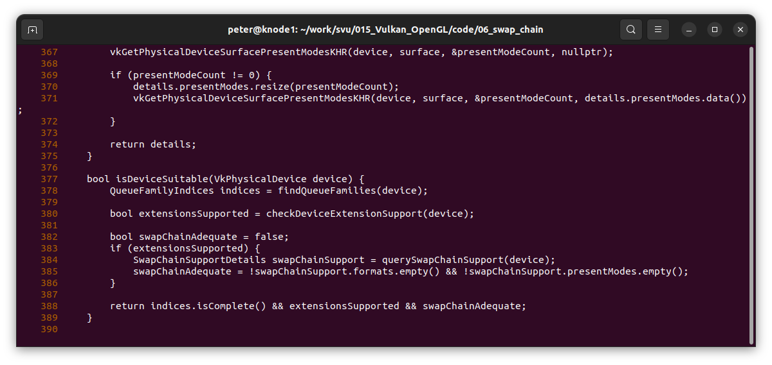
006.1 Check Swap Chain
https://vulkan-tutorial.com/Drawing_a_triangle/Presentation/Swap_chain
Check Device Extension Support

Slide 6
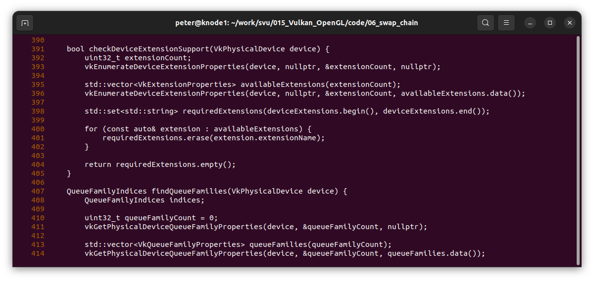
006.1 Check Swap Chain
https://vulkan-tutorial.com/Drawing_a_triangle/Presentation/Swap_chain
Check Device Extension Support

Slide 7
006.2 Enable Device Extension

Slide 8
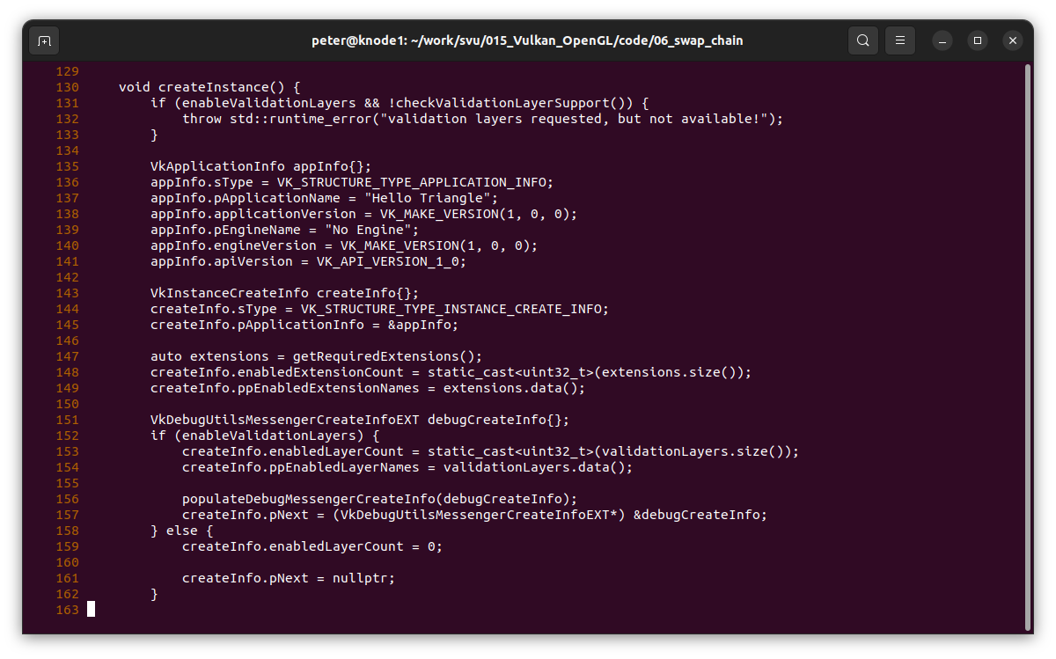
006.2 Enable Device Extension
https://vulkan-tutorial.com/Drawing_a_triangle/Presentation/Swap_chain
Enable Device Extension
Enable Extension Count to non-zero.

Slide 9
006.3 Query Swap Chain

Slide 10
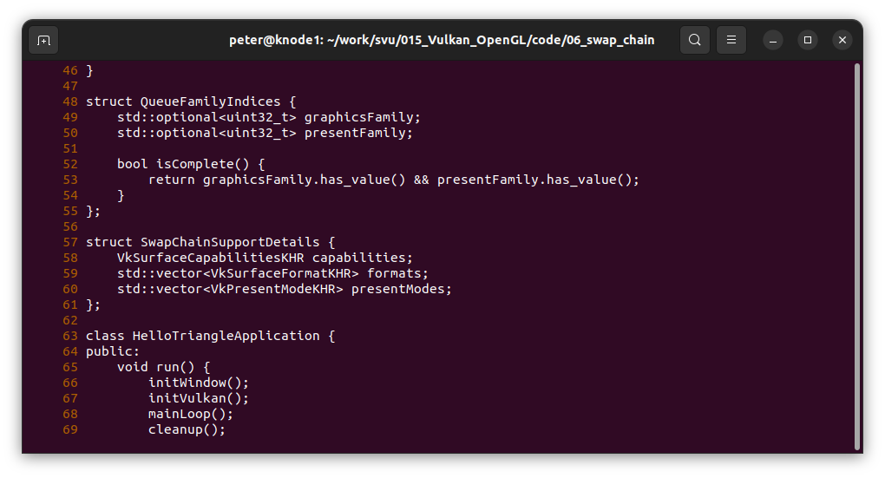
006.3 Query Swap Chain
https://vulkan-tutorial.com/Drawing_a_triangle/Presentation/Swap_chain
Query Swap Chain
1. Basic surface capability
2. Surface format
3. Presentation Mode

Slide 11
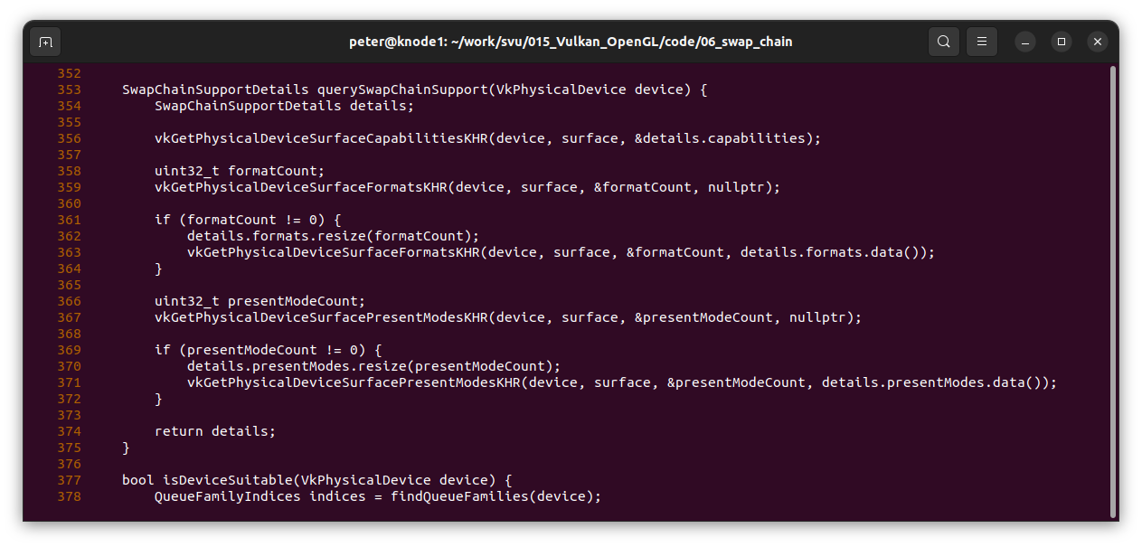
006.3 Query Swap Chain
https://vulkan-tutorial.com/Drawing_a_triangle/Presentation/Swap_chain
Query Swap Chain

Slide 12
006.4 Setup Swap Chain

Slide 13
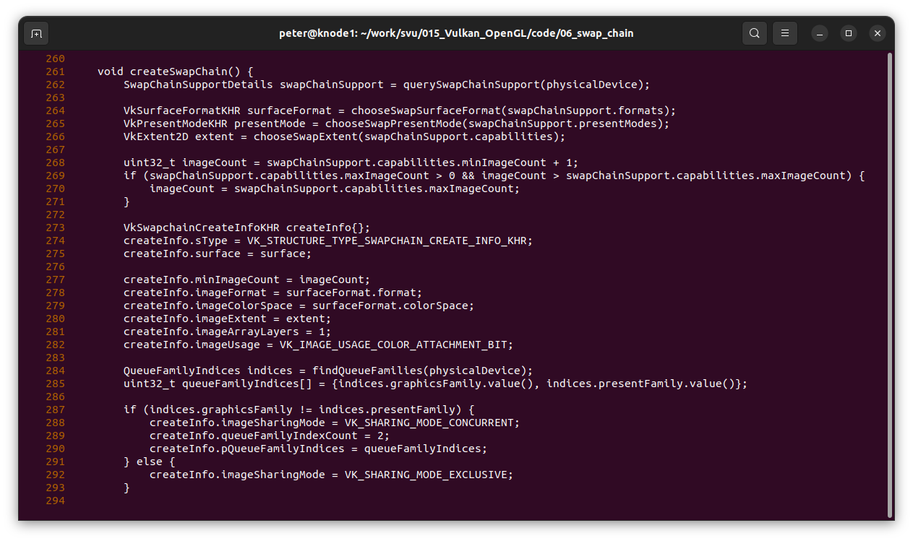
006.4 Setup Swap Chain
https://vulkan-tutorial.com/Drawing_a_triangle/Presentation/Swap_chain
Setup Swap Chain
1. Setup Surface Format
2. Setup Presentation Mode
3. Setup Swap Extent

Slide 14
006.5 Create Swap Chain

Slide 15
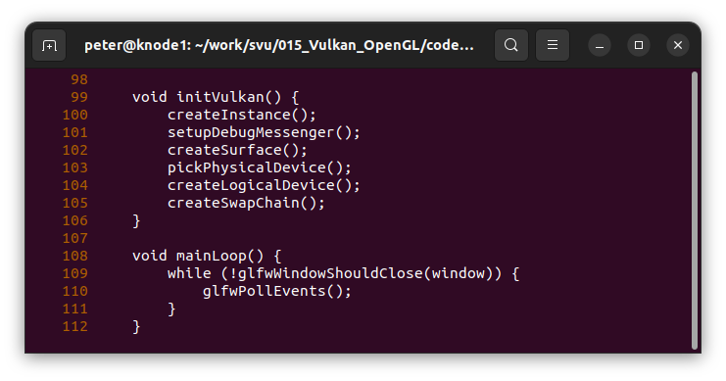
006.5 Create Swap Chain
https://vulkan-tutorial.com/Drawing_a_triangle/Presentation/Swap_chain
Create Swap Chain

Slide 16
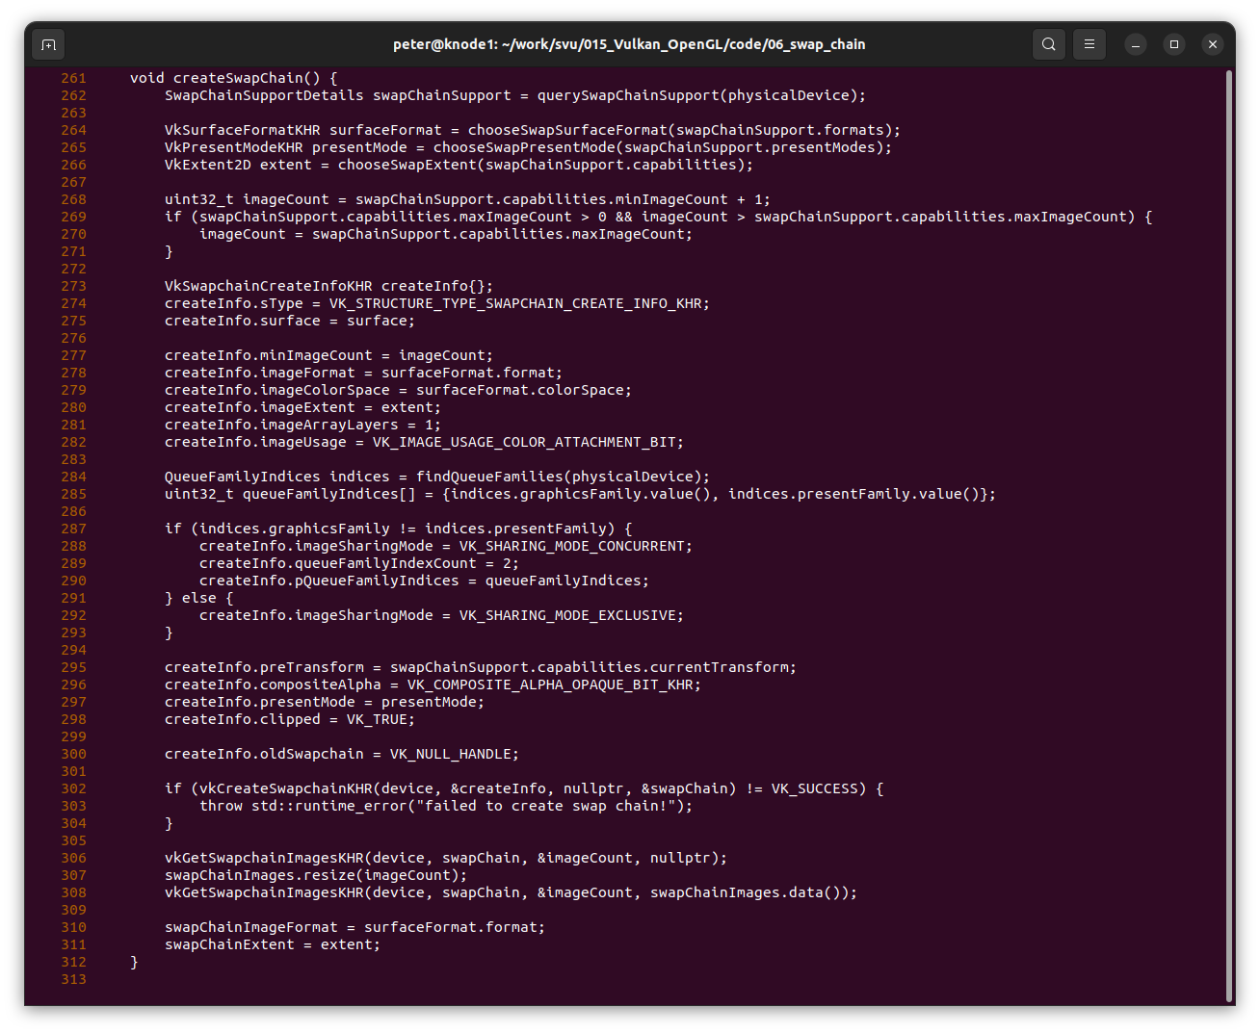
006.5 Create Swap Chain
https://vulkan-tutorial.com/Drawing_a_triangle/Presentation/Swap_chain
Create Swap Chain

Slide 17
006.6 Retrieve Swap Chain Image

Slide 18
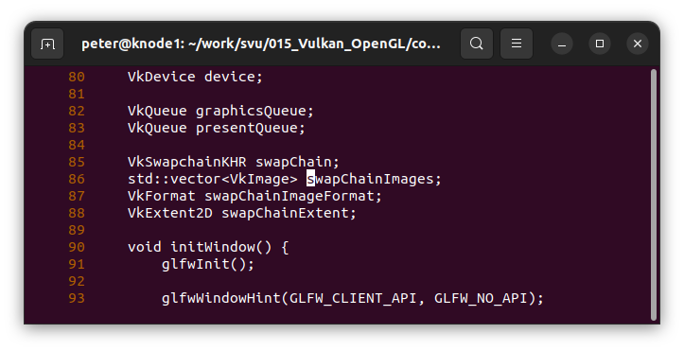
006.6 Retrieve Swap Chain Image
https://vulkan-tutorial.com/Drawing_a_triangle/Presentation/Swap_chain
Retrieve Swap Chain Image
Define Swap Chain Image Data Structure.

Slide 19
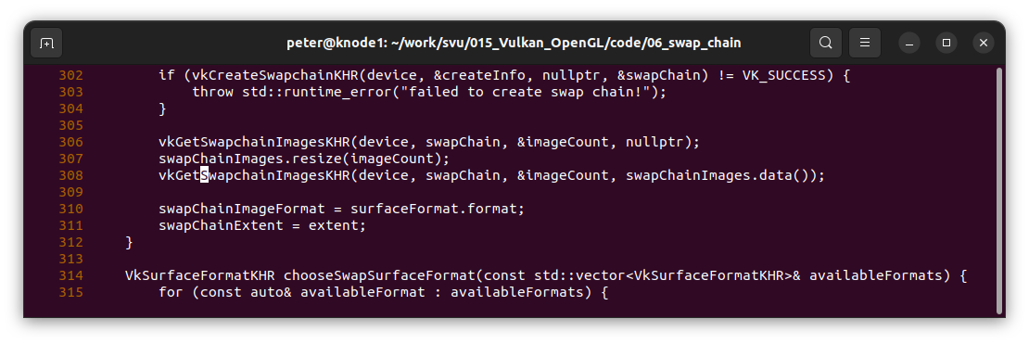
006.6 Retrieve Swap Chain Image
https://vulkan-tutorial.com/Drawing_a_triangle/Presentation/Swap_chain
Retrieve Swap Chain Image
Get Swap Chain Image

Slide 20
End

