Slide 1

003 Physical Device and Queue
Peter H. Chen

Slide 2
002 Physical Device and Queue
https://vulkan-tutorial.com/Drawing_a_triangle/Setup/Physical_devices_and_queue_families
Physical Device and Queue Family
We discuss:
1. Select a Physical Device
2. Device Check
3. Queue Family

Slide 3
002.1 Select Physical Device

Slide 4
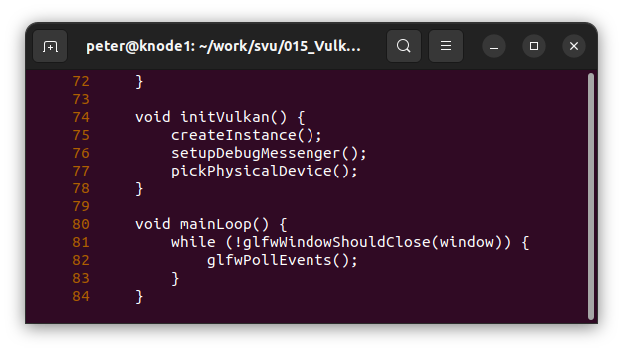
002.1 Select Physical Device
https://vulkan-tutorial.com/Drawing_a_triangle/Setup/Physical_devices_and_queue_families
Select a Physical Device
After initializing the Vulkan library through a VkInstance, we need to select a graphics card.
We can select any number of graphics cards and use them simultaneously, here, we only select the first graphics card.
We add a function pickPhysicalDevice() call.

Slide 5
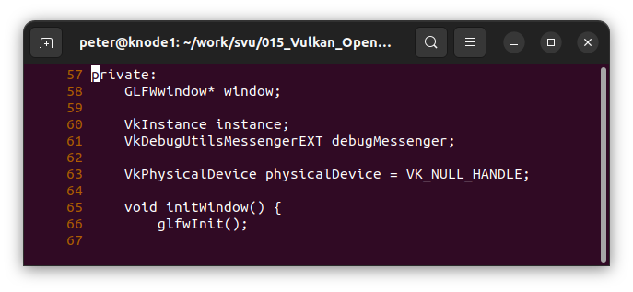
002.1 Select Physical Device
https://vulkan-tutorial.com/Drawing_a_triangle/Setup/Physical_devices_and_queue_families
Initialize Physical Device
Line 63: Initialize Physical Device

Slide 6
002.1 Select Physical Device
https://vulkan-tutorial.com/Drawing_a_triangle/Setup/Physical_devices_and_queue_families
Initialize Physical Device
Line 63: Initialize Physical Device

Slide 7
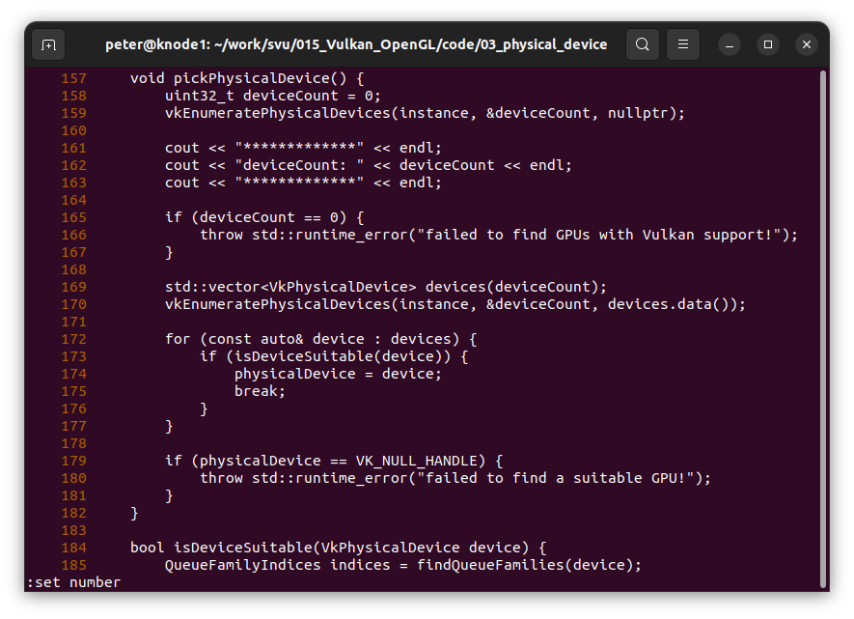
002.1 Select Physical Device
https://vulkan-tutorial.com/Drawing_a_triangle/Setup/Physical_devices_and_queue_families
Initialize Physical Device
Line 158-167: Find how many graphics cards in your computer.

Slide 8
002.1 Select Physical Device
https://vulkan-tutorial.com/Drawing_a_triangle/Setup/Physical_devices_and_queue_families
Initialize Physical Device
Line 168-181: find the device and set the physical device

Slide 9
002.2 Check Device

Slide 10
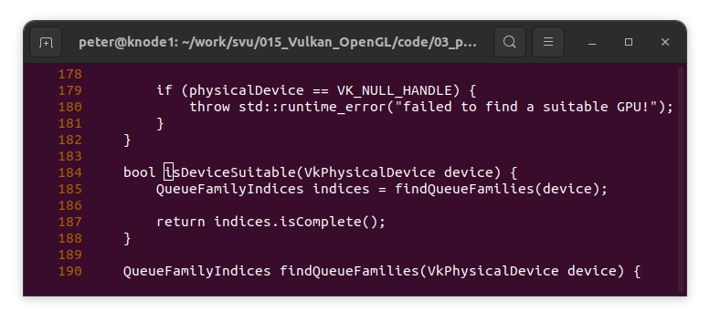
002.2 Check Device
https://vulkan-tutorial.com/Drawing_a_triangle/Setup/Physical_devices_and_queue_families
Check Device
Line 183-189: Check for Queue Families for device.

Slide 11
002.3 Queue Family

Slide 12
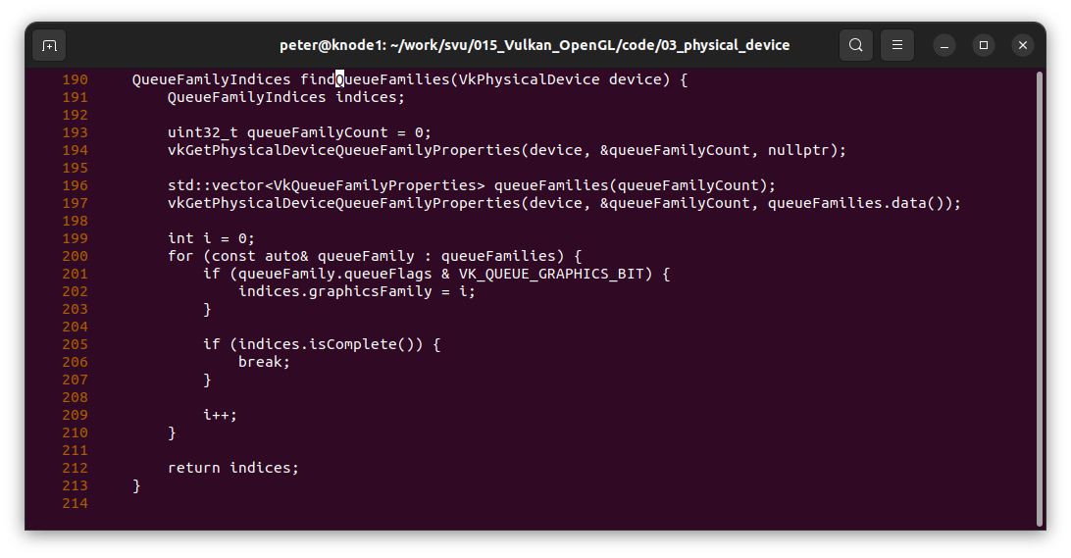
002.3 Queue Family
https://vulkan-tutorial.com/Drawing_a_triangle/Setup/Physical_devices_and_queue_families
Queue Family
Line 190-214: Find graphics queue family.
QueueFamilyCount: We need at least one graphic Family.

Slide 13
002.4 Device and Queue Code

Slide 14
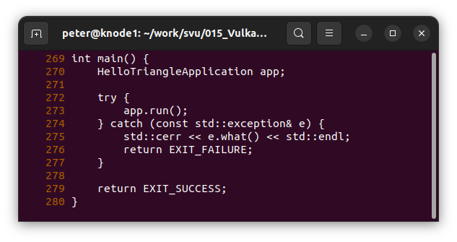
002.4 Device and Queue Code
https://vulkan-tutorial.com/Drawing_a_triangle/Setup/Physical_devices_and_queue_families
Device and Queue Code
main()

Slide 15
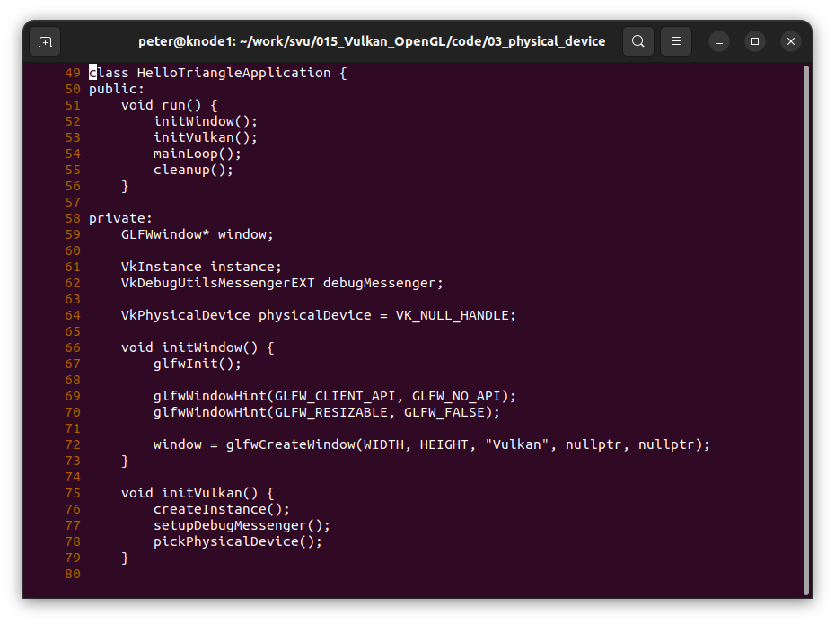
002.4 Device and Queue Code
https://vulkan-tutorial.com/Drawing_a_triangle/Setup/Physical_devices_and_queue_families
Device and Queue Code

Slide 16
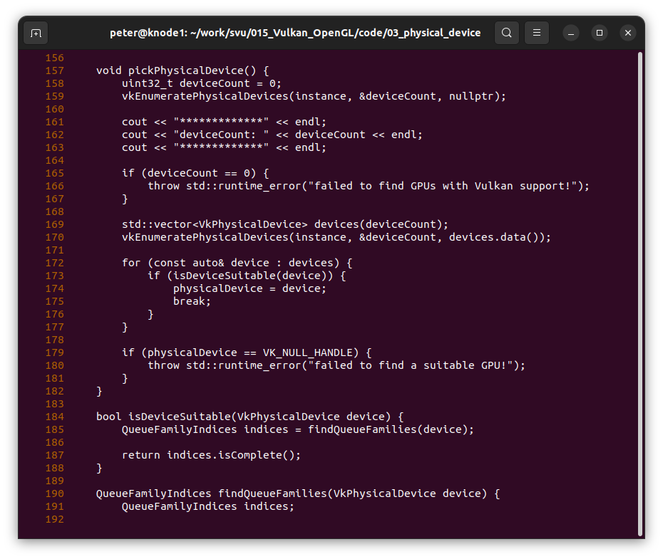
002.4 Device and Queue Code
https://vulkan-tutorial.com/Drawing_a_triangle/Setup/Physical_devices_and_queue_families
Device and Queue Code

Slide 17
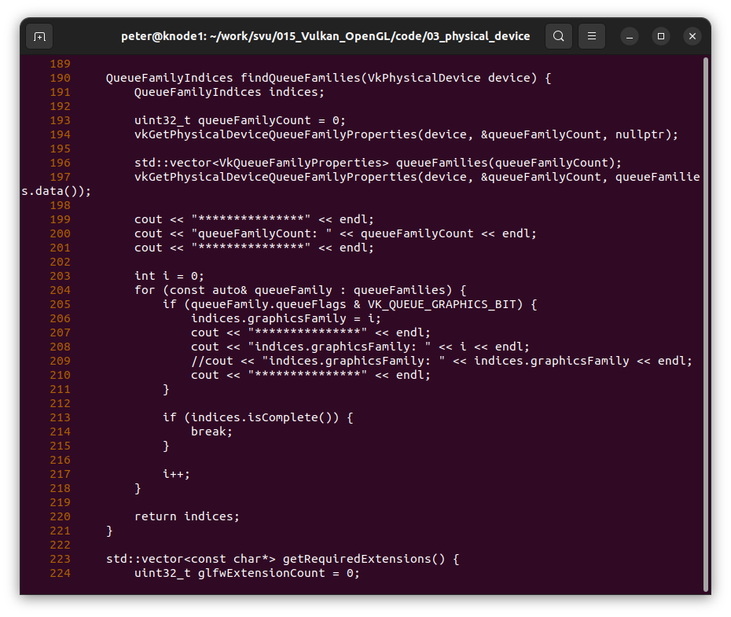
002.4 Device and Queue Code
https://vulkan-tutorial.com/Drawing_a_triangle/Setup/Physical_devices_and_queue_families
Device and Queue Code

Slide 18
002.5 Result

Slide 19
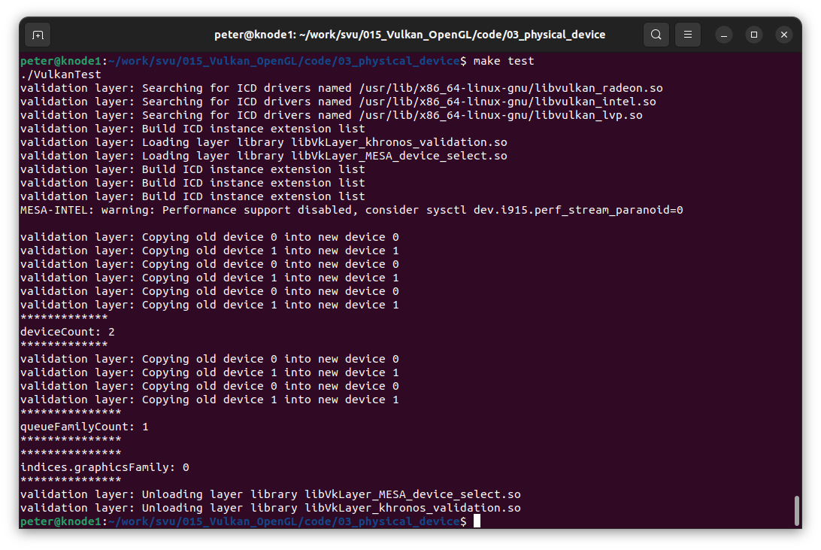
002.5 Result
https://vulkan-tutorial.com/Drawing_a_triangle/Setup/Physical_devices_and_queue_families
Result
Graphic Device Count = 2.
Queue Family = 1
Indics of queue family = 0

Slide 20
End

