Slide 1

00 Base Code
Peter H. Chen

Slide 2
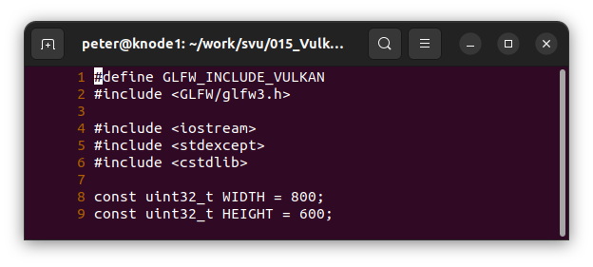
00 Base Code
https://vulkan-tutorial.com/Drawing_a_triangle/Setup/Base_code
Base Code
Lines 1-2: Replace the #include <vulkan/vulkan.h> line with
#define GLFW_INCLUDE_VULKAN
#include <GLFW/glfw3.h>
Lines 8-9: Define Window WIDTH and HEIGHT.

Slide 3
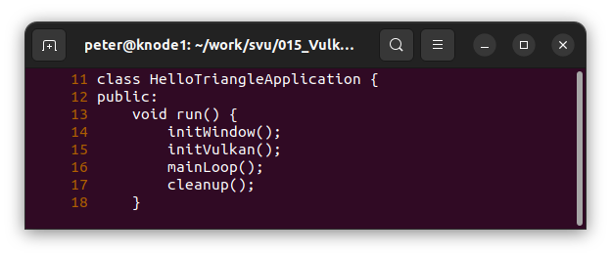
00 Base Code
https://vulkan-tutorial.com/Drawing_a_triangle/Setup/Base_code
Base Code
Lines 13-18: We add initWindow(), initVulkan(), mainLoop(), and cleanup().

Slide 4
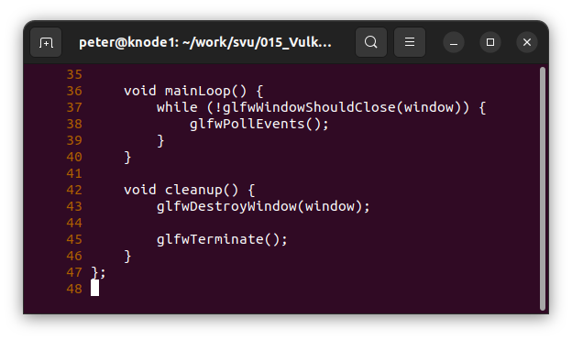
00 Base Code
https://vulkan-tutorial.com/Drawing_a_triangle/Setup/Base_code
Base Code
Lines 36-47: Add mainLoop() and cleanup().
mainLoop(): To keep the application running until either an error occurs or the window is closed, we need to add an event loop to the mainLoop function.
cleanup(): Once the window is closed, we need to clean up resources by destroying it and terminating GLFW itself. This will be our first cleanup code:

Slide 5
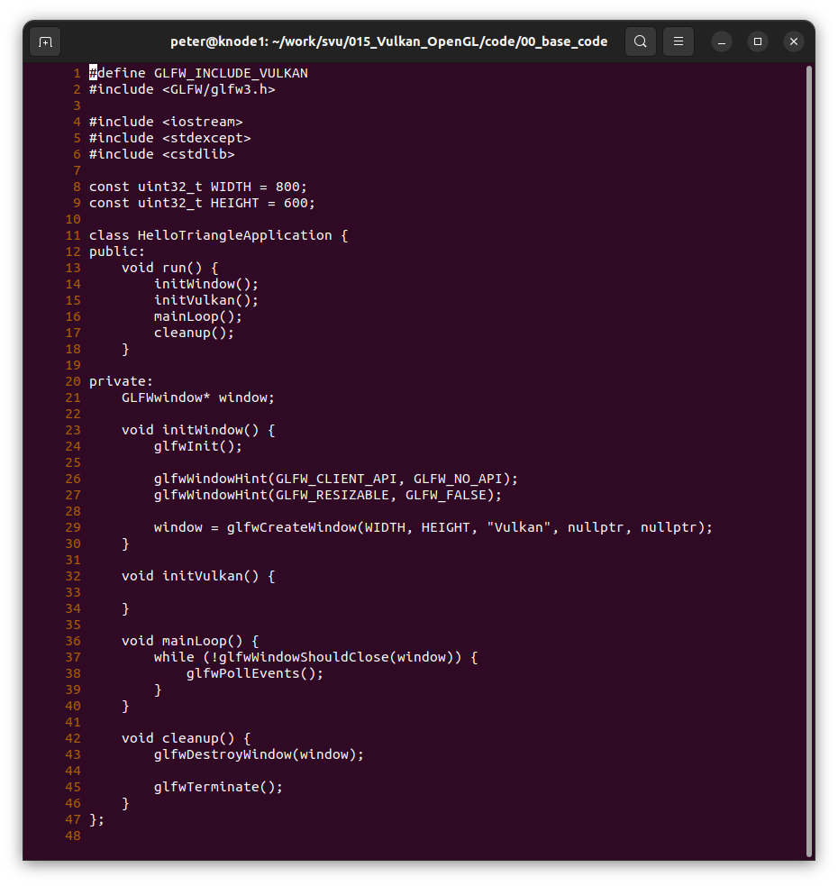
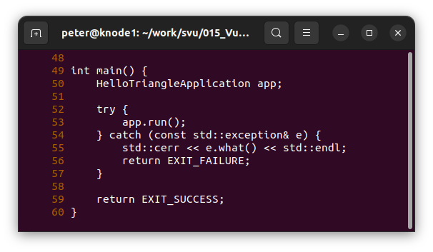
00 Base Code
https://vulkan-tutorial.com/Drawing_a_triangle/Setup/Base_code
Base Code

Slide 6
End

