Slide 1

01 Instance Creation
Peter H. Chen

Slide 2
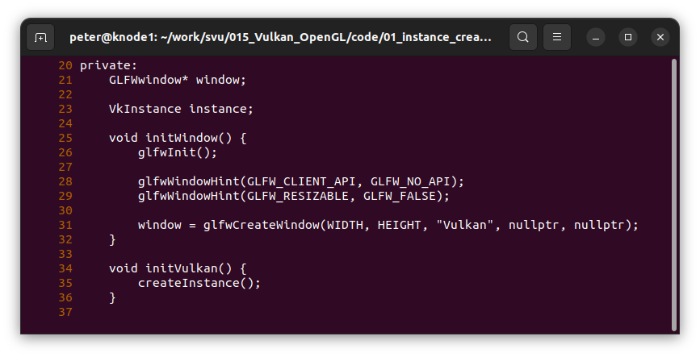
01 Instance Creation
https://vulkan-tutorial.com/Development_environment#page_Linux
Instance Creation
Line 23 and Lines 34-36: In initVulkan(), we add createInstance() for VkInstance instance.

Slide 3
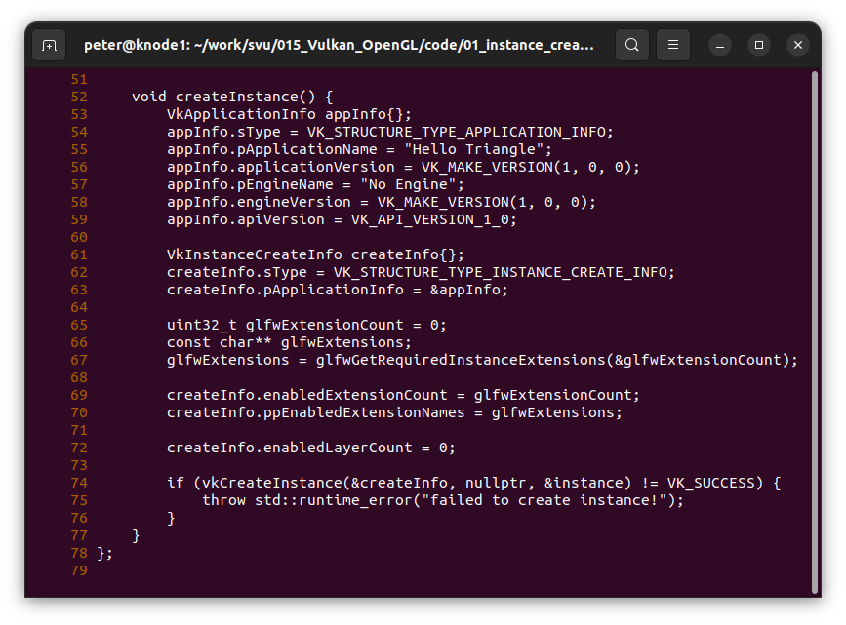
01 Instance Creation
https://vulkan-tutorial.com/Development_environment#page_Linux
Instance Creation
Lines 53-59: We create an instance, we fill in a struct with some information about our application.
This data may provide some useful information to the driver in order to optimize our specific application.
For example, it uses a well-known graphics engine with certain special behavior.
This struct is called VkApplicationInfo:

Slide 4
01 Instance Creation
https://vulkan-tutorial.com/Development_environment#page_Linux
Instance Creation
Lines 61-63: As mentioned before, many structs in Vulkan require you to explicitly specify the type in the sType member.
This is also one of the many structs with a pNext member that can point to extension information in the future. We're using value initialization here to leave it as nullptr.

Slide 5
01 Instance Creation
https://vulkan-tutorial.com/Development_environment#page_Linux
Instance Creation
Lines 65-72: There are some parameters which are straightforward.

Slide 6
01 Instance Creation
https://vulkan-tutorial.com/Development_environment#page_Linux
Instance Creation
Lines 74-76: We create the instance with parameters by vkCreateInstance(parameters):

Slide 7
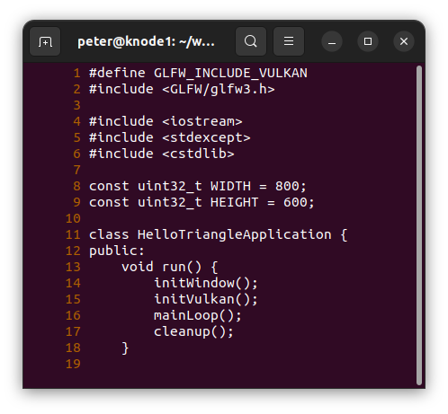
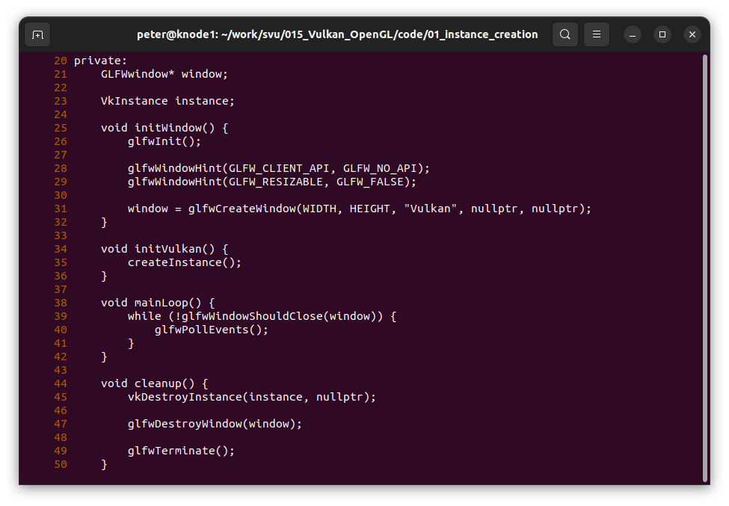
01 Instance Creation
https://vulkan-tutorial.com/Development_environment#page_Linux
Instance Creation Codes

Slide 8
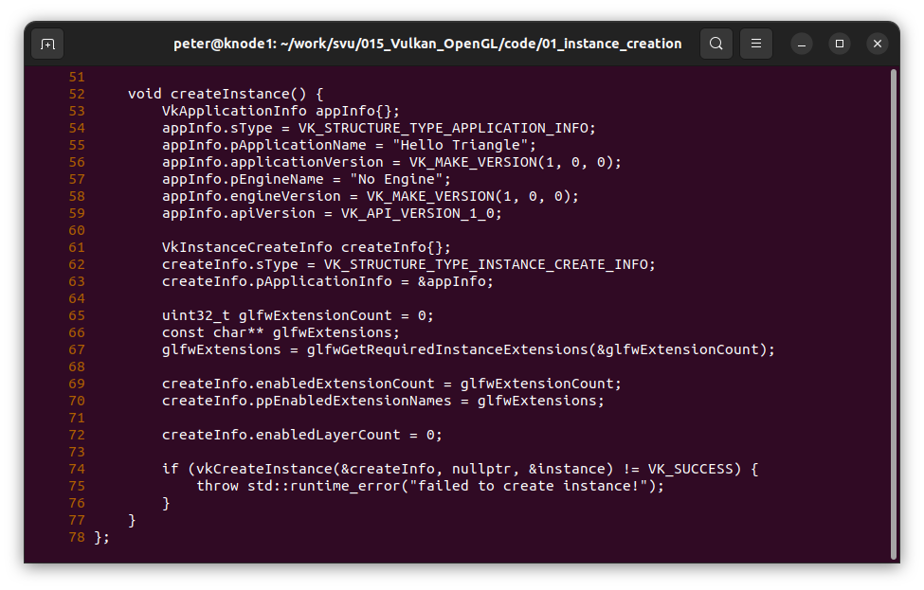
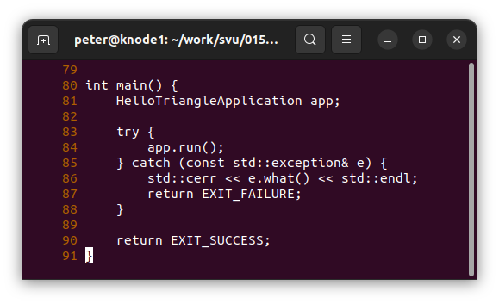
01 Instance Creation
https://vulkan-tutorial.com/Development_environment#page_Linux
Instance Creation Codes

Slide 9
End

