Slide 1

002 Validation Layer
Peter H. Chen

Slide 2
002 Validation Layer
https://vulkan-tutorial.com/Development_environment#page_Linux
What Are Validation Layers?
It is easy to make mistakes in passing parameter.
For example, use GPU feature and forgetting to request it at logical device creation time.
Vulkan provides check for validation layers.
Validation layers are optional function calls.
Common operations in validation layers are:
1. Checking the values of parameters against the specification
2. Tracking creation and destruction of objects to find resource leaks
3. Checking thread safety by tracking the threads that calls originate from
4. Logging every call and its parameters to the standard output
5. Tracing Vulkan calls for profiling and replaying

Slide 3
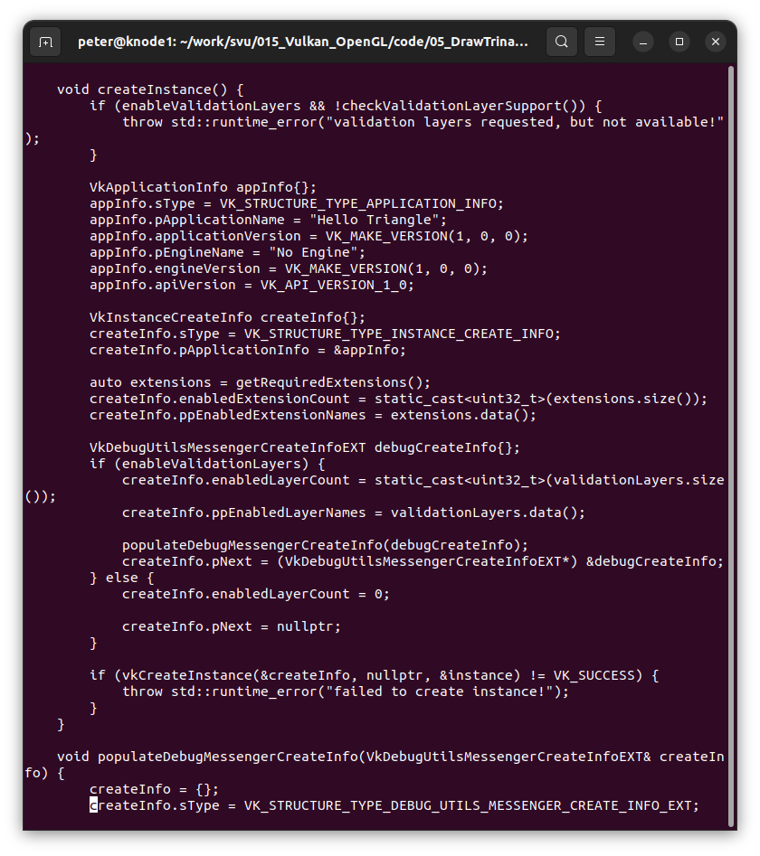
002 Validation Layer
https://vulkan-tutorial.com/Development_environment#page_Linux
Validation Layer
Passed in parameters to vkCreateInstance() to check.
The passing parameters (validation layers) is arbitrary and freely stacked with debugging functionality.

Slide 4
002.1 Define Validation Layer

Slide 5
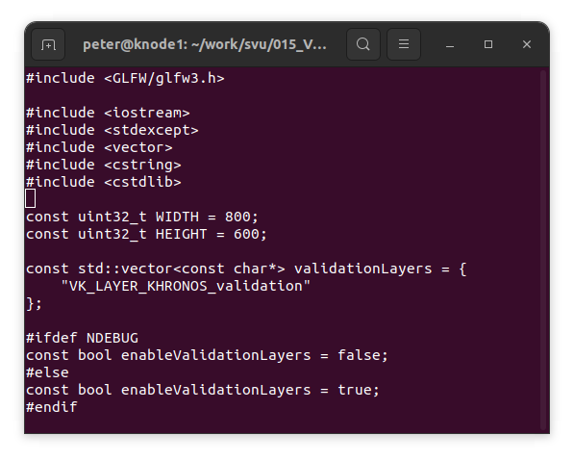
002.1 Define Validation Layer
https://vulkan-tutorial.com/Development_environment#page_Linux
Define Validation Layer
We need to define the validation layers.
C++ standard NDEBUG (not debug) to define the control variable.

Slide 6
002.2 List Validation Layer

Slide 7
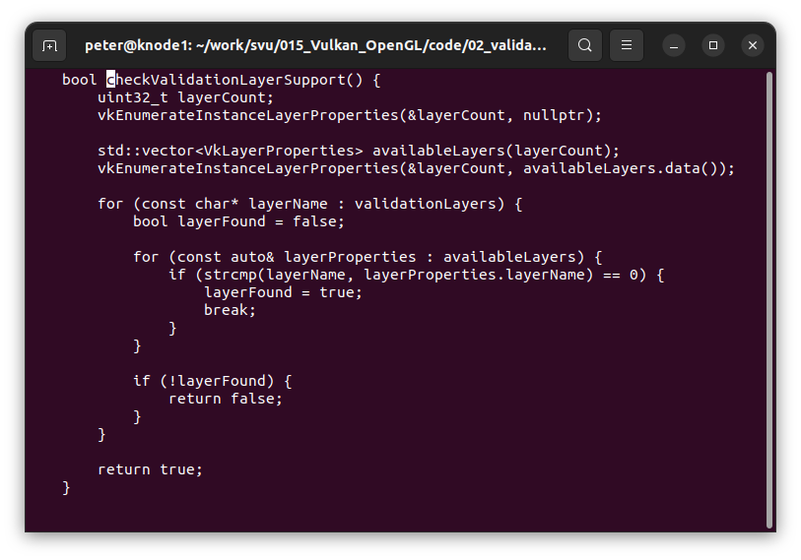
002.2 List Validation Layer
https://vulkan-tutorial.com/Development_environment#page_Linux
List Validation Layer
vkEnumerateInstanceLayerPorperties(): List all the variable layers.

Slide 8
002.3 Loop Validation Layer

Slide 9
002.3 Loop Validation Layer
https://vulkan-tutorial.com/Development_environment#page_Linux
Loop for Validation Layer
Check all the layer name is existed or not.

Slide 10
002.4 Use Validation Flag

Slide 11
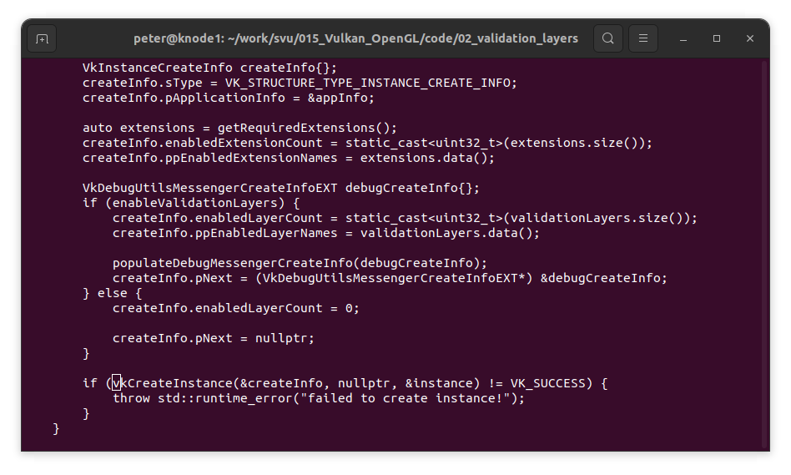
002.4 Use Validation Flag
https://vulkan-tutorial.com/Development_environment#page_Linux
Use Validation Flag
Use Validation flag “enableValidationLayers” to check.

Slide 12
002.5 Message Callback

Slide 13
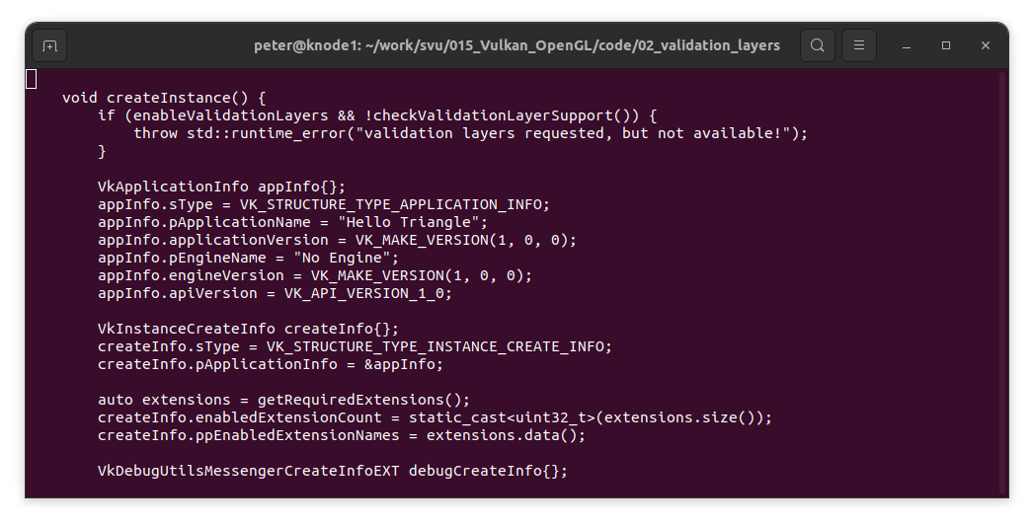
002.5 Message Callback
https://vulkan-tutorial.com/Development_environment#page_Linux
Message Callback
We use defined getRequiredExtensions() to get the return validation.

Slide 14
002.6 Debug Instance Creation

Slide 15
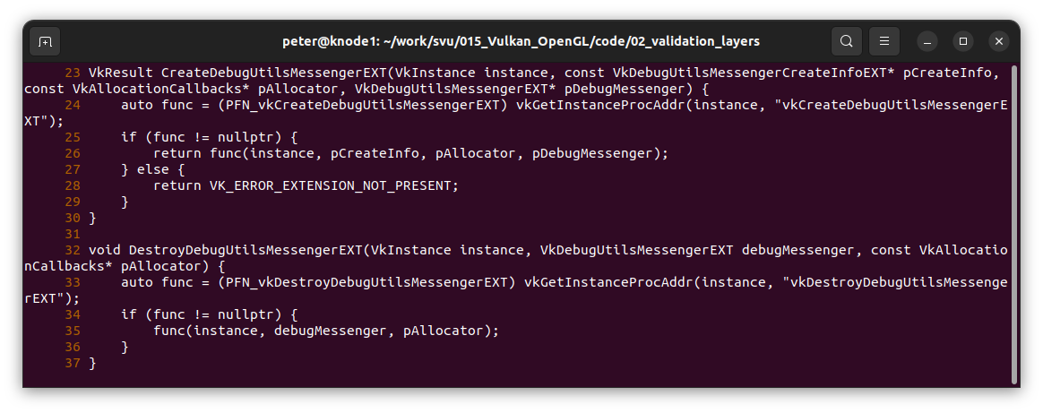
002.6 Debug Instance Creation
https://vulkan-tutorial.com/Development_environment#page_Linux
Debug Instance Creation
Define instance debug function.

Slide 16
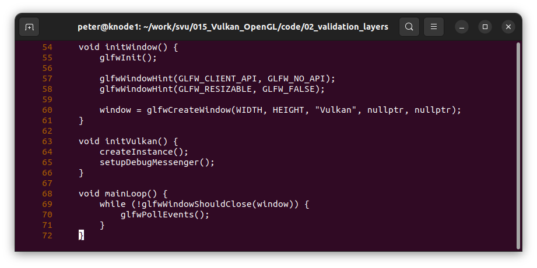
002.6 Creation and Destruction
https://vulkan-tutorial.com/Development_environment#page_Linux
Debug Instance Creation
Add instance debug function in the initVulan().

Slide 17
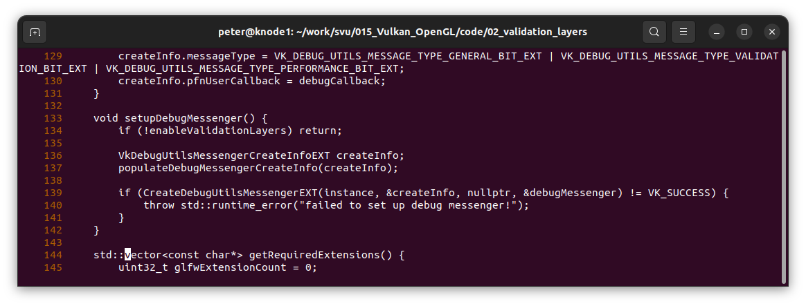
002.6 Creation and Destruction
https://vulkan-tutorial.com/Development_environment#page_Linux
Debug Instance Creation
Add process code in the instance debug funciton.

Slide 18
002.7 Debug Instance Destroy

Slide 19
002.7 Debug Instance Destroy
https://vulkan-tutorial.com/Development_environment#page_Linux
Debug Instance Destroy
Define destroy instance function.

Slide 20
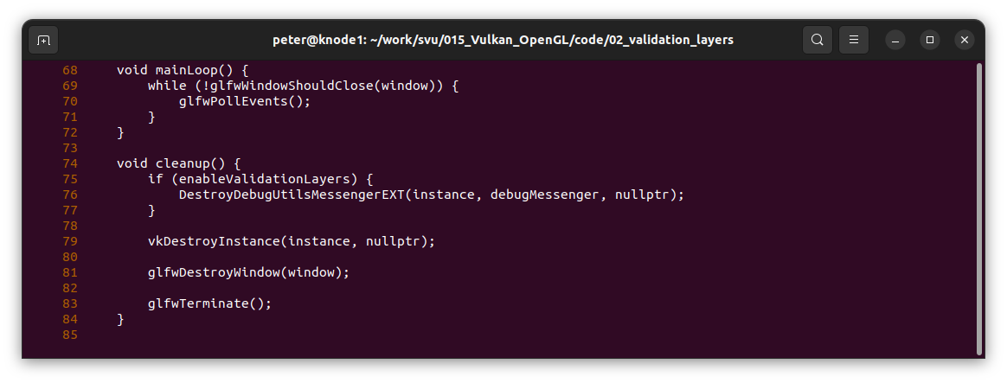
002.7 Debug Instance Destroy
https://vulkan-tutorial.com/Development_environment#page_Linux
Debug Instance Destroy
Add destroy instance function in the cleanup().

Slide 21
002.8 Validate Code

Slide 22
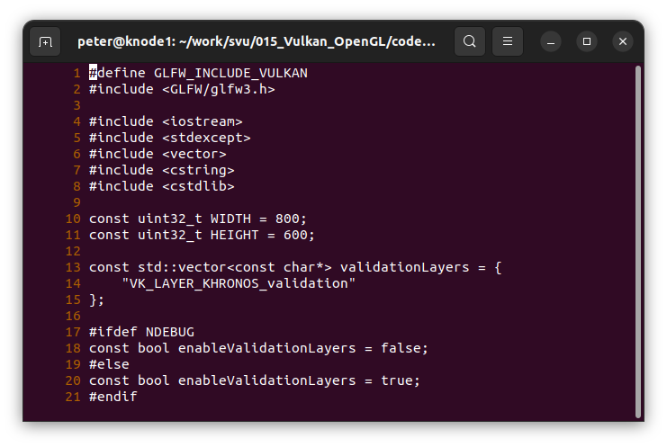
002.8 Validate Code
https://vulkan-tutorial.com/Development_environment#page_Linux
Validate Code (1)
Lines 1-21: Define variables.

Slide 23
002.8 Validate Code
https://vulkan-tutorial.com/Development_environment#page_Linux
Validate Code (2)
Lines 23-38: Define utility function for creation and destroy instance functions.

Slide 24
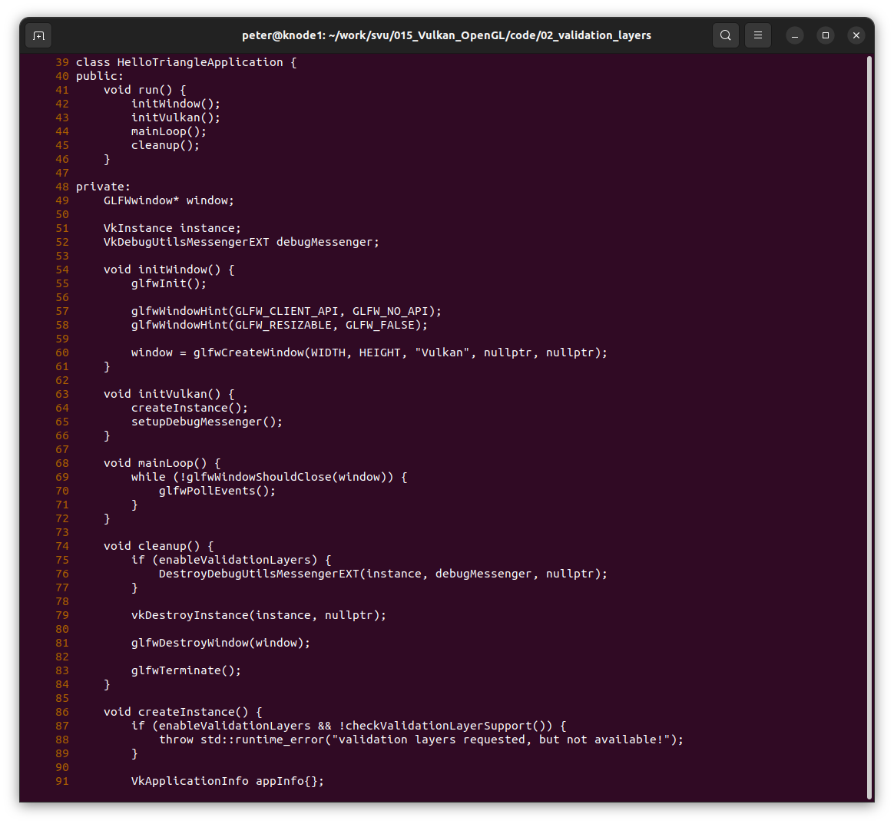
002.8 Validate Code
https://vulkan-tutorial.com/Development_environment#page_Linux
Validate Code (3)
Lines 39-85

Slide 25
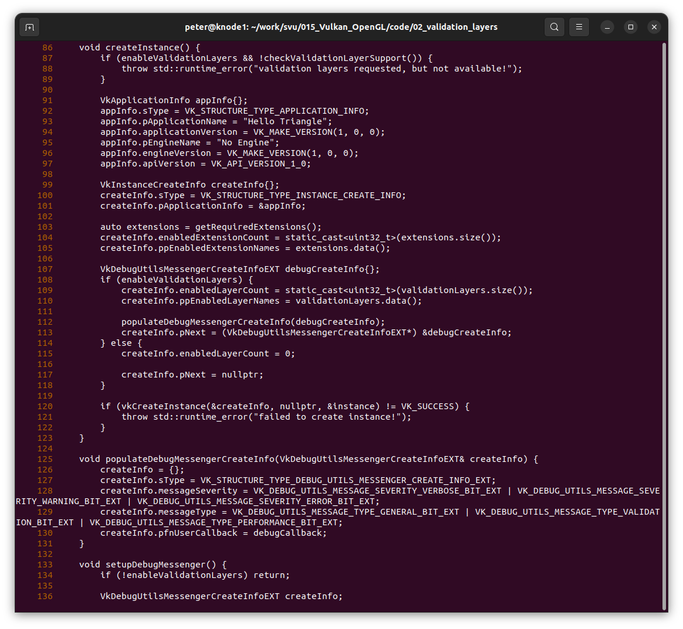
002.8 Validate Code
https://vulkan-tutorial.com/Development_environment#page_Linux
Validate Code (4)
Lines 86-124

Slide 26
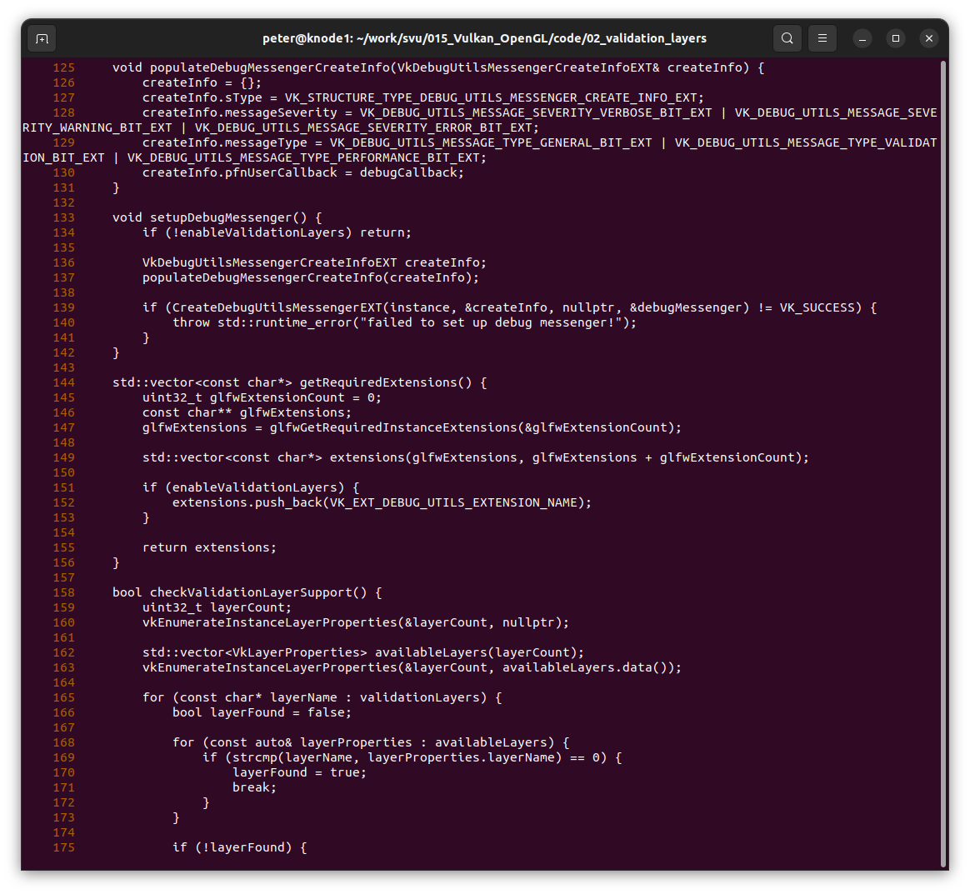
002.8 Validate Code
https://vulkan-tutorial.com/Development_environment#page_Linux
Validate Code (5)
Lines 125-157

Slide 27
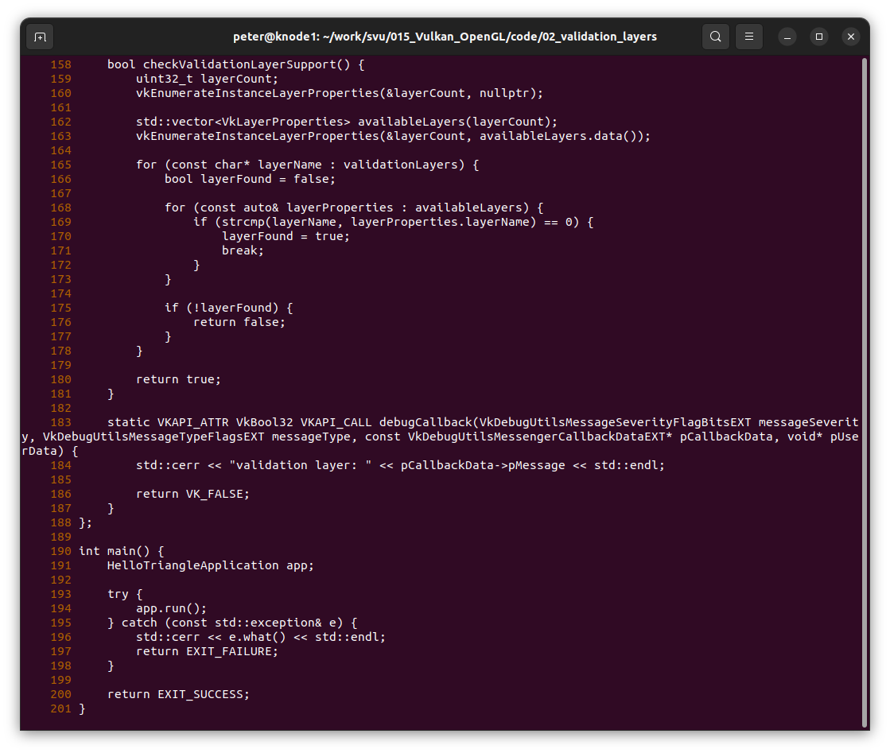
002.8 Validate Code
https://vulkan-tutorial.com/Development_environment#page_Linux
Validate Code (6)
Lines 128-201

Slide 28
End

