Slide 1

01 Vulkan
Peter H. Chen

Slide 2
01 Vulkan
https://www.youtube.com/watch?v=W2I0DofOw9M&list=PLn3eTxaOtL2NH5nbPHMK7gE07SqhcAjmk&index=1
Vulkan
We discussed Vulkan in Windows/Visual Studio/C++.
Vulkan is Germany word for “Volcano”.
You can run Vulkan on Raspberry Pi as well.
Vulkan is
1. Multi-thread for extra performance
2. Can run resource limited system.

Slide 3
01.1 Download Vulkan (Lunar) SDK

Slide 4
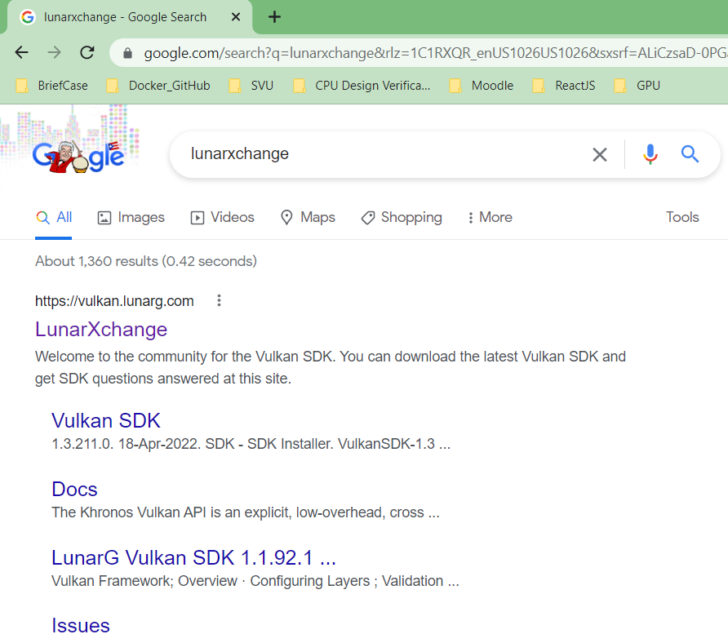
01.1 Download Vulkan (Lunar) SDK
https://www.youtube.com/watch?v=d2jkALhm9EE&list=PLRtjMdoYXLf4A8013lsFWHOgM9qdh0kjH&index=1
Download Vulkan (Lunar) SDK
Search for “LunarXchange”

Slide 5
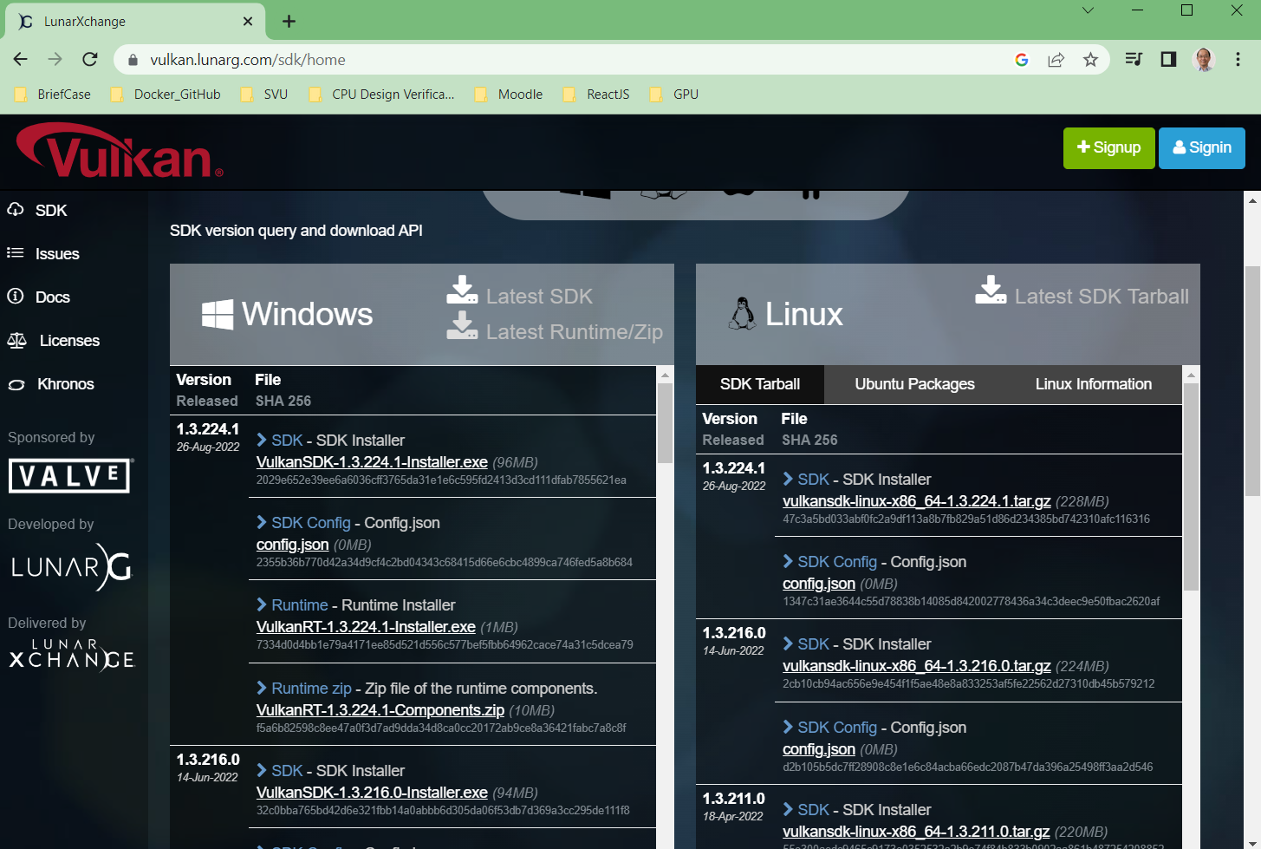
01.1 Download Vulkan (Lunar) SDK
https://www.youtube.com/watch?v=d2jkALhm9EE&list=PLRtjMdoYXLf4A8013lsFWHOgM9qdh0kjH&index=1
Download Vulkan (Lunar) SDK
Download the latest SDK for Windows.

Slide 6
01.2 Install GLFW

Slide 7
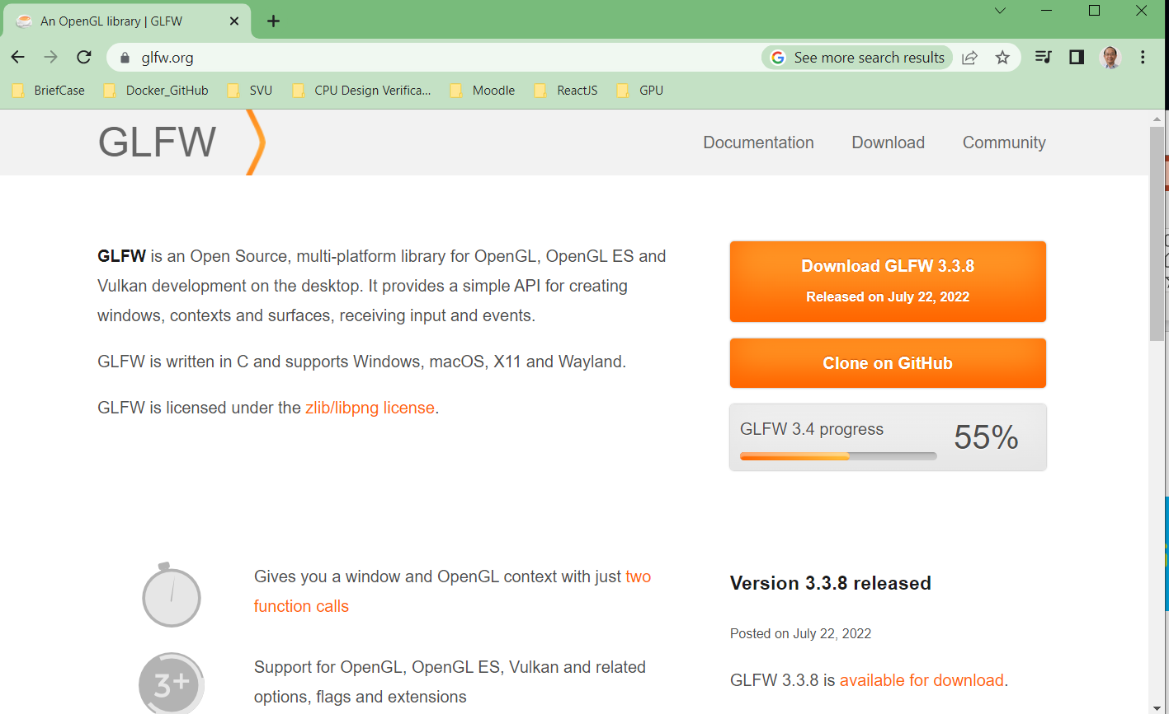
01.2 Install GLFW
https://www.youtube.com/watch?v=d2jkALhm9EE&list=PLRtjMdoYXLf4A8013lsFWHOgM9qdh0kjH&index=1
Install GLFW
We need GLFW. GLFW is commonly used to allow us to create a window, draw Vulkan object.

Slide 8
01.3 Install GLM

Slide 9
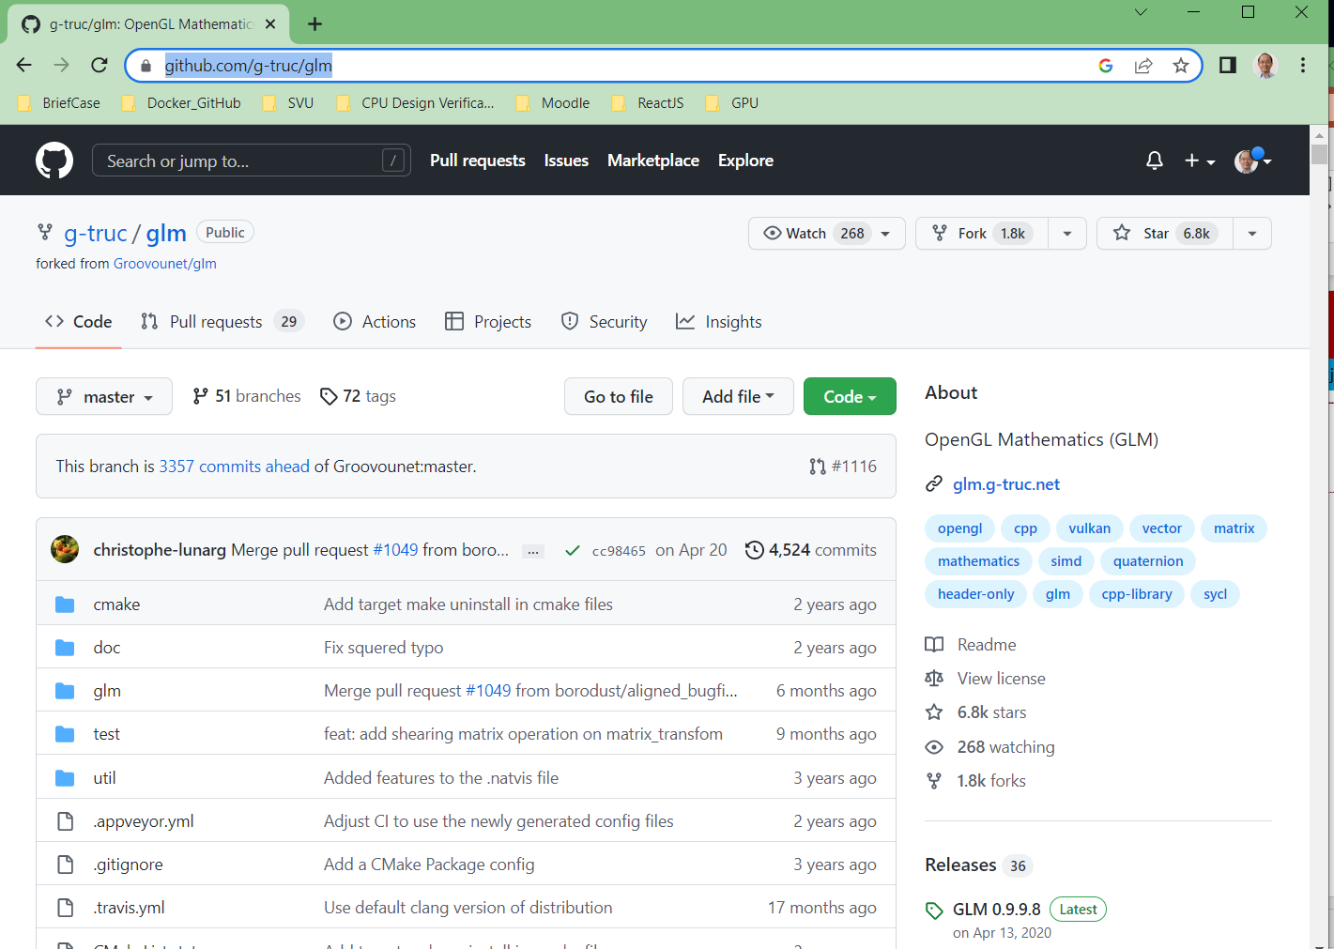
01.3 Install GLM
https://www.youtube.com/watch?v=d2jkALhm9EE&list=PLRtjMdoYXLf4A8013lsFWHOgM9qdh0kjH&index=1
Install GLM
https://github.com/g-truc/glm
We need glm math library at some point of Vulkan development, especially, animation and movement.

Slide 10
01.4 Install Vulkan (Lunar) SDK

Slide 11
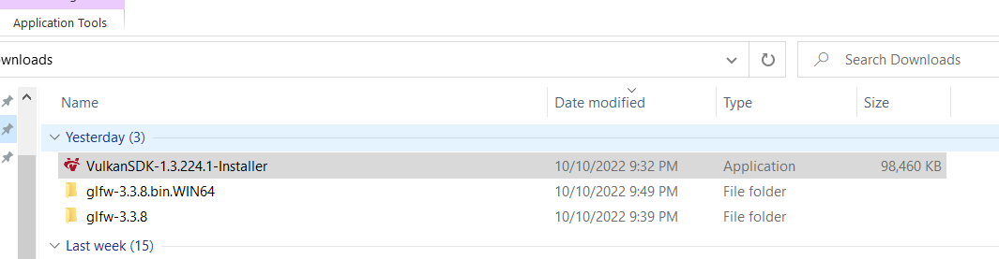
01.4 Install Vulkan (Lunar) SDK
https://www.youtube.com/watch?v=d2jkALhm9EE&list=PLRtjMdoYXLf4A8013lsFWHOgM9qdh0kjH&index=1
Install Vulkan (Lunar) SDK
Double click Downloaded Vulkan SDK.

Slide 12
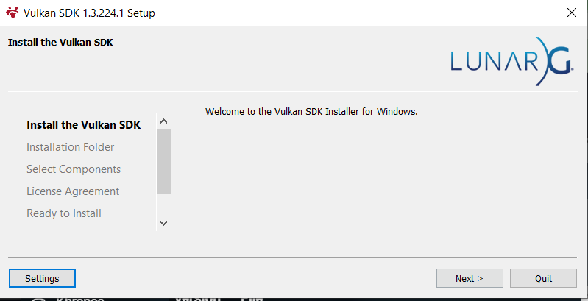
01.4 Install Vulkan (Lunar) SDK
https://www.youtube.com/watch?v=d2jkALhm9EE&list=PLRtjMdoYXLf4A8013lsFWHOgM9qdh0kjH&index=1
Install Vulkan (Lunar) SDK
Download and install the latest SDK for Windows.

Slide 13
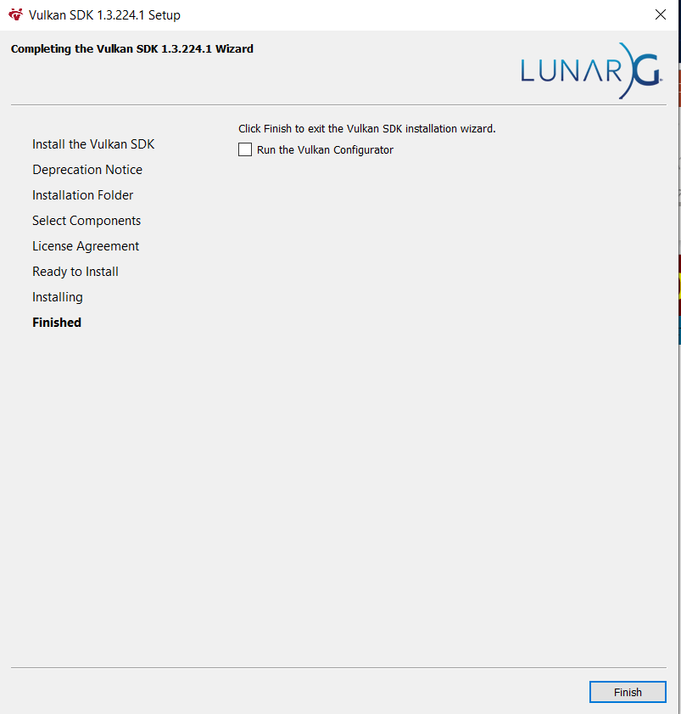
01.4 Install Vulkan (Lunar) SDK
https://www.youtube.com/watch?v=d2jkALhm9EE&list=PLRtjMdoYXLf4A8013lsFWHOgM9qdh0kjH&index=1
Install Vulkan (Lunar) SDK

Slide 14
01.5 Verify Vulkan Installation

Slide 15
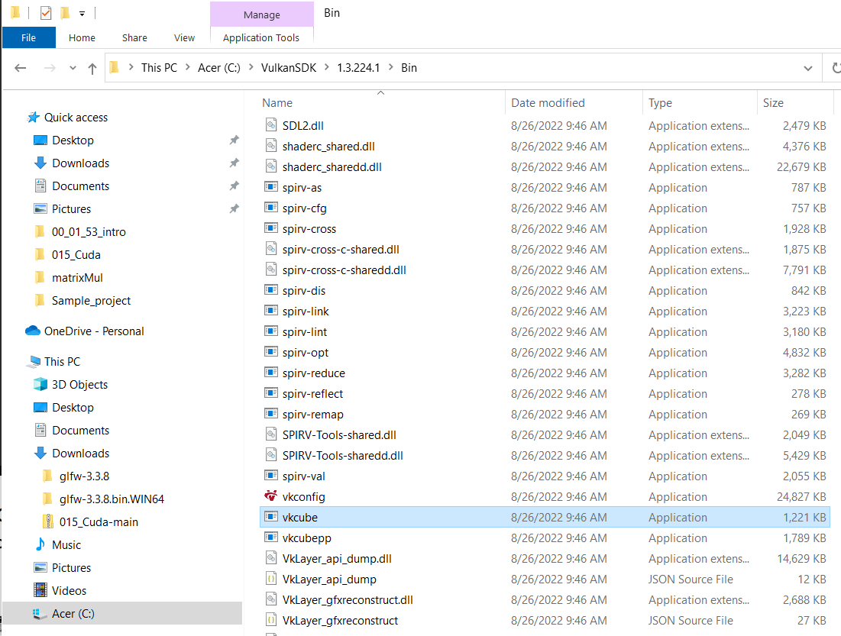
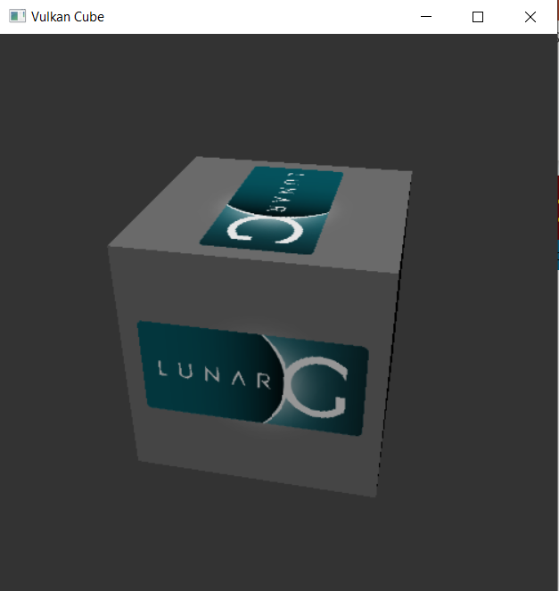
01.5 Verify Vulkan Installation
https://www.youtube.com/watch?v=d2jkALhm9EE&list=PLRtjMdoYXLf4A8013lsFWHOgM9qdh0kjH&index=1
Verify Vulkan Installtion
Double click “C:\VulkanSDK\1.3.224.1\Bin\vkcube.exe” to run Vulkan Cube Application.
You can see the spinning Vulkan Cube. The Vulkan installation is good.
If it does not work, the NVIDIA driver is not at the latest version and need to be upgraded.

Slide 16
01.6 Verify NVIDIA Driver for Vulkan

Slide 17
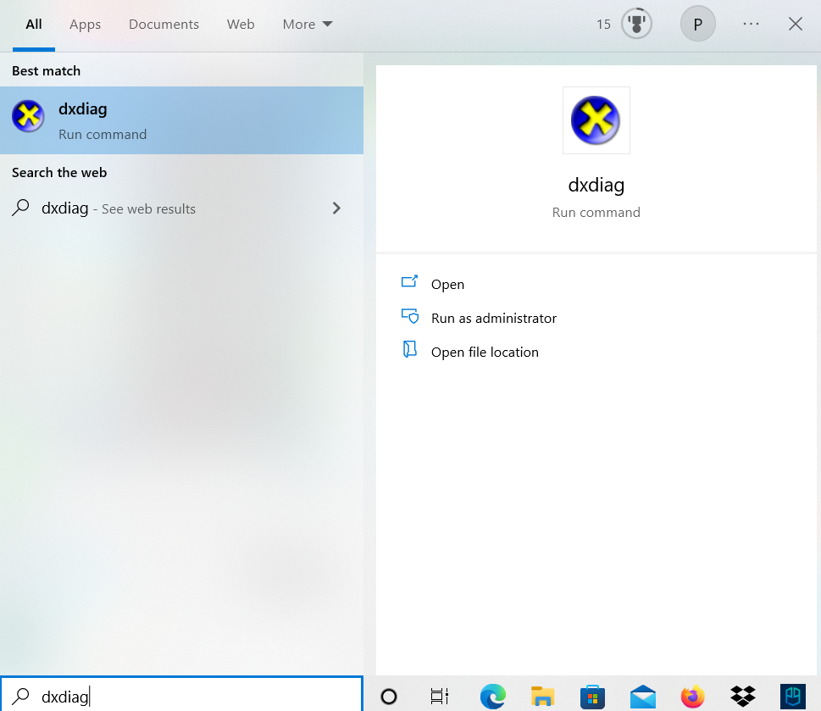
01.6 Verify NVIDIA Driver for Vulkan
https://www.youtube.com/watch?v=d2jkALhm9EE&list=PLRtjMdoYXLf4A8013lsFWHOgM9qdh0kjH&index=1
Verify NVIDIA Driver for Vulkan
To check your GPU display driver is up-to-day or not.
> dxdiag

Slide 18
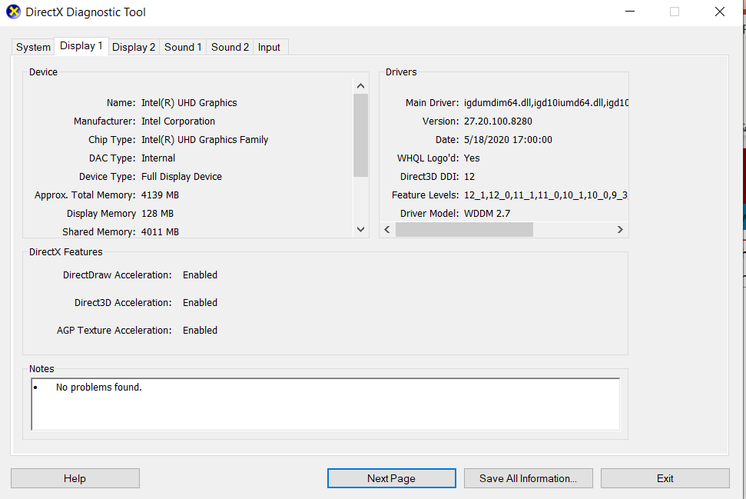
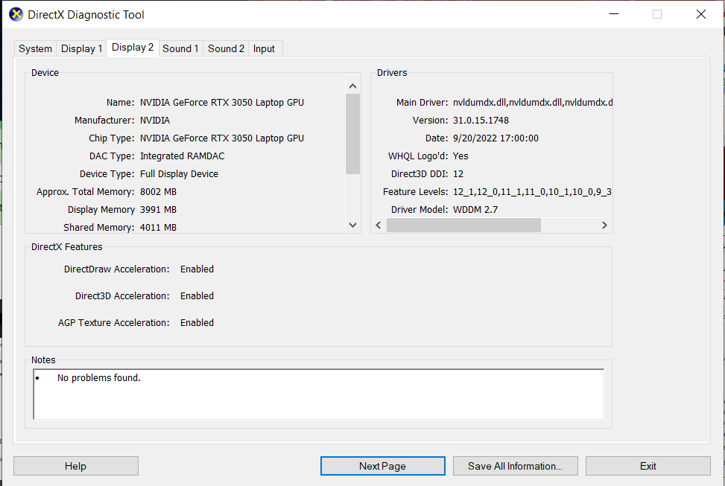
01.6 Verify NVIDIA Driver for Vulkan
https://www.youtube.com/watch?v=d2jkALhm9EE&list=PLRtjMdoYXLf4A8013lsFWHOgM9qdh0kjH&index=1
Verify NVIDIA Driver for Vulkan
Check Display 1 and Display 2.

Slide 19
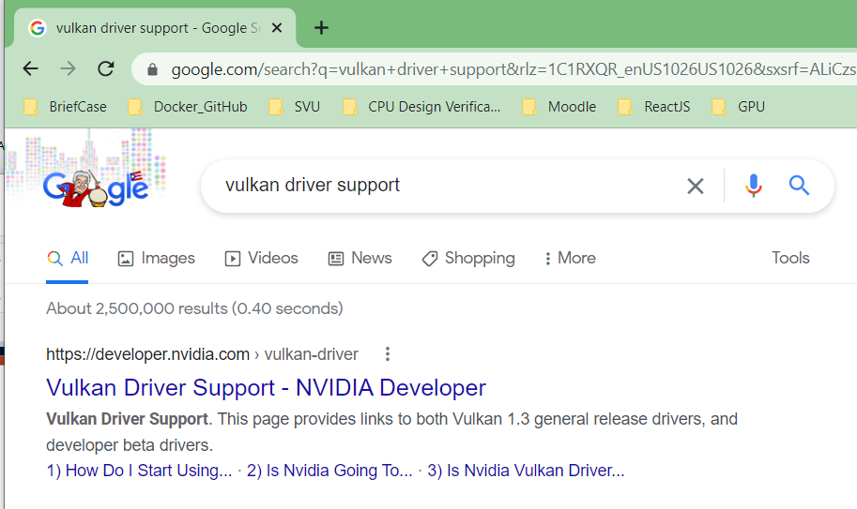
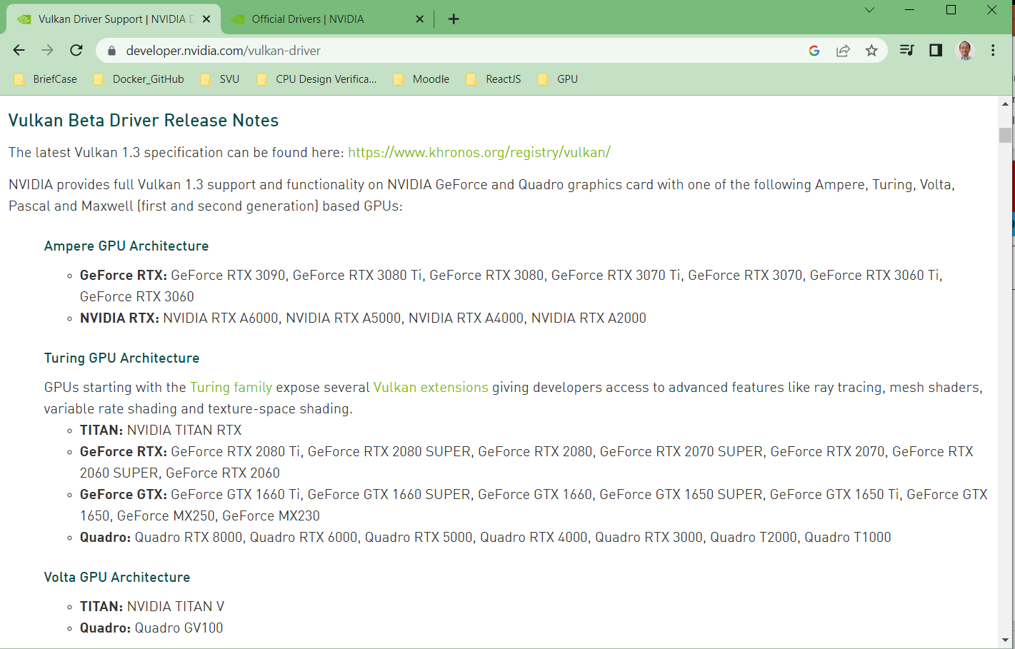
01.6 Verify NVIDIA Driver for Vulkan
https://www.youtube.com/watch?v=d2jkALhm9EE&list=PLRtjMdoYXLf4A8013lsFWHOgM9qdh0kjH&index=1
Verify NVIDIA Driver for Vulkan
Search for “Vulkan Driver Support” (https://developer.nvidia.com).

Slide 20
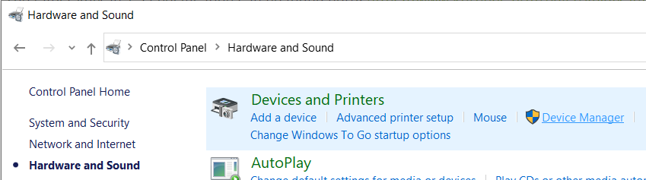
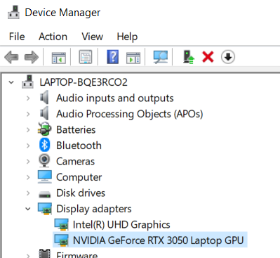
01.6 Verify NVIDIA Driver for Vulkan
https://www.youtube.com/watch?v=d2jkALhm9EE&list=PLRtjMdoYXLf4A8013lsFWHOgM9qdh0kjH&index=1
Verify NVIDIA Driver for Vulkan
Check GPU on my computer.
> Control Panel
> Hardware and Sound
> Device Manager
> Display adapters:
1) Intel (R) UHD Graphics,
2) NVIDIA GeForce RTX 3050 Laptop GPU.

Slide 21
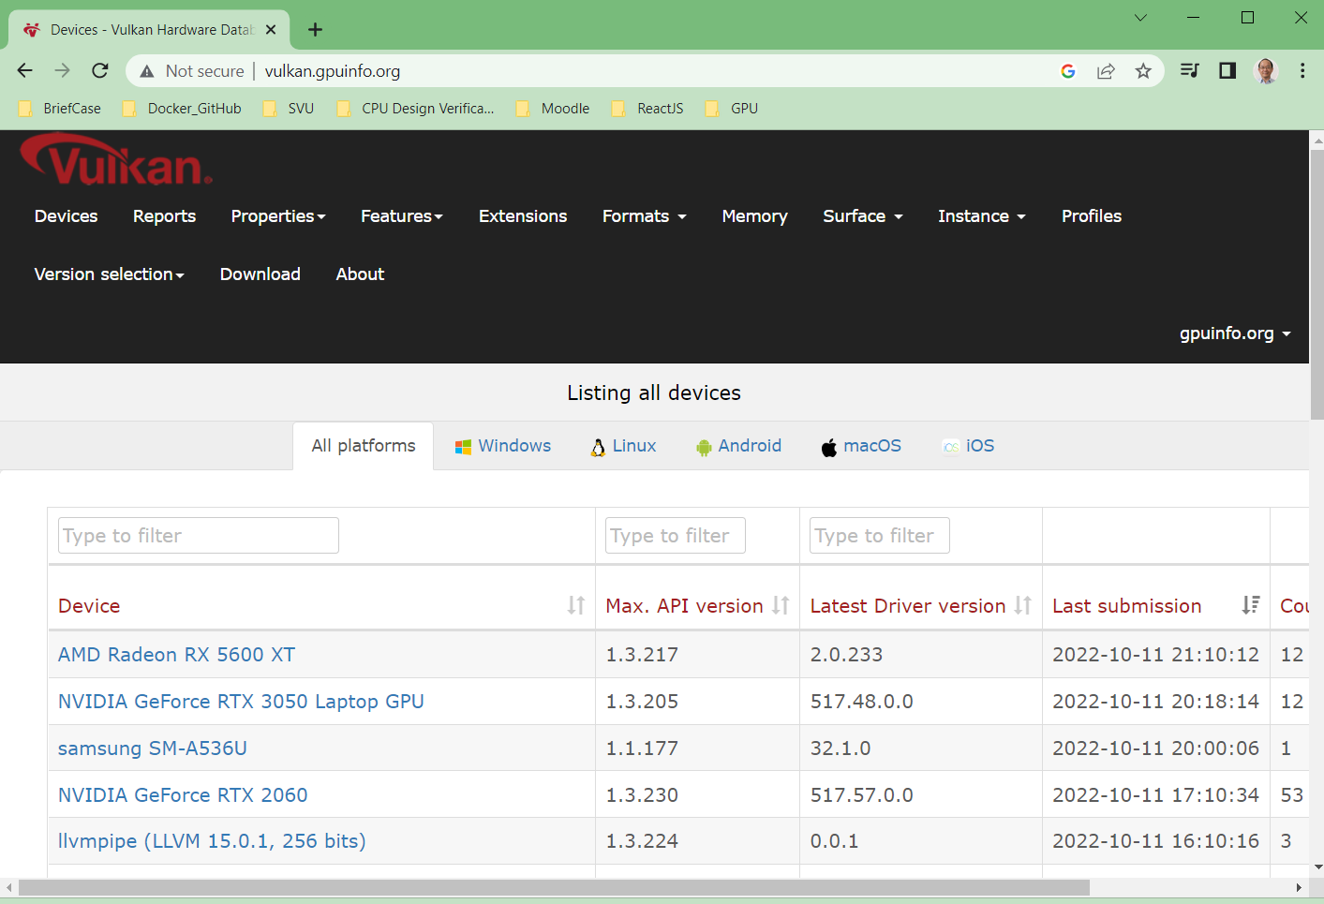
01.6 Verify NVIDIA Driver for Vulkan
https://www.youtube.com/watch?v=d2jkALhm9EE&list=PLRtjMdoYXLf4A8013lsFWHOgM9qdh0kjH&index=1
Verify NVIDIA Driver for Vulkan
For more accurate information, search “Vulkan GPU Info” (http://www.vulkan.gpuinfo.org/).
This web site contains more accurate information than NVIDIA.

Slide 22
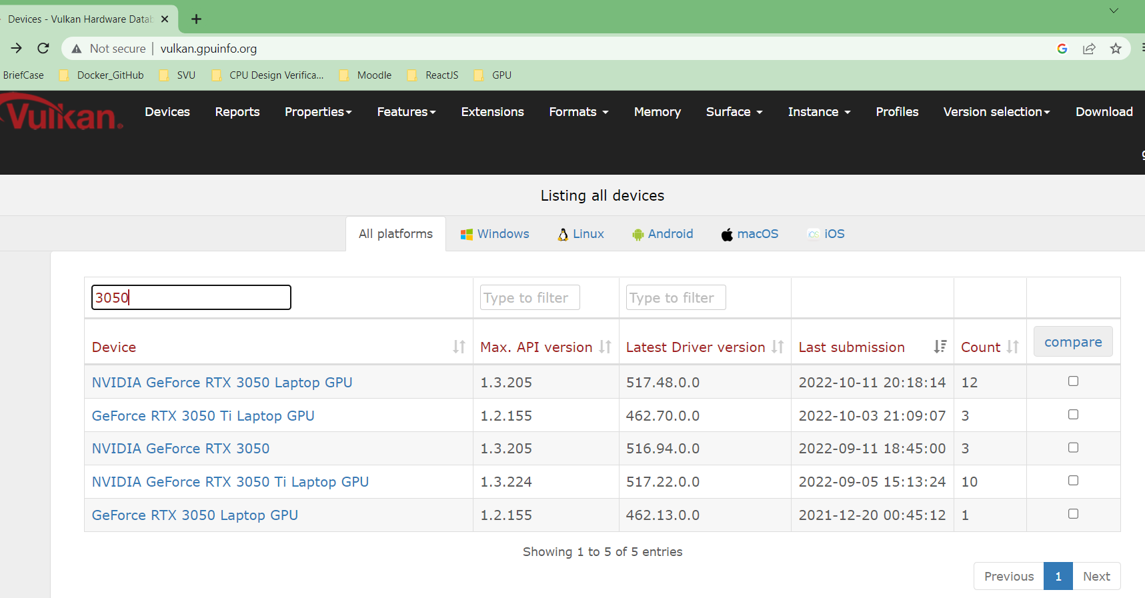
01.6 Verify NVIDIA Driver for Vulkan
https://www.youtube.com/watch?v=d2jkALhm9EE&list=PLRtjMdoYXLf4A8013lsFWHOgM9qdh0kjH&index=1
Verify NVIDIA Driver for Vulkan
My GPU is “NVIDIA GeForce RTX 3050 Laptop”.
Search “3050”. My computer GPU is supported.

Slide 23
01.7 Install Visual Studio

Slide 24
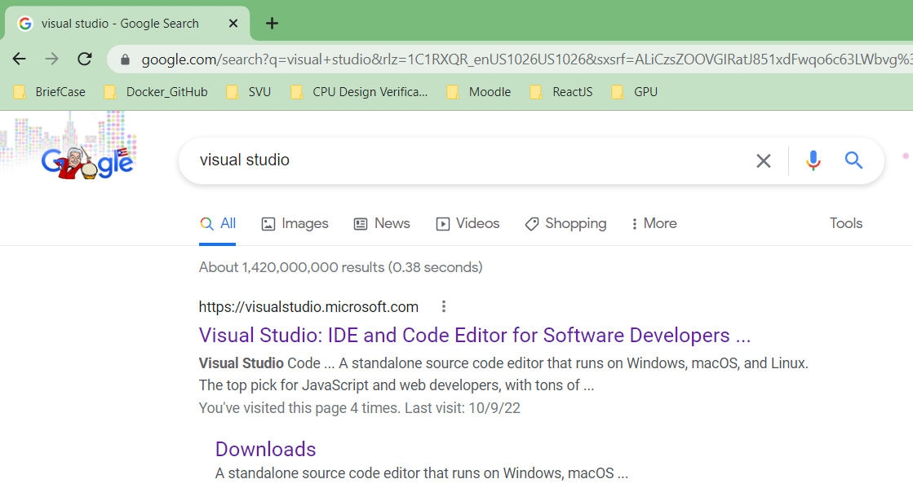
01.7 Install Visual Studio
https://www.youtube.com/watch?v=d2jkALhm9EE&list=PLRtjMdoYXLf4A8013lsFWHOgM9qdh0kjH&index=1
Install Visual Studio
Search for “Visual Studio”.

Slide 25
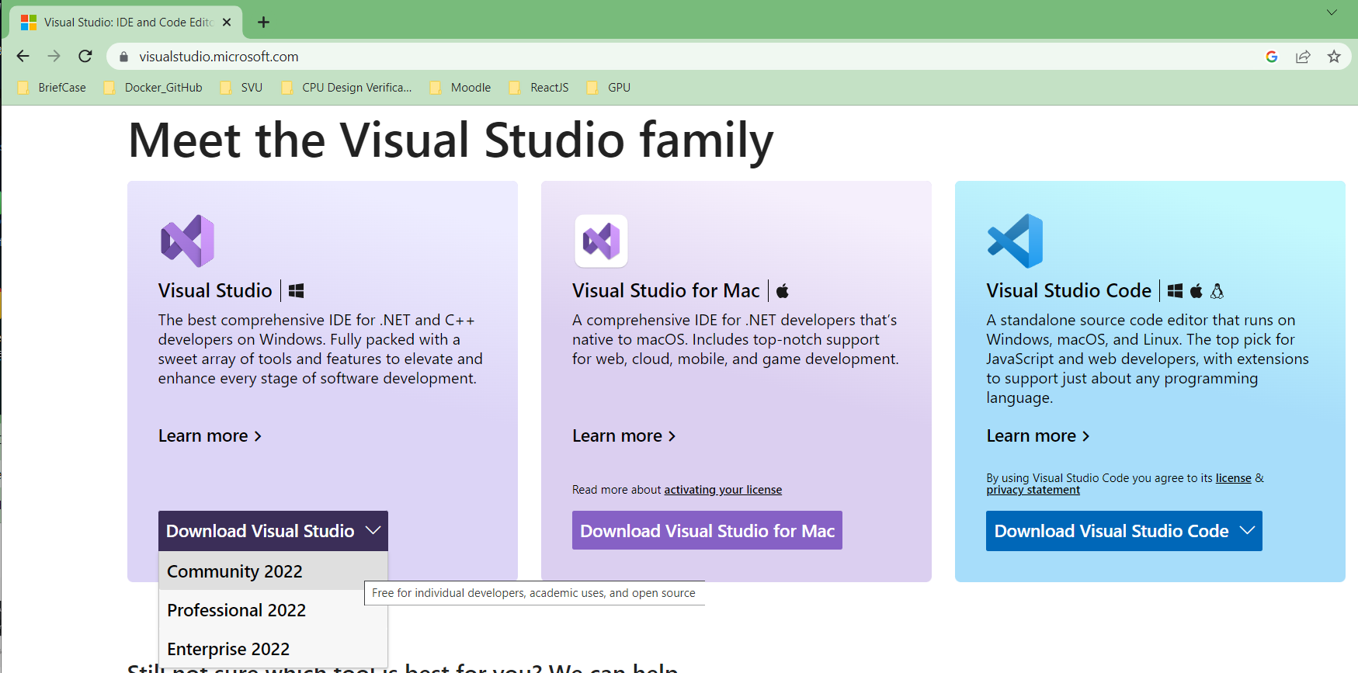
01.7 Install Visual Studio
https://www.youtube.com/watch?v=d2jkALhm9EE&list=PLRtjMdoYXLf4A8013lsFWHOgM9qdh0kjH&index=1
Install Visual Studio
Search for “Visual Studio”.
Download “Community 2022”

Slide 26
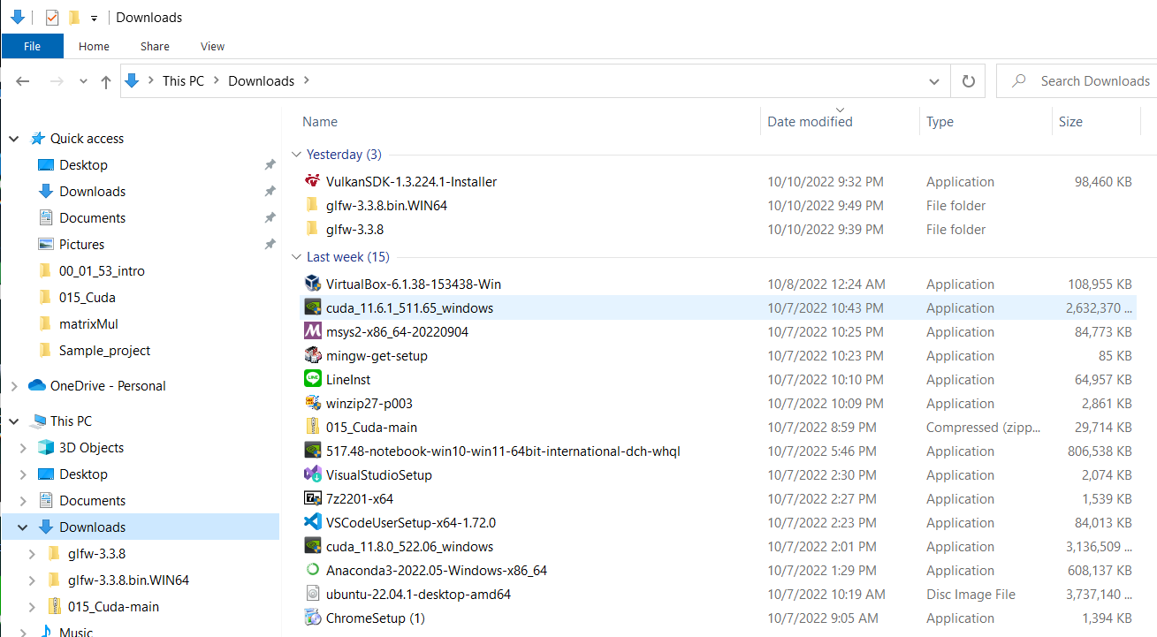
01.7 Install Visual Studio
https://www.youtube.com/watch?v=d2jkALhm9EE&list=PLRtjMdoYXLf4A8013lsFWHOgM9qdh0kjH&index=1
Install Visual Studio
Double click “VisualStudioSetup” to install.

Slide 27
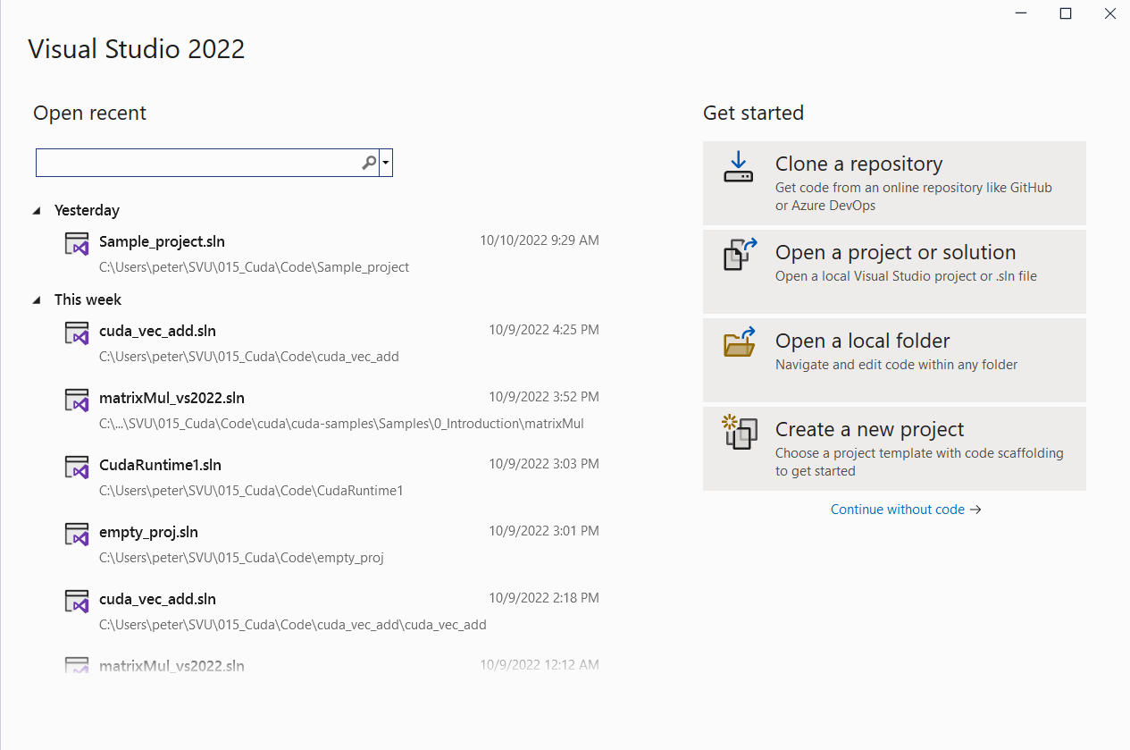
01.7 Install Visual Studio
https://www.youtube.com/watch?v=d2jkALhm9EE&list=PLRtjMdoYXLf4A8013lsFWHOgM9qdh0kjH&index=1
Install Visual Studio
Click “Create a new project”.

Slide 28
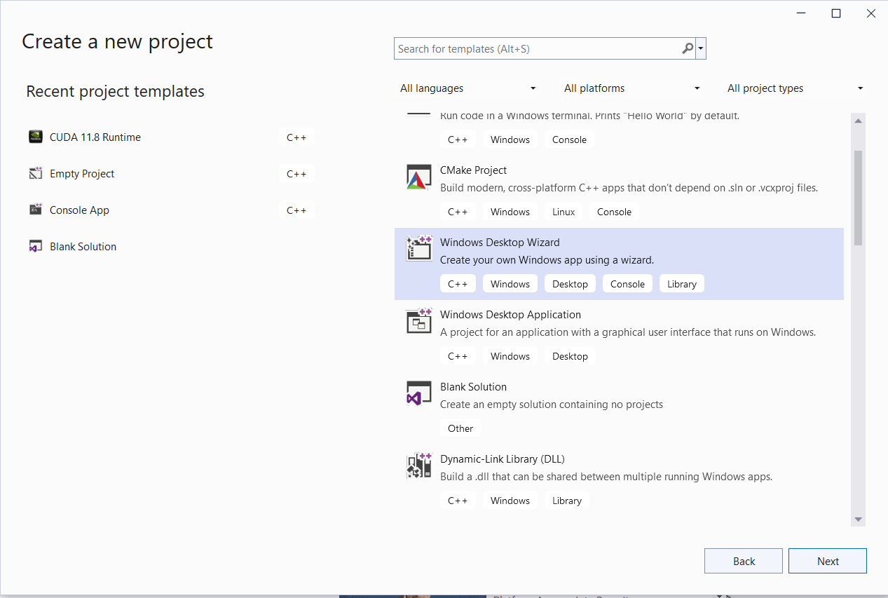
01.7 Install Visual Studio
https://www.youtube.com/watch?v=d2jkALhm9EE&list=PLRtjMdoYXLf4A8013lsFWHOgM9qdh0kjH&index=1
Install Visual Studio
Select “Windows Desktop Wizard”.

Slide 29
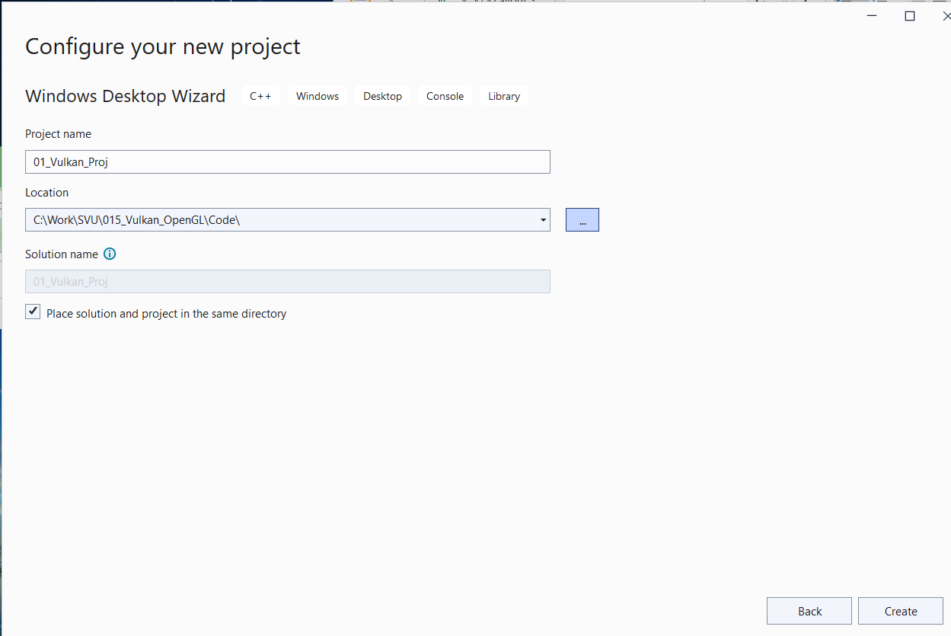
01.7 Install Visual Studio
https://www.youtube.com/watch?v=d2jkALhm9EE&list=PLRtjMdoYXLf4A8013lsFWHOgM9qdh0kjH&index=1
Install Visual Studio
1. Location: C:\Work\SVU\015_Vulkan_OpenGL\Code
2. Project Name: 01_Vulkan_Proj
2
1

Slide 30
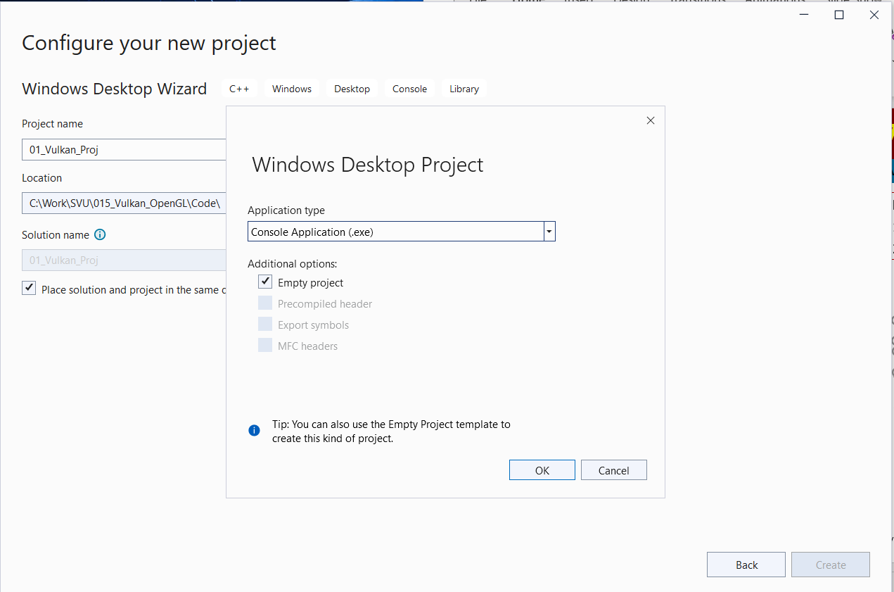
01.7 Install Visual Studio
https://www.youtube.com/watch?v=d2jkALhm9EE&list=PLRtjMdoYXLf4A8013lsFWHOgM9qdh0kjH&index=1
Window Desktop Project
1. Application type: Console Application (.exe)
2. Additional options: Empty project
1
2

Slide 31
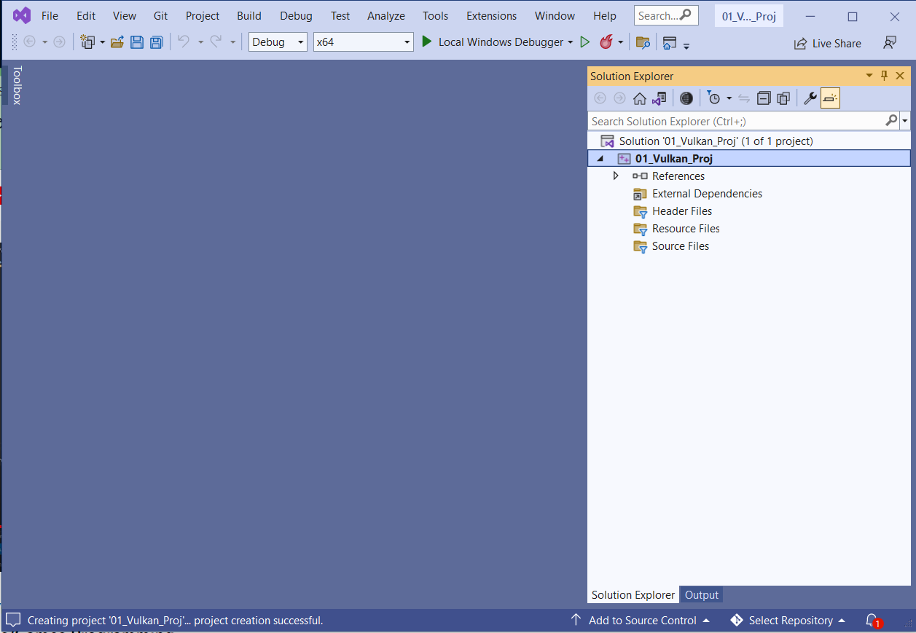
01.7 Install Visual Studio
https://www.youtube.com/watch?v=d2jkALhm9EE&list=PLRtjMdoYXLf4A8013lsFWHOgM9qdh0kjH&index=1
Window Desktop Project
1. Application type: Console Application (.exe)
2. Additional options: Empty project

Slide 32
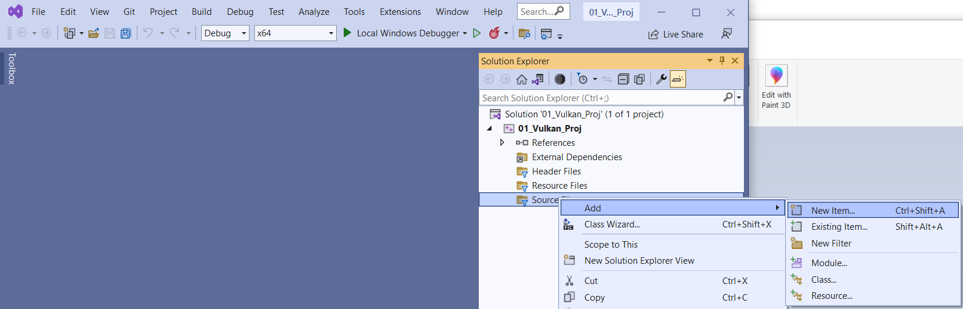
01.7 Install Visual Studio
https://www.youtube.com/watch?v=d2jkALhm9EE&list=PLRtjMdoYXLf4A8013lsFWHOgM9qdh0kjH&index=1
Window Desktop Project
1. Select “Source Files”. Right Click Mouse.
2. Source Files > Add > New Item…

Slide 33
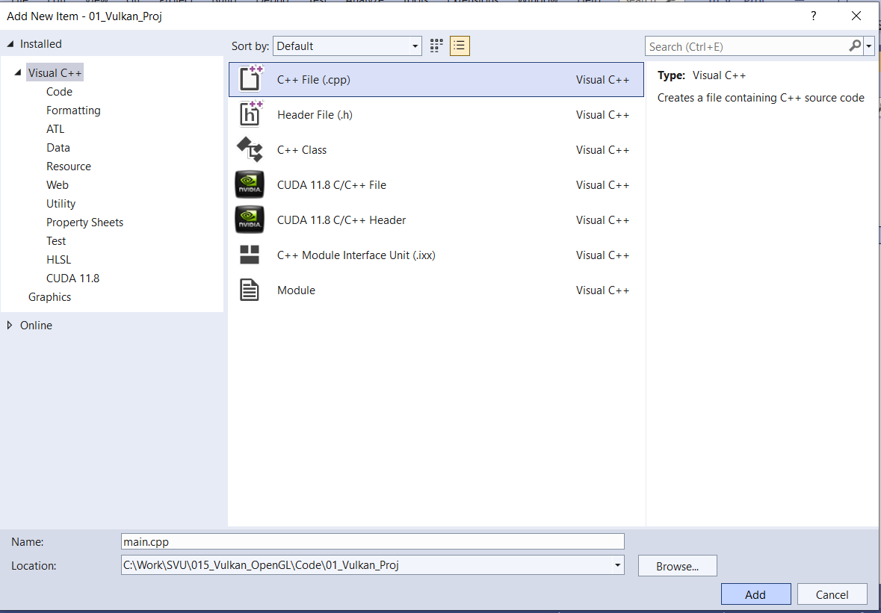
01.7 Install Visual Studio
https://www.youtube.com/watch?v=d2jkALhm9EE&list=PLRtjMdoYXLf4A8013lsFWHOgM9qdh0kjH&index=1
Window Desktop Project
1. Select “C++ File (.cpp)”.
2. main.cpp
1
2

Slide 34
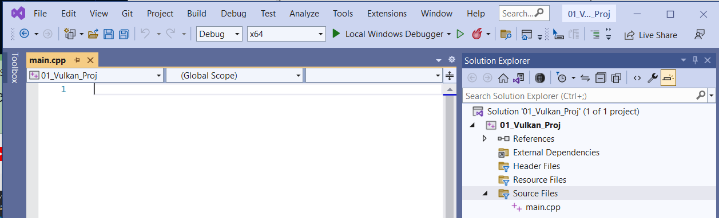
01.7 Install Visual Studio
https://www.youtube.com/watch?v=d2jkALhm9EE&list=PLRtjMdoYXLf4A8013lsFWHOgM9qdh0kjH&index=1
Window Desktop Project
We have the main.cpp
Let copy some Vulkan code (https://github.com/SonarSystems/Vulkan-Tutorials).

Slide 35
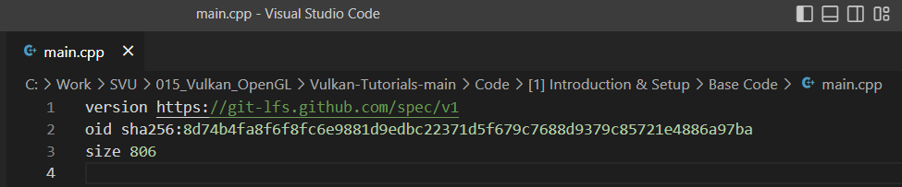
01.7 Install Visual Studio
https://www.youtube.com/watch?v=d2jkALhm9EE&list=PLRtjMdoYXLf4A8013lsFWHOgM9qdh0kjH&index=1
Window Desktop Project
Note:
Vulkan code (https://github.com/SonarSystems/Vulkan-Tutorials).
is encoding with “shad256”
How to decode?

Slide 36
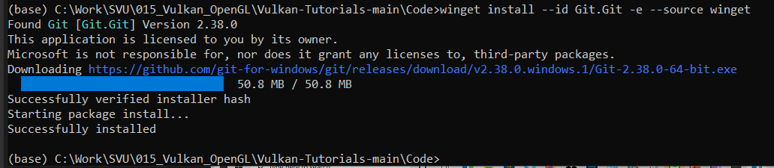
01.7 Install Visual Studio
https://www.youtube.com/watch?v=d2jkALhm9EE&list=PLRtjMdoYXLf4A8013lsFWHOgM9qdh0kjH&index=1
Window Desktop Project
How to decode “sha256” (https://git-lfs.github.com/)
1. Get git.
> winget install –id Git.Git –e –source winget
2.

Slide 37
End

