Slide 1

02 Vulkan Component Overview
Peter H. Chen

Slide 2
02 Vulkan Component Overview
https://www.youtube.com/watch?v=2NVlG9TFT1c&list=PLn3eTxaOtL2NH5nbPHMK7gE07SqhcAjmk&index=2
Vulkan Component Overview
Before we go into code, we discuss the components of vulkan program.

Slide 3
02.1 Instance, Device, and Queue

Slide 4
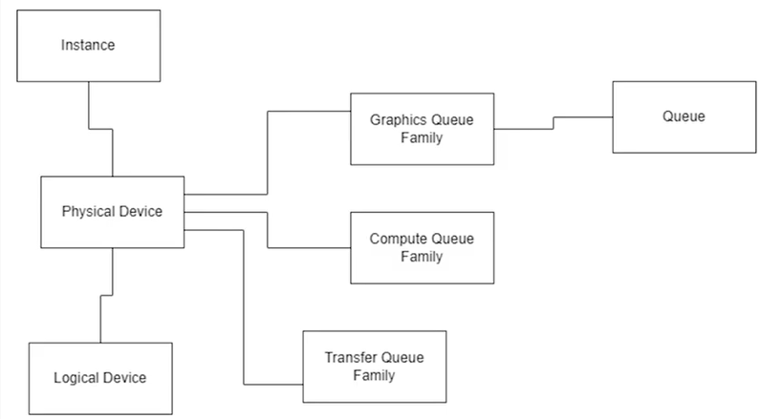
02.1 Instance, Device, and Queue
https://www.youtube.com/watch?v=2NVlG9TFT1c&list=PLn3eTxaOtL2NH5nbPHMK7gE07SqhcAjmk&index=2
Vulkan Component Overview
Vulkan uses graphic card driver to configure every single stage of graphic card.

Slide 5
02.1 Instance, Device, and Queue
https://www.youtube.com/watch?v=2NVlG9TFT1c&list=PLn3eTxaOtL2NH5nbPHMK7gE07SqhcAjmk&index=2
Vulkan Instance
We start with vulkan instance which is similar to an OpenGL context except it is not locked to a single frame.
This instance will track things, such as, the name of program, the version of vulkan, the minimum version of supported vulkan, and etc.

Slide 6
02.1 Instance, Device, and Queue
https://www.youtube.com/watch?v=2NVlG9TFT1c&list=PLn3eTxaOtL2NH5nbPHMK7gE07SqhcAjmk&index=2
Graphics Device
After, we created an instance, we want to query our system and select a physical device to work with.
We do not just have one, we can have multiples. It is more common than we think for a system to have more than one physical graphics device.

Slide 7
02.1 Instance, Device, and Queue
https://www.youtube.com/watch?v=2NVlG9TFT1c&list=PLn3eTxaOtL2NH5nbPHMK7gE07SqhcAjmk&index=2
Graphics Card (1:36/12:24)
For example, laptops often have a choice between an off-board graphics card, discrete graphics card, or the CPU integrated graphics card which are less performance but use less power.

Slide 8
02.1 Instance, Device, and Queue
https://www.youtube.com/watch?v=2NVlG9TFT1c&list=PLn3eTxaOtL2NH5nbPHMK7gE07SqhcAjmk&index=2
Physical Device and Logical Device (1:45/12:24)
So, the physical device is almost like a read-only thing that we can pretty much just query, and we can query what capabilities it has.
In order to use a physical device called vulkan, we can look at it as the logical device, a representation of our physical device.

Slide 9
02.1 Instance, Device, and Queue
https://www.youtube.com/watch?v=2NVlG9TFT1c&list=PLn3eTxaOtL2NH5nbPHMK7gE07SqhcAjmk&index=2
Logical Device Opeations and Physical Device Family (1:57/12:24)
This logical device is used in most other operations.
We can think of the logical device as Vulcan's window into the graphics card.
The physical device also has access to several graphics queue family.
A queue family is a set of command functions used in a type of operation.

Slide 10
02.1 Instance, Device, and Queue
https://www.youtube.com/watch?v=2NVlG9TFT1c&list=PLn3eTxaOtL2NH5nbPHMK7gE07SqhcAjmk&index=2
Graphics Queue, Compute Queue, and Transfer Queue (2:16/12:24)
The physical device can be graphics queue family, compute queue family, or transfer queue family for transferring data.
However, there is an overlap here, for example, a graphic queue family will support data transfer.

Slide 11
02.1 Instance, Device, and Queue
https://www.youtube.com/watch?v=2NVlG9TFT1c&list=PLn3eTxaOtL2NH5nbPHMK7gE07SqhcAjmk&index=2
Queue and Object (2:41/12:24)
Now, what a queue family does is that it allocate queue and a queue is like an abstract object on which commands can be issued.
So, if we want to draw something, we issue a command on the queue to draw it if want to transfer an image form the CPU memory to GPU memory.

Slide 12
02.1 Instance, Device, and Queue
https://www.youtube.com/watch?v=2NVlG9TFT1c&list=PLn3eTxaOtL2NH5nbPHMK7gE07SqhcAjmk&index=2
Record and Issue Command and (3:05/12:24)
We record that command and issue it on the queue.

Slide 13
02.2 Window Surface, Swapchain, Buffer, and Image

Slide 14
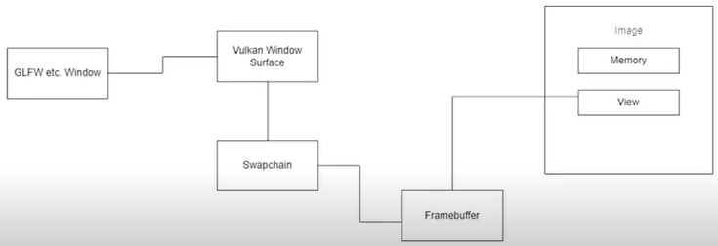
02.2 Window Surface, Swapchain, Buffer, and Image
https://www.youtube.com/watch?v=2NVlG9TFT1c&list=PLn3eTxaOtL2NH5nbPHMK7gE07SqhcAjmk&index=2
Window (3:06/12:24)
Next part, we have a window library.
Two common examples, are GLFW (Graphic Library Framework) and SDL (Specification Description Language). They are very similar to each other.
For example, we could use Qt if we wanted or any other window library, just to handle inputs and things, however, because vulkan is not tied to a specific platform, Vulkan cannot talk specifically to our GLFW window.
What we need is a vulkan window surface, a vulkan window object that basically abstracts the specific window and let us talk to it.

Slide 15
02.2 Window Surface, Swapchain, Buffer, and Image
https://www.youtube.com/watch?v=2NVlG9TFT1c&list=PLn3eTxaOtL2NH5nbPHMK7gE07SqhcAjmk&index=2
Swapchain (3:51/12:24)
Now, we need a Swapchain.
A Swapchain is a double buffered rendering system.
A Swapchain is a series of persistent images which hang around in memory.
In Swapchain, we can grab an image and we can render to it and stick it back on Swap chain.
And we can grab another image and put present that up on the screen and things like that.

Slide 16
02.2 Window Surface, Swapchain, Buffer, and Image
https://www.youtube.com/watch?v=2NVlG9TFT1c&list=PLn3eTxaOtL2NH5nbPHMK7gE07SqhcAjmk&index=2
What is Image? (4:15/12:24)
An image is a kind of a composite structure.
An image has two components.
An image has a memory which is stored somewhere by memory allocation for the pixels.
An image also has a view.
A view basically is a protocol for how to access the contents of the memory.
Images have different layouts based on how they are being used.

Slide 17
02.2 Window Surface, Swapchain, Buffer, and Image
https://www.youtube.com/watch?v=2NVlG9TFT1c&list=PLn3eTxaOtL2NH5nbPHMK7gE07SqhcAjmk&index=2
Image layout (4:46/12:24)
If we want to write an image, for example, we give it a linear layout but that may not be the optimal layout for reading an image.
To read an image, there is something called a tiled layout or optimal layout which is not as simply addressable, but it is optimized for viewing.
We will discuss more detail in components.

Slide 18
02.2 Window Surface, Swapchain, Buffer, and Image
https://www.youtube.com/watch?v=2NVlG9TFT1c&list=PLn3eTxaOtL2NH5nbPHMK7gE07SqhcAjmk&index=2
Memory, Host Coherent, Image Memory (5:20/12:24)
Memory is the physical location where it is located.
There is the host visible memory which is on CPU that we can map to it directly.
There is host coherent memory which is like a print statement which comes up right away. That is coherent
If we worked with C, sometimes, we need to flush a buffer.
So, we might write to an image memory, however, it is not host coherent which means it is waiting but we need to flush that right operation.
So, there is many options of memory.

Slide 19
02.2 Window Surface, Swapchain, Buffer, and Image
https://www.youtube.com/watch?v=2NVlG9TFT1c&list=PLn3eTxaOtL2NH5nbPHMK7gE07SqhcAjmk&index=2
Send Image from CPU to GPU (6:11/12:24)
Change the location of memory if we want to change from residing on CPU mappable address space to the GPU.
This is not as simple as setting a flag.
We must queue up a memory transfer operation and send it through with that way.
So, we have images and image views are referenced by frame buffers.

Slide 20
02.3 Renderpass, Graphics Pipeline, GLSL, and SPIR-V

Slide 21
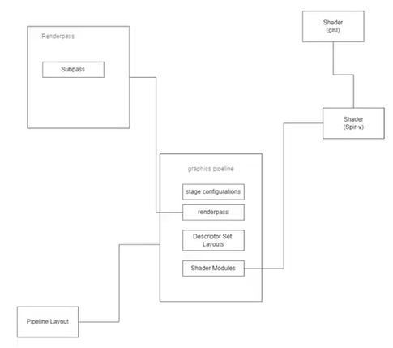
02.3 Renderpass, Graphics Pipeline, GLSL, and SPIR-V
https://www.youtube.com/watch?v=2NVlG9TFT1c&list=PLn3eTxaOtL2NH5nbPHMK7gE07SqhcAjmk&index=2
Frame Buffer (6:35/12:24)
And frame buffers are tied in with the swap chain.
The swap chain has the graphics pipeline.
Graphics Pipeline and OpenGL are pretty much ready made.
All we need to do is load in a shader.
We can just write text code to load it for graphics pipeline and OpenGL.
We may want to change a few things, such as, configure for depth testing or back face culling.
But we also can change it on the fly.
Shader
(glsl)
Renderpass
Subpass
Shader
(Spir-V)
graphics pipeline
stage configurable
renderpass
Descriptor Set Layouts
Pipeline Layout
Shader Modules

Slide 22
02.3 Renderpass, Graphics Pipeline, GLSL, and SPIR-V
https://www.youtube.com/watch?v=2NVlG9TFT1c&list=PLn3eTxaOtL2NH5nbPHMK7gE07SqhcAjmk&index=2
Graphics Pipeline (7:04/12:24)
In graphics pipeline, every single stage needs to be configured.
Even the very little change, we need to recreate the graphics pipeline.
So, if we have a window, we can minimize it and we can bring it back up again.
The graphics pipeline has been destroyed and need to be recreated.
So, we also have a few things.
So, we have the graphics pipeline and then we have a description of it, caked a pipeline layout.
Shader
(glsl)
Renderpass
Subpass
Shader
(Spir-V)
graphics pipeline
stage configurable
renderpass
Descriptor Set Layouts
Pipeline Layout
Shader Modules

Slide 23
02.3 Renderpass, Graphics Pipeline, GLSL, and SPIR-V
https://www.youtube.com/watch?v=2NVlG9TFT1c&list=PLn3eTxaOtL2NH5nbPHMK7gE07SqhcAjmk&index=2
Describe Graphic Pipeline and Renderpass (7:42/12:24)
Now, this is important because we might have multiple pipelines.
We need to be able to describe the graphic pipelines in a generic way with pipeline layout.
And we have a renderpass.
Renderpass is basically describes the types of resources which are used in a render in a draw call.
So, the types of attachments that we are going to have a depth image, color images, clear image, then draw image, and etc.
Shader
(glsl)
Renderpass
Subpass
Shader
(Spir-V)
graphics pipeline
stage configurable
renderpass
Descriptor Set Layouts
Pipeline Layout
Shader Modules

Slide 24
02.3 Renderpass, Graphics Pipeline, GLSL, and SPIR-V
https://www.youtube.com/watch?v=2NVlG9TFT1c&list=PLn3eTxaOtL2NH5nbPHMK7gE07SqhcAjmk&index=2
Renderpass, Shader Modules, and GLSL (7:42/12:24)
A renderpass can also have subpass.
If we want to chain up a bunch of different render passes, we can set that up.
But, by default, we always must have at least one renderpass in there.
Of course, we have shader modules.
So, we used to write shader in GLSL (Graphic Library Shader Language), however, there are some issues with GL Shader Language.
For example, there is an issues in error checking is done on the system level.
Shader
(glsl)
Renderpass
Subpass
Shader
(Spir-V)
graphics pipeline
stage configurable
renderpass
Descriptor Set Layouts
Pipeline Layout
Shader Modules

Slide 25
02.3 Renderpass, Graphics Pipeline, GLSL, and SPIR-V
https://www.youtube.com/watch?v=2NVlG9TFT1c&list=PLn3eTxaOtL2NH5nbPHMK7gE07SqhcAjmk&index=2
Renderpass, Shader Modules, GLSL, and SPIR-V (8:38/12:24)
For example, there is an issues in error checking is done on the system level.
Which mean one of the downsides to that is when a shader fails.
We do not really have good debugging on that.
This issues is never happened with Vulkan.
So, with Vulkan, if we take that GLSL (Graphic Library Shader Language), we compile GLSL into to SPIR-V (Standard Portable Intermediate Representation Version V).
SPIR-V is basically byte code.
SPIR -V removes the inconsistencies of different vendors in GLSL.
Shader
(glsl)
Renderpass
Subpass
Shader
(Spir-V)
graphics pipeline
stage configurable
renderpass
Descriptor Set Layouts
Pipeline Layout
Shader Modules

Slide 26
02.3 Renderpass, Graphics Pipeline, GLSL, and SPIR-V
https://www.youtube.com/watch?v=2NVlG9TFT1c&list=PLn3eTxaOtL2NH5nbPHMK7gE07SqhcAjmk&index=2
Renderpass, Shader Modules, GLSL, and SPIR-V (9:09/12:24)
SPIR-V also improves the quality of debugging that we can do.
So, we compile GLSL down to SPIR-V.
And them we load those in as Shader Modules.
And that is our graphics pipeline.
Shader
(glsl)
Renderpass
Subpass
Shader
(Spir-V)
graphics pipeline
stage configurable
renderpass
Descriptor Set Layouts
Pipeline Layout
Shader Modules

Slide 27
02.4 Draw, Descriptor Set/Pool, and Command Pool/Buffer

Slide 28
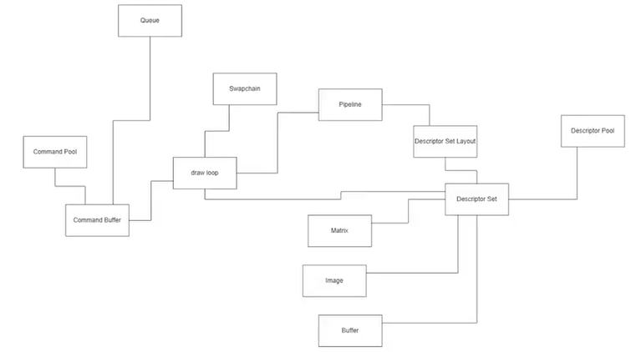
02.4 Draw, Descriptor Set/Pool, and Command Pool/Buffer
https://www.youtube.com/watch?v=2NVlG9TFT1c&list=PLn3eTxaOtL2NH5nbPHMK7gE07SqhcAjmk&index=2
Pass in Data and Draw (9:09/12:24)
Final step is how do we draw something.
Well, we have a few things.
One thing, we want to be able to pass in data, not just vertex.
We want to pass in matrix for transforms.
We want to pass in texture images.
All those thing are all called descriptors.
Queue
Swapchain
Pipeline
Descriptor Set Layout
Descriptor Pool
Command Pool
Draw loop
Matrix
Descriptor Set
Command Buffer
Image

Slide 29
02.4 Draw, Descriptor Set/Pool, and Command Pool/Buffer
https://www.youtube.com/watch?v=2NVlG9TFT1c&list=PLn3eTxaOtL2NH5nbPHMK7gE07SqhcAjmk&index=2
Descriptor Set (10:09/12:24)
We have resources like matrix or a transformation, buffer of some arbitrary data. We want to passing these data like parameters for the environment.
For example, fog color or a bunch of images that we want to sample.
Now, these data are referenced by the descriptor set.
What the descriptor set?
A Descriptor set is a set of references to those existing resources.
A descriptor set is allocated by a descriptor pool.
Queue
Swapchain
Pipeline
Descriptor Set Layout
Descriptor Pool
Command Pool
Draw loop
Matrix
Descriptor Set
Command Buffer
Image

Slide 30
02.4 Draw, Descriptor Set/Pool, and Command Pool/Buffer
https://www.youtube.com/watch?v=2NVlG9TFT1c&list=PLn3eTxaOtL2NH5nbPHMK7gE07SqhcAjmk&index=2
Descriptor Pool (10:24/12:24)
The descriptor pool allocates a bunch of memory.
And the data is written in there.
The descriptor sets are written from there.
And all of the descriptor sets must comply to a descriptor layout.
The benefit is it allows different descriptor sets to exist and be bound under the same layout.
Queue
Swapchain
Pipeline
Descriptor Set Layout
Descriptor Pool
Command Pool
Draw loop
Matrix
Descriptor Set
Command Buffer
Image

Slide 31
02.4 Draw, Descriptor Set/Pool, and Command Pool/Buffer
https://www.youtube.com/watch?v=2NVlG9TFT1c&list=PLn3eTxaOtL2NH5nbPHMK7gE07SqhcAjmk&index=2
Descriptor Set and Device (10:47/12:24)
So, we take descriptor sets and we bind those to our device.
And then we need a command buffer to do drawing, basically.
So, we have a command pool and command pool allocate a command buffer.
And on a command buffer, the draw instructions are recorded.
They are kind of pre-baked.
It is very command to do this once per frame.
We create a new command buffer for every frame.
Queue
Swapchain
Pipeline
Descriptor Set Layout
Descriptor Pool
Command Pool
Draw loop
Matrix
Descriptor Set
Command Buffer
Image

Slide 32
02.4 Draw, Descriptor Set/Pool, and Command Pool/Buffer
https://www.youtube.com/watch?v=2NVlG9TFT1c&list=PLn3eTxaOtL2NH5nbPHMK7gE07SqhcAjmk&index=2
Command Pool (11:14/12:24)
We record commands, every frame is fine.
It is very light weight. It does not take a lot of resource.
What takes resources is submitting that command buffer for operation on the graphics queue.
That takes overhead.
For that reason, one of the major philosophy of Vulkan is to try to setup our scene so we can in the minimum amount of draw calls.
Queue
Swapchain
Pipeline
Descriptor Set Layout
Descriptor Pool
Command Pool
Draw loop
Matrix
Descriptor Set
Command Buffer
Image

Slide 33
02.5 Summary

Slide 34
02.5 Summary
https://www.youtube.com/watch?v=2NVlG9TFT1c&list=PLn3eTxaOtL2NH5nbPHMK7gE07SqhcAjmk&index=2
Summary (11:45/12:24)
Now, we are not going to worry about that at this moment.
Because, for now, we just want to get the things working.
But that is direction that Vulkan moves in.
That is the most benefits are seen.
Anyway, as you can see, there are a lot of tiny little granular components.
We will look at one at a time in a level of details and make sure we can handle that.
Queue
Swapchain
Pipeline
Descriptor Set Layout
Descriptor Pool
Command Pool
Draw loop
Matrix
Descriptor Set
Command Buffer
Image

Slide 35
End

