Slide 1

004 Vulkan by Linux
Peter H. Chen

Slide 2
004 Vulkan by Linux
https://vulkan-tutorial.com/Development_environment#page_Linux
Vulkan by Linux
The following instructions are used at Ubuntu, Fedora, and Arch Linux users, but you may be able to follow along by changing the package manager-specific commands to the ones that are appropriate for you.
You should have a compiler that supports C++17 (GCC 7+ or Clang 5+).
We will also need make.

Slide 3
004.1 Vulkan Packages

Slide 4
004.1 Vulkan Packages
https://vulkan-tutorial.com/Development_environment#page_Linux
Vulkan Packages
The most important components you'll need for developing Vulkan applications on Linux are the Vulkan loader, validation layers, and a couple of command-line utilities to test whether your machine is Vulkan-capable:
> sudo apt install vulkan-tools or
> sudo dnf install vulkan-tools:
Command-line utilities, most importantly vulkaninfo and vkcube. Run these to confirm your machine supports Vulkan.
> sudo apt install libvulkan-dev or
> sudo dnf install vulkan-loader-devel:
Installs Vulkan loader. The loader looks up the functions in the driver at runtime, similarly to GLEW for OpenGL - if you're familiar with that.

Slide 5
004.1 Vulkan Packages
https://vulkan-tutorial.com/Development_environment#page_Linux
Vulkan Packages
> sudo apt install vulkan-validationlayers-dev spirv-tools or
> sudo dnf install mesa-vulkan-devel vulkan-validation-layers-devel:
Installs the standard validation layers and required SPIR-V tools. These are crucial when debugging Vulkan applications, and we'll discuss them in the upcoming chapter.
On Arch Linux, you can run
> sudo pacman -S vulkan-devel
to install all the required tools above.

Slide 6
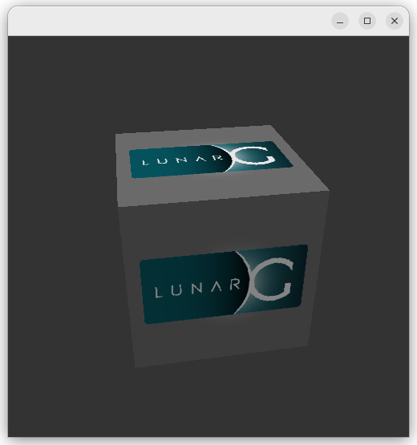
004.1 Vulkan Packages
https://vulkan-tutorial.com/Development_environment#page_Linux
Vulkan Packages
If installation was successful, you should be all set with the Vulkan portion.
Remember to run
> vkcube
and ensure you see the following pop up in a window:

Slide 7
004.2 GLFW

Slide 8
004.2 GLFW
https://vulkan-tutorial.com/Development_environment#page_Linux
GLFW (Graphics Library Framework)
Vulkan by itself is a platform agnostic (unknown)API and does not include tools for creation a window to display the rendered results.
To benefit from the cross-platform advantages of Vulkan and to avoid the horrors of X11, we'll use the GLFW library to create a window, which supports Windows, Linux and MacOS.
There are other libraries available for this purpose, like SDL, but the advantage of GLFW is that it also abstracts away some of the other platform-specific things in Vulkan besides just window creation.
We'll be installing GLFW from the following command:
> sudo apt install libglfw3-dev or
> sudo dnf install glfw-devel or
> sudo pacman -S glfw-wayland # glfw-x11 for X11 users

Slide 9
004.3 GLM

Slide 10
004.3 GLM
https://vulkan-tutorial.com/Development_environment#page_Linux
GLM (Generalized Linear Model)
Unlike DirectX 12, Vulkan does not include a library for linear algebra operations, so we'll have to download one.
GLM is a nice library that is designed for use with graphics APIs and is also commonly used with OpenGL.
It is a header-only library that can be installed from the libglm-dev or glm-devel package:
> sudo apt install libglm-dev or
> sudo dnf install glm-devel or
> sudo pacman -S glm

Slide 11
004.4 Shader Compiler

Slide 12
004.4 Shader Compiler
https://vulkan-tutorial.com/Development_environment#page_Linux
Shader Compiler
We have just about all we need, except we'll want a program to compile shaders from the human-readable GLSL (OpenGL Shader Language) to bytecode.
Two popular shader compilers are Khronos Group's glslangValidator and Google's glslc (OpenGL Shader Language Compiler).
The glslc has a familiar GCC- and Clang-like usage, so we'll go with that: on Ubuntu, download Google's unofficial binaries and copy glslc to your /usr/local/bin.
Download glslc (install.gz)
> cd /install/bin
> sudo * /usr/local/bin
To test, run glslc and it should rightfully complain we didn't pass any shaders to compile:
> glslc: error: no input files

Slide 13
004.5 Setup Vulkan Project

Slide 14
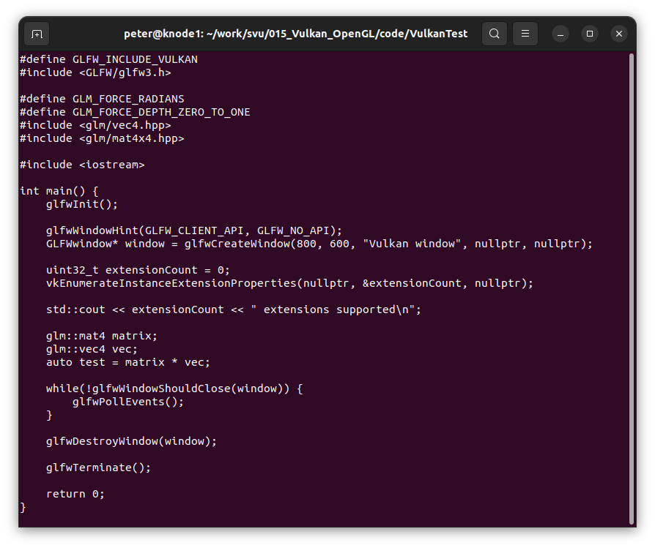
004.5 Setup Vulkan Project
https://vulkan-tutorial.com/Development_environment#page_Linux
Setup Vulkan Project
Now that you have installed all of the dependencies, we can set up a basic makefile project for Vulkan and write a little bit of code to make sure that everything works.
Create a new directory at a convenient location with a name like VulkanTest.
Create a source file called main.cpp.

Slide 15
004.5 Setup Vulkan Project
https://vulkan-tutorial.com/Development_environment#page_Linux
Setup Vulkan Project
Write Makefile.
We'll first define a couple of variables to simplify the remainder of the file.
Define a CFLAGS variable that will specify the basic compiler flags:
> CFLAGS = -std=c++17 -O2
We're going to use modern C++ (-std=c++17), and we'll set optimization level to O2.
We can remove -O2 to compile programs faster, but we should remember to place it back for release builds.

Slide 16
004.5 Setup Vulkan Project
https://vulkan-tutorial.com/Development_environment#page_Linux
Setup Vulkan Project
Similarly, define the linker flags in a LDFLAGS variable:
> LDFLAGS = -lglfw -lvulkan -ldl -lpthread -lX11 -lXxf86vm -lXrandr -lXi
The flag -lglfw is for GLFW, -lvulkan links with the Vulkan function loader and the remaining flags are low-level system libraries that GLFW needs.
The remaining flags are dependencies of GLFW itself: the threading and window management.
It is possible that the Xxf68vm and Xi libraries are not yet installed on your system.

Slide 17
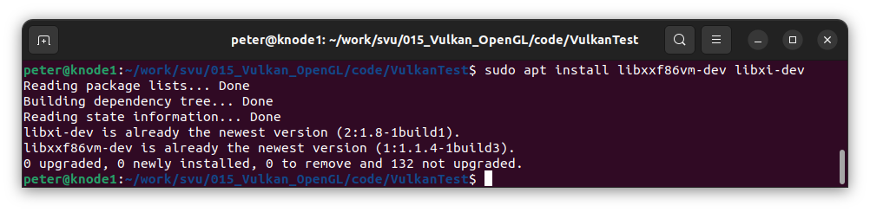
004.5 Setup Vulkan Project
https://vulkan-tutorial.com/Development_environment#page_Linux
Setup Vulkan Project
You can find them in the following packages:
> sudo apt install libxxf86vm-dev libxi-dev

Slide 18
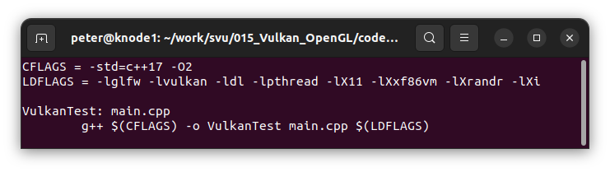
004.5 Setup Vulkan Project
https://vulkan-tutorial.com/Development_environment#page_Linux
Setup Vulkan Project
Specifying the rule to compile VulkanTest is straightforward now.
Make sure to use tabs for indentation instead of spaces.
> VulkanTest: main.cpp
> g++ $(CFLAGS) -o VulkanTest main.cpp $(LDFLAGS)

Slide 19
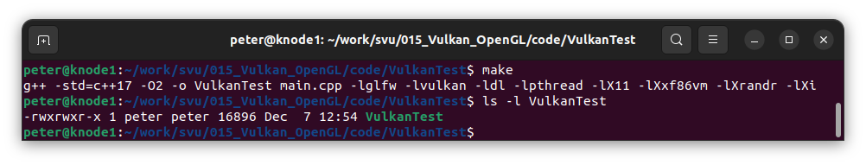
004.5 Setup Vulkan Project
https://vulkan-tutorial.com/Development_environment#page_Linux
Setup Vulkan Project
Verify the VulkanTest compilation:
> make
> ls -l VulkanTest

Slide 20
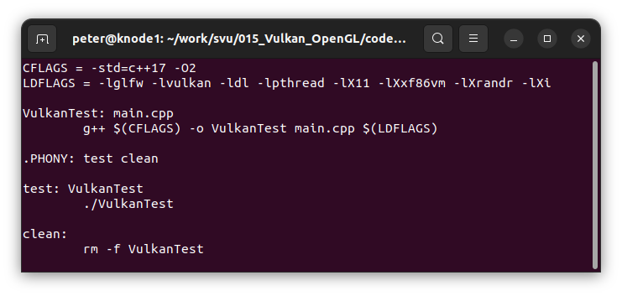
004.5 Setup Vulkan Project
https://vulkan-tutorial.com/Development_environment#page_Linux
Setup Vulkan Project
We now define two more rules, test and clean, where the former will run the executable and the latter will remove a built executable:
> .PHONY: test clean
> test: VulkanTest
> ./VulkanTest
> clean:
> rm -f VulkanTest

Slide 21
End

