Slide 1

00 Base Code
Peter H. Chen

Slide 2
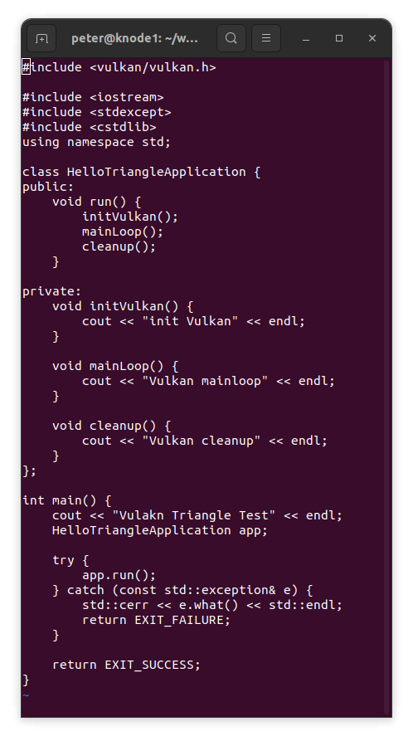
00 Base Code
https://vulkan-tutorial.com/Drawing_a_triangle/Setup/Base_code
Setup
In the previous chapter you've created a Vulkan project with all of the proper configuration and tested it with the sample code.
In this chapter we're starting from scratch with the following code:

Slide 3
00 Base Code
https://vulkan-tutorial.com/Drawing_a_triangle/Setup/Base_code
Setup
We first include the Vulkan header from the LunarG SDK, which provides the functions, structures and enumerations.
The stdexcept and iostream headers are included for reporting and propagating errors.
The cstdlib header provides the EXIT_SUCCESS and EXIT_FAILURE macros.

Slide 4
00 Base Code
https://vulkan-tutorial.com/Drawing_a_triangle/Setup/Base_code
Setup
The program itself is wrapped into a class where we'll store the Vulkan objects as private class members and add functions to initiate each of them, which will be called from the initVulkan function.
Once everything has been prepared, we enter the main loop to start rendering frames. We'll fill in the mainLoop function to include a loop that iterates until the window is closed in a moment.
Once the window is closed and mainLoop returns, we'll make sure to deallocate the resources we've used in the cleanup function.

Slide 5
00 Base Code
https://vulkan-tutorial.com/Drawing_a_triangle/Setup/Base_code
Setup
If any kind of fatal error occurs during execution then we'll throw a std::runtime_error exception with a descriptive message, which will propagate back to the main function and be printed to the command prompt.
To handle a variety of standard exception types as well, we catch the more general std::exception.
One example of an error that we will deal with soon is finding out that a certain required extension is not supported.

Slide 6
00 Base Code
https://vulkan-tutorial.com/Drawing_a_triangle/Setup/Base_code
Setup
Roughly every chapter that follows after this one will add one new function that will be called from initVulkan and one or more new Vulkan objects to the private class members that need to be freed at the end in cleanup.

Slide 7
End

