Slide 1

005 Draw Triangle
Peter H. Chen

Slide 2
001 Instance Creation

Slide 3
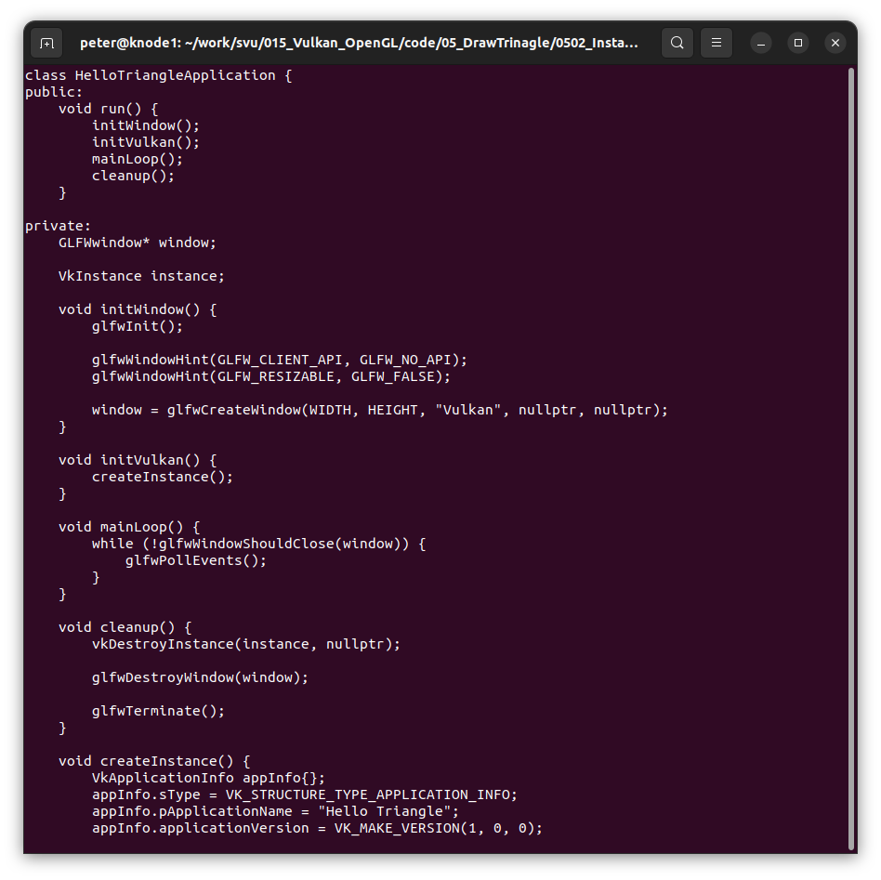
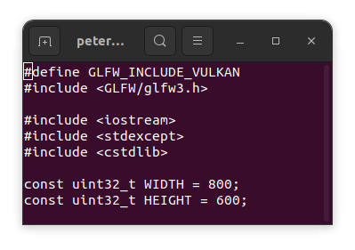
005.2 Instance Creation
https://vulkan-tutorial.com/Development_environment#page_Linux
Instance Creation
Create Instance.

Slide 4
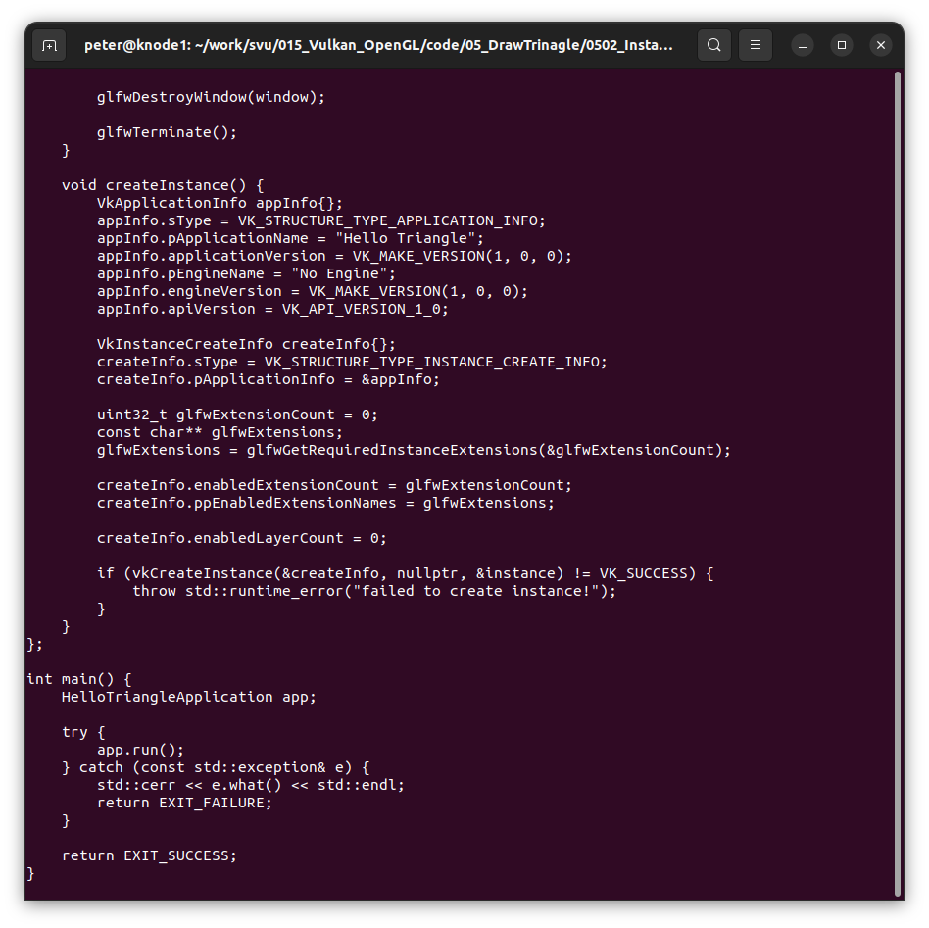
005.2 Instance Creation
https://vulkan-tutorial.com/Development_environment#page_Linux
Instance Creation
Create Instance.

Slide 5
End

