Slide 1

002 Validation Layer
Peter H. Chen

Slide 2
002 Validation Layer
https://vulkan-tutorial.com/Development_environment#page_Linux
Validation Layer
Common operations in validation layers are:
Checking the values of parameters against the specification to detect misuse
Tracking creation and destruction of objects to find resource leaks
Checking thread safety by tracking the threads that calls originate from
Logging every call and its parameters to the standard output
Tracing Vulkan calls for profiling and replaying

Slide 3
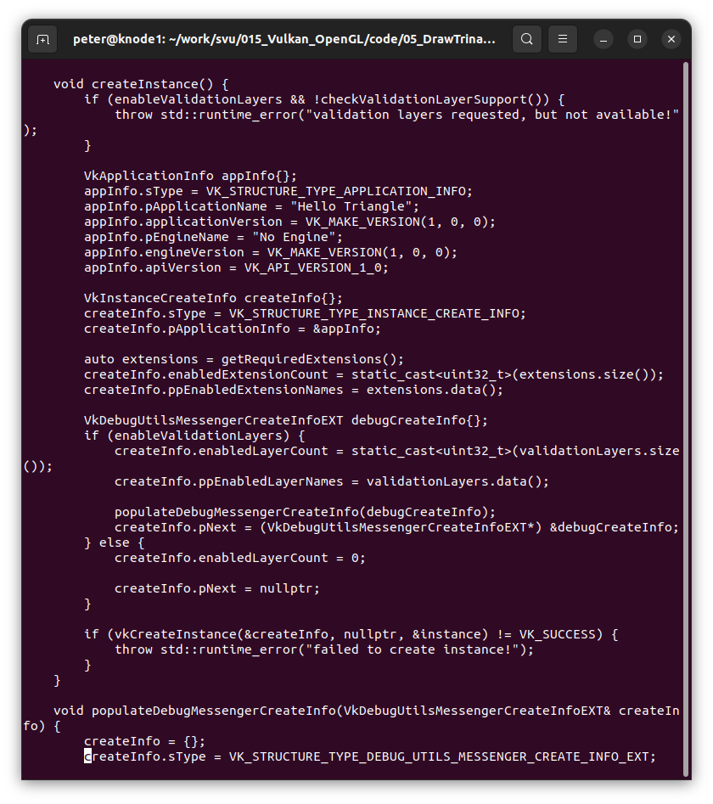
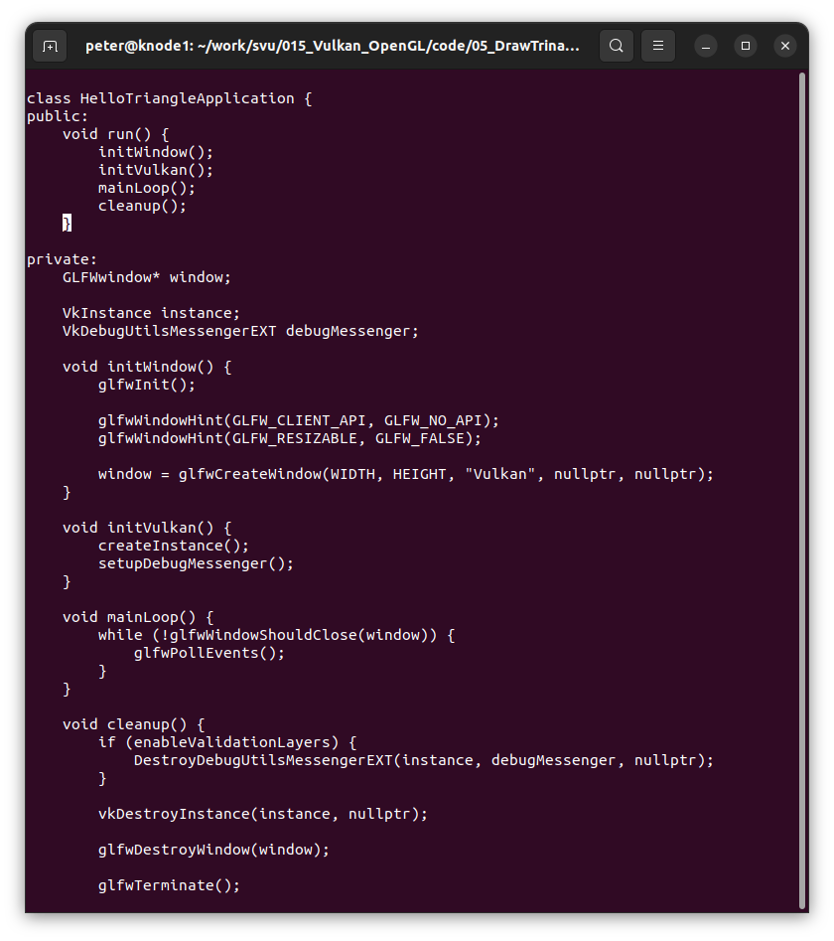
002 Validation Layer
https://vulkan-tutorial.com/Development_environment#page_Linux
Validation Layer

Slide 4
End

