Slide 1

003 Vulkan by Window Visual Studio
Peter H. Chen

Slide 2
003 Vulkan by Window Visual Studio
https://vulkan-tutorial.com/Development_environment
Vulkan by Window Visual Studio
We discuss
1. Download/Install VulkanSDK (Vulkan SDK)
2. Download/install glfw (Graphic Library Framework)
3. Download/install glm (Generalized Linear Model)
4. Visual Studio configuration for include files for glm, glfw, VulkanSDK
5. Visual Studio configuration for link libraries for glfw and VulkanSDK
6. Visual Studio configuration for link defined symbolic libraries: vulkan_1.lib and glfw3.lib
7. Build/Compile Vulkan Project by Visual Studio, and
8. Run Vulkan Project by Visual Sutdio.

Slide 3
002.1 Windows: Vulkan SDK

Slide 4
002.1 Windows: Vulkan SDK
https://vulkan-tutorial.com/Development_environment
Windows: Vulkan SDK
We discuss Vulkan development under Windows.
We assume that we are suing Visual Studio to compile your code.
For complete C++17 support, we use VS (Visual Studio) 2017, 2019, or 2022.
The steps outlined below were written for VS 2017 and 2022.
Vulkan SDK
The most important component you'll need for developing Vulkan applications is the SDK.
It includes the headers, standard validation layers, debugging tools and a loader for the Vulkan functions.
The loader looks up the functions in the driver at runtime, similarly to GLEW for OpenGL.

Slide 5
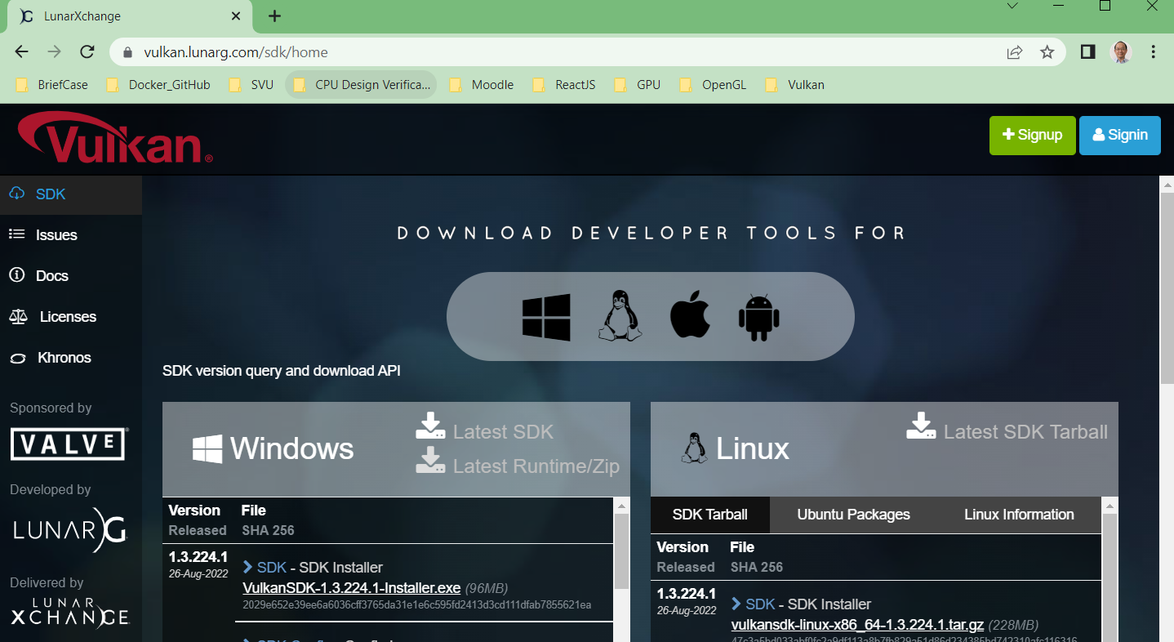
002.1 Windows: Vulkan SDK
https://vulkan-tutorial.com/Development_environment
Vulkan SDK
The SDK can be downloaded from LunarG website as blow:
https://vulkan.lunarg.com/sdk/home
Users just need to download the SDK.

Slide 6
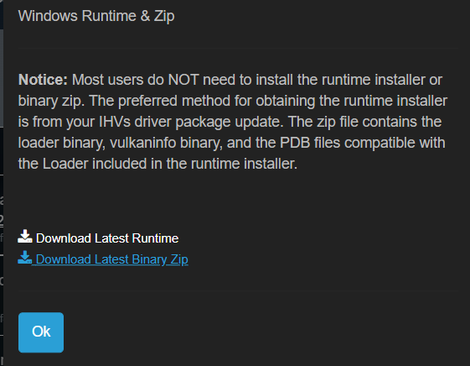
002.1 Windows: Vulkan SDK
https://vulkan-tutorial.com/Development_environment
Vulkan SDK
Most uses just need the Vulkan SDK and do not need the runtime install or binary zip.

Slide 7
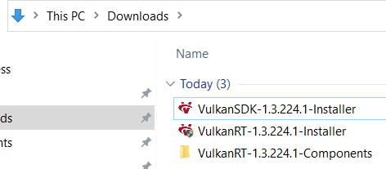
002.1 Windows: Vulkan SDK
https://vulkan-tutorial.com/Development_environment
Vulkan SDK
Most uses just need the Vulkan SDK and do not need the runtime install or binary zip.
1
Most users Required
2
Most users do not need

Slide 8
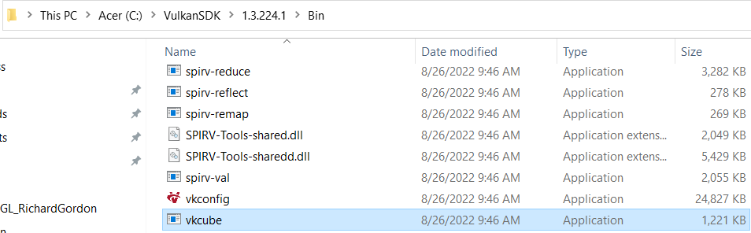
002.1 Windows: Vulkan SDK
https://vulkan-tutorial.com/Development_environment
Vulkan SDK
After the Vulkan SDK installed, By default, the VulkanSDK is install in the “C:/ VulkanSDK”.
In “C:/VulkanSDK/x.x.xx.x/Bin, double click vkcube.exe.

Slide 9
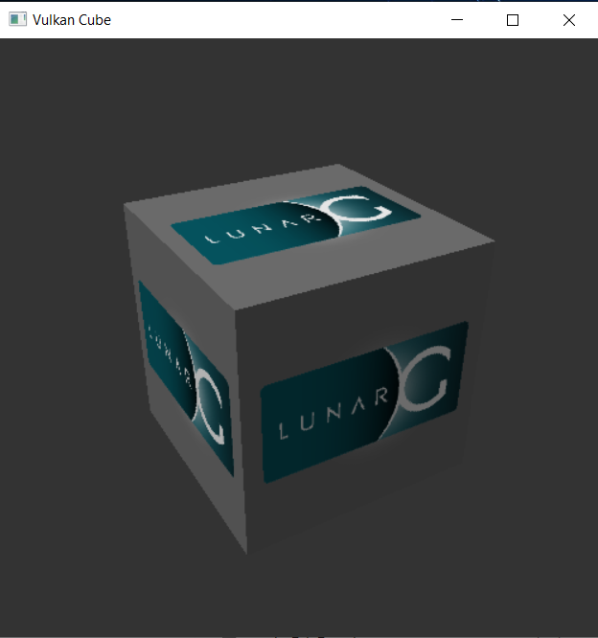
002.1 Windows: Vulkan SDK
https://vulkan-tutorial.com/Development_environment
Vulkan SDK
You should get the following spinning “LunarG”.
This mean your installation is good.

Slide 10
002.1 Windows: Vulkan SDK
https://vulkan-tutorial.com/Development_environment
Vulkan SDK
If you receive an error message then ensure that your drivers are up-to-date, include the Vulkan runtime and that your graphics card is supported.
For NIVIDA Graphic Card support link: https://developer.nvidia.com/vulkan-driver
There is another program in this directory that will be useful for development.
The glslangValidator.exe and glslc.exe programs will be used to compile shaders from the human-readable GLSL (Graphic Library Shading Language) to bytecode.
We'll cover this in depth in the shader modules chapter.
The Bin directory also contains the binaries of the Vulkan loader and the validation layers, while the Lib directory contains the libraries.
Lastly, there's the Include directory that contains the Vulkan headers.
Feel free to explore the other files, but we won't need them for this tutorial.

Slide 11
002.2 Windows: GLFW

Slide 12
002.2 Windows: GLFW
https://vulkan-tutorial.com/Development_environment
Windows: GLFW
As mentioned before, Vulkan by itself is a platform agnostic (self-recognized) API and does not include tools for creating a window to display the rendered results.
To benefit from the cross-platform advantages of Vulkan, we'll use the GLFW library (Graphic Library Framework) to create a window, which supports Windows, Linux and MacOS.
There are other libraries available for this purpose, like SDL (Simple DirecMedia Layer), but the advantage of GLFW is that it also abstracts away some of the other platform-specific things in Vulkan besides just window creation.
You can find the latest release of GLFW on the official website (https://www.glfw.org/download.html).
We will be using the 64-bit binaries (but you can of course also choose to build in 32-bit mode).
In that case make sure to link with the Vulkan SDK binaries in the Lib32 directory instead of Lib.
After downloading it, extract the archive to a convenient location. I've chosen to create a Libraries directory in the Visual Studio directory under documents.

Slide 13
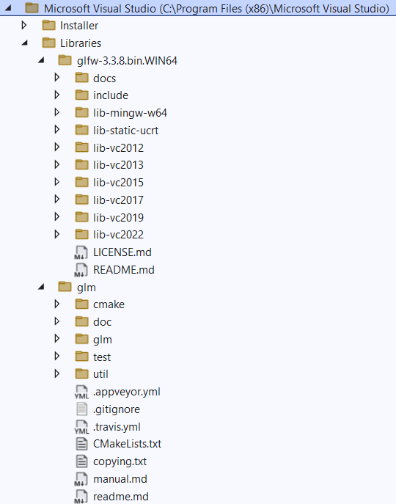
002.2 Windows: GLFW
https://vulkan-tutorial.com/Development_environment
Windows: GLFW
Here, we create Libraries and three library folders (glfw-xxx.bin.WIN64, glm) under Visual Studio.
1. glfw-x.x.x.bin.WIN64 (Graphic Library Framework)
2. glm (Generalized Linear Model)
Note:
Vulkan SDK: We keep the default installation by VulkanSDK in “C:/Vulkan SDK”.

Slide 14
002.3 Windows: GLM

Slide 15
002.3 Windows: GLM
https://vulkan-tutorial.com/Development_environment
Windows: GLM
Unlike DirectX 12, Vulkan does not include a library for linear algebra operations, so we'll have to download one.
GLM (Generalized Linear Model) is a nice library that is designed for use with graphics APIs and is also commonly used with OpenGL.
GLM is a header-only library, so just download the latest version (https://github.com/g-truc/glm/releases) and store it in a convenient location.
We have directory structure like the following now.

Slide 16
002.4 Setup Visual Studio

Slide 17
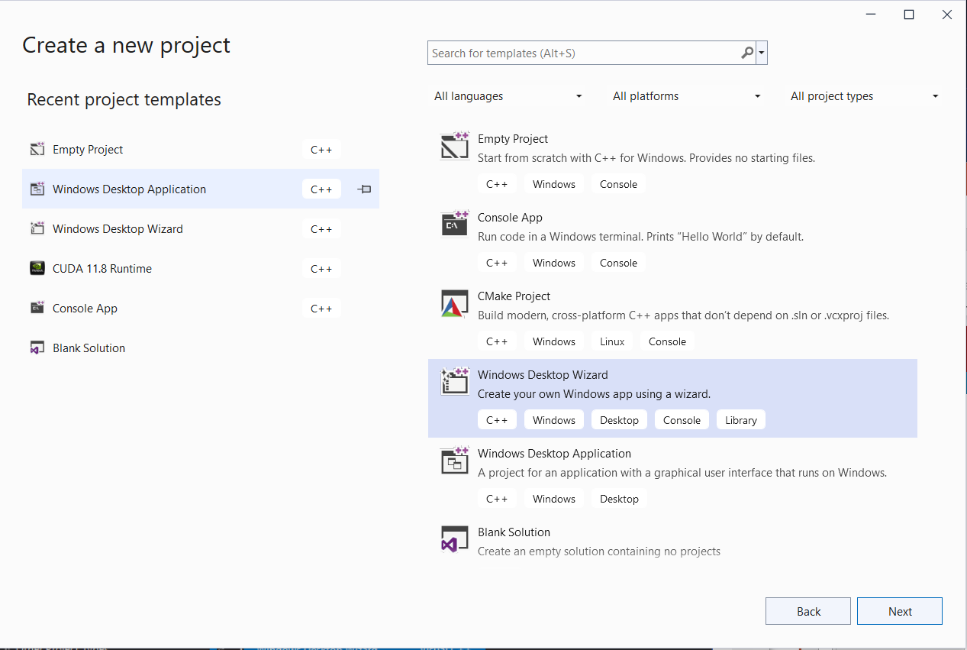
002.4 Setup Visual Studio
https://vulkan-tutorial.com/Development_environment
Setup Visual Studio
Now that you've installed all the dependencies, we can set up a basic Visual Studio project for Vulkan and write a little bit of code to make sure that everything works.
Start Visual Studio and Create a new project and select Windows Desktop Wizard by entering a name and pressing Next.

Slide 18
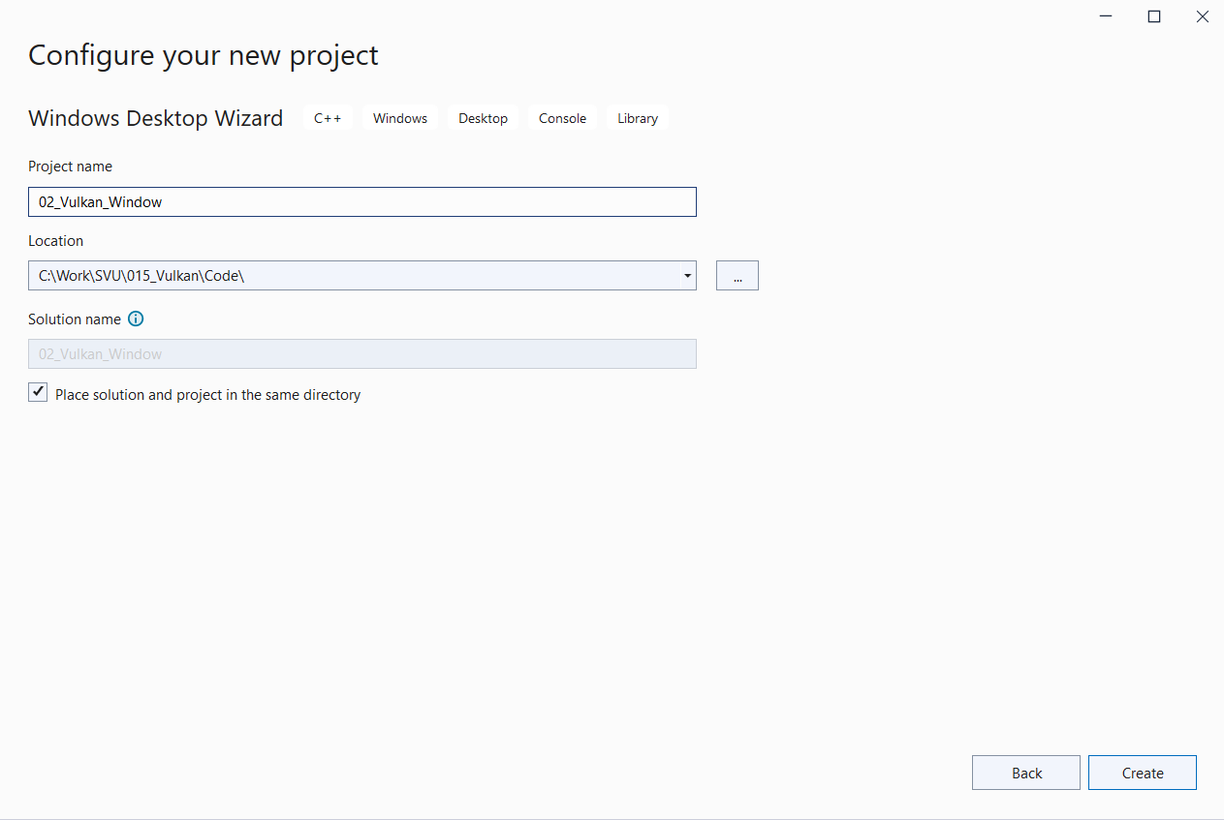
002.4 Setup Visual Studio
https://vulkan-tutorial.com/Development_environment
Setup Visual Studio
Enter project name: 02_Vulkan_Window
Click “Create”.

Slide 19
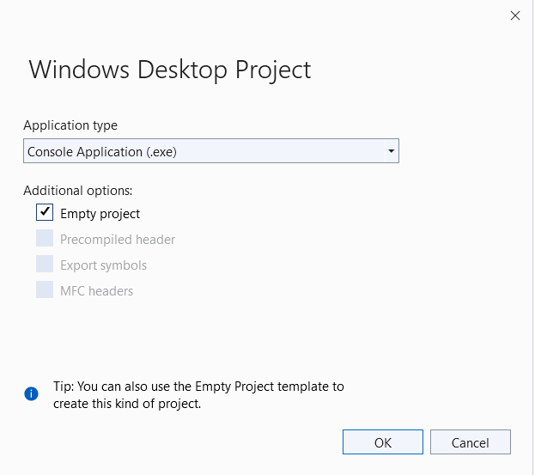
002.4 Setup Visual Studio
https://vulkan-tutorial.com/Development_environment
Setup Visual Studio
Select “Console Application (.exe)
Select “Empty Project”.

Slide 20
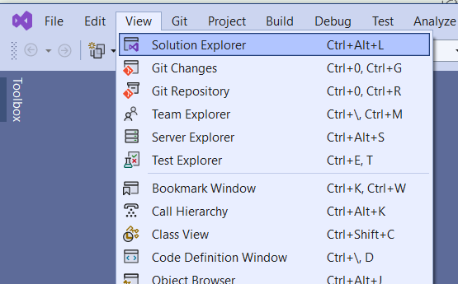
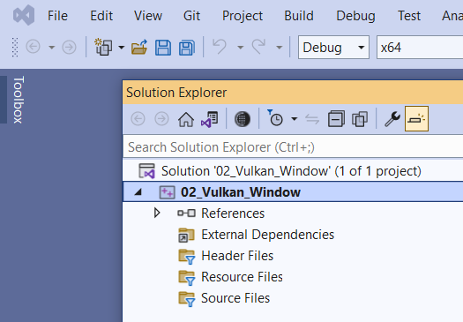
002.4 Setup Visual Studio
https://vulkan-tutorial.com/Development_environment
Setup Visual Studio
Select View > Solution Explorer

Slide 21
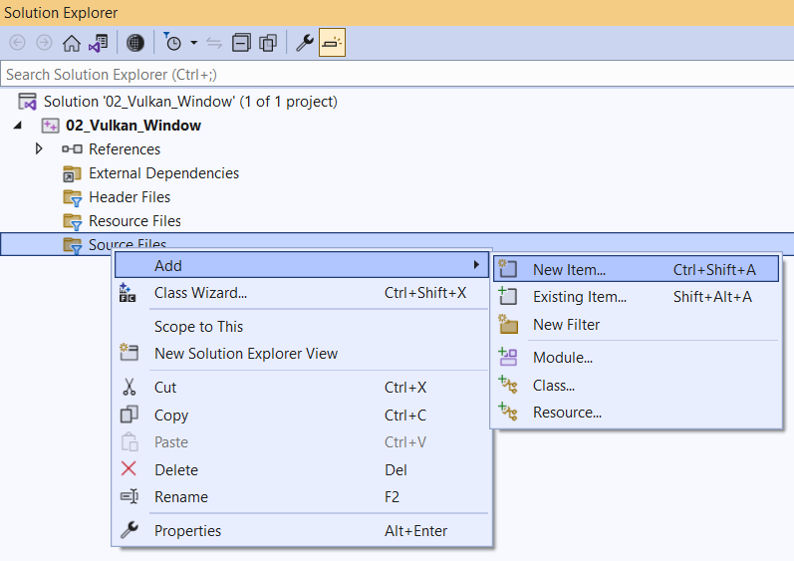
002.4 Setup Visual Studio
https://vulkan-tutorial.com/Development_environment
Setup Visual Studio
Click Source Files
RMB Add > New Item…

Slide 22
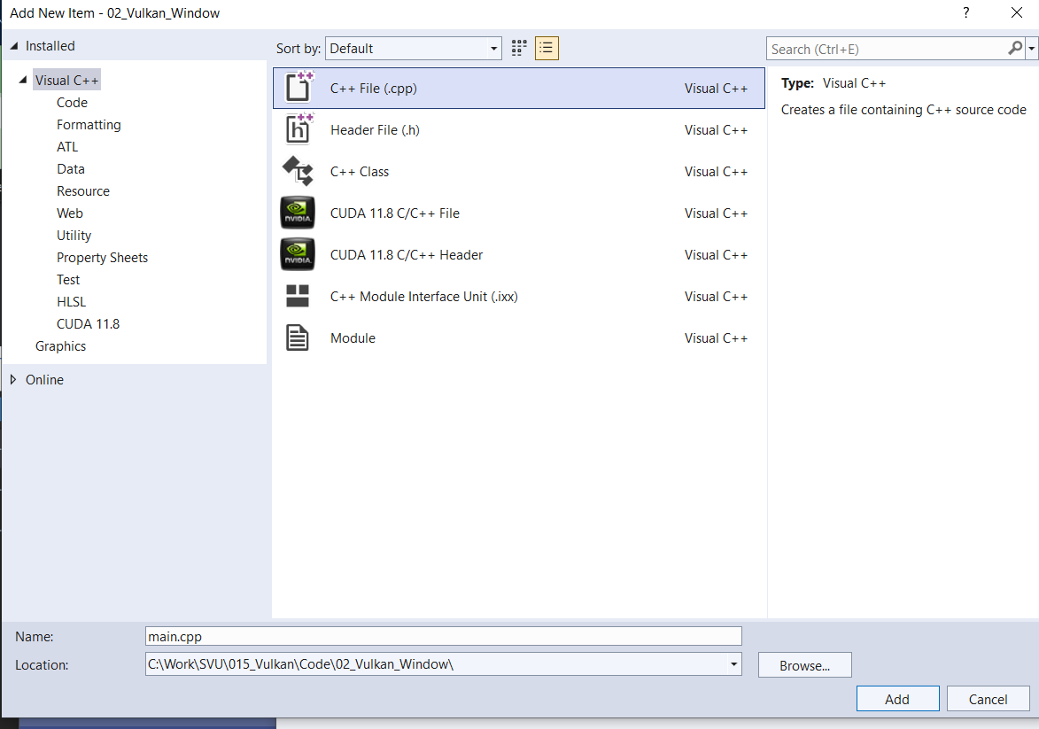
002.4 Setup Visual Studio
https://vulkan-tutorial.com/Development_environment
Setup Visual Studio
C++ File and Click “Add”

Slide 23
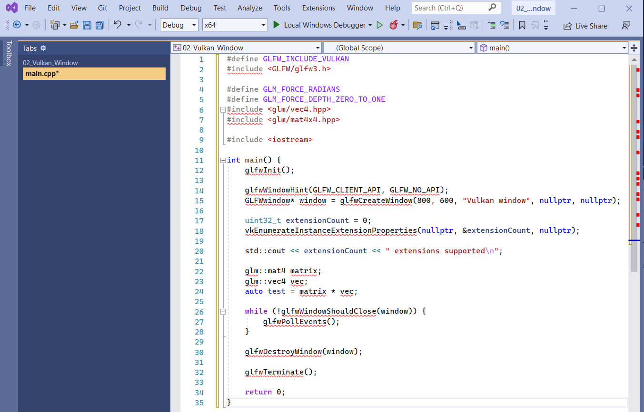
002.4 Setup Visual Studio
https://vulkan-tutorial.com/Development_environment
Setup Visual Studio
Add C++ Code as below:

Slide 24
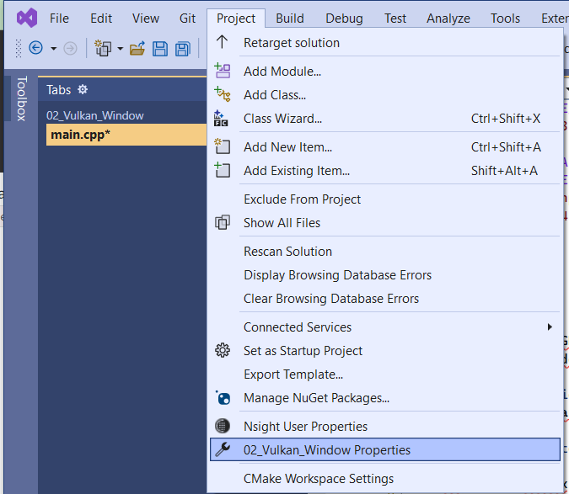
002.4 Setup Visual Studio
https://vulkan-tutorial.com/Development_environment
Setup Visual Studio
Project > 02_Vulkan_Window Properties

Slide 25
002.5 Visual Studio: Add Include File

Slide 26
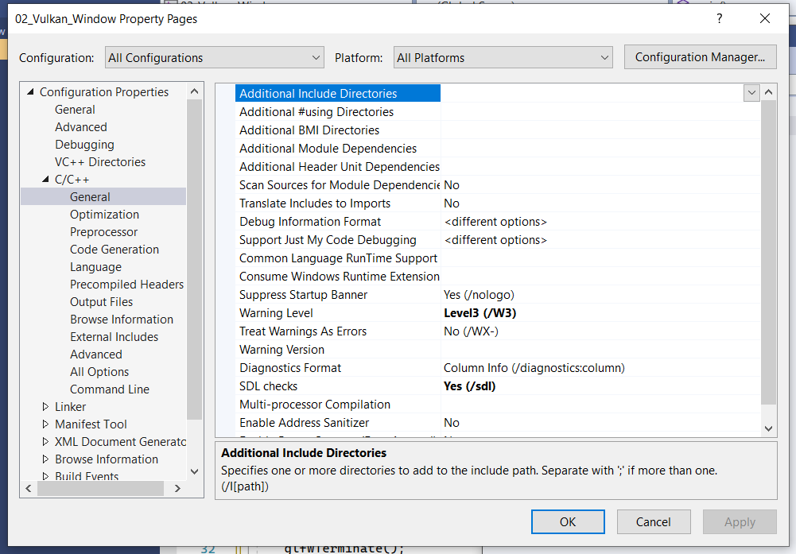
002.5 Visual Studio: Add Include File
https://vulkan-tutorial.com/Development_environment
Add Include Files
1. Configuration: All Configurations
2. Platforms: All Platforms
3. Configuration Properties > C/C++ > General: Additional Include Directories
1
2
3

Slide 27
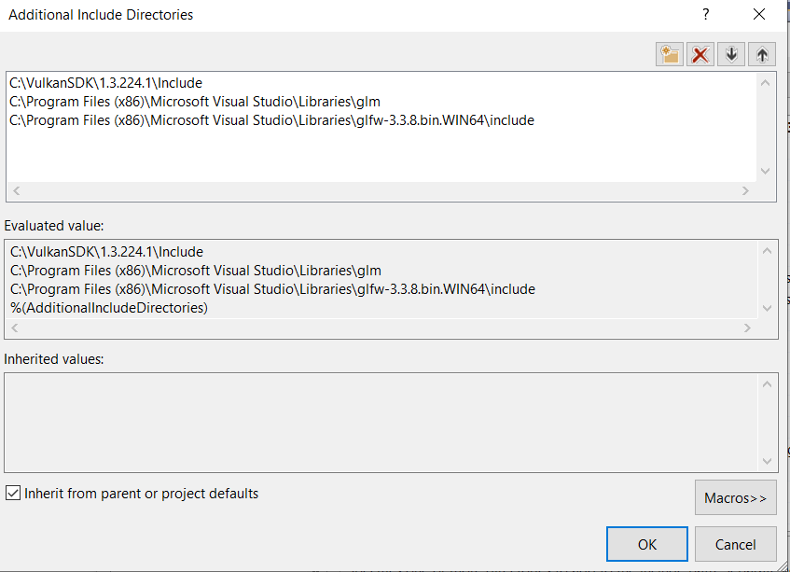
002.5 Visual Studio: Add Include File
https://vulkan-tutorial.com/Development_environment
Add Include Files
Add Include directory for Vulkan, GLFW, and GLM.
Note: Visual Studio cannot to see files. We must use file explorer to see all files.
Note:
1. VulkanSDK: “Include” is uppercase
2. glm: glm name is lowercase. It is header file only. No “include” keyword is required.
3. glfw: The “include” is lowercase.
1
2
3

Slide 28
002.6 Visual Studio: Add General Library

Slide 29
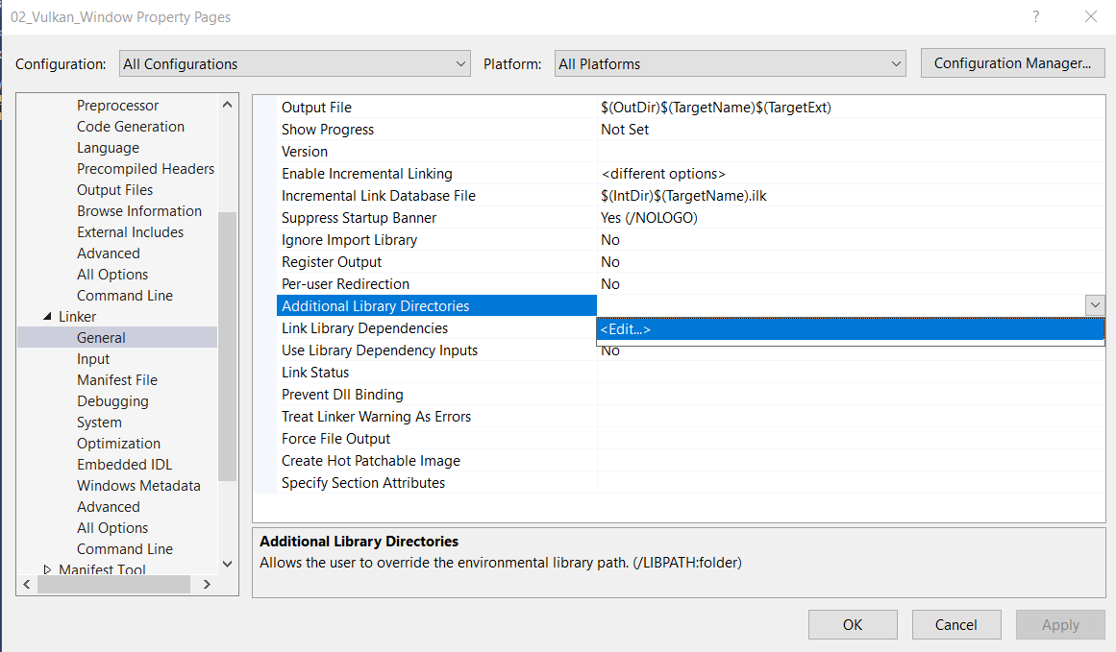
002.6 Visual Studio: Add General Library
https://vulkan-tutorial.com/Development_environment
Add General Libraries
Next, open the editor for libraries: Linker > General : Additional Library Directories

Slide 30
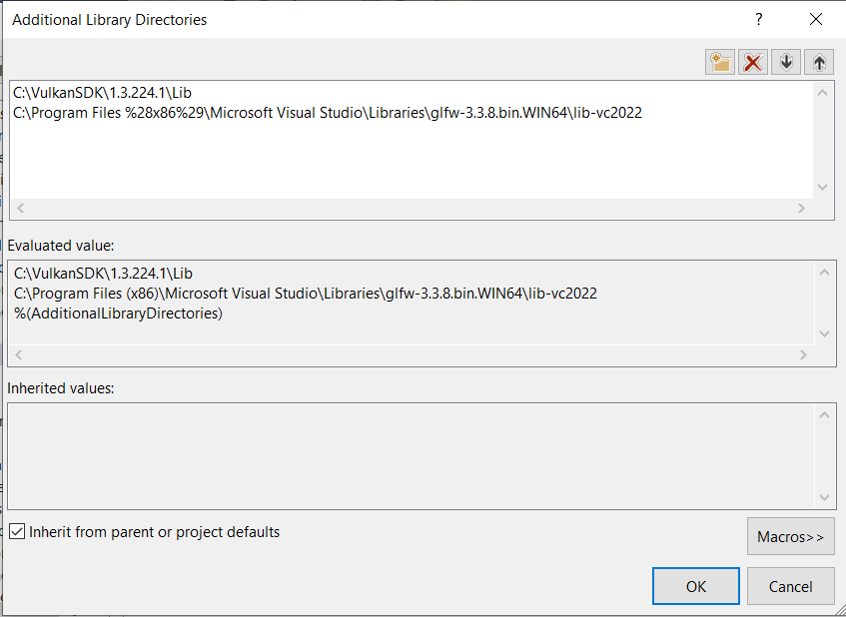
002.6 Visual Studio: Add General Library
https://vulkan-tutorial.com/Development_environment
Add General Libraries
Add libraries for VulkanSDK and glfw.
Note:
1. VulkanSDK: We select from “C:\VulkanSDK\x.x.xxx.x\Lib
2. glfw: We select from “Visual Studio\Libraries” with the latest version lib-vc2022.
Note:
We do not link glm library since glm have include files and have no library files.
1
2

Slide 31
002.7 Add Defined Symbols for Libraries

Slide 32
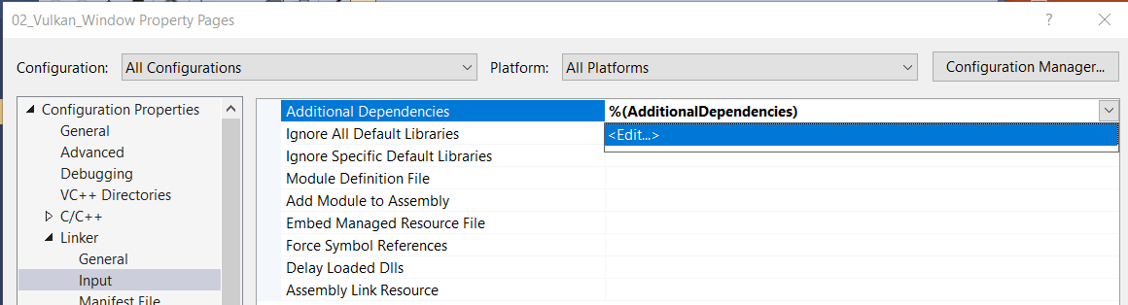
002.7 Add Defined Symbols for Libraries
https://vulkan-tutorial.com/Development_environment
Add Defined Symbols for Libraries
Configuration Properties > Input > Additional Dependencies

Slide 33
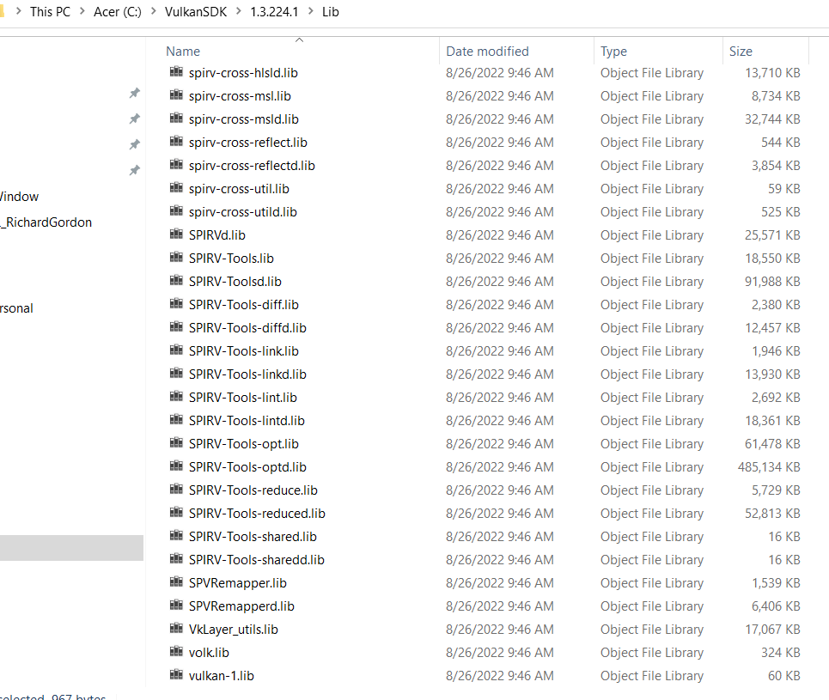
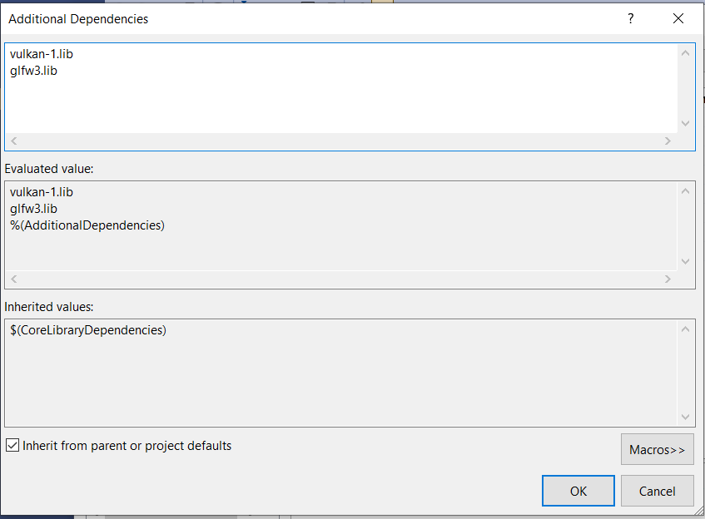
002.7 Add Defined Symbols for Libraries
https://vulkan-tutorial.com/Development_environment
Add Defined Symbols for Libraries
Add: “vulkan-1.lib” and “glfw3.lib”.

Slide 34
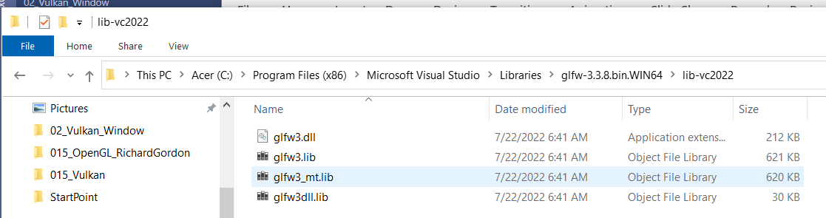
002.7 Add Defined Symbols for Libraries
https://vulkan-tutorial.com/Development_environment
Add Defined Symbols for Libraries
Add: “vulkan-1.lib” and “glfw3.lib”.

Slide 35
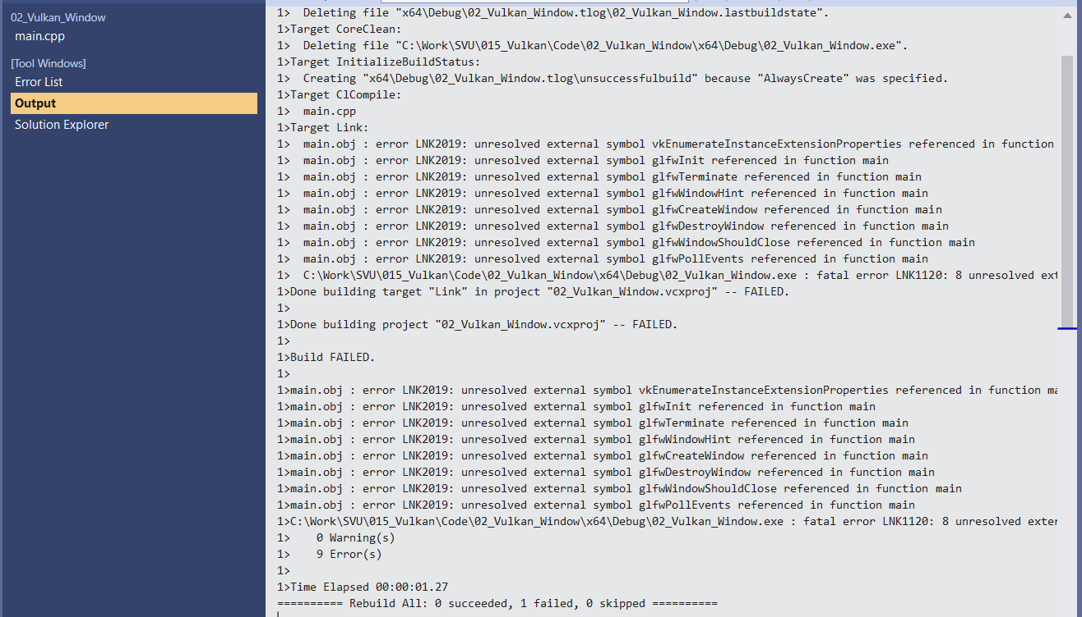
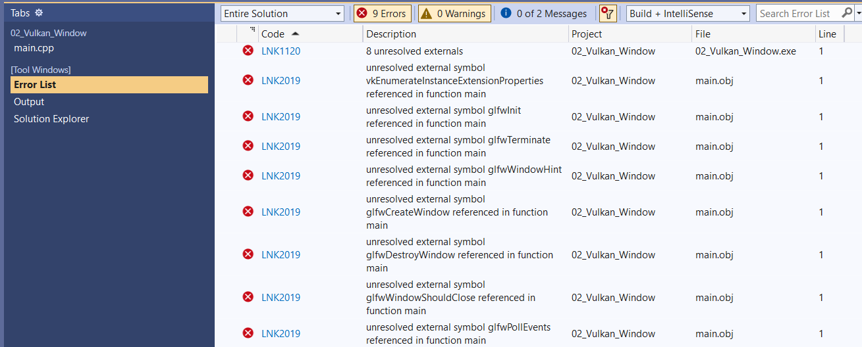
002.7 Add Defined Symbols for Libraries
https://vulkan-tutorial.com/Development_environment
Add Defined Symbols for Libraries
Note:
The “vulkan-1.lib” and “glfw3.lib” contains the symbol definitions for external libraries.
If you remove them, then we have the below undefine symbol error messages when re-build project.

Slide 36
002.8 Visual Studio: Build

Slide 37
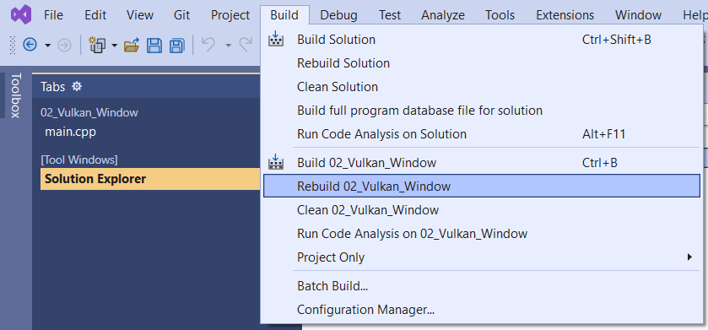
002.8 Visual Studio: Build
https://vulkan-tutorial.com/Development_environment
Build
Build > Rebuild 02_Vulkan_Window

Slide 38
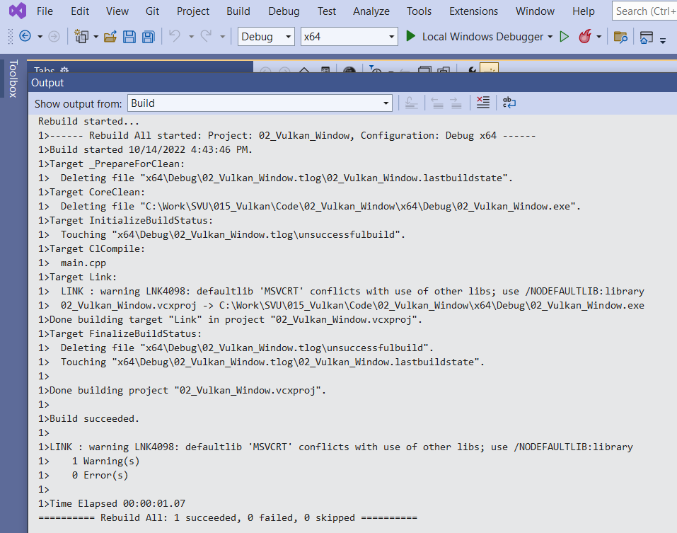
002.8 Visual Studio: Build
https://vulkan-tutorial.com/Development_environment
Build
Compiled successfully.

Slide 39
002.9 Visual Studio: Run

Slide 40
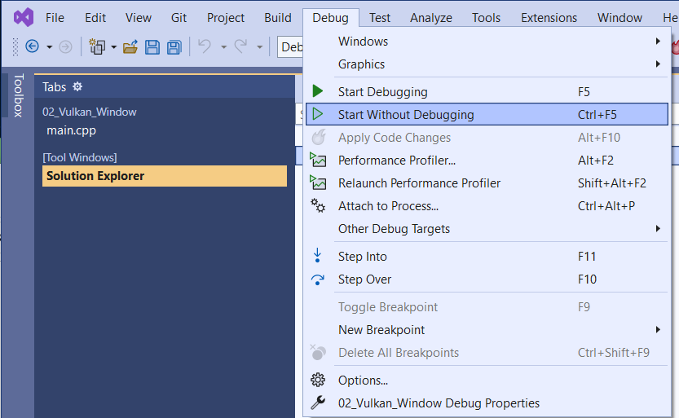
002.9 Visual Studio: Run
https://vulkan-tutorial.com/Development_environment
Run
Debug > Start Without Debugging

Slide 41
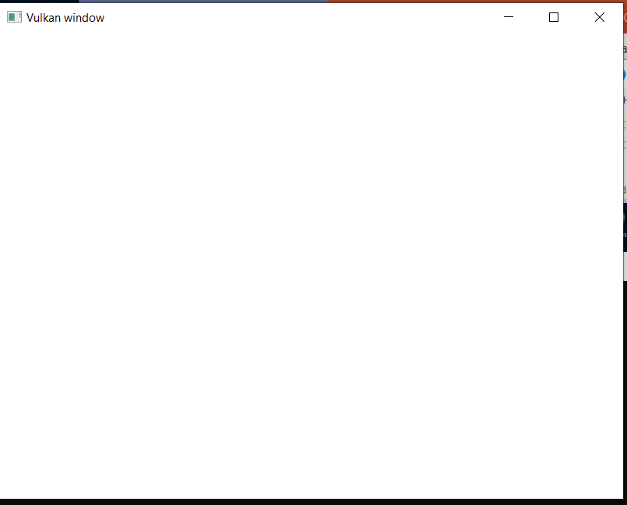
002.9 Visual Studio: Run
https://vulkan-tutorial.com/Development_environment
Run
Output Window

Slide 42
End

