Slide 1

004 Logical Device and Queue
Peter H. Chen

Slide 2
004 Logical Device and Queue
https://vulkan-tutorial.com/Drawing_a_triangle/Setup/Physical_devices_and_queue_families
Logical Device and Queue Family
We discuss:
1. Introduction
2. Specify queue creation
3. Specify device feature
4. Create logical device
5. Retrieve queue handle

Slide 3
004.1 Introduction

Slide 4
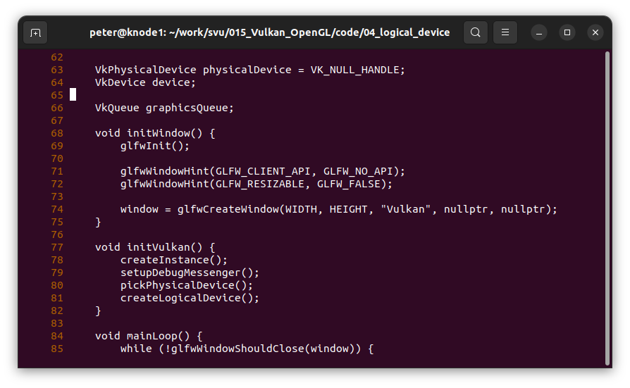
004.1 Introduction
https://vulkan-tutorial.com/Drawing_a_triangle/Setup/Physical_devices_and_queue_families
Introduction
After selecting a physical device, we need to set up a logical device.
We also need to specify the queues for the selected queue family.
You can create multiple logical devices from the same physical device.

Slide 5
004.2 Specify Queue

Slide 6
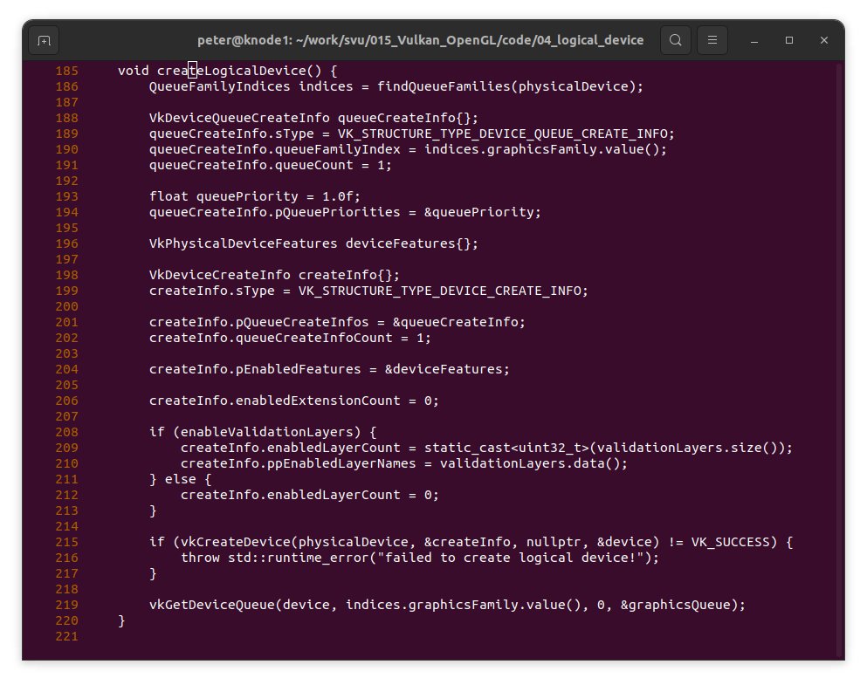
004.2 Specify Queue
https://vulkan-tutorial.com/Drawing_a_triangle/Setup/Physical_devices_and_queue_families
Specify Data Structure for Queue
We specify the data structure for queue.

Slide 7
004.3 Specify Device Feature

Slide 8
004.3 Specify Device Feature
https://vulkan-tutorial.com/Drawing_a_triangle/Setup/Physical_devices_and_queue_families
Specify Device Feature

Slide 9
004.4 Create Logical Device

Slide 10
004.4 Create Logical Device
https://vulkan-tutorial.com/Drawing_a_triangle/Setup/Physical_devices_and_queue_families
Create Logical Device

Slide 11
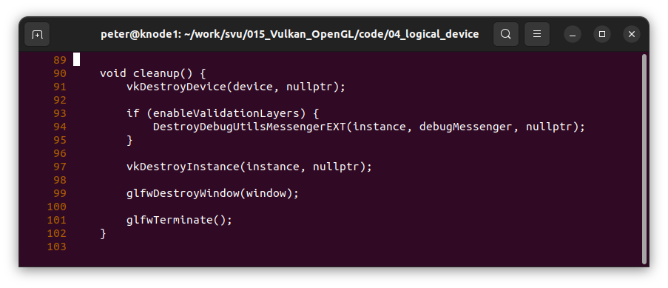
004.4 Create Logical Device
https://vulkan-tutorial.com/Drawing_a_triangle/Setup/Physical_devices_and_queue_families
Destroy Device

Slide 12
004.5 Retrieve Queue Handle

Slide 13
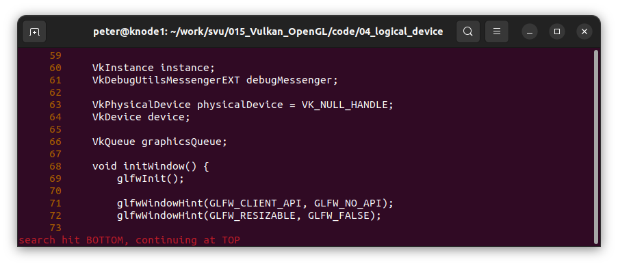
004.5 Retrieve Queue Handle
https://vulkan-tutorial.com/Drawing_a_triangle/Setup/Physical_devices_and_queue_families
Declare Graphic Queue

Slide 14
004.5 Retrieve Queue Handle
https://vulkan-tutorial.com/Drawing_a_triangle/Setup/Physical_devices_and_queue_families
Retrieve Graphic Queue Handle

Slide 15
End

