Slide 1

4 Adv Cache Optimization Technique II (Part 1)
Peter H. Chen

Slide 2
4 Adv Cache Optimization Technique II (Part 1)
https://nptel.ac.in/courses/106103183
Advanced Cache Optimization Technique II (Part 1) (00:32/17:43
00:29 we will continue our discussion on Advanced Cache Optimization Techniques. Last lecture
00:35 we have seen some of the optimization techniques that are used to reduce average memory access
00:43 time.
00:45 Continue our discussion our basic assumption was like average memory access time is dependent
00:52 on hit time, miss rate and the miss penalty. Now any of these three parameters let say

Slide 3
4 Adv Cache Optimization Technique II (Part 1)
https://nptel.ac.in/courses/106103183
Advanced Cache Optimization Technique II (Part 1) (00:32/17:43
01:00 its hit time, miss rate or miss penalty; a variation in any of these three parameter
01:06 is going to affect your average memory access time.
01:08 The next technique we are going to work on is merging write buffer; we have seen that
01:15 there are two category of caches depending on how write is updated to next level of memory.
01:21 We have write back caches and write through caches; write back caches are those in which
01:27 main memory will be updated only if a cache memory block is been evicted out. All writing
01:35 happens strictly in the cache memory such that all further reads will be serviced from
01:40 cache memory itself. So, there is no need for cache memory and
01:43 main memory to be coherent, but when you flush out a block you see whether the block is modified
01:48 or not; if the block is modified then the writing back happens. Another category of
01:56 cache is called write through cache, any writing that happens on cache memory is being updated

Slide 4
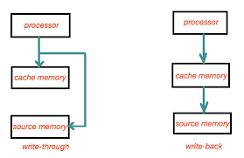
4 Adv Cache Optimization Technique II (Part 1)
https://www.geeksforgeeks.org/write-through-and-write-back-in-cache/
Write through and write back cache
Cache is a technique of storing a copy of data temporarily in rapidly accessible storage memory. Cache stores most recently used words in small memory to increase the speed at which data is accessed. It acts as a buffer between RAM and CPU and thus increases the speed at which data is available to the processor. Whenever a Processor wants to write a word, it checks to see if the address it wants to write the data to, is present in the cache or not. If the address is present in the cache, i.e., Write Hit. We can update the value in the cache and avoid expensive main memory access. But this results in Inconsistent Data Problem. As both cache and main memory have different data, it will cause problems in two or more devices sharing the main memory (as in a multiprocessor system). This is where Write Through and Write Back comes into the picture.

Slide 5
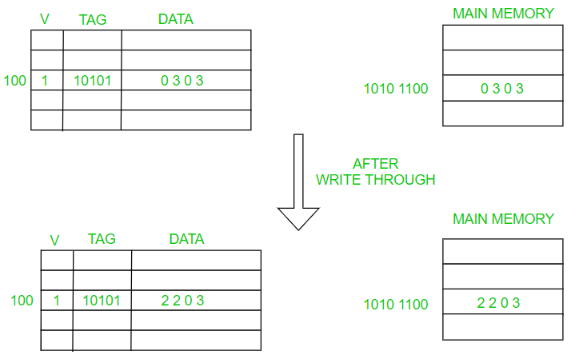
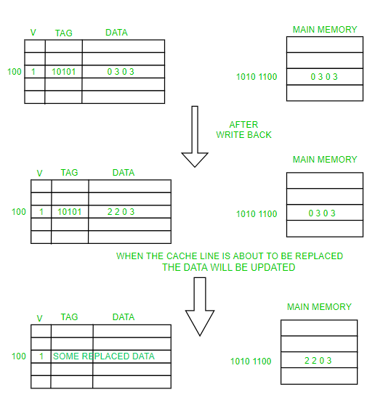
4 Adv Cache Optimization Technique II (Part 1)
https://www.geeksforgeeks.org/write-through-and-write-back-in-cache/
Write through and write back cache
1. write-through: data is simultaneously updated to cache and memory.
This process is simpler and more reliable. This is used when there are no frequent writes to the cache(The number of write operations is less). It helps in data recovery (In case of a power outage or system failure). A data write will experience latency (delay) as we have to write to two locations (both Memory and Cache). It Solves the inconsistency problem. But it questions the advantage of having a cache in write operation (As the whole point of using a cache was to avoid multiple access to the main memory).
2. Write-Back: The data is updated only in the cache and updated into the memory at a later time. Data is updated in the memory only when the cache line is ready to be replaced (cache line replacement is done using Belady’s Anomaly, Least Recently Used Algorithm, FIFO, LIFO, and others depending on the application).
Write back
Write through

Slide 6
4 Adv Cache Optimization Technique II (Part 1)
https://nptel.ac.in/courses/106103183
Advanced Cache Optimization Technique II (Part 1) (00:32/17:43
02:05 in the main memory also. But processor need not wait for the entire write to get over
02:12 a special storage structure called a write buffer is used in this context.
02:17 The idea of write buffer is when processor want some update to happen in the next level
02:22 of memory; writes in cache the same time its writes in the write buffer also. Write buffer
02:29 will write it into the main memory of the next level of memory at the same time processor
02:36 is continuing. So, by this processor is not stalled, the
02:41 writing happens in background and in the foreground processor is working. The optimization that
02:46 we are going to discuss now is about write buffer merging; write buffer merging to reduce
02:54 miss penalty. So, write buffer is a structure where processor will continue without waiting

Slide 7
4 Adv Cache Optimization Technique II (Part 1)
https://nptel.ac.in/courses/106103183
Advanced Cache Optimization Technique II (Part 1) (00:32/17:43
03:01 for the writes to get over. So, when you perform a store or a write on
03:06 a block that is already pending in the write buffer update the write buffer that is an
03:11 idea. So, any write that you do an entry is made into the write buffer for that particular
03:18 block; there is a change that happened in one of the word one of the word is modified
03:22 and the entire block is kept in the write buffer. So, in the near future let say one
03:30 more write happens into the same block that also will find a new entry in the write buffer.
03:36 But the optimization of write buffer merging means when you put a new field or a new entry
03:43 into the write buffer; you search inside the write buffer to see whether a same block has
03:50 already an entry or not; if so, you merge the write buffer entry, this will reduce the
03:55 stalls due to the write due to full write buffer. The policy is any write that happens

Slide 8
4 Adv Cache Optimization Technique II (Part 1)
https://nptel.ac.in/courses/106103183
Advanced Cache Optimization Technique II (Part 1) (00:32/17:43)
04:01 an entry is done in the write buffer also. Let us say there are a write buffer can accommodate
04:08 only four, such a writes; once four writes are there and write buffer has four valid
04:13 entries then processor is stalled because of the fact that anymore write there is no
04:18 more space in the write buffer. So, when write buffer completes one write
04:22 in the main memory then one of the entries freed. So, when you have multiple writes to
04:30 the same block in an un optimized write buffer; all these writes will occupy one block or
04:38 one entry each in the write buffer. The idea of write buffer optimization is to make sure
04:46 that pending write buffer concepts are already been improved; so, if the write buffer is
04:50 full writes incur a processor stalls. So, consider this case you can see that there
04:57 were four write that happened into addresses 100, 108, 116 and 124. So, to memory location

Slide 9
4 Adv Cache Optimization Technique II (Part 1)
https://nptel.ac.in/courses/106103183
Advanced Cache Optimization Technique II (Part 1) (00:32/17:43)
05:06100, 108, 116 and 124 were returned; let say, in subsequent clock cycles. Since all these
05:14are writes, write buffer is actually taking one entry each. So, 4 entries in the write
05:20buffer are already done. Now by this then the write buffer is full, the optimization
05:25means write buffer controller should have an intelligence such that it has to understand
05:31that 100, 108, 116 and 124; they are part of the same block; this is what is known as
05:41write buffer merging. So, when you have write buffer merging it
05:48is go in to help us; that means, a sequential addresses can be place in one entry. So, we
05:53will get more amount of space.
05:56Moving onto the next optimization is called compiler optimization this is a place where

Slide 10
4 Adv Cache Optimization Technique II (Part 1)
https://nptel.ac.in/courses/106103183
Advanced Cache Optimization Technique II (Part 1) (00:32/17:43)
06:02 little bit of extra information, if a compiler can provide to the architecture; then we can
06:10 improve the performance; average memory access time can be improved.
06:14 So, compiler optimization to reduce miss rate; the first one is known as loop interchange.
06:21 So, whenever we have loops especially in the case of nested loops sometimes swapping of
06:29 the indexes of the loops will give you better memory access because of the spatial locality
06:35 that is available. In this mechanism what we are trying to do is maximize the use of
06:41 data in the cache before it is discarded. Let say in an application especially when
06:46 you work with loop you are going to bring the block of data. In the block few of the
06:54 sub elements may be accessed and then you are going to bring the next block. So, once
06:59 you bring newer blocks the older blocks has to be thrown out; you may need these older

Slide 11
4 Adv Cache Optimization Technique II (Part 1)
https://nptel.ac.in/courses/106103183
Advanced Cache Optimization Technique II (Part 1) (00:32/17:43)
07:05 blocks again. Because your algorithm is written in such a way that you are not going to make
07:10 use of the entire data that is available inside the block; you bring a block only partially
07:14 used data that is available all. So, in this case if you if the compiler can
07:20 reorganize its code in such a way that the available spatial locality should be fully utilized.
Consider a loop like this
for j = 0 that is vary and
then you have i loop and
then you have an array that is getting updated x[i][j] = 2 * x[i][j]
So, whatever is the number that is stored in x[i][j] have to double them.
So, the idea is you have an array, take an element multiply it with 2, store it back into the array.
Now the peculiarity of this loop is you can see that the second index of the array is varied by the outer loop.

Slide 12
4 Adv Cache Optimization Technique II (Part 1)
https://nptel.ac.in/courses/106103183
Advanced Cache Optimization Technique II (Part 1) (00:32/17:43)
08:04 Since in arrays are stored in row major format such a kind of an access is going to create more number of misses.
Rather than that if the compiler could generate a code something like this;
08:14 it is actually memory friendly. What we do is only interchanging the i and j loops the
08:20 body remains same. So, whatever you have brought they are in
08:24 row major format and the access is also in row major format. So, this technique is called
08:31 as loop interchange where we are going to reduce the number of misses significantly.

Slide 13
4 Adv Cache Optimization Technique II (Part 1)
https://nptel.ac.in/courses/106103183
Advanced Cache Optimization Technique II (Part 1) (00:32/17:43)
08:38 Moving into one more type of compiler optimization is known as blocking;
instead of accessing entire rows or columns, what do you do is subdivide it into smaller matrix of smaller
08:53 size this require more access, but it improves the locality of access.
08:58 So, consider the case that you are going to perform a matrix multiplication our standard matrix multiplication loop with i j and k loops.

Slide 14
4 Adv Cache Optimization Technique II (Part 1)
https://nptel.ac.in/courses/106103183
Advanced Cache Optimization Technique II (Part 1) (00:32/17:43)
09:04 Let say, this is the value that you
09:12 are going to get in x by multiplying the value of y and the z. We can see that those array
09:21 elements which are light they are not touched; they are not yet worked out.
09:27 Light color means especially these sections. They are older access and dark color means
09:34 these are all newer access or recent access. Our conventional matrix multiplication code
09:43 when you work, then you could see that whatever elements you have brought in they are not
09:49 completely utilized.
09:52 This can be this code can be rearranged in such a way that this is a modified version

Slide 15
4 Adv Cache Optimization Technique II (Part 1)
https://nptel.ac.in/courses/106103183
Advanced Cache Optimization Technique II (Part 1) (00:32/17:43)
09:58 of this code done with the help of blocking technique; where whatever elements of y and the z already brought; they are been completely utilizes such that in future we do not want.

Slide 16
End

