Slide 1

010 Hadoop Ecosystem: 03
Peter H. Chen

Slide 2
010 Hadoop Ecosystem: 03
https://www.youtube.com/watch?v=LiTYA4WBJgE&list=PLlgLmuG_KgbasW0lpInSAIxYd2vqAEPit&index=10
Hadoop Ecosystem: 03 (20:00/28:06)
Then, we have SPARK.
The Spark Streaming is a component inside SPARK tools.
SPARK is in-memory execution engine.
SPARK is classified as the batch processing system but very fast.
SPARK is same as MapReduce but much faster than MapReduce.
SPARK is near real-time, not real-time.
Spark Streaming is real-time, but SPARK is near real-time, not hundred percent real time but very close.
Cloudera
Format
Spark Streaming | Flink | Storm
Flat File
JSON
Flume
Kafka
New Application
XML
Transaction
SPARK
CRM (Customer Relation Management)
MR (MapReduce)
Sqoop
Pig
Hive
Core Banking Data
HDFS

Slide 3
010 Hadoop Ecosystem: 03
https://www.youtube.com/watch?v=LiTYA4WBJgE&list=PLlgLmuG_KgbasW0lpInSAIxYd2vqAEPit&index=10
Hadoop Ecosystem: 03 (20:55/28:06)
SPARK can write to Hive with HiveQL.
SAPRK has SPARK SQL Library can read tables from Hive and run on top of Hive.
Hive is not obsolete.
If we want to run very high volume of table, Hive is good for that.
Hive read the whole table of data and process.
If we have small table.
Only one row is select, then Hive is not good for that.
Cloudera
Format
Spark Streaming | Flink | Storm
Flat File
JSON
Flume
Kafka
New Application
XML
Transaction
SPARK
CRM (Customer Relation Management)
MR (MapReduce)
Sqoop
Pig
Hive
Core Banking Data
HDFS

Slide 4
010 Hadoop Ecosystem: 03
https://www.youtube.com/watch?v=LiTYA4WBJgE&list=PLlgLmuG_KgbasW0lpInSAIxYd2vqAEPit&index=10
Hadoop Ecosystem: 03 (24:00/28:06)
For small data or small table, there are Impala | HAOOQ, LLAP | Presto | Drill | Phoenix.
What is Impala? They are very fast in memory query for small row selection but not fault tolerant.
Phoenix is used to write HBase.
HBase is non-relational and distributed database.
Phoenix and HBase are combined into OLAP (On-Line Analytical Processing).
Phoenix is NoSQL for HBase, Phoenix does not understand SQL.
Cloudera
Format
Spark Streaming | Flink | Storm
Flat File
JSON
Flume
Kafka
New Application
XML
Impala | Hawk, LLAP | Presto |Drill | Phoenix
Transaction
SPARK
HBase
CRM (Customer Relation Management)
MR (MapReduce)
Sqoop
Pig
Hive
Core Banking Data
HDFS

Slide 5
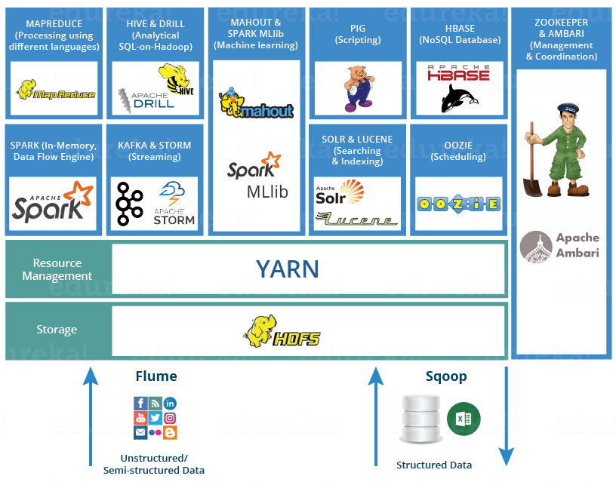
010 Hadoop Ecosystem: 03
https://www.youtube.com/watch?v=LiTYA4WBJgE&list=PLlgLmuG_KgbasW0lpInSAIxYd2vqAEPit&index=10
Hadoop Ecosystem: 03 (27:25/28:06)

Slide 6
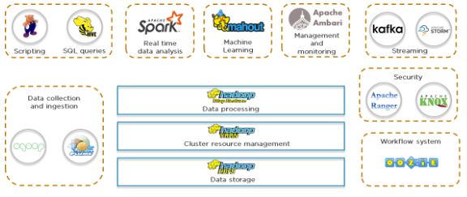
010 Hadoop Ecosystem: 03
https://www.simplilearn.com/tutorials/hadoop-tutorial/hadoop-ecosystem
Hadoop Ecosystem

Slide 7
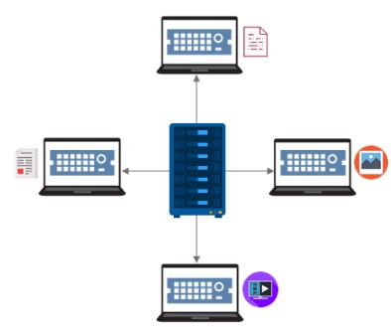
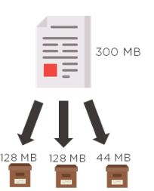
010 Hadoop Ecosystem: 03
https://www.simplilearn.com/tutorials/hadoop-tutorial/hadoop-ecosystem
HDFS:
NameNode: Master daemon. NameNode manage the DataNode and store metadata to find the DataNode.
DataNode: Salve Daemon. Multiple DataNodes. DataNode store actual data.
DataNode 1
NameNode
DataNode 2
DataNode 3
DataNode 1
DataNode 3
DataNode 4
DataNode 2

Slide 8
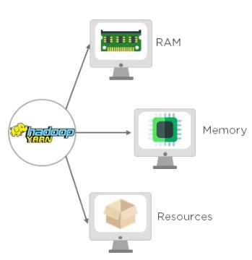
010 Hadoop Ecosystem: 03
https://www.simplilearn.com/tutorials/hadoop-tutorial/hadoop-ecosystem
YARN (Yet Another Resource Negotiator)
YARN handles the cluster of nodes and Hadoop resource management.
YARN allocates RAM, memory, and other resources to different applications.
YARN has two components :
ResourceManager (Master):
This is the master daemon.
It manages the assignment of resources such as CPU, memory, and network bandwidth.
NodeManager (Slave) :
This is the slave daemon, and it reports the resource usage to the Resource Manager.

Slide 9
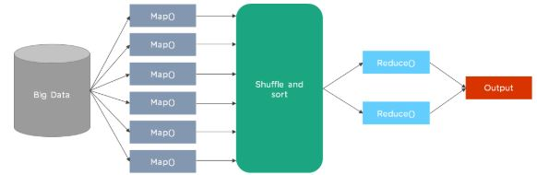
010 Hadoop Ecosystem: 03
https://www.simplilearn.com/tutorials/hadoop-tutorial/hadoop-ecosystem
MapReduce
Map: Big data divide into multiple distributed computers
Reduce: Reduce to single output.

Slide 10
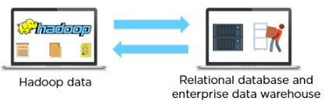
010 Hadoop Ecosystem: 03
https://www.simplilearn.com/tutorials/hadoop-tutorial/hadoop-ecosystem
Sqoop (SQL Hadoop)
Sqoop handle RDBMS (Relational Hadoop Database Management System)

Slide 11
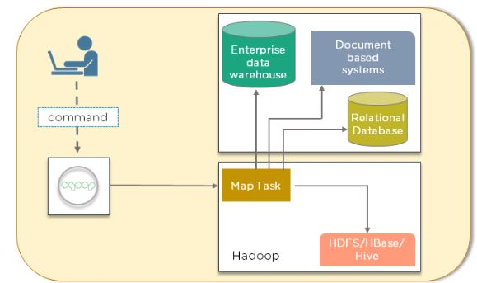
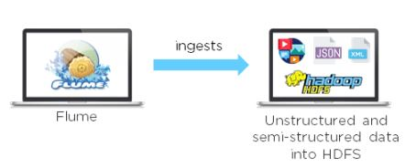
010 Hadoop Ecosystem: 03
https://www.simplilearn.com/tutorials/hadoop-tutorial/hadoop-ecosystem
Flume
Flume handle the unstructured data (Not structured SQL-data): format file, log file (telephone, text message), JSON (NoSQL MongoDB) file, XML file, etc.

Slide 12
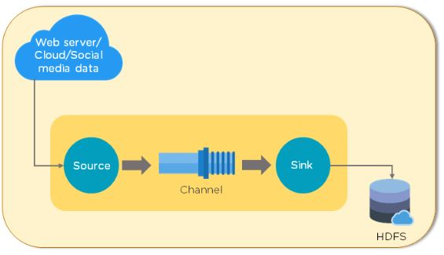
010 Hadoop Ecosystem: 03
https://www.simplilearn.com/tutorials/hadoop-tutorial/hadoop-ecosystem
Flume
Flume handle the unstructured data (Not structured SQL-data): format file, log file (telephone, text message), JSON (NoSQL MongoDB) file, XML file, etc.

Slide 13
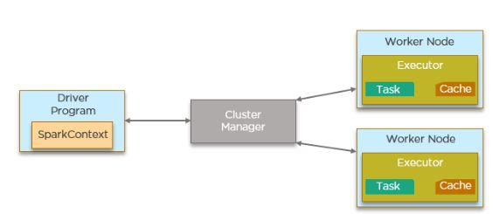
010 Hadoop Ecosystem: 03
https://www.simplilearn.com/tutorials/hadoop-tutorial/hadoop-ecosystem
Spark
Real-time process user request, such as, credit card fraud or not based on default 7 days history or machine learning model (from non-real time HDFS post processing)

Slide 14
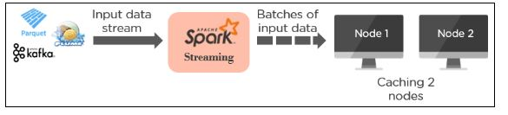
010 Hadoop Ecosystem: 03
https://www.simplilearn.com/tutorials/hadoop-tutorial/hadoop-ecosystem
Kafka
Real-time topic collection data. Can be accessed by all of the users

Slide 15

010 Hadoop Ecosystem: 03
https://www.simplilearn.com/tutorials/hadoop-tutorial/hadoop-ecosystem
Hive
SQL Query interface for data warehouse for HDFS.

Slide 16

010 Hadoop Ecosystem: 03
https://www.simplilearn.com/tutorials/hadoop-tutorial/hadoop-ecosystem
HBase
HBase is No-SQL, distributed database from Google.

Slide 17
010 Hadoop Ecosystem: 03
https://www.simplilearn.com/tutorials/hadoop-tutorial/hadoop-ecosystem
Storm
Real-time processing like Spark streaming. Storm is deprecated.
Pig
Pig is non-real-time HDFS post processing. Pig is deprecated.

Slide 18
End

