Slide 1

501 Apache Flume Introduction
Peter H. Chen

Slide 2
501 Apache Flume Introduction
https://www.youtube.com/watch?v=62yqIHHtIYM&list=PLeUBsMTwZBi0vPhPHRfurknpsqh1cZE0t
Apache Flume Introduction (00:02/9:47)
We discuss the Apache Flume introduction, Flume Architecture, and compare Apache Flume with Kafka.
Cloudera
Format
Spark Streaming | Flink | Storm
Flat File
JSON
Flume
Kafka
New Application
XML
Transaction
SPARK
CRM (Customer Relation Management)
MR (MapReduce)
Sqoop
Pig
Hive
Core Banking Data
HDFS

Slide 3
501.1 Why Need Apache Flume?

Slide 4
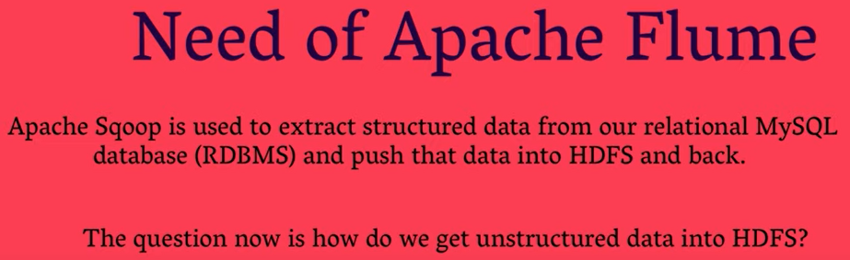
501.1 Why Need Apache Flume?
https://www.youtube.com/watch?v=62yqIHHtIYM&list=PLeUBsMTwZBi0vPhPHRfurknpsqh1cZE0t
Why Need Apache Flume? (00:18/9:47)
The first question, which come into our mind:
1. When do we need the Apache Flume?
2. Why do we learn it?
3. Why do we need to use Flume?
We will answer these.
First, we will compare Apache Sqoop (SQL Hadoop) with Apache Flume.
Apache Sqoop is the tool to int the Apache Hadoop ecosystem that is used to extract structured SQL data from RDBMAS (e.g., MySQL or Oracle database) and push to HDFS (Hadoop File System).

Slide 5
501.1 Why Need Apache Flume?
https://www.youtube.com/watch?v=62yqIHHtIYM&list=PLeUBsMTwZBi0vPhPHRfurknpsqh1cZE0t
Why Need Apache Flume? (01:01/9:47)
Now, question is “Most of the data is unstructured. How do we get unstructured Data into HDFS?
The answer is use Apache Flume to extract the unstructured data.
For example, we have a accompany which has multiple services that are running on multiple servers.
…and the company is producing a lot of data, a lot of logs.
In order to get insight and understand the behavior od the clients or end users, we need to analyze these logs all together.
For that purpose, we need a tool to get this log.

Slide 6
501.1 Why Need Apache Flume?
https://www.youtube.com/watch?v=62yqIHHtIYM&list=PLeUBsMTwZBi0vPhPHRfurknpsqh1cZE0t
Why Need Apache Flume? (01:32/9:47)
First, injected into our HDFS.
In this case, Apache Flume will be helping to get the data collection.
In this scenario, this is the need of Apache Flume that to get that data first injected into HDFS. Later, we can do some analysis of the data.
This is the need of Apache Flume.

Slide 7
501.2 What is Apache Flume?

Slide 8
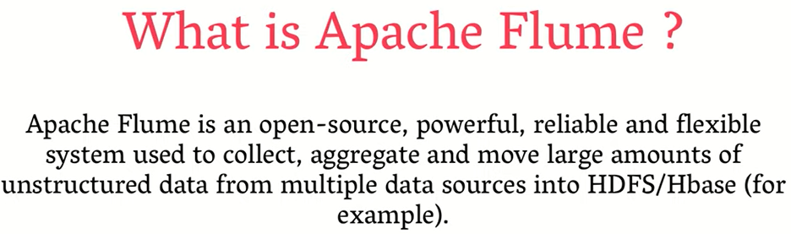
501.2 What is Apache Flume?
https://www.youtube.com/watch?v=62yqIHHtIYM&list=PLeUBsMTwZBi0vPhPHRfurknpsqh1cZE0t
What is Apache Flume (02:20/9:47)
Apache Flume is an Open-Source, it is free.
It is powerful and reliable. We can rely on it.
It is a flexible system used to collect, aggregate from multiple sources.
…and move large amount of unstructured data from multiple data sources. The multiple sources can be web logs, social media data.
…into HDFS or HBase, for example.
Formal definition of Apache Flume: Apache Flume is the tool to get unstructured data injected into the HDFS.

Slide 9
501.3 Architecture

Slide 10
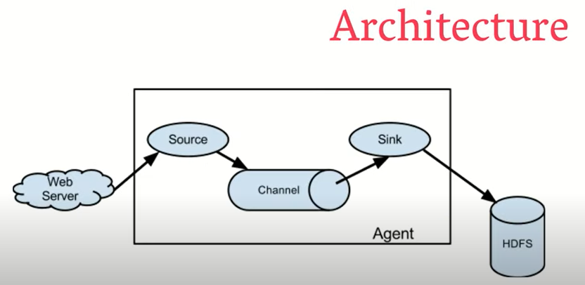
501.3 Architecture
https://www.youtube.com/watch?v=62yqIHHtIYM&list=PLeUBsMTwZBi0vPhPHRfurknpsqh1cZE0t
Architecture (02:27/9:47)
Below diagram shows there are few components in the Hadoop architecture.
We have agent, which is has three components: Source, Channel, and Sink.
In the left side, we have Web Server.
In the right side, we have HDFS.
What is Flume agent?
Flume agent is an independent JVM (Java Virtual Machine) Process in Apache Flume.

Slide 11
501.3 Architecture
https://www.youtube.com/watch?v=62yqIHHtIYM&list=PLeUBsMTwZBi0vPhPHRfurknpsqh1cZE0t
Architecture (03:10/9:47)
A Flume agent receiving events from clients or other Flume agents.
A Flume can pass to the next destination.
The destination can be sink and can be other agents.
In summary, we can say an agent is an independent JVM (Java Virtual Machine) Process which consists of three things: Source, Channel, and Sink.
Let’s discuss the details of the Flume.

Slide 12
501.4 Event

Slide 13
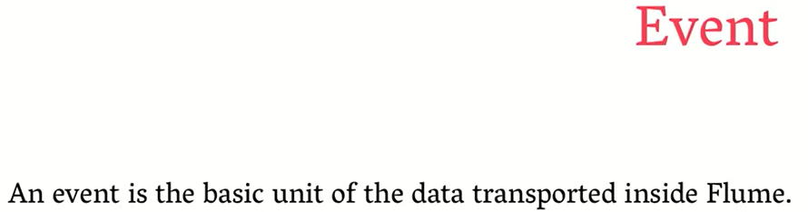
501.4 Event
https://www.youtube.com/watch?v=62yqIHHtIYM&list=PLeUBsMTwZBi0vPhPHRfurknpsqh1cZE0t
Event (04:15/9:47)
Before we discuss the Source, Channel, and Sink, we have keyword called event.
Why event is so important?
An events is the basic unit of data transported inside Flume.
What is that mean?
In OSI (Open System Interconnection) Model, each layer have some key word.
In the network layer, we have packet.
In physical layer, we have bits and data frames.
In Apache Flume, we have basic unit called event which transport the data inside Flume.

Slide 14
501.5 Source

Slide 15
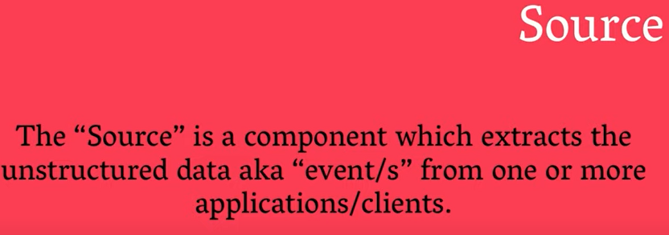
501.5 Source
https://www.youtube.com/watch?v=62yqIHHtIYM&list=PLeUBsMTwZBi0vPhPHRfurknpsqh1cZE0t
Source (4:24/9:47)
The first component of agents is “Source”.
What is source?
Source is a component which extracts the unstructured data, which we called as event. Event is the basic unit of data inside the Flume from one or more applications or clients.
So, source is a component which will be extracting the data from one or more applications which can be twitter data, web server log. These are the source of application.
After getting the data through the source, what is the next point?

Slide 16
501.6 Channel

Slide 17
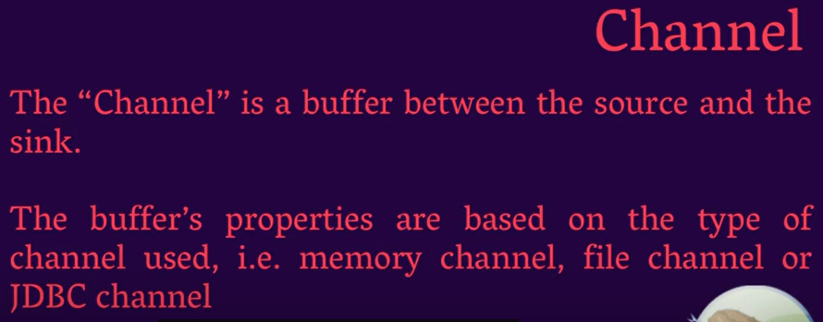
501.6 Channel
https://www.youtube.com/watch?v=62yqIHHtIYM&list=PLeUBsMTwZBi0vPhPHRfurknpsqh1cZE0t
Channel (05:11/9:47)
After the extraction of data in source, the next point will be the channel.
What is channel?
Channel is the buffer between source and sink.
We have three components in agent. We have source, channel, and sink.
Channel is a buffer, a memory space between source and sink.
Why do we need a buffer?
For example, we have twitter data coming in at very fast speed. We need to store somewhere for some moment.
That is why we need some buffer.

Slide 18
501.6 Channel
https://www.youtube.com/watch?v=62yqIHHtIYM&list=PLeUBsMTwZBi0vPhPHRfurknpsqh1cZE0t
Channel (5:45/9:47)
Channel is a bridge between source and sink.
The buffer properties based on type of channel.
We have different type of channel, we can use memory channel, file channel, or JDBC (Java Database Connectivity) channel.
Channel is a buffer which we require to hold data for a moment.
We can transport the data in buffer to the sink.
Next point is sink.

Slide 19
501.7 Sink

Slide 20
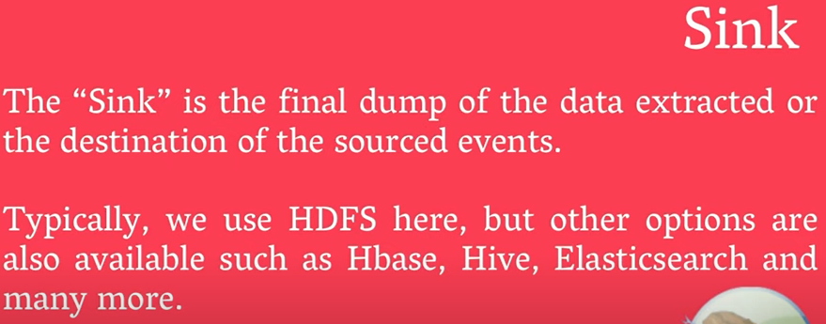
501.7 Sink
https://www.youtube.com/watch?v=62yqIHHtIYM&list=PLeUBsMTwZBi0vPhPHRfurknpsqh1cZE0t
Sink (06:26/9:47)
What is Sink?
Sink is the last point of agent.
Sink is the final dump of data extracted.
Sink is the one which connected to the HDFS.
This is the point which interacting with the HDFS.
That is why we specified it is the final dump of data extracted or the destination of a source events.

Slide 21
501.7 Sink
https://www.youtube.com/watch?v=62yqIHHtIYM&list=PLeUBsMTwZBi0vPhPHRfurknpsqh1cZE0t
Sink (06:56/9:47)
Typically, we used HDFS at sink.
…But we have other options which can be HBase, HIVE, Elastic Search, and many more.
In the diagram, we have web server, then we have source, then we have channel, then we have sink, and ultimately, we are dumping the data into the HDFS.
Sink is the one which is interacting the HDFS.

Slide 22
501.8 Flume vs. Kafka

Slide 23
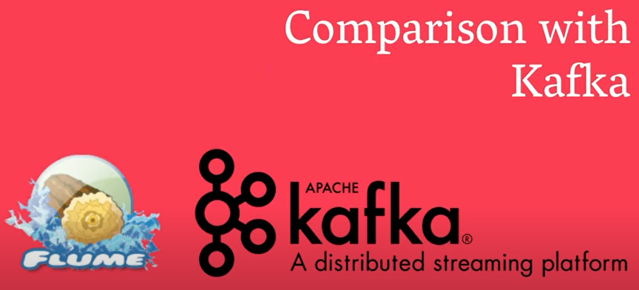
501.8 Flume vs. Kafka
https://www.youtube.com/watch?v=62yqIHHtIYM&list=PLeUBsMTwZBi0vPhPHRfurknpsqh1cZE0t
Flume Compare with Kafka (7:26/9:47)
In the last point, we compare the Flume with Kafka.
In general, Flume and Kafka are very similar.
There are some differences:
1. We use Kafka for messaging system. We can use Kafka to get messaging system and send message to multiple channels.
However, Flume requires data injection. The data can be flat file or format file (log, JSON, XML, CSV).

Slide 24
501.8 Flume vs. Kafka
https://www.youtube.com/watch?v=62yqIHHtIYM&list=PLeUBsMTwZBi0vPhPHRfurknpsqh1cZE0t
Flume Compare with Kafka (8:37/9:47)
2. Kafka is a kind of Pull model because customer or consumer Pull data.
However, Flume is a Push Model. Because messages are pushed to the consumer by Flume. The Kafka is a Pull Model and Flume is a Push Model.
3. When to use?
Kafka main use is to a distributed publish/subscribe messaging system. It is also known as publish/subscribe messaging system. Most people use Kafka for messaging system.
However, Flume is used to inject data into Hadoop. Flume is tightly integrated with the Hadoop monitoring system.

Slide 25
End

