Slide 1

004 Hadoop
Peter H. Chen

Slide 2
003 Hadoop
https://www.youtube.com/watch?v=44xO9XmL2Co&list=PLlgLmuG_KgbasW0lpInSAIxYd2vqAEPit&index=4
Hadoop (00:50/13:40)
We discuss the Hadoop architecture and MapReduce.
The MapReduce is the default programming framework of Hadoop.
If anybody want to analyze the data on top of Hadoop, they use MapReduce.
Today, there is a lot of ways to analyze data, not only MapReduce.
If you want to know MapReduce, we should know Java first because MapReduce Programs are written in Java.
We can use Python and other language for MapReduce.
But natively people write MapReduce programs in Java.
Polyglot
Format
ETL (Extract, Transform, and Load)
Flat File
JSON
XML
CRM (Customer Relation Management)
ETL
Data Warehouse
MySQL
D/W
OLAP
Core Banking Data
Oracle

Slide 3
003 Hadoop
https://www.youtube.com/watch?v=44xO9XmL2Co&list=PLlgLmuG_KgbasW0lpInSAIxYd2vqAEPit&index=4
Hadoop (01:11/13:40)
Since not everyone are familiar with Java and comfortable with Java, it may not make much sense out of you.
Why do you learn MapReduce? MapReduce is to help you in Spark which we discuss.
Spark uses similar concepts as MapReduce.
We do not really need to understand every line of code in Spark.
We just need to understand the logic of MapReduce and Spark of how they are working.
Not everybody will be able to follow and understand deeper.
Polyglot
Format
ETL (Extract, Transform, and Load)
Flat File
JSON
XML
CRM (Customer Relation Management)
ETL
Data Warehouse
MySQL
D/W
OLAP
Core Banking Data
Oracle

Slide 4
003 Hadoop
https://www.youtube.com/watch?v=44xO9XmL2Co&list=PLlgLmuG_KgbasW0lpInSAIxYd2vqAEPit&index=4
Hadoop (02:21/13:40)
Our Hadoop Architecture is as below diagram.
Hadoop is a very old technology came out at 2005.
In 2005, the Hadoop framework was created by Doug Cutting and Mike Cafarella.
Doug and Mike took the original idea from Google.
Google have done a lot of distributed computing and Google has done a lot of big data.
Google published couple of white papers and Doug Cutting and Mike Cafarella took the idea from Google and then created a framework called Hadoop.
Later, Doug and Mike gave to Apache as an open-source project.
Format
ETL
Hadoop
Flat File
JSON
XML
CRM (Customer Relation Management)
ETL
MySQL
Core Banking Data
Oracle

Slide 5
003 Hadoop
https://www.youtube.com/watch?v=44xO9XmL2Co&list=PLlgLmuG_KgbasW0lpInSAIxYd2vqAEPit&index=4
Hadoop (03:38/13:40)
Hadoop is an Open-source Project which is Apache open-source project.
We can download Hadoop and install it for free.
Since it is free, it does not have drawback of without support.
For example, you have Android phone. The Android OS is free.
iPhone OS is not free.
You can see the difference between the Android Phone and iPhone.
Android phone might get a lot of bugs which may not appear in Apple phone.
The Android OS is open-source.
Every company modify the Open-source based on their requirements.
For example, Samsung phone also use Android OS with their own Android.
Format
ETL
Hadoop
Flat File
JSON
XML
CRM (Customer Relation Management)
ETL
MySQL
Core Banking Data
Oracle

Slide 6
003 Hadoop
https://www.youtube.com/watch?v=44xO9XmL2Co&list=PLlgLmuG_KgbasW0lpInSAIxYd2vqAEPit&index=4
Hadoop (04:27/13:40)
For example, Samsung phone also use Android OS with their own Android OS.
A lot of bugs may come out due to modify the Android open-source.
The platform may not be so stable.
If it is an Apple Phone, if somebody call a bug, Apple will fix it because there is only release version.
Apple knows what bugs may come or may not come.
So, same story here.
Originally, it was Apache Hadoop, and you download from their web site.
If Hadoop is crashes, nobody is there is fix it because it is an open-Source.
Format
ETL
Hadoop
Flat File
JSON
XML
CRM (Customer Relation Management)
ETL
MySQL
Core Banking Data
Oracle

Slide 7
003 Hadoop
https://www.youtube.com/watch?v=44xO9XmL2Co&list=PLlgLmuG_KgbasW0lpInSAIxYd2vqAEPit&index=4
Hadoop (05:08/13:40)
Therefore, a company called Cloudera come out.
Cloudera is a first company which created a commercial distribution for Hadoop and related tools.
Today, you also can go to Cloudera to give you Hadoop.
What is the difference?
We will get the same Hadoop or almost similar Hadoop that you got from Apache web site.
But if you install it and if something is not working, they will fix it.
Cloudera
Format
ETL
Hadoop
Flat File
JSON
XML
CRM (Customer Relation Management)
ETL
MySQL
Core Banking Data
Oracle

Slide 8
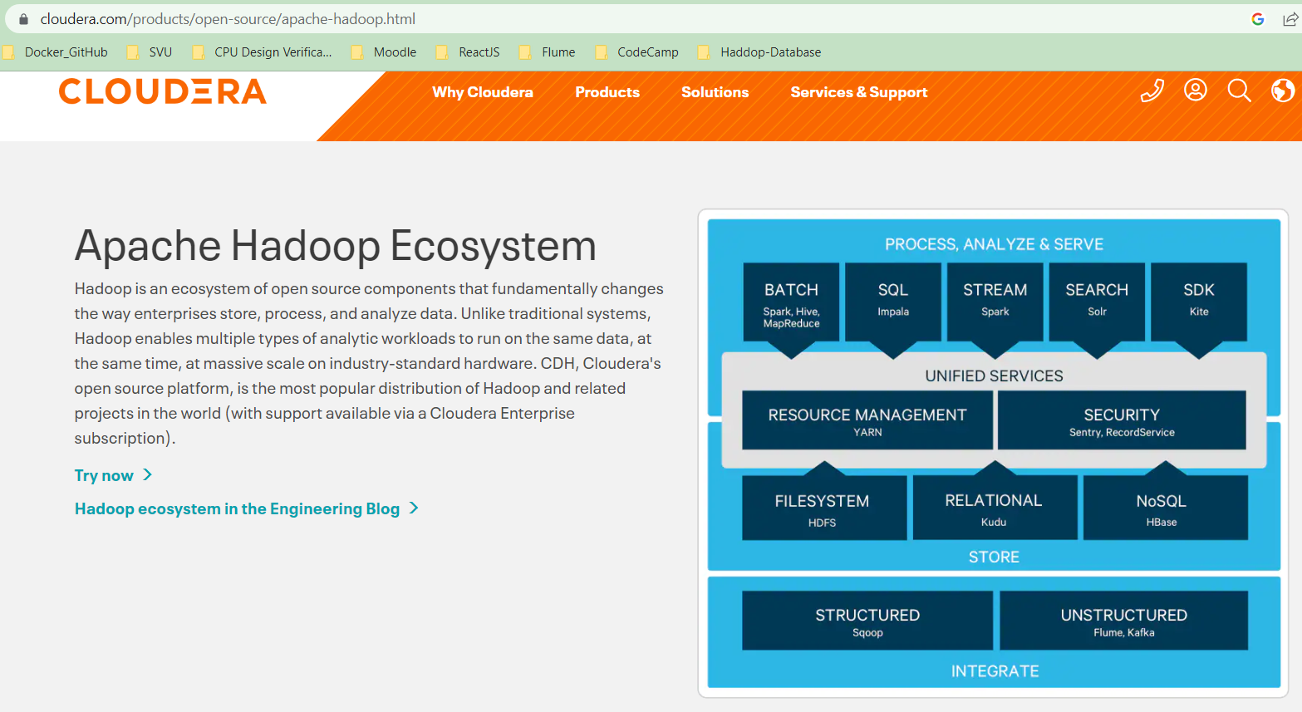
003 Hadoop
https://www.youtube.com/watch?v=44xO9XmL2Co&list=PLlgLmuG_KgbasW0lpInSAIxYd2vqAEPit&index=4
Hadoop (05:42/13:40)
Since you are paying the money to Cloudera, you get support just like vendor.
One of the popular companies in Big Data is Cloudera (Cloudera acquire Hortonworks).
Cloudera sells Hadoop, Spark, etc. as a bundle.
Cloudera also provide the free version, but we will not get the support.
Hadoop with Support: Cloudera

Slide 9
003 Hadoop
https://www.youtube.com/watch?v=44xO9XmL2Co&list=PLlgLmuG_KgbasW0lpInSAIxYd2vqAEPit&index=4
Hadoop (06:21/13:40)
If we start a company from Apache, we modify the source code and sell the code.
Since you get from open source, we should give it free opensource or we can offer with support.
Same as Linux, we have Ubuntu Linux (Free Open-source without support) and Red Hat Linux (Free Open source with charged support). What is difference between them?
We can download both of Apache (Apache open-source without support) and Cloudera (free open-source with charged support) from their web site.
Hadoop with Support: Cloudera

Slide 10
003 Hadoop
https://www.youtube.com/watch?v=44xO9XmL2Co&list=PLlgLmuG_KgbasW0lpInSAIxYd2vqAEPit&index=4
Hadoop (07:00/13:40)
The Cloudera (merge Hortonworks in 2018) is the leading companies of Big Data world.
Cloudera provide certification exams in the Big Data world.
We can try the Cloudera certification exam after Spark class. Why people trust Microsoft, Apple, Oracle, etc.?
They support the products. If you found something that does not work, you have power to ask them to fix the bugs for you.
Hadoop with Support: Cloudera

Slide 11
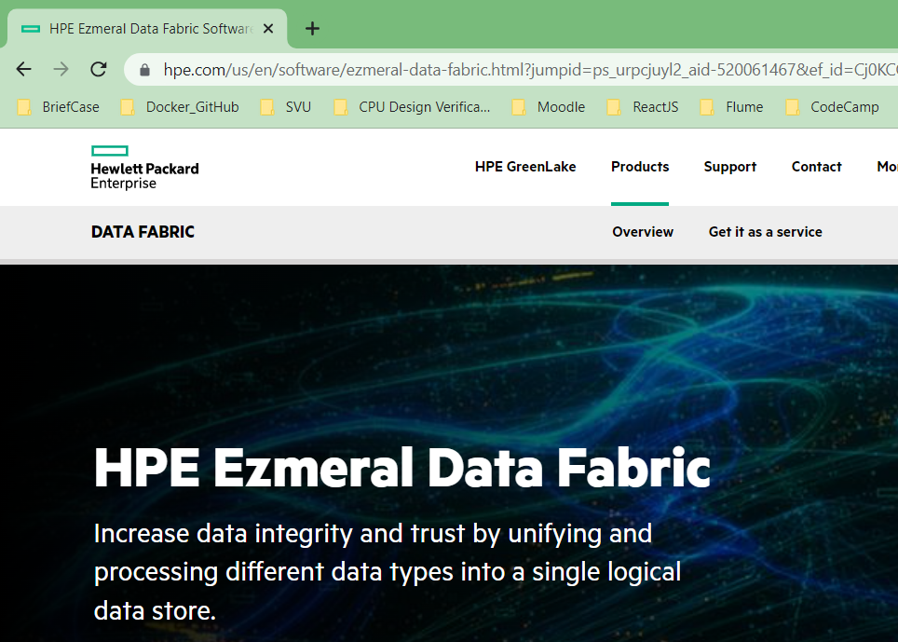
003 Hadoop
https://www.youtube.com/watch?v=44xO9XmL2Co&list=PLlgLmuG_KgbasW0lpInSAIxYd2vqAEPit&index=4
Hadoop (07:29/13:40)
MapR is another big data company.
MapR is shutdown in 2019 and HP acquires MapR business assets.
Now MapR is called HPE (Hewlett Packard Enterprise).
Hadoop with Support: HPE

Slide 12
003 Hadoop
https://www.youtube.com/watch?v=44xO9XmL2Co&list=PLlgLmuG_KgbasW0lpInSAIxYd2vqAEPit&index=4
Hadoop (08:12/13:40)
Every company has their own name of Hadoop, for example, Microsoft Hadoop called HDInsight, IBM Hadoop called BigInsight, Amazon Hadoop called EMR (Elastic MapReduce)
For end user, there is no much of difference in all of three platforms.
The differences are Cloudera fixes some bugs on Hadoop.
It is like Samsung cell phone and Google cell phone.
There is no much difference. Internally, they are Android.
Samsung said our Android is better, more bug free.
If we download LINE or whatsapp, both apps will be run on Samsung and Google phone.
It is same source with different commercial distributions. This is same as Linux. You can buy from Red Hat, Susie, or Ubuntu. Internally, they are all the same. The “ls” command will work for all of the Linux distributions.
Cloudera is the most popular platform among all of the big data platforms because they head start in 2008.

Slide 13
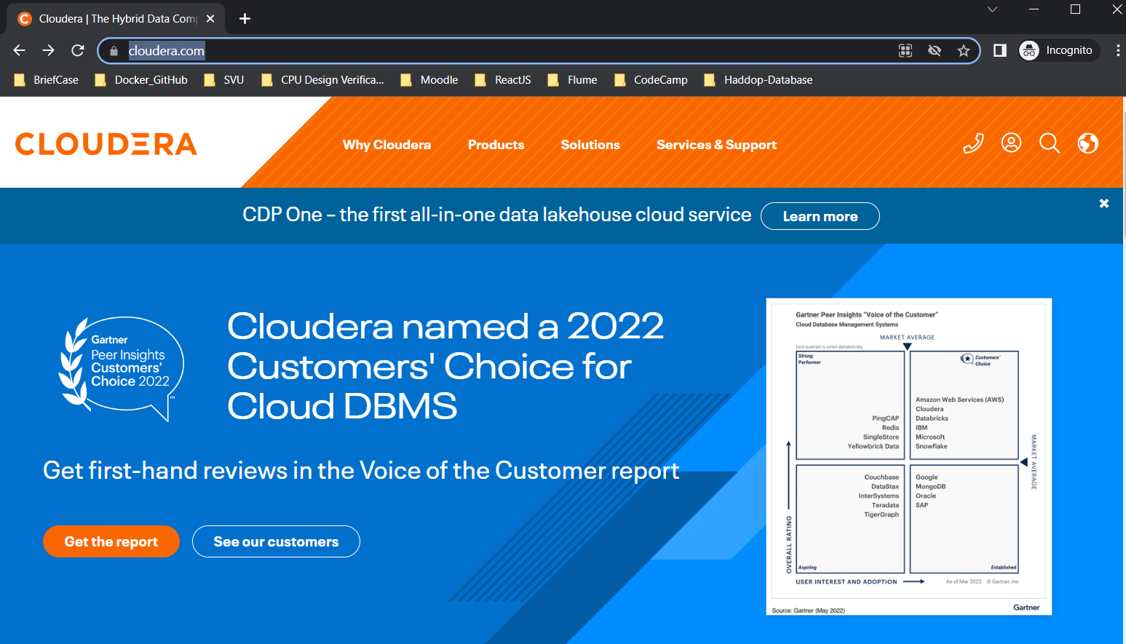
003 Hadoop
https://www.youtube.com/watch?v=44xO9XmL2Co&list=PLlgLmuG_KgbasW0lpInSAIxYd2vqAEPit&index=4
Hadoop (10:17/13:40)
A lot of companies already have the MapReduce program, and they want to go to Spark.
If you want to go to Spark, we should know MapReduce first.
To learn Spark, MapReduce is import.
Spark is built based on MapReduce.
How the MapReduce work and how to run MapReduce is the basic concepts that will help you to learn Spark in a better way.

Slide 14
003 Hadoop
https://www.youtube.com/watch?v=44xO9XmL2Co&list=PLlgLmuG_KgbasW0lpInSAIxYd2vqAEPit&index=4
Hadoop (10:31/13:40)
In Enterprise, the MapReduce name is totally gone.
MapReduce can work as data warehouse, but the performance is poor compared to Spark.
Hadoop is a batch processing system, not real-time.
If we have 100 tera data, we need Spark process in real-time.

Slide 15
003 Hadoop
https://www.youtube.com/watch?v=44xO9XmL2Co&list=PLlgLmuG_KgbasW0lpInSAIxYd2vqAEPit&index=4
Hadoop (11:10/13:40)
Most company are deploying everything over Amazon Web Services.
Amazon offers fully managed Hadoop solutions on the cloud.
If you go to Amazon and you ask for Hadoop solution, everything is installed up and running with automation.

Slide 16
003 Hadoop
https://www.youtube.com/watch?v=44xO9XmL2Co&list=PLlgLmuG_KgbasW0lpInSAIxYd2vqAEPit&index=4
Hadoop (11:30/13:40)
Amazon also give you data warehouse, there is a solution called redshift.
Redshift is Amazon cloud-based data warehouse.
Amazon offers redshift for you if you want data to be stored.
Everything can be given in one solution.
We need cheaper and fast speed are not possible.

Slide 17
003 Hadoop
https://www.youtube.com/watch?v=44xO9XmL2Co&list=PLlgLmuG_KgbasW0lpInSAIxYd2vqAEPit&index=4
Hadoop (12:20/13:40)
We need to compromised price with real-time access.
People think that I have a single machine, how much data can I store?
The personal machine is insufficient in storage, we can add Network attached Storage, such as, SAN (Storage Area Network), and as much as we want.

Slide 18
End

