Slide 1

8 Workspace
Peter H. Chen

Slide 2
8 Workspace
https://www.tutorialspoint.com/eclipse/eclipse_workspaces.htm
Eclipse Workspace
The eclipse workspace contains resources such as −
Projects
Files
Folders
The workspace has a hierarchical structure.
Projects are at the top level of the hierarchy and inside them you can have files and folders.
Plug-ins use an API provided by the resources plug-in to manage the resources in the workspace.

Slide 3
8.1 Workspace Management

Slide 4
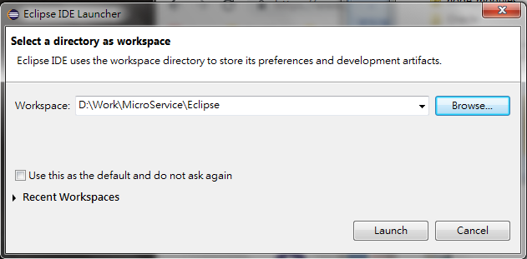
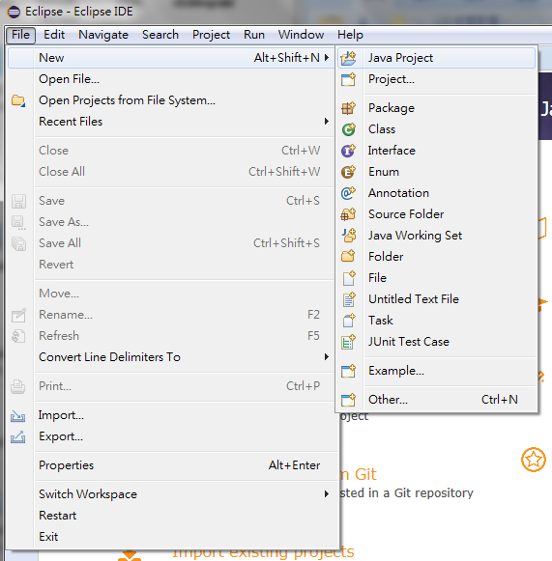
8.1 Workspace Management
https://www.tutorialspoint.com/eclipse/eclipse_workspaces.htm
Select the workspace
File > New > Java Project

Slide 5
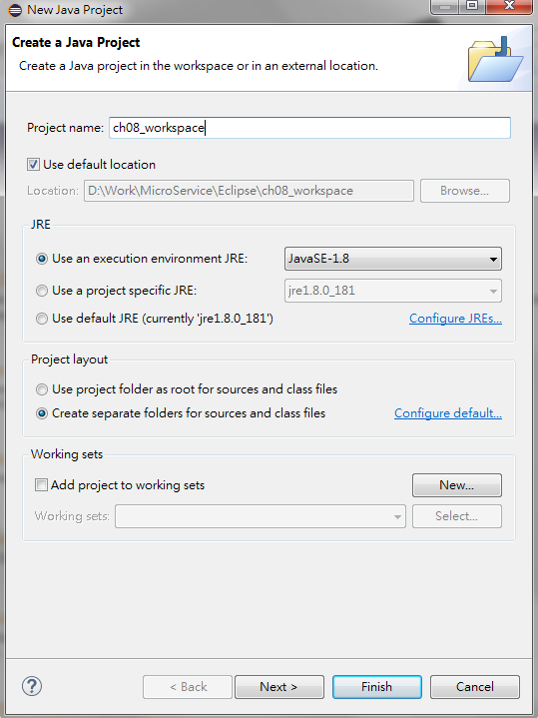
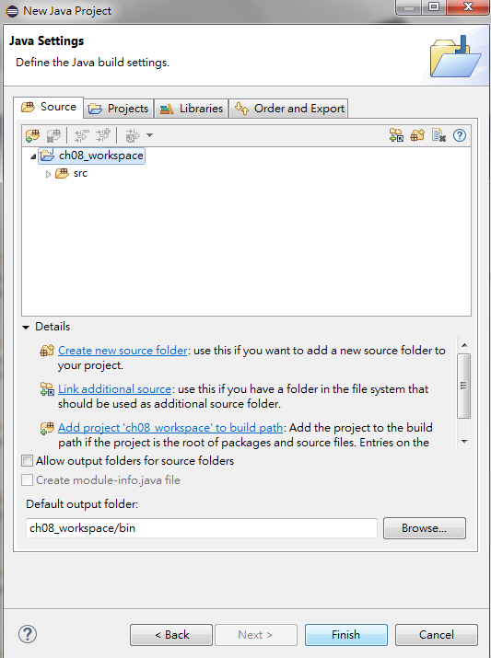
8.1 Workspace Management
https://www.tutorialspoint.com/eclipse/eclipse_workspaces.htm
Project name: ch08_workspace
Next
Finish

Slide 6
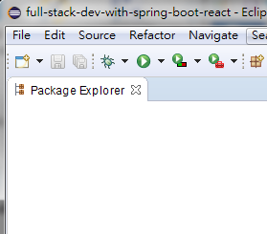
8.1 Workspace Management
https://www.tutorialspoint.com/eclipse/eclipse_workspaces.htm
Users use the functionality provided by views, editors, and wizard to create and manage resources in the workspace.
One among the many views that show the content of the workspace is the Project Explorer view.

Slide 7
8.2 Create File

Slide 8
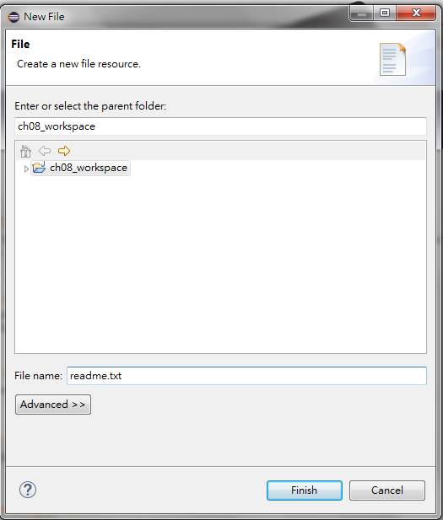
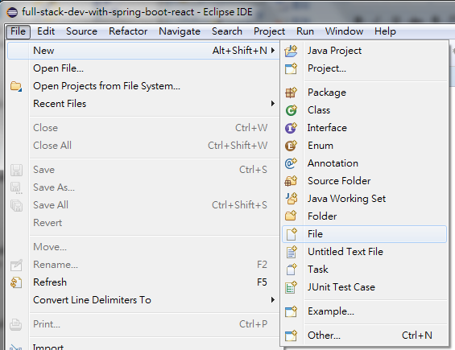
8.2 Create File
https://www.tutorialspoint.com/eclipse/eclipse_workspaces.htm
The File Wizard (File > New > File) can be used to create a new file.
Enter or select the parent folder: ch08_workspace
File name: readme.txt
Click “Finish” button.

Slide 9
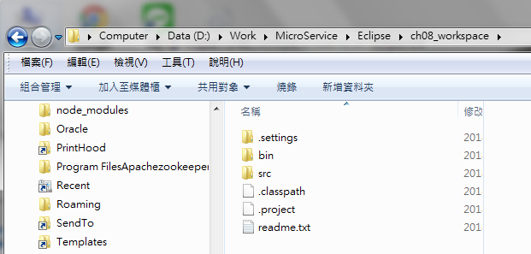
8.2 Create File
https://www.tutorialspoint.com/eclipse/eclipse_workspaces.htm
Browse folder: D:\Work\MicroService\Eclipse\ch08_workspace\readme.txt

Slide 10
8.3 Create Folder

Slide 11
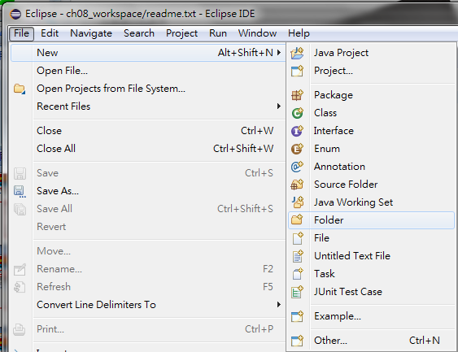
8.3 Create Folder
https://www.tutorialspoint.com/eclipse/eclipse_workspaces.htm
New > File > Folder

Slide 12
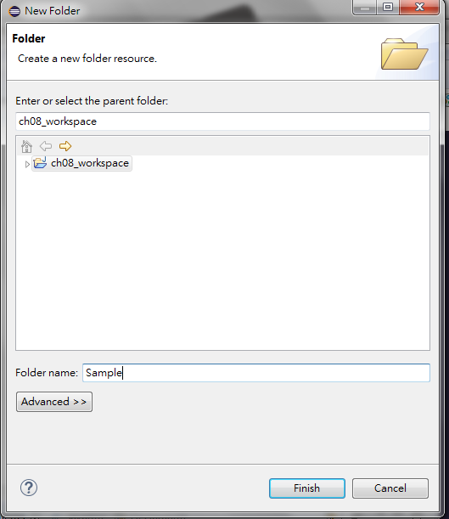
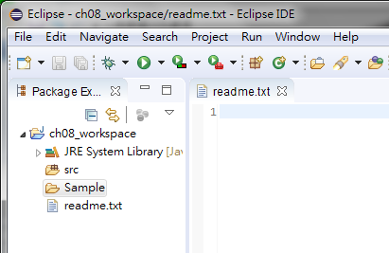
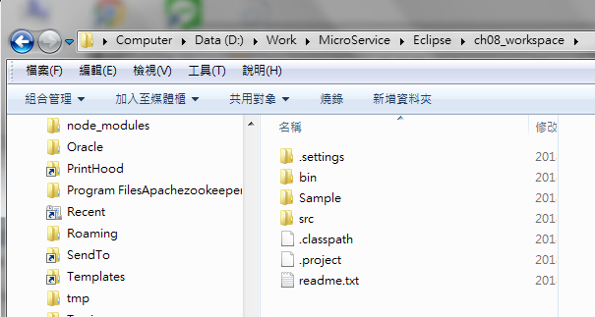
8.3 Create Folder
https://www.tutorialspoint.com/eclipse/eclipse_workspaces.htm
Browse folder: D:\Work\MicroService\Eclipse\ch08_workspace\sample

Slide 13
End of Chapter

