Slide 1

9 Create Java Project
Peter H. Chen

Slide 2
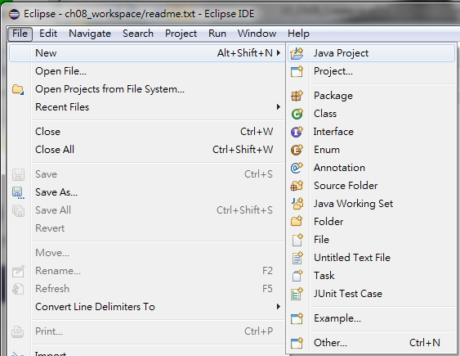
9 Create Java Project
https://www.tutorialspoint.com/eclipse/eclipse_create_java_project.htm
Create Java Project
New > Java Project

Slide 3
9.1 Java Project Wizard

Slide 4
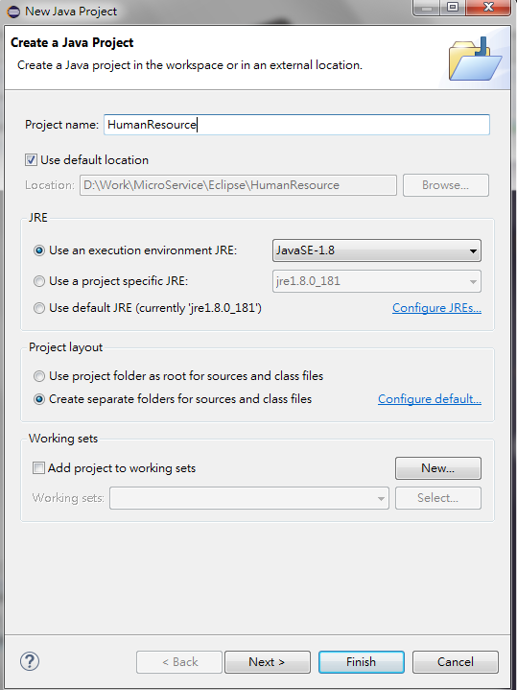
9.1 Java Project Wizard
https://www.tutorialspoint.com/eclipse/eclipse_create_java_project.htm
Project name: HumanResource
Click Next button to change the Java build setting.

Slide 5
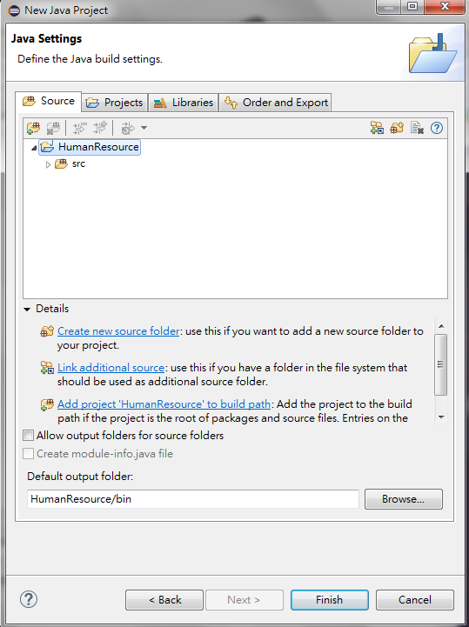
9.1 Java Project Wizard
https://www.tutorialspoint.com/eclipse/eclipse_create_java_project.htm
On the second page you can change the Java Build Settings.
Setting the Project dependency (if there are multiple projects)
Adding additional jar files to the build path.

Slide 6
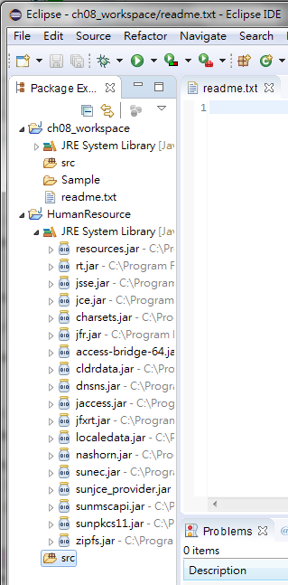
9.1 Java Project Wizard
https://www.tutorialspoint.com/eclipse/eclipse_create_java_project.htm
On the second page you can change the Java Build Settings.
Setting the Project dependency (if there are multiple projects)
Adding additional jar files to the build path.

Slide 7
9.2 Build Path

Slide 8
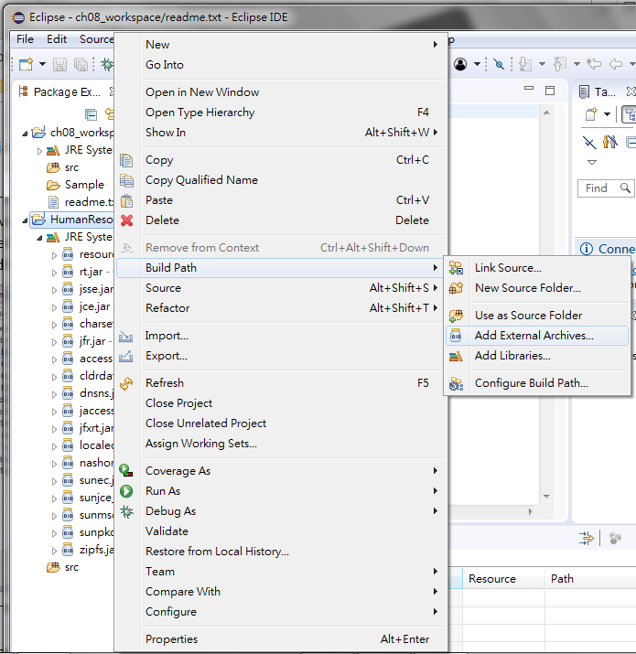
9.2 Build Path
https://www.tutorialspoint.com/eclipse/eclipse_java_build_path.htm
The Java build path is used while compiling a Java project to discover dependent classes .
It is made up of the following items −
Code in the source folders.
Jars and classes folder associated with the project.
Classes and libraries exported by projects referenced by this project.
The java build path can be seen and modified by using the Java Build Path page of the Java Project properties dialog.
To bring up the Java Project properties dialog box, right click on a Java Project in the Package Explorer view and select the Properties menu item. On the left hand side tree select Java Build Path.

Slide 9
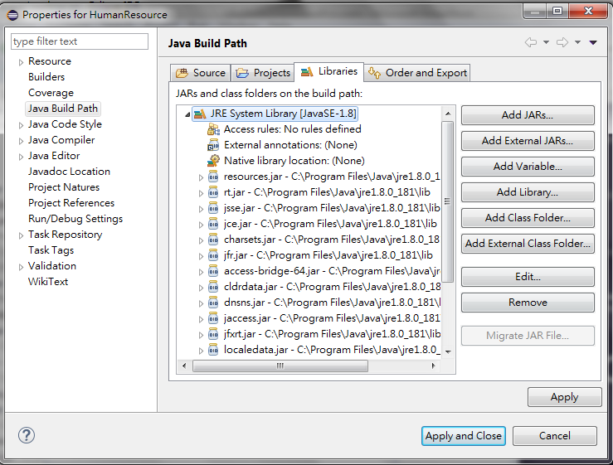
9.2 Build Path
https://www.tutorialspoint.com/eclipse/eclipse_java_build_path.htm
Add jars to the java build path.
In the Libraries tab:
Click on Add JARs if the jar is already in the Eclipse workspace
Click on Add External JARs if the jar is elsewhere in the file system.

Slide 10
End of Chapter

