Slide 1

Ch05 Aggregate Function Function
Peter H. Chen

Slide 2
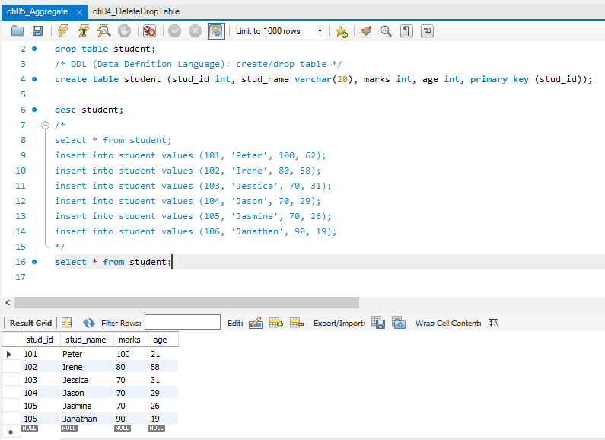
Ch05 Aggregate Function
https://www.youtube.com/watch?v=M9PftruJiJM&index=4&list=PLsyeobzWxl7oJca2fwLyKbDwlKUDPl3RE
This section discusses different aggregate function in MySQL.
We have a table student. We have a Query to retrieve data in student table.
We have a table with six rows and four columns as follow.

Slide 3
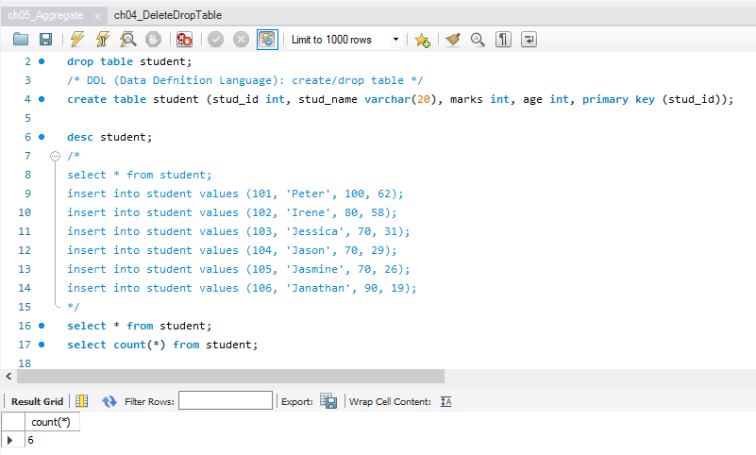
Ch05 Aggregate Function
https://www.youtube.com/watch?v=M9PftruJiJM&index=4&list=PLsyeobzWxl7oJca2fwLyKbDwlKUDPl3RE
We want to know how many rows?
> select count(*) from student; /* count (*) = 6 */

Slide 4
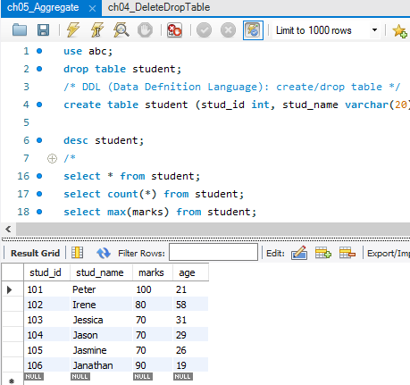
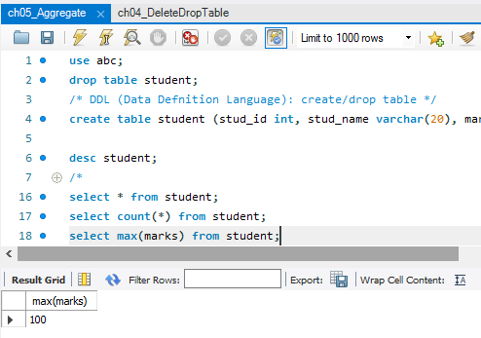
Ch05 Aggregate Function
https://www.youtube.com/watch?v=M9PftruJiJM&index=4&list=PLsyeobzWxl7oJca2fwLyKbDwlKUDPl3RE
We want to know the maximum marks. We can use aggregate function max().
> select max(marks) from student;

Slide 5
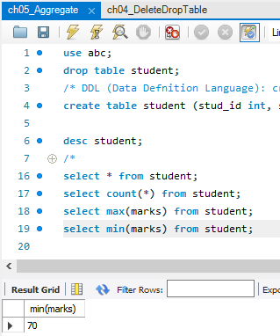
Ch05 Aggregate Function
https://www.youtube.com/watch?v=M9PftruJiJM&index=4&list=PLsyeobzWxl7oJca2fwLyKbDwlKUDPl3RE
We want to know the minimum marks. We can use aggregate function main().
> select min(marks) from student;

Slide 6
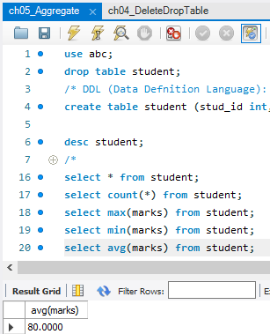
Ch05 Aggregate Function
https://www.youtube.com/watch?v=M9PftruJiJM&index=4&list=PLsyeobzWxl7oJca2fwLyKbDwlKUDPl3RE
We want to know the average marks. We can use aggregate function avg().
> select avg(marks) from student;

Slide 7
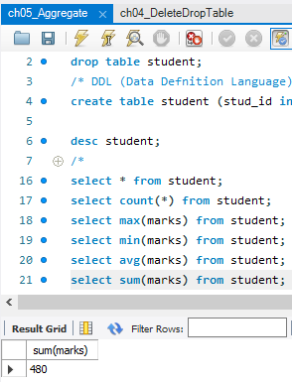
Ch05 Aggregate Function
https://www.youtube.com/watch?v=M9PftruJiJM&index=4&list=PLsyeobzWxl7oJca2fwLyKbDwlKUDPl3RE
We want to know the sum of marks. We can use aggregate function sum().
> select sum (marks) from student;

Slide 8
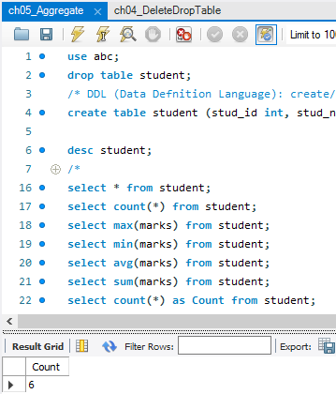
Ch05 Aggregate Function
https://www.youtube.com/watch?v=M9PftruJiJM&index=4&list=PLsyeobzWxl7oJca2fwLyKbDwlKUDPl3RE
We want to assign the count(*) into a variable name Count.
> select count (*) as Count from student;

Slide 9
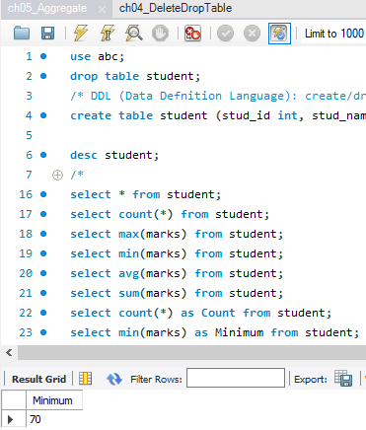
Ch05 Aggregate Function
https://www.youtube.com/watch?v=M9PftruJiJM&index=4&list=PLsyeobzWxl7oJca2fwLyKbDwlKUDPl3RE
We want to assign the min(*) into a variable name Minimum.
> select min(*) as Minimum from student;

Slide 10
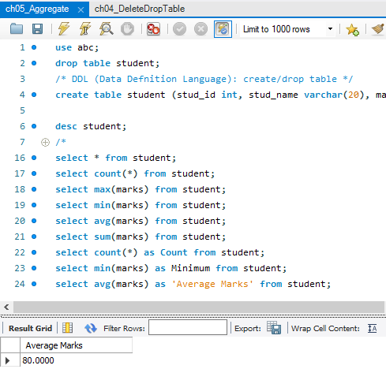
Ch05 Aggregate Function
https://www.youtube.com/watch?v=M9PftruJiJM&index=4&list=PLsyeobzWxl7oJca2fwLyKbDwlKUDPl3RE
We want to assign the avg(*) into a ‘Average Marks’. This is called a alias.
> select count (*) as ‘Average Marks’ from student;

Slide 11
End of Chapter

