Slide 1

Ch02 Create Table and Insert/Select
Peter H. Chen

Slide 2
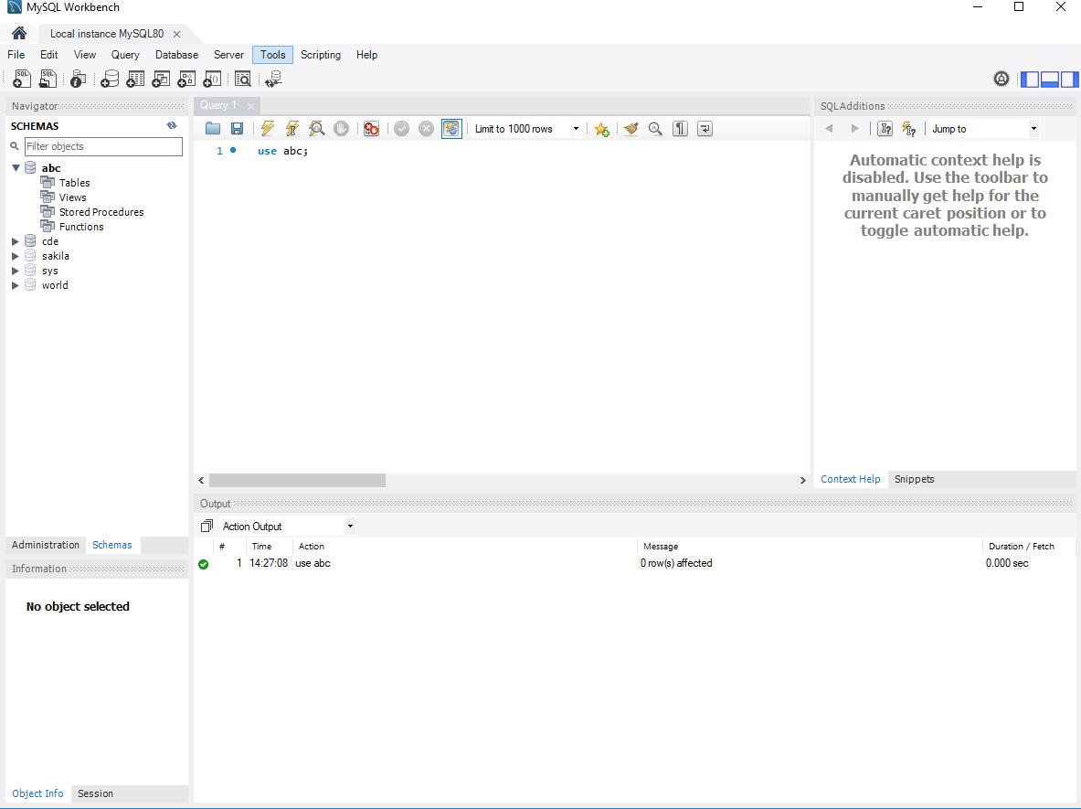
Ch02 Create Table and Insert/Select
https://www.youtube.com/watch?v=-RrfsIPy4uE&list=PLsyeobzWxl7oJca2fwLyKbDwlKUDPl3RE&index=2
In the last section, we create and connect the database.
In this section, we will create table, insert data, and select data for the database.

Slide 3
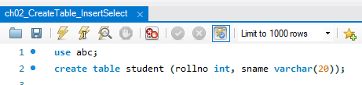
Ch02 Create Table and Insert/Select
https://www.youtube.com/watch?v=-RrfsIPy4uE&list=PLsyeobzWxl7oJca2fwLyKbDwlKUDPl3RE&index=2
The ALTER or CREATE Table is used to add or change content of table.
Create table student (rollno, int, sname varchar (20));
Press Control+<Enter> to execute.

Slide 4
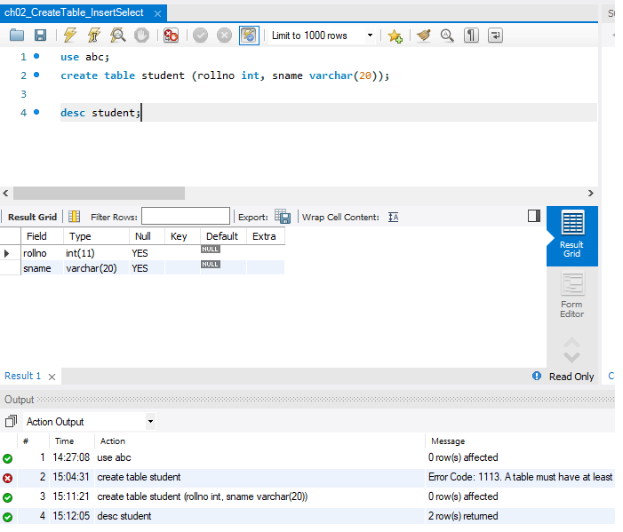
Ch02 Create Table and Insert/Select
https://www.youtube.com/watch?v=-RrfsIPy4uE&list=PLsyeobzWxl7oJca2fwLyKbDwlKUDPl3RE&index=2
How to check our table is created successfully or not?
Use “desc student” (Describe student table) to see the table.
Press Control+<Enter>. The student table is displayed.

Slide 5
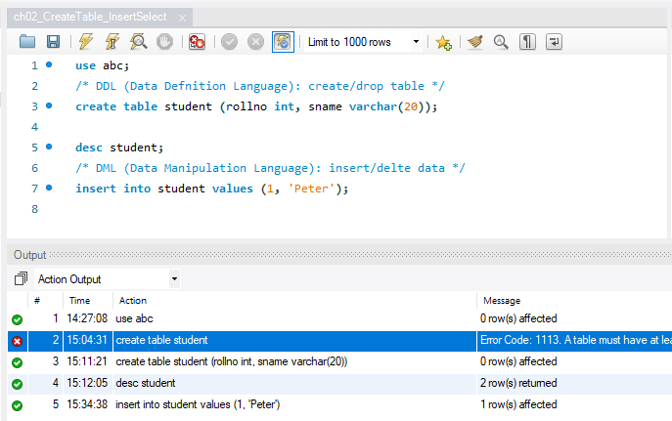
Ch02 Create Table and Insert/Select
https://www.youtube.com/watch?v=-RrfsIPy4uE&list=PLsyeobzWxl7oJca2fwLyKbDwlKUDPl3RE&index=2
To insert the data, we have to use DDL (Data Definition Language), DML (Data Manipulation Language), DRL/DQL (Data Retrieve Language/Data Query Language).
When we create/drop table, we use DDL.
When we insert/delete value, we use DML.
When we select value, we use DRL/DQL.
Next, we will insert some data in the table.
Since we are inset value with DML.
You can see the values are created below.

Slide 6
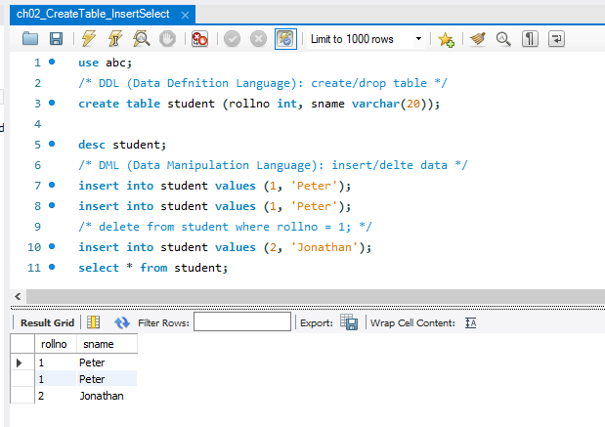
Ch02 Create Table and Insert/Select
https://www.youtube.com/watch?v=-RrfsIPy4uE&list=PLsyeobzWxl7oJca2fwLyKbDwlKUDPl3RE&index=2
Continue to insert and display the table content.

Slide 7
End of Chapter

