Slide 1
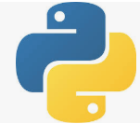
3 First Django App: Part 1: Part 1
Peter H. Chen

Slide 2
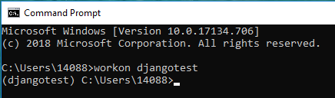
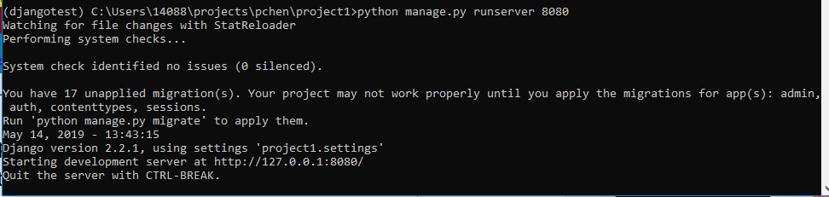
3 First Django App: Part 1
https://www.youtube.com/watch?v=ykpuyNy5oUM&list=PLsyeobzWxl7r2ukVgTqIQcl-1T0C2mzau&index=3
This project location: C:\Users\14088\projects\pchen\project1
First Django App
Open command prompt:
> workon djangotest”
> cd projects\pchen\project1
> python manage.py runserver 8080

Slide 3
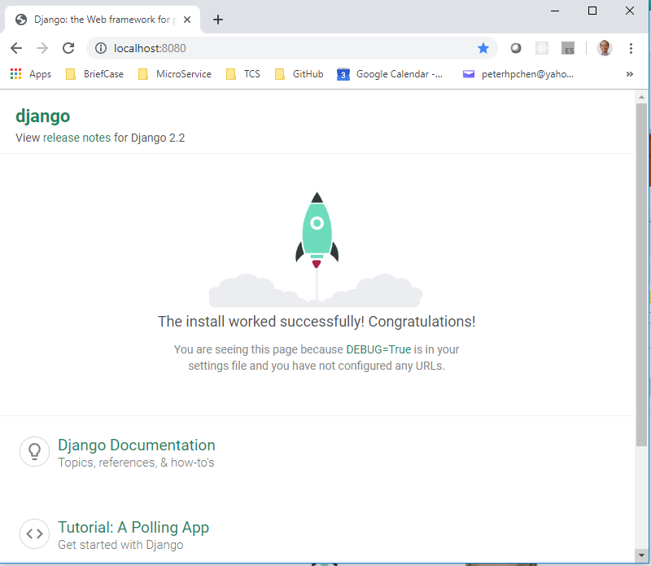
3 First Django App: Part 1
https://www.youtube.com/watch?v=ykpuyNy5oUM&list=PLsyeobzWxl7r2ukVgTqIQcl-1T0C2mzau&index=3
Open Chrome
Enter: localhost:8080

Slide 4
3 First Django App: Part 1
https://www.youtube.com/watch?v=ykpuyNy5oUM&list=PLsyeobzWxl7r2ukVgTqIQcl-1T0C2mzau&index=3
This is the basic the default server page.
We want to build our own app by the Django server.
We build a simple “hello world” on the page.
Download and install the community version of visual studio as the IDE.

Slide 5
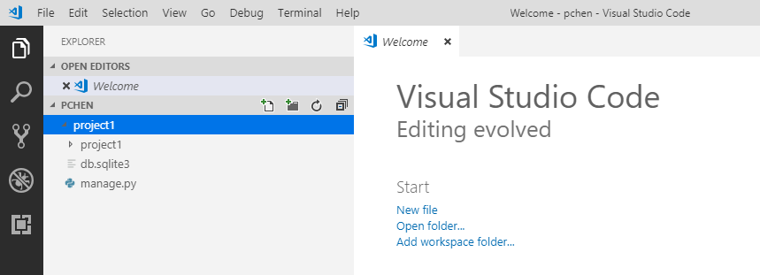
3 First Django App: Part 1
https://www.youtube.com/watch?v=ykpuyNy5oUM&list=PLsyeobzWxl7r2ukVgTqIQcl-1T0C2mzau&index=3
Open the pchen folder, we have created project1 and manager.py.

Slide 6
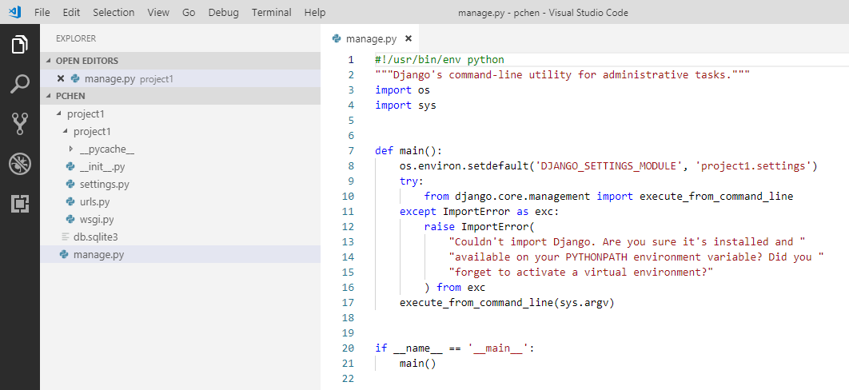
3 First Django App: Part 1
https://www.youtube.com/watch?v=ykpuyNy5oUM&list=PLsyeobzWxl7r2ukVgTqIQcl-1T0C2mzau&index=3
Inside the project1, we have __init__.py, settings.py, urls.py, and wsgi.py.
Outside the project folder, we have manage.py which is useful to manage your project.

Slide 7
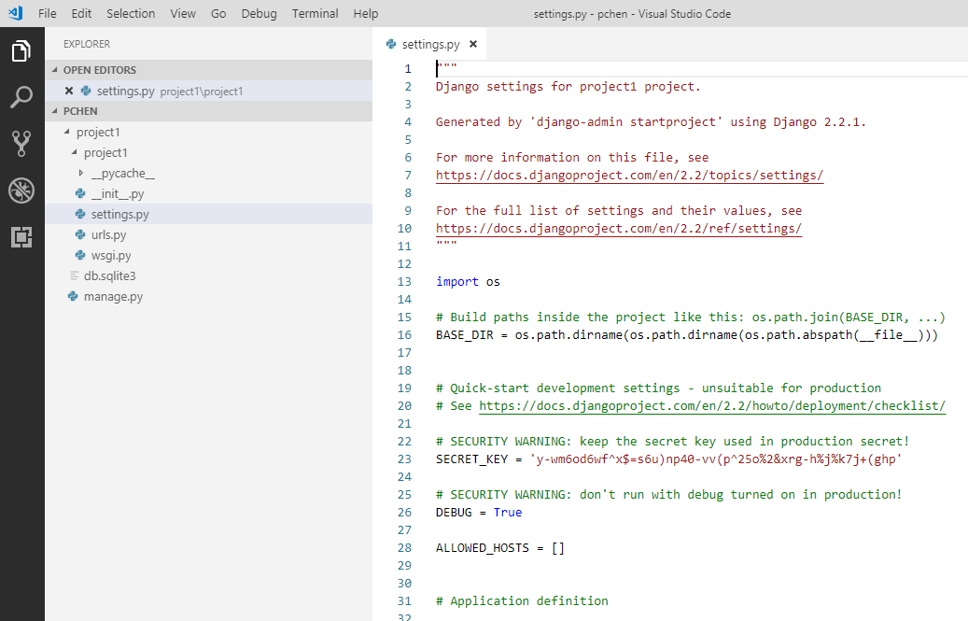
3 First Django App: Part 1
https://www.youtube.com/watch?v=ykpuyNy5oUM&list=PLsyeobzWxl7r2ukVgTqIQcl-1T0C2mzau&index=3
The file settings.py is very important if you have some setting in your project.
We do not edit this file very frequently but need to understand it.

Slide 8
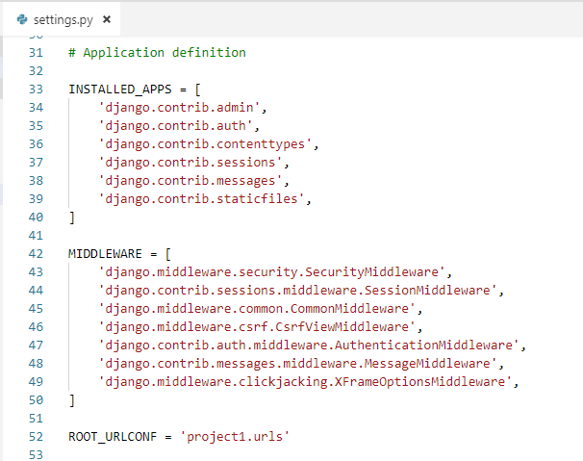
3 First Django App: Part 1
https://www.youtube.com/watch?v=ykpuyNy5oUM&list=PLsyeobzWxl7r2ukVgTqIQcl-1T0C2mzau&index=3
The INSTALLED_APPS includes the installed apps.
The MIDDLEWARE includes the installed middlewares.

Slide 9
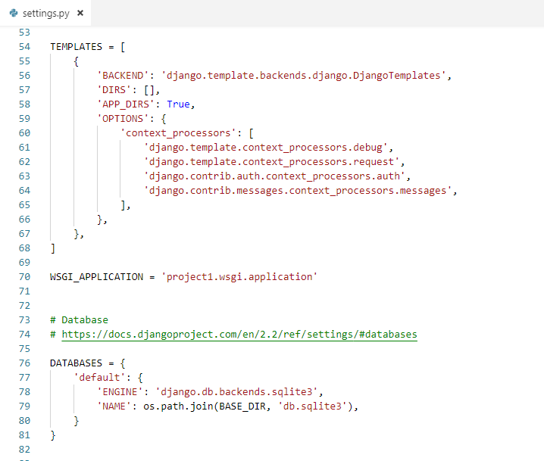
3 First Django App: Part 1
https://www.youtube.com/watch?v=ykpuyNy5oUM&list=PLsyeobzWxl7r2ukVgTqIQcl-1T0C2mzau&index=3
The TEMPLATES includes the installed Django template.
The DATABASES includes the SQLite engine behind the scene.

Slide 10
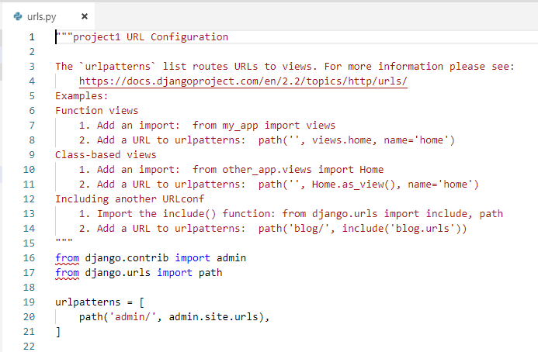
3 First Django App: Part 1
https://www.youtube.com/watch?v=ykpuyNy5oUM&list=PLsyeobzWxl7r2ukVgTqIQcl-1T0C2mzau&index=3
We have urls.py defines the url for admin.

Slide 11
3 First Django App: Part 1
https://www.youtube.com/watch?v=ykpuyNy5oUM&list=PLsyeobzWxl7r2ukVgTqIQcl-1T0C2mzau&index=3
We start to the our app.
Django may includes admin, e-commerce site web site, products as a module, shipping as a module, and etc. We have different set for different apps.
All the different apps will be provided in one particular project which your website in general. For example, log-in will be in one app and showing the products will be in another app.

Slide 12
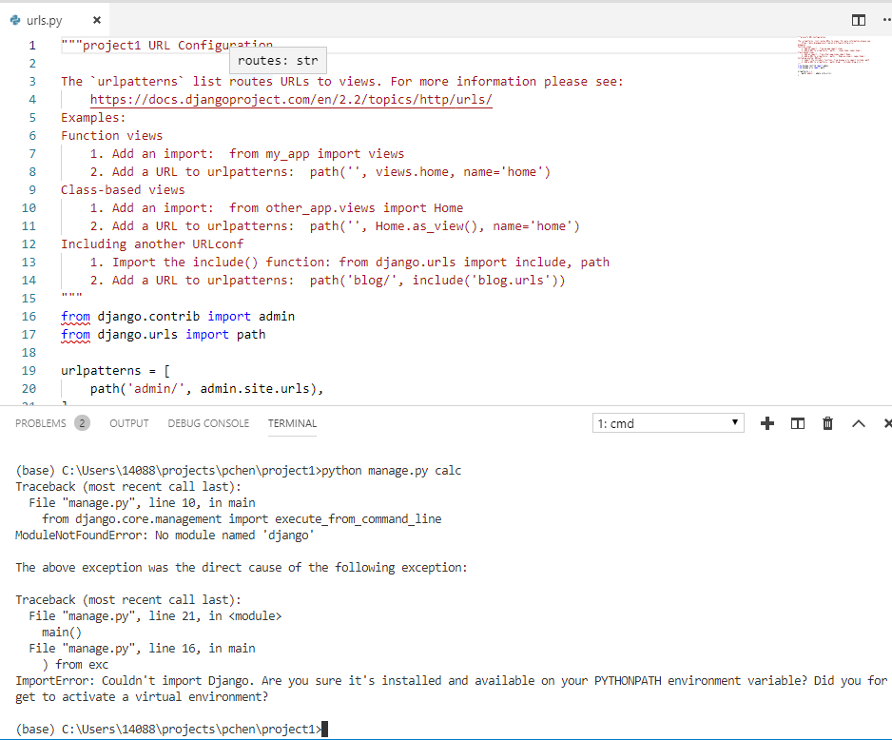
3 First Django App: Part 1
https://www.youtube.com/watch?v=ykpuyNy5oUM&list=PLsyeobzWxl7r2ukVgTqIQcl-1T0C2mzau&index=3
How do you create an app which name is “calc”?
Open a terminal in the Visual Studio.
> python manage.py calc
…
ImportError: …
Note: There is no virtual endowment in visual studio.

Slide 13
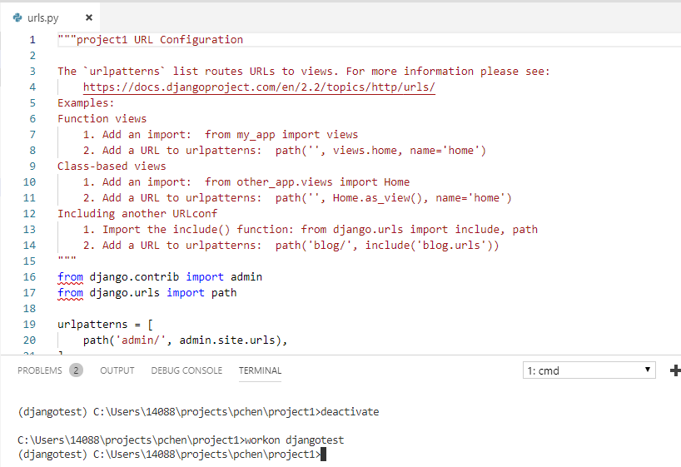
3 First Django App: Part 1
https://www.youtube.com/watch?v=ykpuyNy5oUM&list=PLsyeobzWxl7r2ukVgTqIQcl-1T0C2mzau&index=3
Deactivate the current virtual environment
> deactive
Workon djangotest virtual environment
> workon djangotest
(djangotest) C:\Users\14088\projects\pchen\project1>

Slide 14
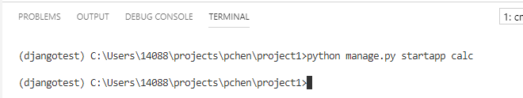
3 First Django App: Part 1
https://www.youtube.com/watch?v=ykpuyNy5oUM&list=PLsyeobzWxl7r2ukVgTqIQcl-1T0C2mzau&index=3
Create app:
(djangotest) C:\Users\14088\projects\pchen\project1> python manage.py startapp calc

Slide 15
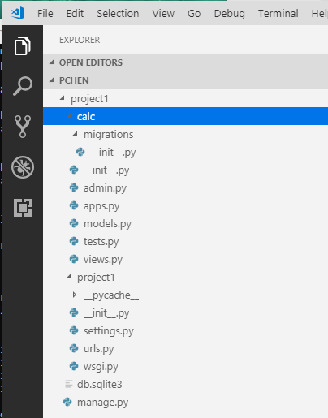
3 First Django App: Part 1
https://www.youtube.com/watch?v=ykpuyNy5oUM&list=PLsyeobzWxl7r2ukVgTqIQcl-1T0C2mzau&index=3
We got the folder ‘calc’ which is created by Django.

Slide 16
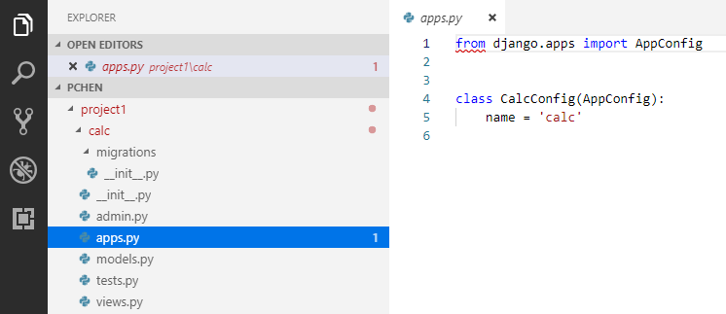
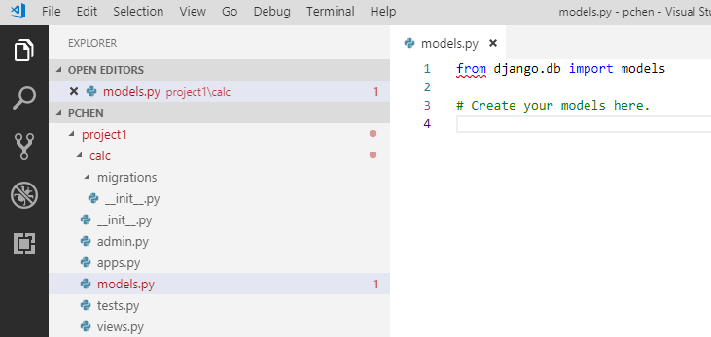
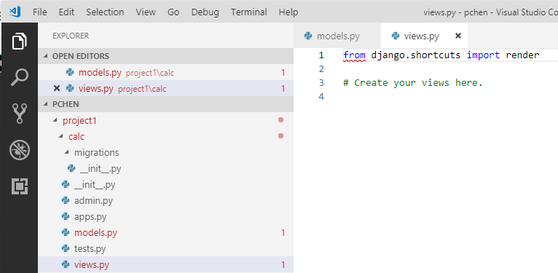
3 First Django App: Part 1
https://www.youtube.com/watch?v=ykpuyNy5oUM&list=PLsyeobzWxl7r2ukVgTqIQcl-1T0C2mzau&index=3
The app folder does not include ‘settings.py’
We have admin.py, apps.py. We have empty models.py, tests.py, and views.py.

Slide 17
End of Chapter

