Slide 1
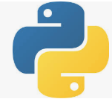
3 First Django App: Part 2
Peter H. Chen

Slide 2
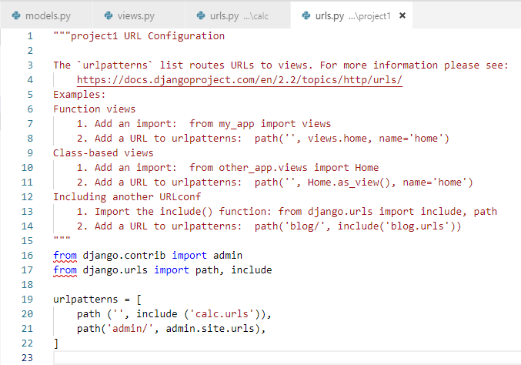
3 First Django App: Part 2
https://www.youtube.com/watch?v=4UMs7DxWn_Q&list=PLsyeobzWxl7r2ukVgTqIQcl-1T0C2mzau&index=4
This project location: C:\Users\14088\projects\pchen\project1
First, add default path for “calc.urls”

Slide 3
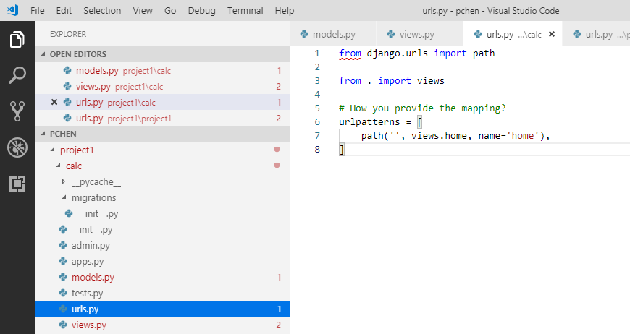
3 First Django App: Part 2
https://www.youtube.com/watch?v=4UMs7DxWn_Q&list=PLsyeobzWxl7r2ukVgTqIQcl-1T0C2mzau&index=4
In app folder, add urlpatterns and views.home

Slide 4
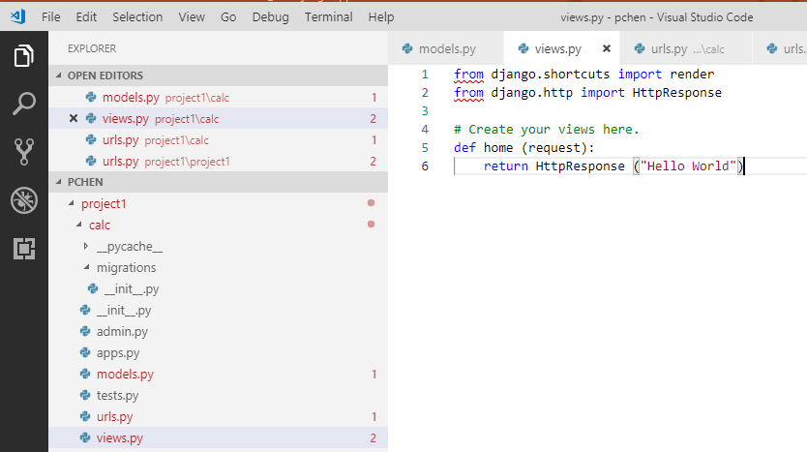
3 First Django App: Part 2
https://www.youtube.com/watch?v=4UMs7DxWn_Q&list=PLsyeobzWxl7r2ukVgTqIQcl-1T0C2mzau&index=4
In app folder, add HttpRespose (“Hello World”)

Slide 5
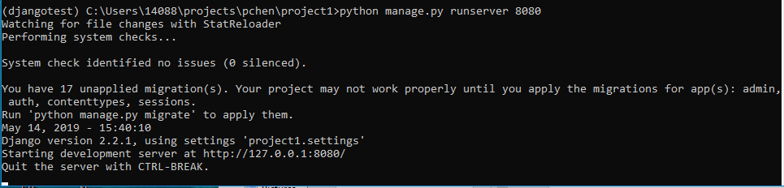
3 First Django App: Part 2
https://www.youtube.com/watch?v=4UMs7DxWn_Q&list=PLsyeobzWxl7r2ukVgTqIQcl-1T0C2mzau&index=4
Restart the server, make sure no compilation error message.

Slide 6
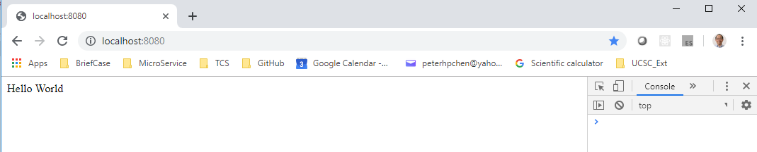
3 First Django App: Part 2
https://www.youtube.com/watch?v=4UMs7DxWn_Q&list=PLsyeobzWxl7r2ukVgTqIQcl-1T0C2mzau&index=4
Open Chrome, enter “localhost:8080”
The “Hello World” is displayed.

Slide 7
End of Chapter

