Slide 1
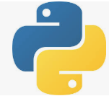
2 Setup Virtual Environment
Peter H. Chen

Slide 2
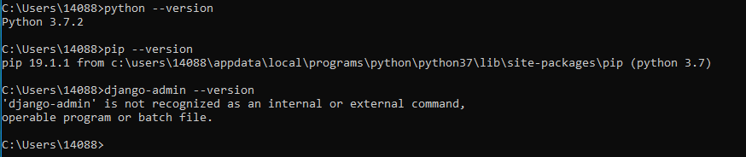
2 Setup Virtual Environment
https://www.youtube.com/watch?v=VuETrwKYLTM&list=PLsyeobzWxl7r2ukVgTqIQcl-1T0C2mzau&index=2
Setup Django for windows.
When you installed the Python, you already have the pip (Python installation package).
> python --version
> pip --version
> django-admin --version

Slide 3
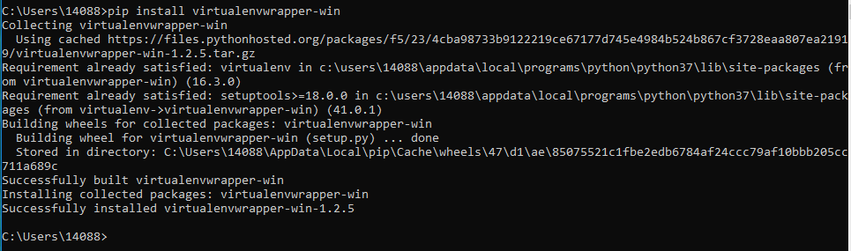
2 Setup Virtual Environment
https://www.youtube.com/watch?v=VuETrwKYLTM&list=PLsyeobzWxl7r2ukVgTqIQcl-1T0C2mzau&index=2
Django provides the virtual environment wrapper (vip).
Install the virtual environment wrapper.
> pip install virtualenvwrapper-win

Slide 4
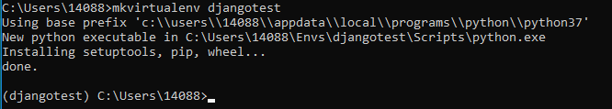
2 Setup Virtual Environment
https://www.youtube.com/watch?v=VuETrwKYLTM&list=PLsyeobzWxl7r2ukVgTqIQcl-1T0C2mzau&index=2
https://virtualenvwrapper.readthedocs.io/en/latest/command_ref.html
Make virtual environment:
> mkvirtualenv djagnotest
…
(djangotest) C:\Users\14088 >

Slide 5

2 Setup Virtual Environment
https://www.youtube.com/watch?v=VuETrwKYLTM&list=PLsyeobzWxl7r2ukVgTqIQcl-1T0C2mzau&index=2
Activate and deactivate the virtual environment djangotest.
After the virtualenv is create, use workon command to change to virtual env:
> workon djangotest
(djangotest) C:\Users\14088>deactivate
C:\User\14088>

Slide 6
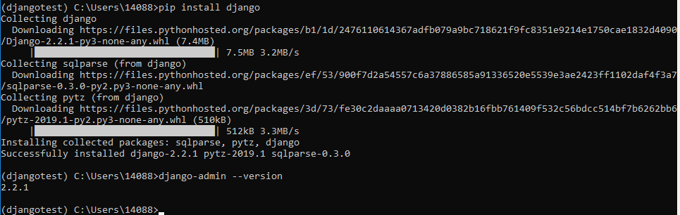
2 Setup Virtual Environment
https://www.youtube.com/watch?v=VuETrwKYLTM&list=PLsyeobzWxl7r2ukVgTqIQcl-1T0C2mzau&index=2
After we got the environment, we have to install the Django under the environment.
(djangotest> C:\Users\14088> pip install Django
You can see Django 2.2 is installed.
> django-admin --version

Slide 7
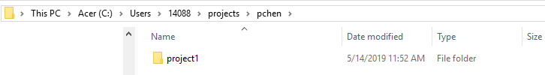
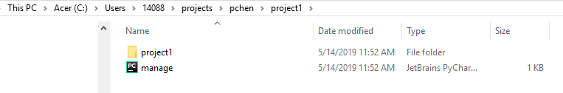
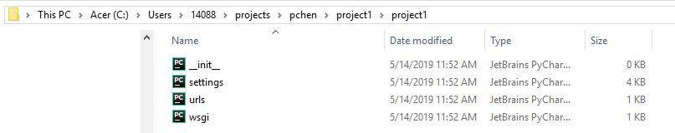
2 Setup Virtual Environment
https://www.youtube.com/watch?v=VuETrwKYLTM&list=PLsyeobzWxl7r2ukVgTqIQcl-1T0C2mzau&index=2
Create project:
> mkdir pchen
> django-admin startproject project1
We have the manage.py in the project1 folder

Slide 8
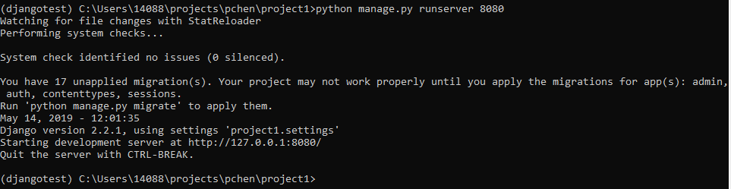
2 Setup Virtual Environment
https://www.youtube.com/watch?v=VuETrwKYLTM&list=PLsyeobzWxl7r2ukVgTqIQcl-1T0C2mzau&index=2
In the project1 folder:
> python manage.py runserver 8080

Slide 9
End of Chapter

