Slide 1
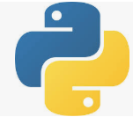
1 Django
Peter H. Chen

Slide 2
1 Django
https://www.youtube.com/watch?v=SIyxjRJ8VNY&list=PLsyeobzWxl7r2ukVgTqIQcl-1T0C2mzau
Django is the web framework for Python.
Django uses MVT (Model View Template) instead of MVC (Model View Controller).
Why use Django?
Fast
Components: All bundle in Django.
Security: Django provides the security.
Scalability: Scale up for more users.

Slide 3
End of Chapter

