Slide 1

6 Upload File to GitHub by Eclipse
Peter H. Chen

Slide 2
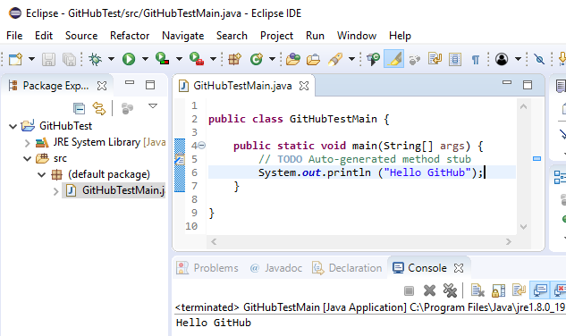
6 Upload File to GitHub by Eclipse
https://www.youtube.com/watch?v=Huwf0TgWrOw&list=PLsyeobzWxl7q2eaUkorLZExfd7qko9sZC&index=7
In this section, we discuss how to upload files into GitHub by Eclipse.
Create Java Project: GitHubTest, Class Name: GitHubTestMain.
We also can use command line to check into the GitHub Server.

Slide 3
6 Upload File to GitHub by Eclipse
https://www.youtube.com/watch?v=Huwf0TgWrOw&list=PLsyeobzWxl7q2eaUkorLZExfd7qko9sZC&index=7
We can use Eclipse, the easy way. We can use Eclipse to push our project to the GitHub.
We will push the Java project “GitHubTest” into the GitHub. The project contains one file GitHubTestMain.java. It does not matter how much codes you have.

Slide 4
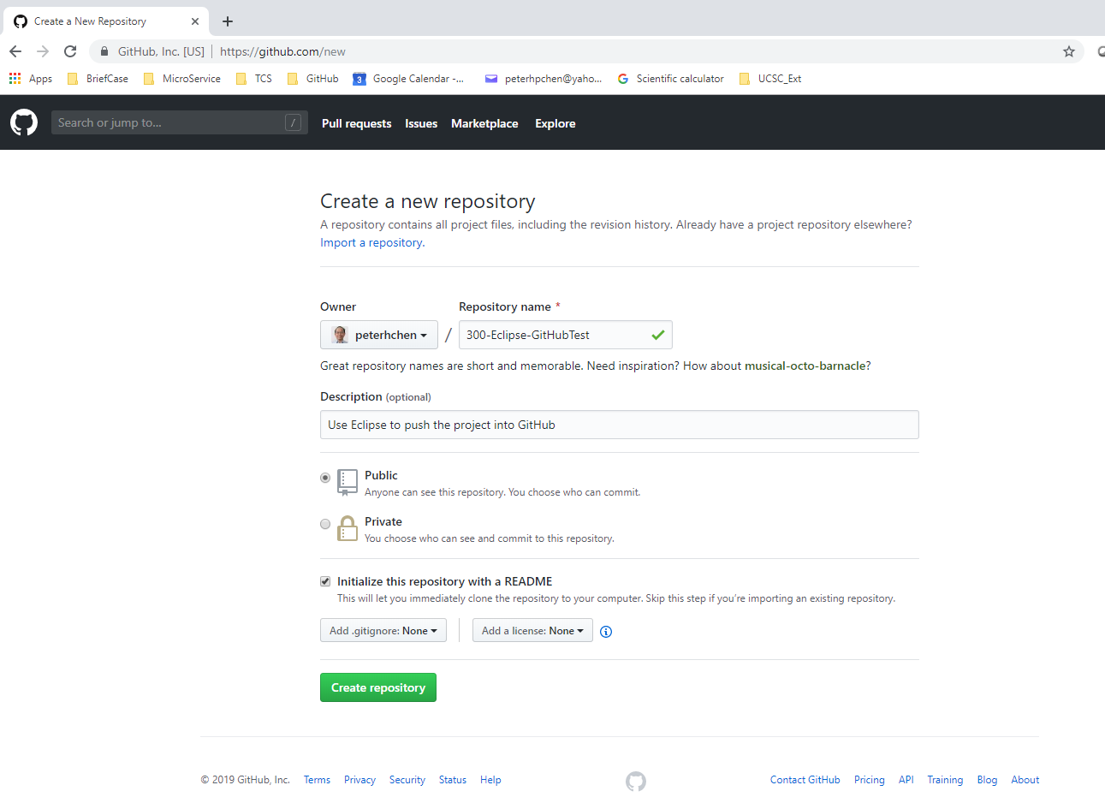
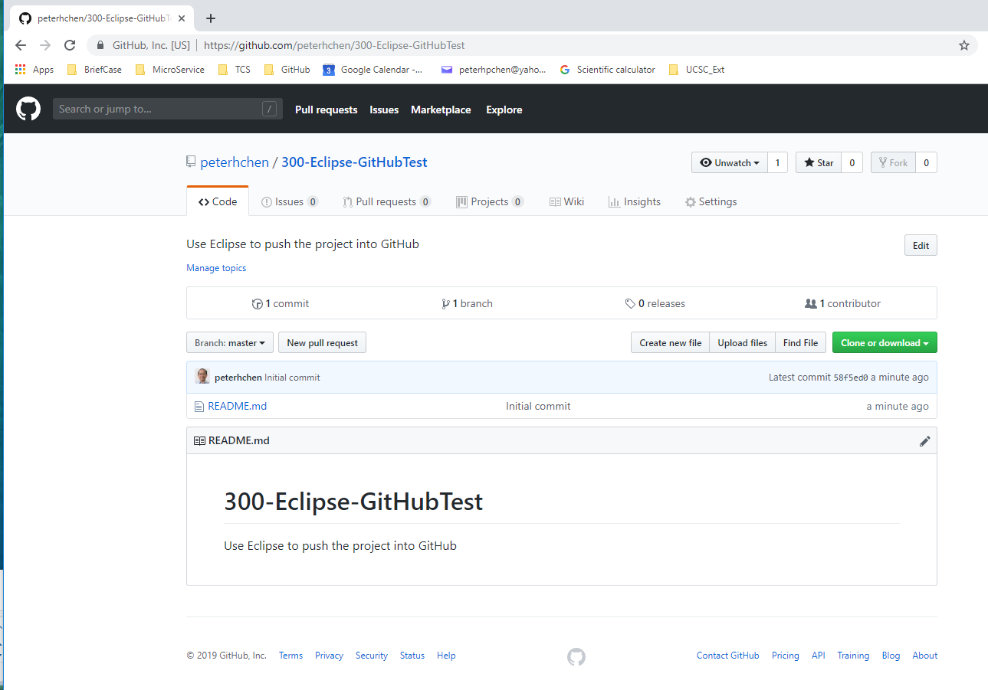
6 Upload File to GitHub by Eclipse
https://www.youtube.com/watch?v=Huwf0TgWrOw&list=PLsyeobzWxl7q2eaUkorLZExfd7qko9sZC&index=7
Create a new repository “300-Eclipse-GitHubTest” on GitHub.

Slide 5
6.1 Create Local Repository

Slide 6
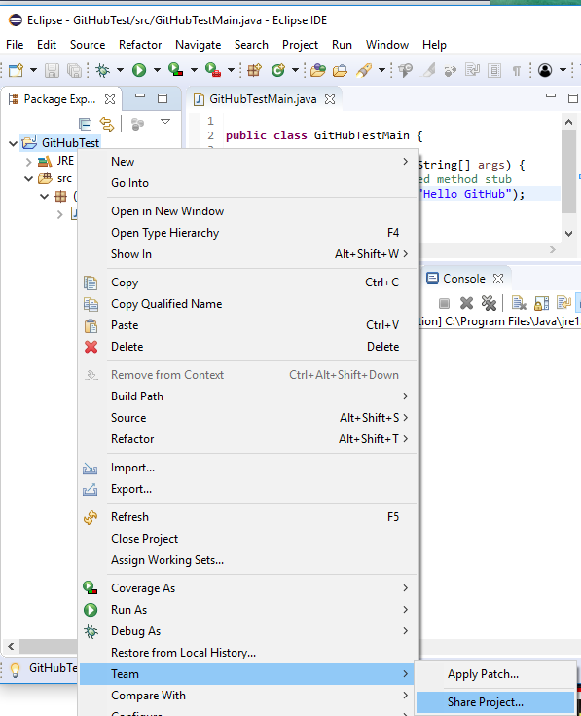
6.1 Create Local Repository
https://www.youtube.com/watch?v=Huwf0TgWrOw&list=PLsyeobzWxl7q2eaUkorLZExfd7qko9sZC&index=7
In the Eclipse, click Project Name: “GitHubTest” > Team > Share Project …
Put your project on the local repository. You need to install the git for your local repository.

Slide 7
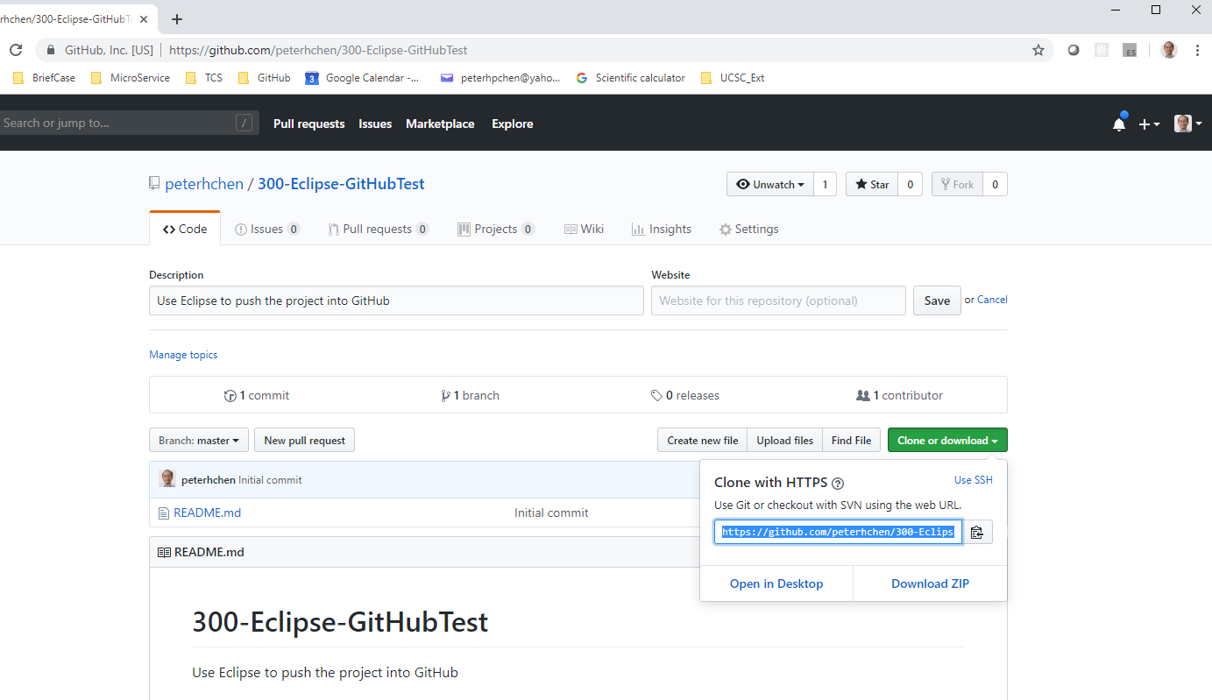
6.1 Create Local Repository
https://www.youtube.com/watch?v=Huwf0TgWrOw&list=PLsyeobzWxl7q2eaUkorLZExfd7qko9sZC&index=7
Get the link of repository “https://github.com/peterhchen/300-Eclipse-GitHubTest.git”

Slide 8
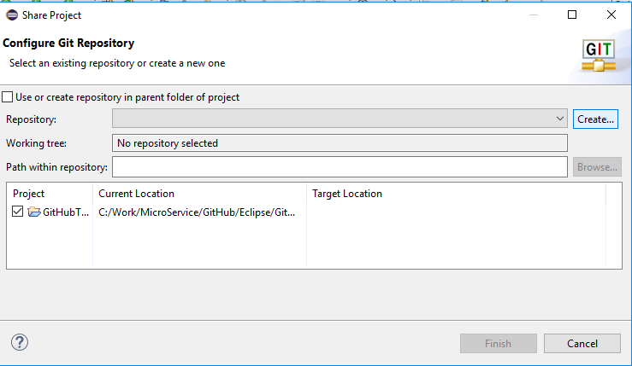
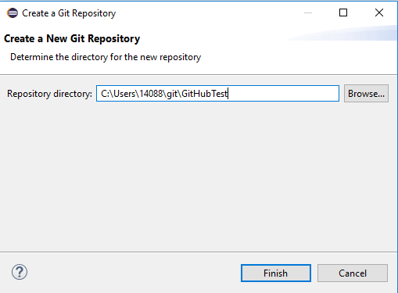
6.1 Create Local Repository
https://www.youtube.com/watch?v=Huwf0TgWrOw&list=PLsyeobzWxl7q2eaUkorLZExfd7qko9sZC&index=7
Click “Create…” to create local repository.
Give the name of local repository “GitHubTest”.

Slide 9
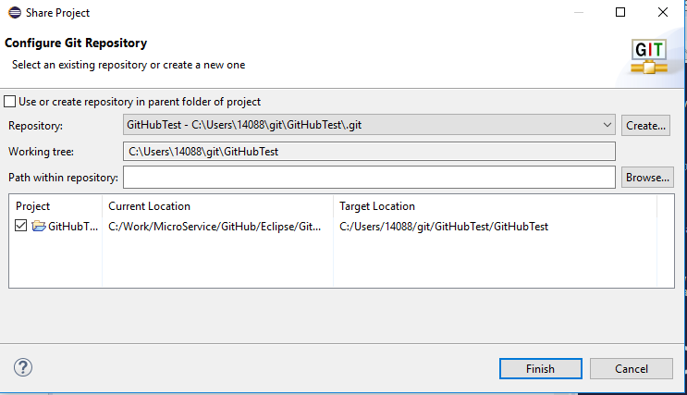
6.1 Create Local Repository
https://www.youtube.com/watch?v=Huwf0TgWrOw&list=PLsyeobzWxl7q2eaUkorLZExfd7qko9sZC&index=7
The local Git repository is “C:\Users\14088\git\GitHubTest\.git”.

Slide 10
6.2 Commit Project to Local Repository

Slide 11
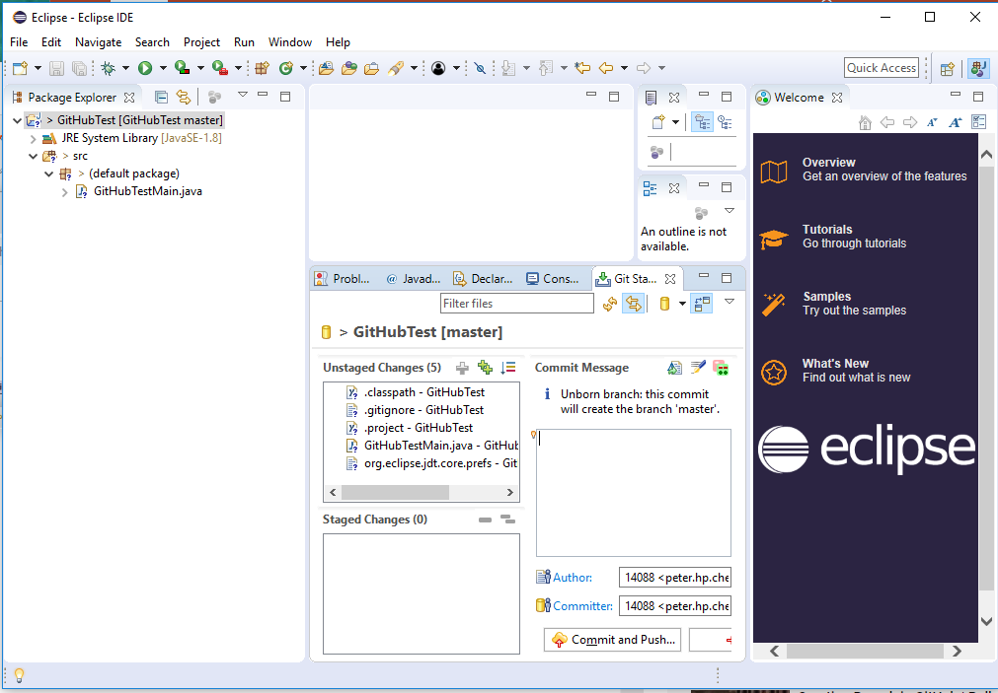
6.2 Commit Project to Local Repository
https://www.youtube.com/watch?v=Huwf0TgWrOw&list=PLsyeobzWxl7q2eaUkorLZExfd7qko9sZC&index=7
Select Project: GitHubTest > Team > Commit …

Slide 12
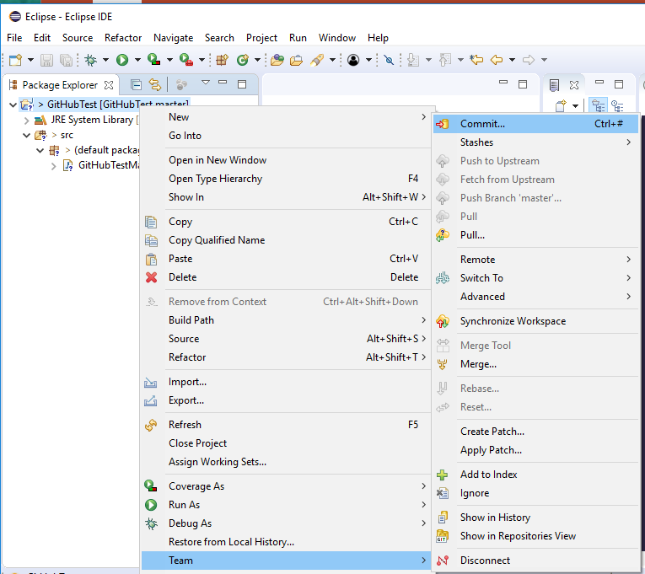
6.2 Commit Project to Local Repository
https://www.youtube.com/watch?v=Huwf0TgWrOw&list=PLsyeobzWxl7q2eaUkorLZExfd7qko9sZC&index=7
Select Project: GitHubTest > Team > Commit …

Slide 13
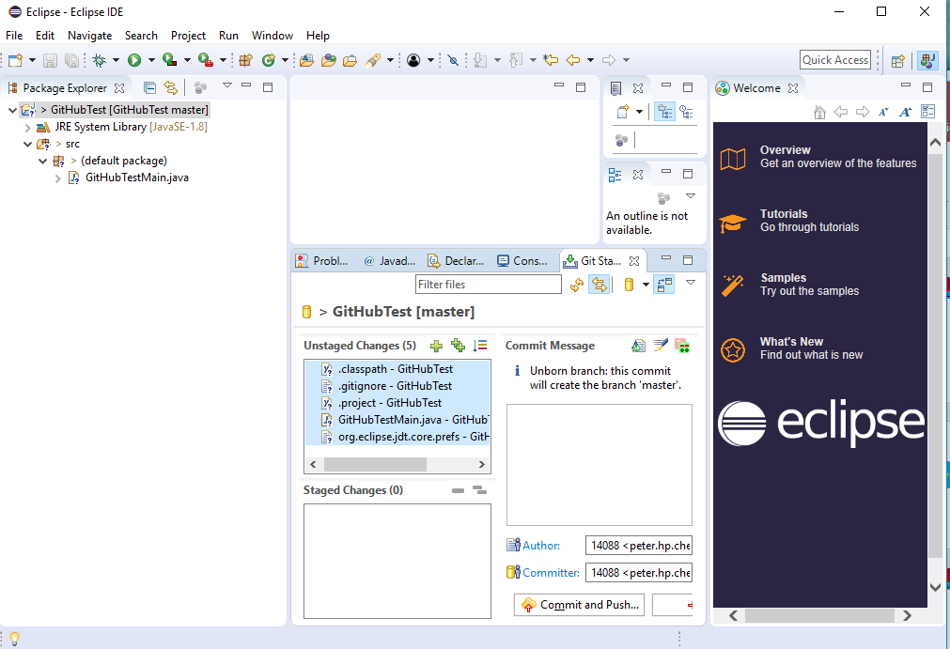
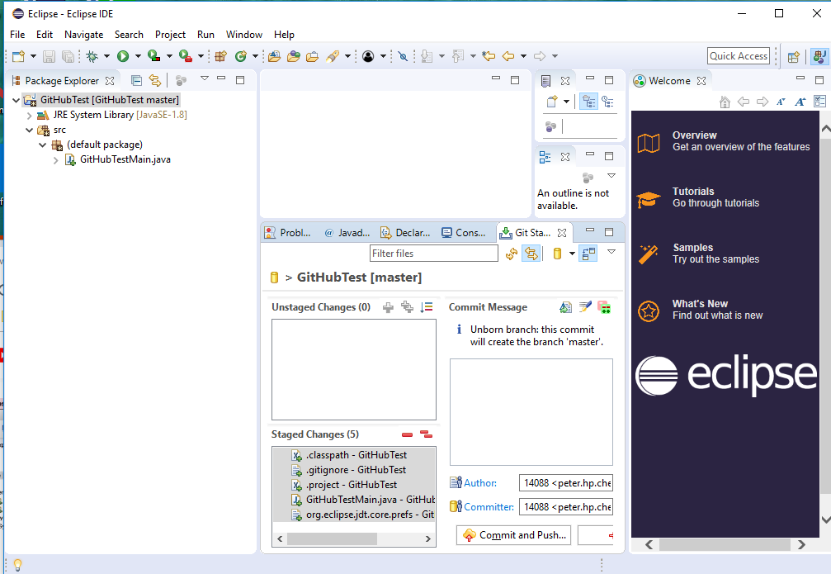
6.2 Commit Project to Local Repository
https://www.youtube.com/watch?v=Huwf0TgWrOw&list=PLsyeobzWxl7q2eaUkorLZExfd7qko9sZC&index=7
Select all the files to commit.
Drag-and-drop from “Unstaged Changes” into “Staged Changes” area.

Slide 14
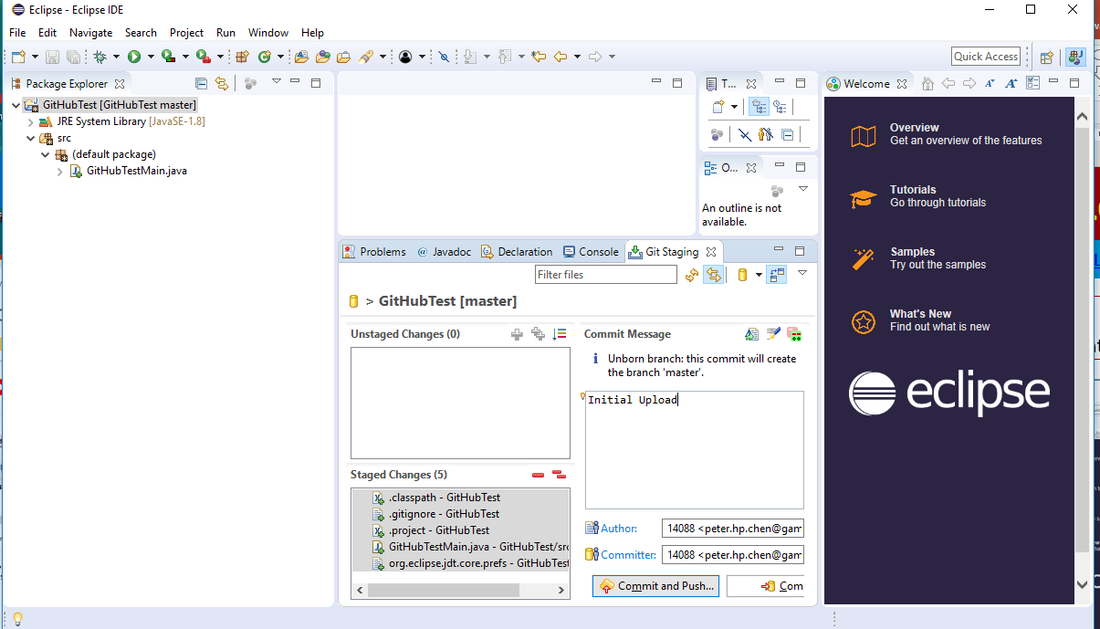
6.2 Commit Project to Local Repository
https://www.youtube.com/watch?v=Huwf0TgWrOw&list=PLsyeobzWxl7q2eaUkorLZExfd7qko9sZC&index=7
Type in log “Initial Uploaded”
Click “Commit and Push” button.

Slide 15
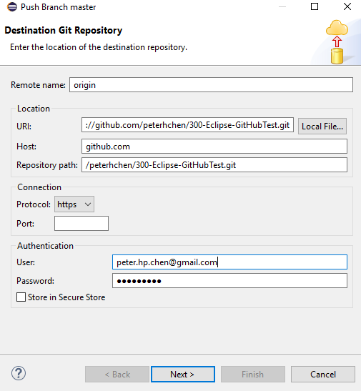
6.2 Commit Project to Local Repository
https://www.youtube.com/watch?v=Huwf0TgWrOw&list=PLsyeobzWxl7q2eaUkorLZExfd7qko9sZC&index=7
Copy the GitHub URI: https://github.com/peterhchen/300-Eclipse-GitHubTest.git
User name: peter.hp.chen@gamil.com, password: PCxxxx=xx

Slide 16
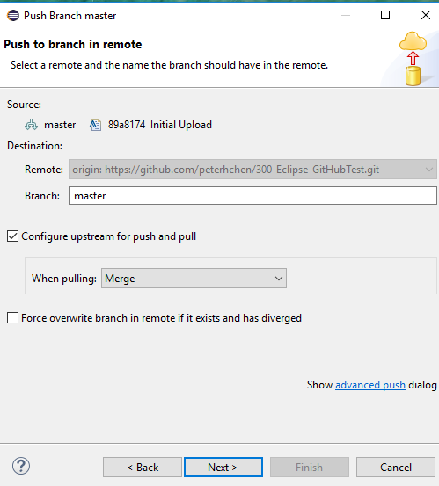
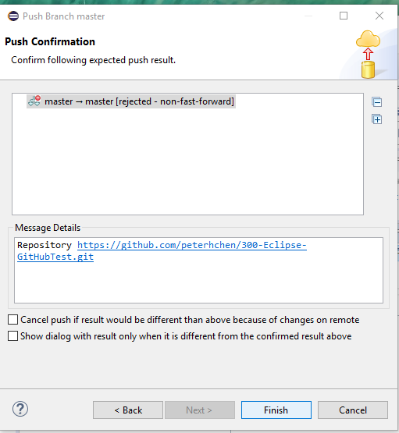
6.2 Commit Project to Local Repository
https://www.youtube.com/watch?v=Huwf0TgWrOw&list=PLsyeobzWxl7q2eaUkorLZExfd7qko9sZC&index=7
Branch: Master
There is an error message that does not allowed.

Slide 17
End of Chapter

