Slide 1

4 Branch and Pull Request/Merge
Peter H. Chen

Slide 2
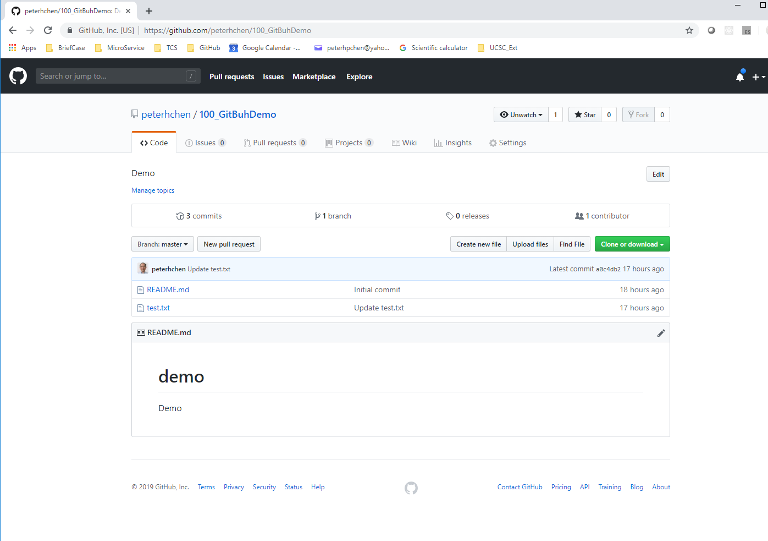
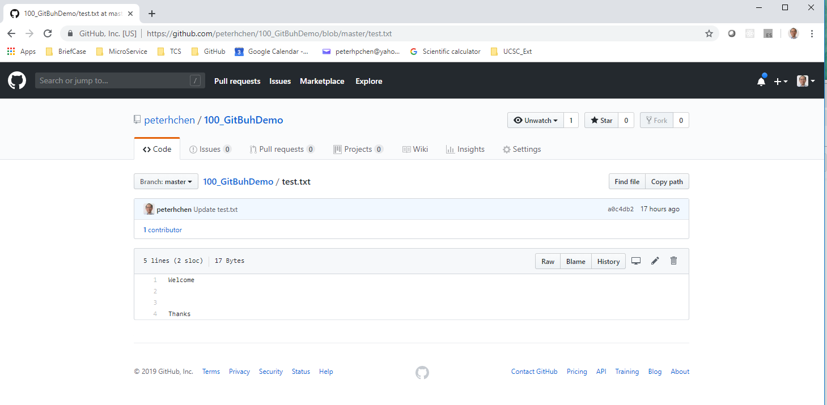
4 Branch and Pull Request/Merge
https://www.youtube.com/watch?v=OVQK2zzb6U8&list=PLsyeobzWxl7q2eaUkorLZExfd7qko9sZC&index=5
We have test.txt file here. It is a text file with several lines inside.
Double click “test.txt” to check the file content. We would like to add some more descriptions.

Slide 3
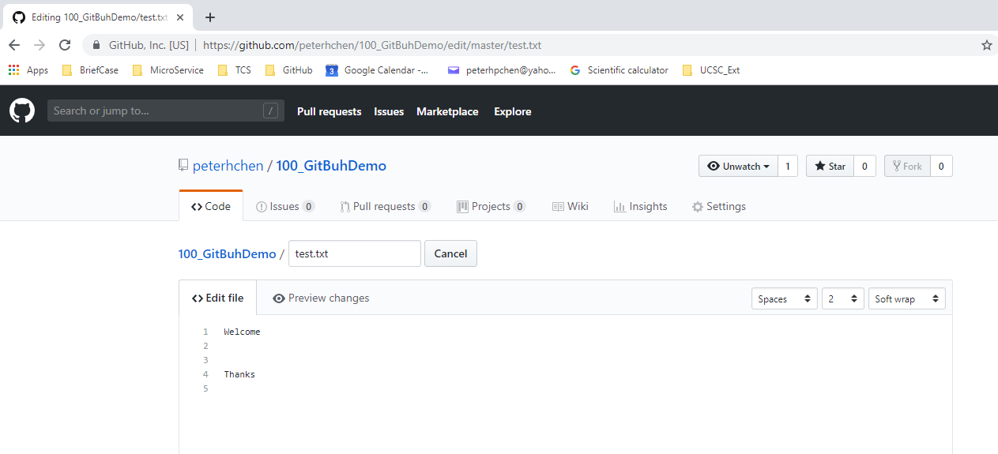
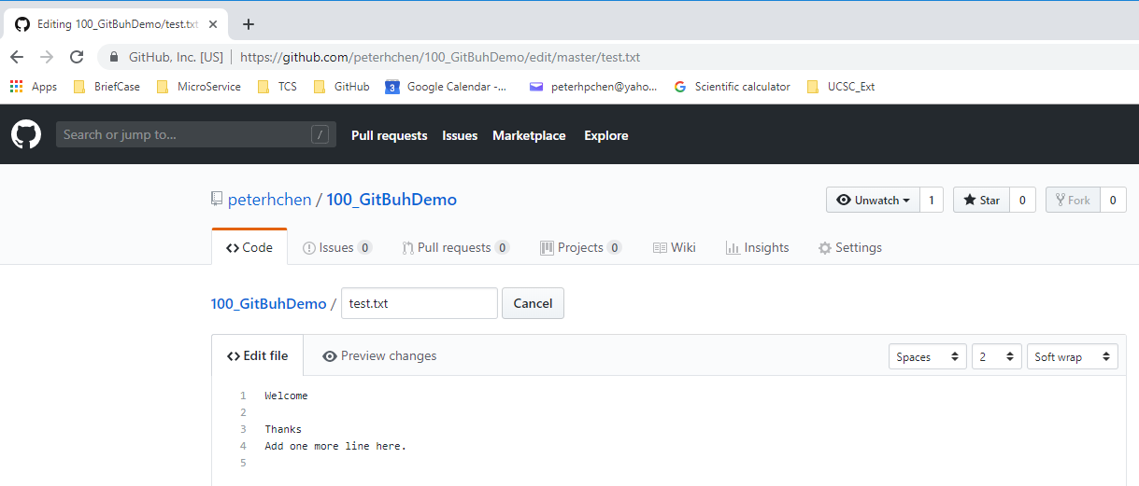
4 Branch and Pull Request/Merge
https://www.youtube.com/watch?v=OVQK2zzb6U8&list=PLsyeobzWxl7q2eaUkorLZExfd7qko9sZC&index=5
Click “Edit” logo to edit the file content.
Type “Add one line here”

Slide 4
4.1 Branch

Slide 5
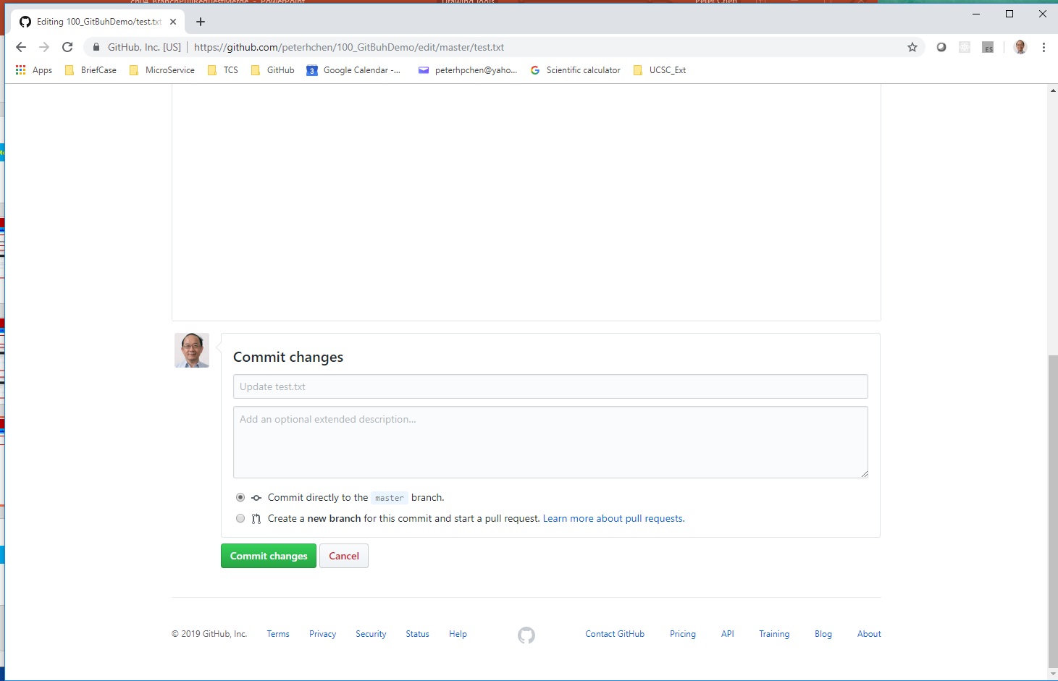
4.1 Branch
https://www.youtube.com/watch?v=OVQK2zzb6U8&list=PLsyeobzWxl7q2eaUkorLZExfd7qko9sZC&index=5
After modified, scroll down page to see the commit button.
There are two choices: The default choice is “Commit directly to master branch.”
The second choice is “Create a new branch for this commit and start a pull request.”

Slide 6
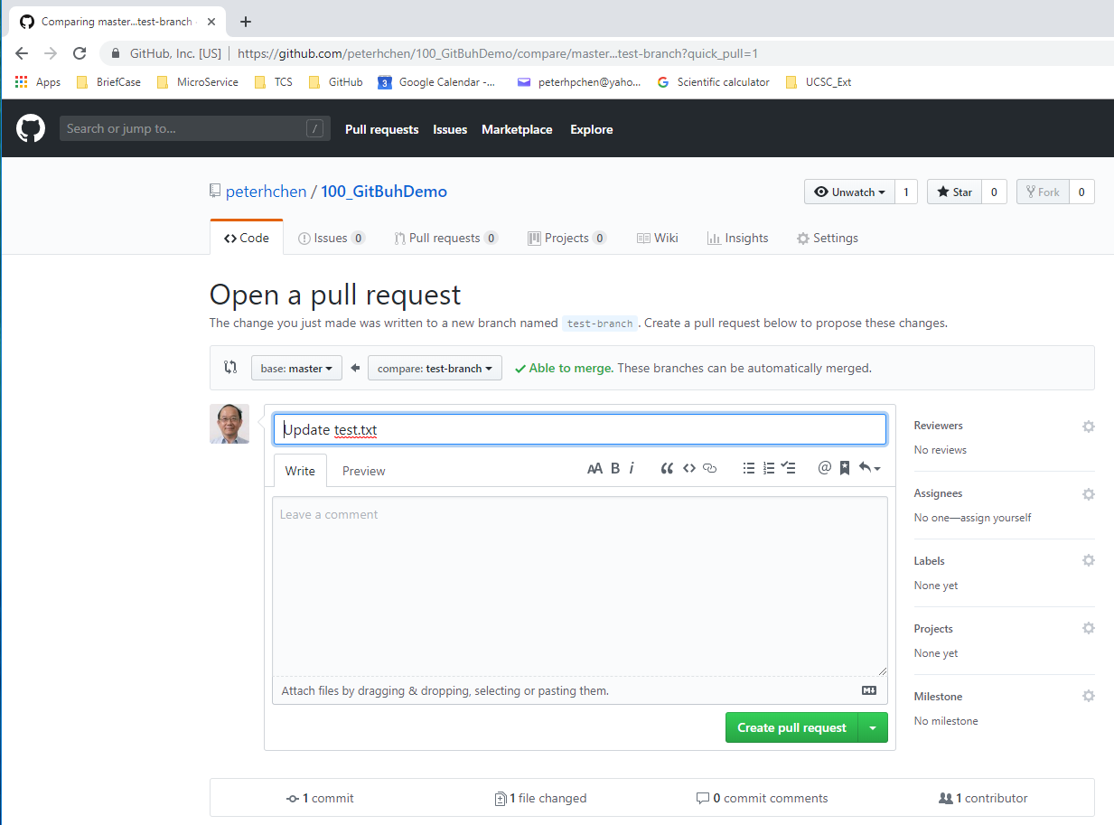
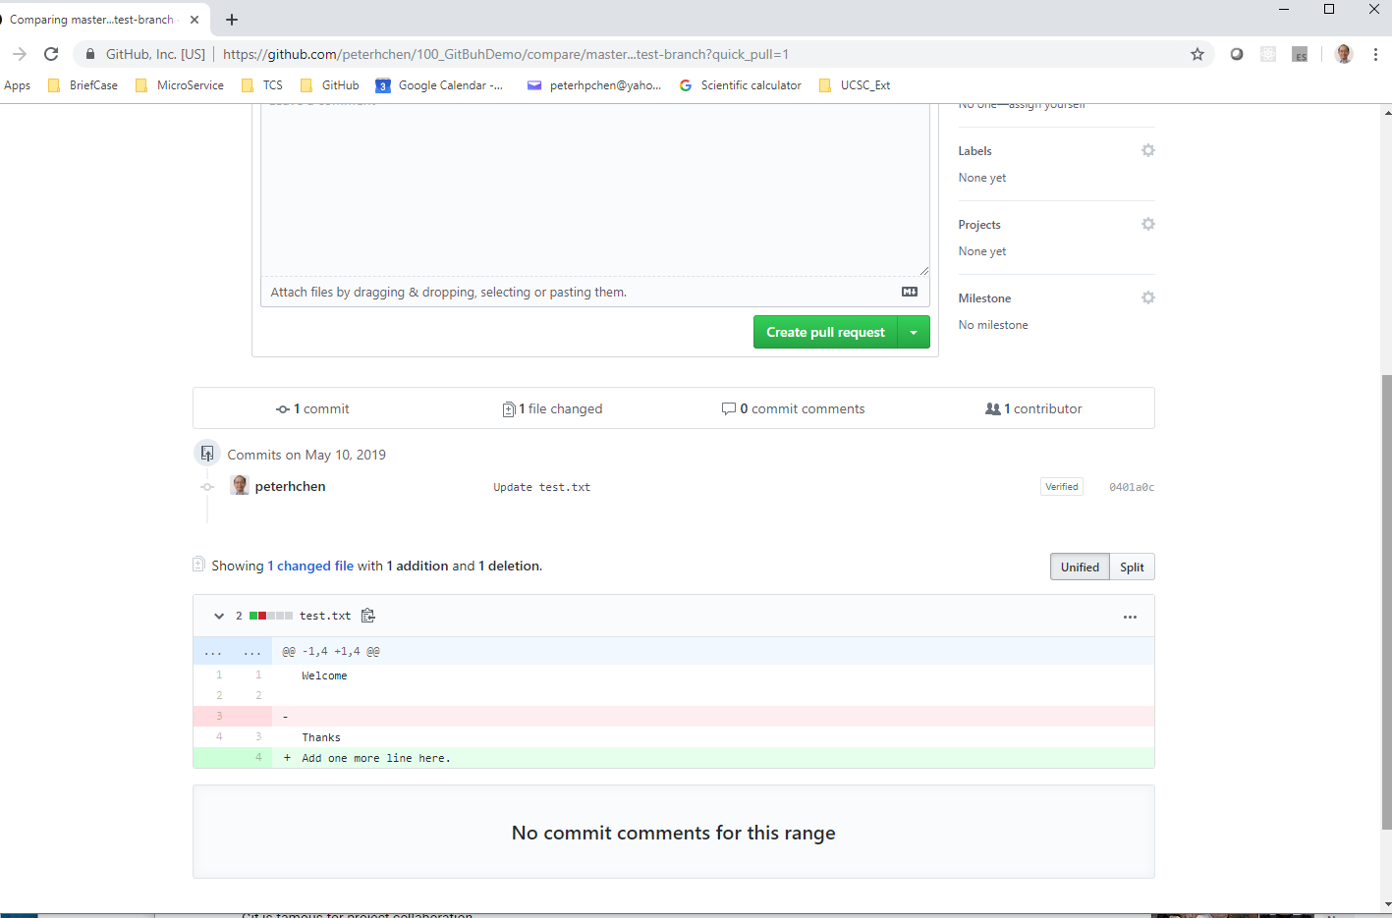
4.1 Branch
https://www.youtube.com/watch?v=OVQK2zzb6U8&list=PLsyeobzWxl7q2eaUkorLZExfd7qko9sZC&index=5
Now, you can see the new branch created.
Scroll the page to see the modification.

Slide 7
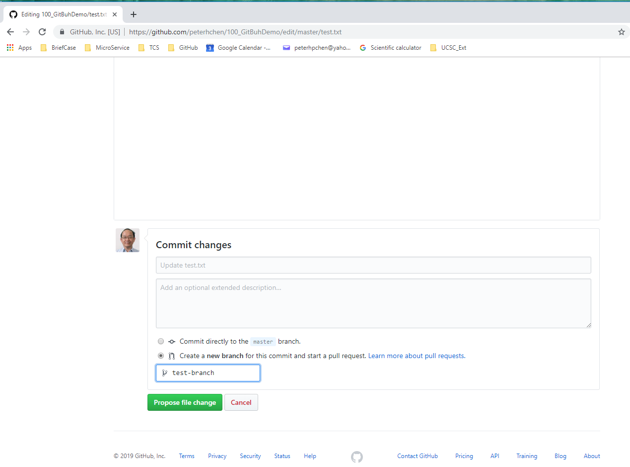
4.1 Branch
https://www.youtube.com/watch?v=OVQK2zzb6U8&list=PLsyeobzWxl7q2eaUkorLZExfd7qko9sZC&index=5
Click the second choice “Create a new branch for this commit and start a pull request.” and give branch name “test-branch”.
Click “Propose file change” button.

Slide 8
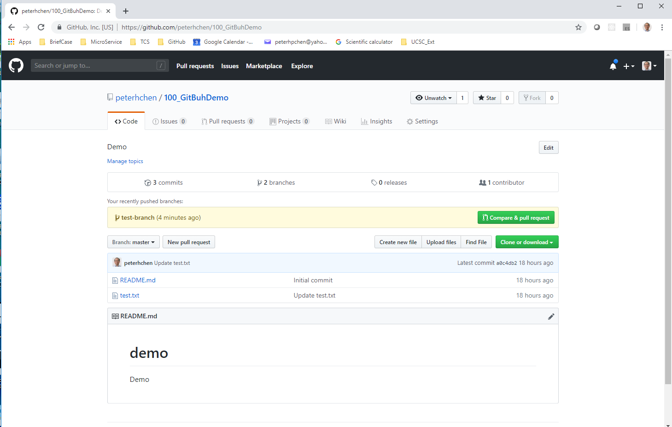
4.1 Branch
https://www.youtube.com/watch?v=OVQK2zzb6U8&list=PLsyeobzWxl7q2eaUkorLZExfd7qko9sZC&index=5
Click the “Code” tab, we can see there is a new branch called “test-branch”

Slide 9
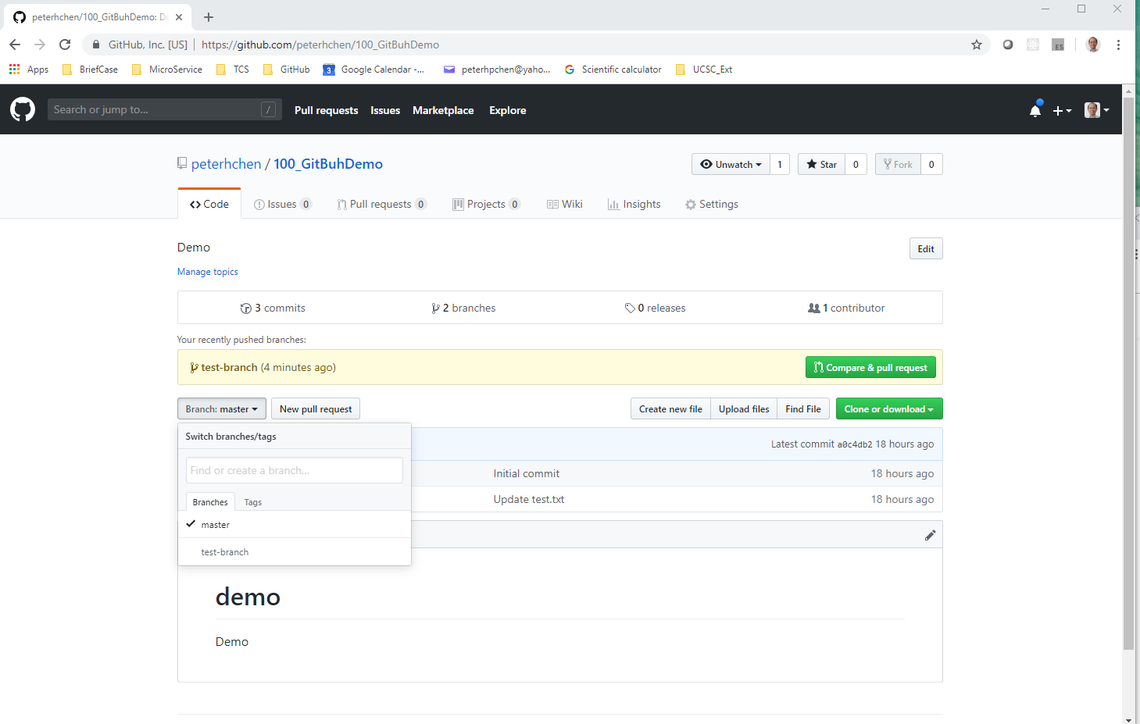
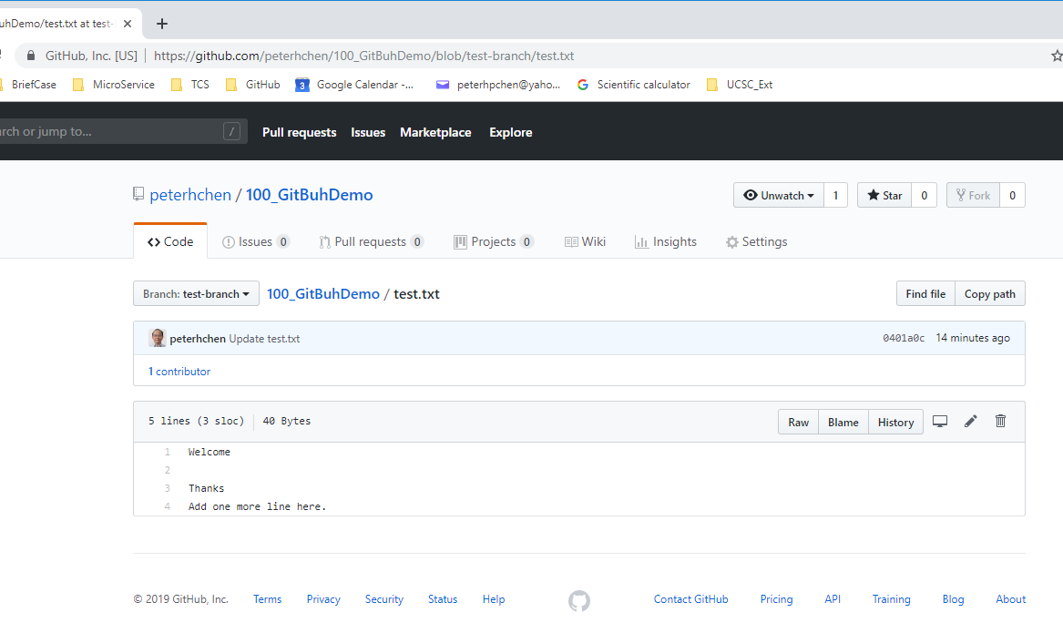
4.1 Branch
https://www.youtube.com/watch?v=OVQK2zzb6U8&list=PLsyeobzWxl7q2eaUkorLZExfd7qko9sZC&index=5
Click the “Branch Master” selection button, we can see there is a “master” branch and “test-branch”.
Select the “test-branch”.

Slide 10
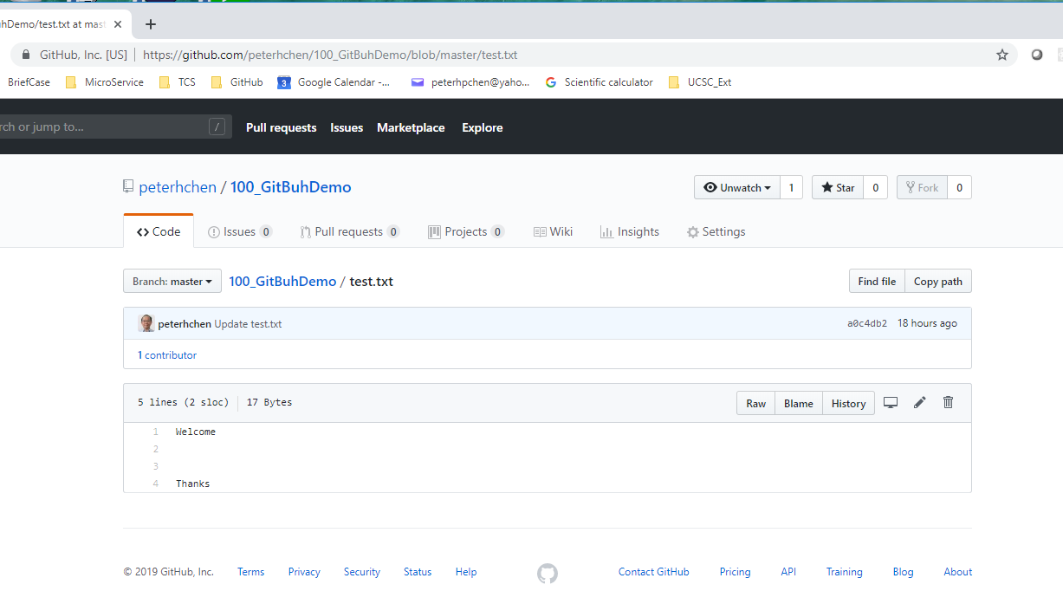
4.1 Branch
https://www.youtube.com/watch?v=OVQK2zzb6U8&list=PLsyeobzWxl7q2eaUkorLZExfd7qko9sZC&index=5
Select “master” branch and the “test-branch”.
Check the difference of file content between the master and test-branch.

Slide 11
4.2 Pull Request/Merge

Slide 12
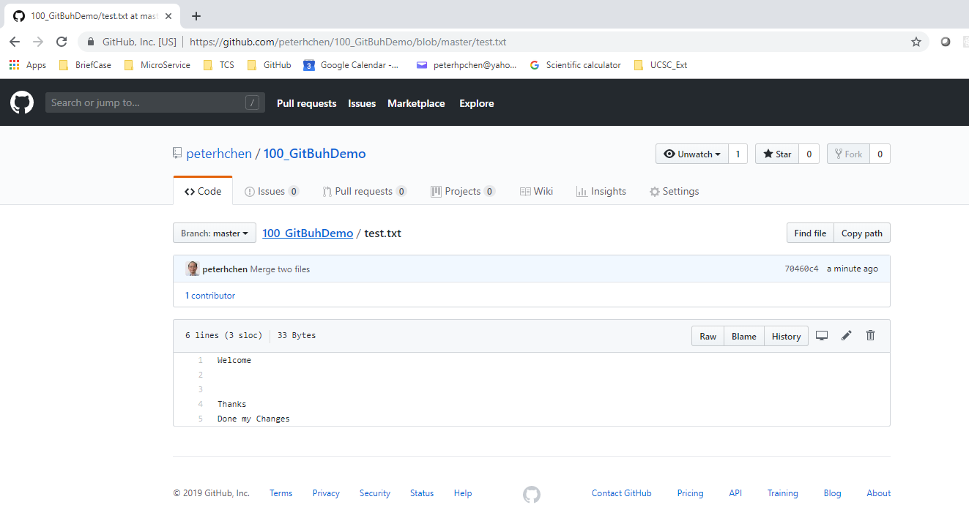
4.2 Pull Request/Merge
https://www.youtube.com/watch?v=OVQK2zzb6U8&list=PLsyeobzWxl7q2eaUkorLZExfd7qko9sZC&index=5
Now, we have “master” branch and “test-branch”.
We need to merge “master” branch and “test-branch”.
We have to find the merge page with “Compare & pull request”.
Click “100_GitHubDemo”

Slide 13
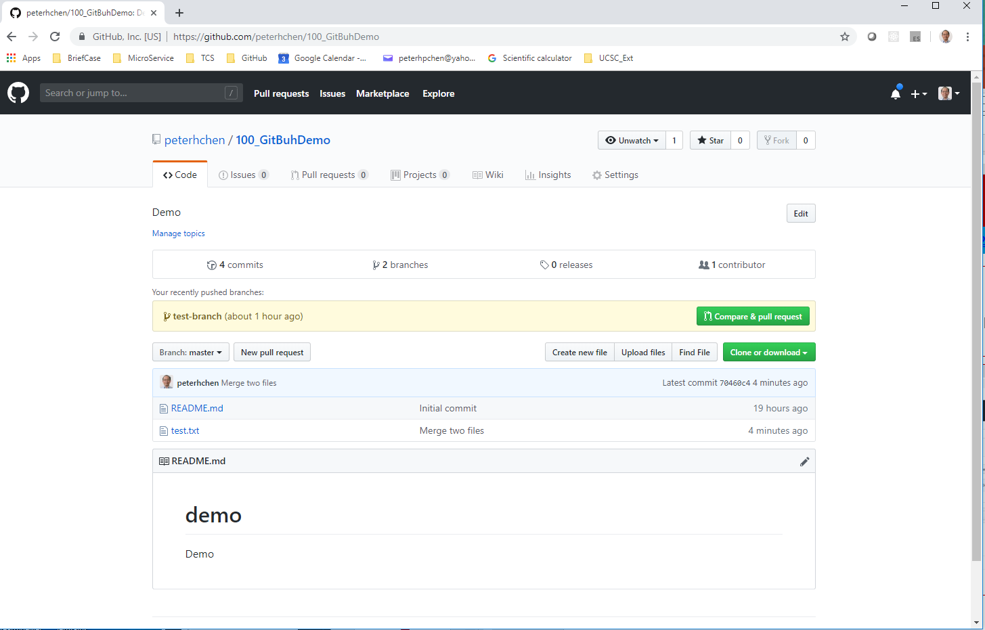
4.2 Pull Request/Merge
https://www.youtube.com/watch?v=OVQK2zzb6U8&list=PLsyeobzWxl7q2eaUkorLZExfd7qko9sZC&index=5
Click “Compare & pull request”

Slide 14
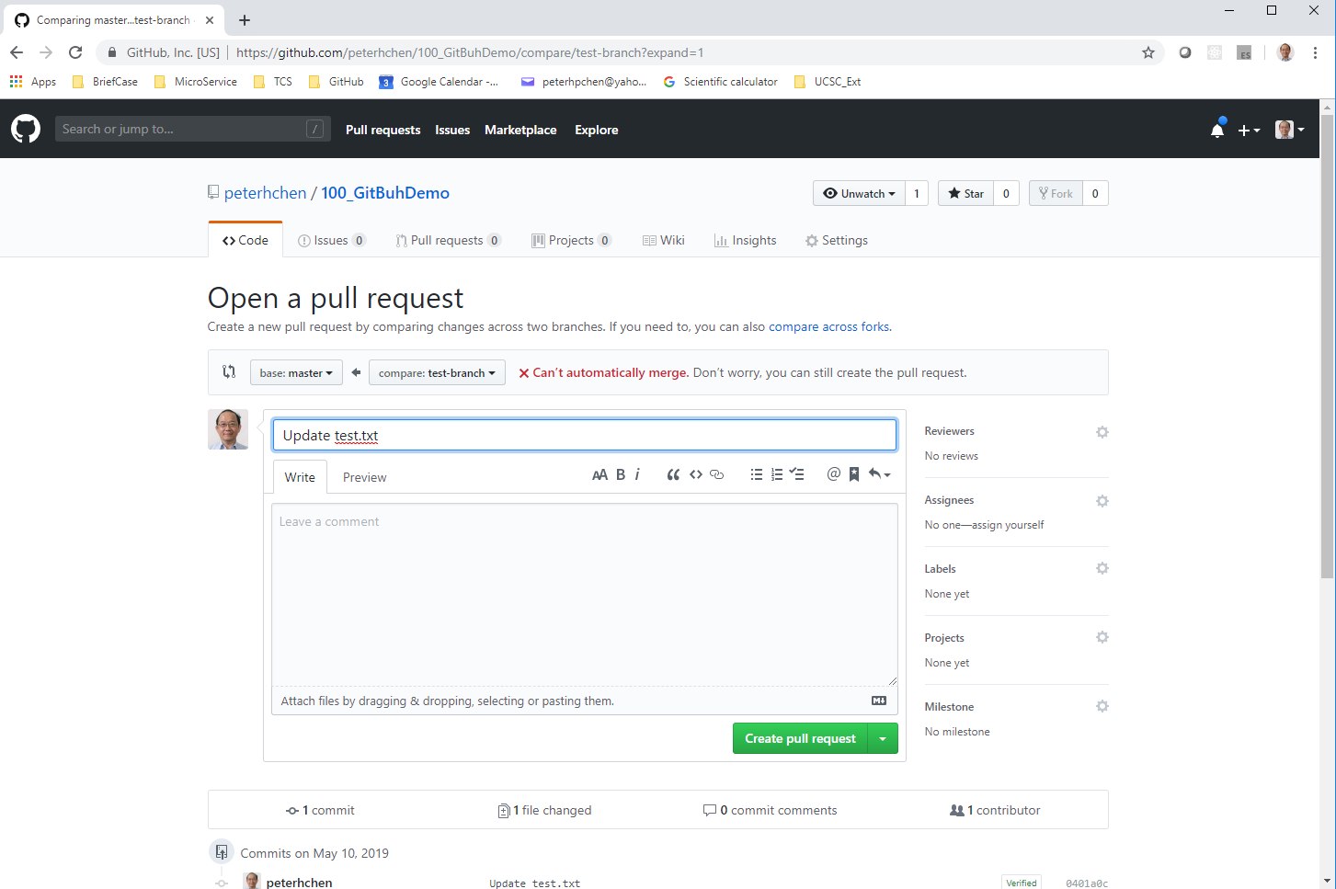
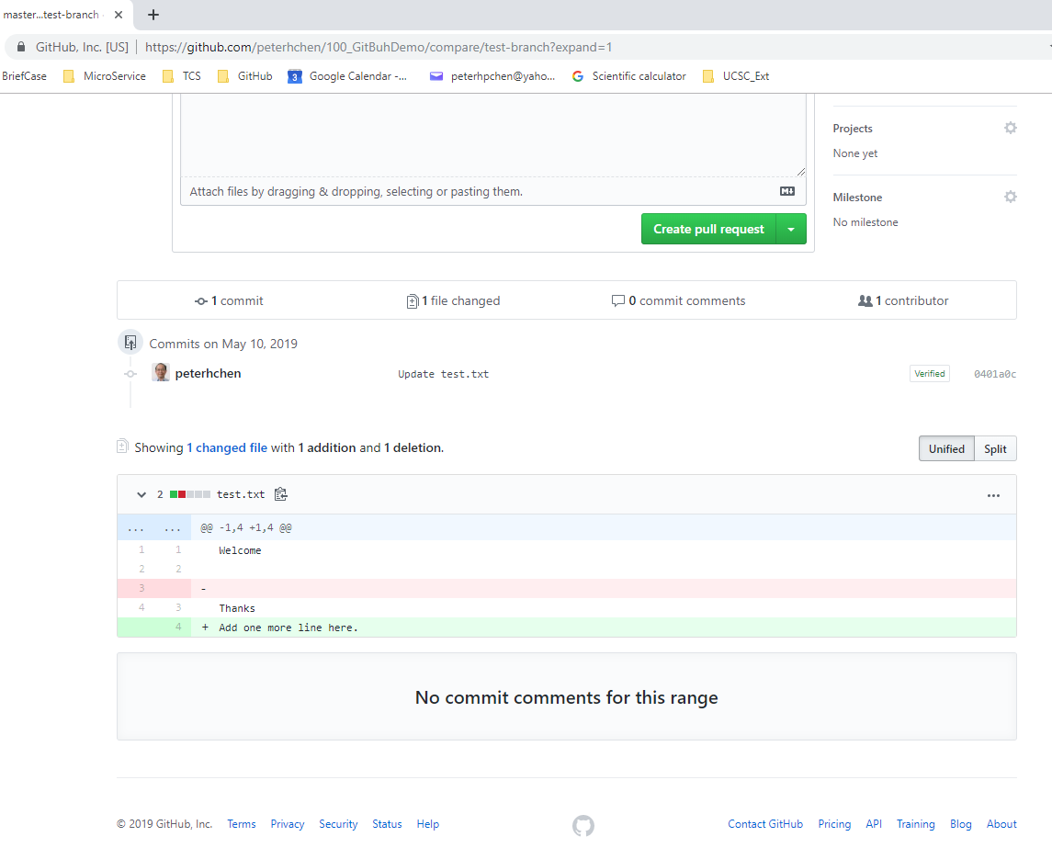
4.2 Pull Request/Merge
https://www.youtube.com/watch?v=OVQK2zzb6U8&list=PLsyeobzWxl7q2eaUkorLZExfd7qko9sZC&index=5
We have to send a “pull request” and merge the test-branch into the master branch.
You can see the message “Can’t automatically merge”, normally, it happens because we have some conflict. Scroll down the page to see the conflict.

Slide 15
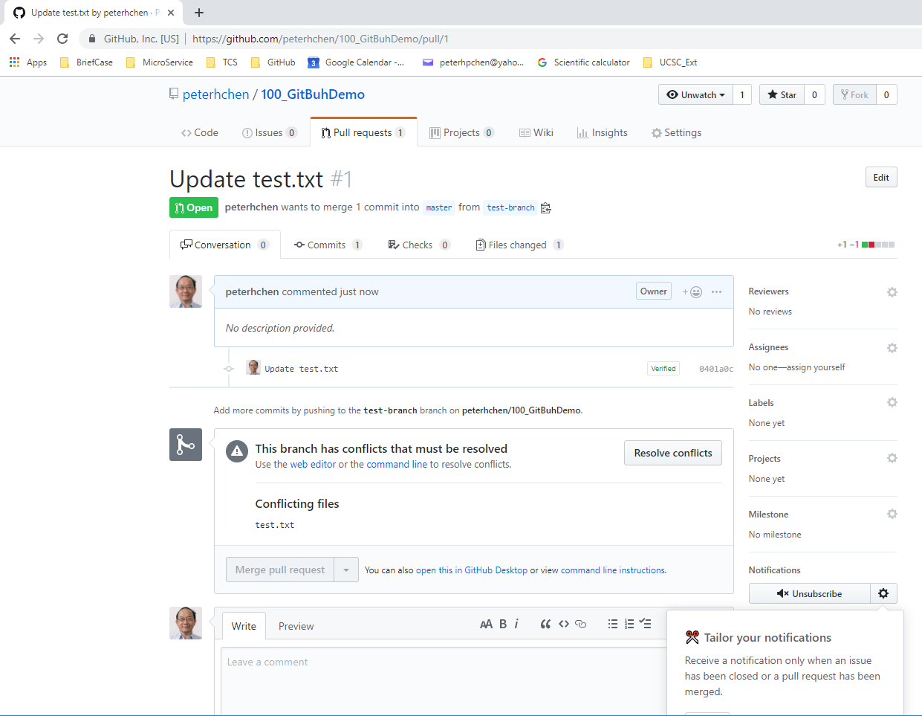
4.2 Pull Request/Merge
https://www.youtube.com/watch?v=OVQK2zzb6U8&list=PLsyeobzWxl7q2eaUkorLZExfd7qko9sZC&index=5
Click “Create pull request” button.
You can see “This branch has conflicts that must be resolved”.

Slide 16
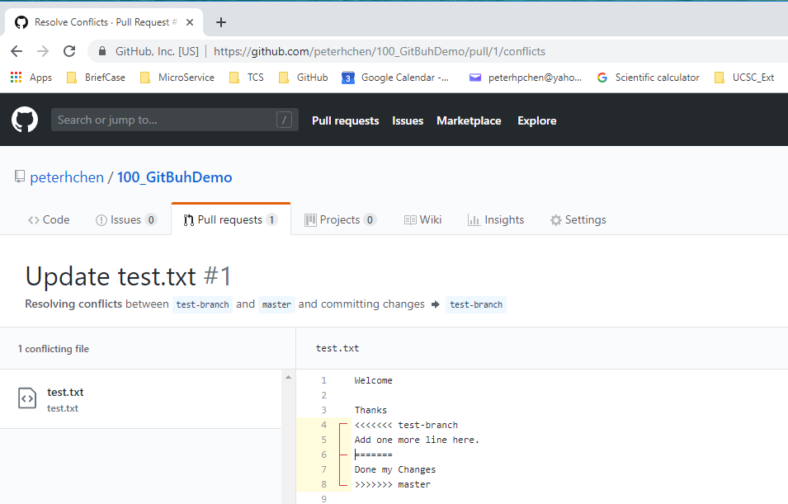
4.2 Pull Request/Merge
https://www.youtube.com/watch?v=OVQK2zzb6U8&list=PLsyeobzWxl7q2eaUkorLZExfd7qko9sZC&index=5
Click “Resolve conflicts” button.
This need to resolve by human now.

Slide 17
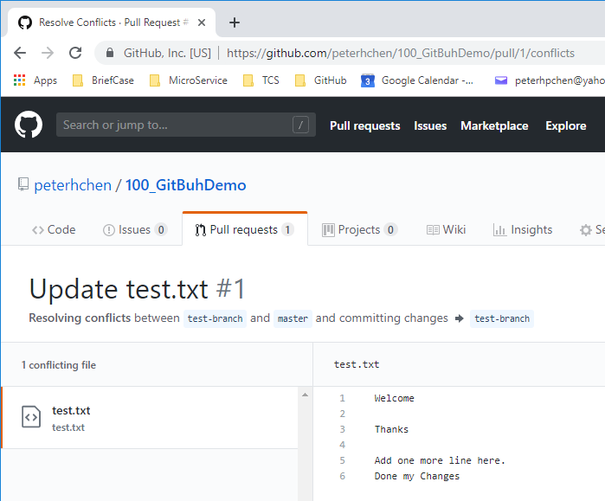
4.2 Pull Request/Merge
https://www.youtube.com/watch?v=OVQK2zzb6U8&list=PLsyeobzWxl7q2eaUkorLZExfd7qko9sZC&index=5
We have one part came from test-branch with (<<<<) and the other part came from master branch with (>>>>). These two parts are separated by a separator “=====“.
We can remove “<<<<< test-branch”, “=======“, and “>>>> master”
This part came from test_branch
This part came from master branch

Slide 18
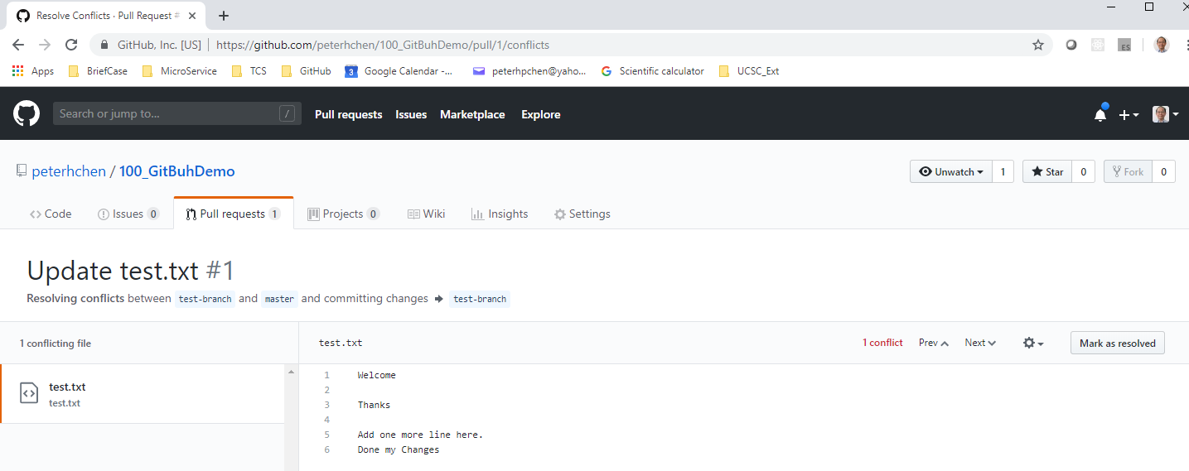
4.2 Pull Request/Merge
https://www.youtube.com/watch?v=OVQK2zzb6U8&list=PLsyeobzWxl7q2eaUkorLZExfd7qko9sZC&index=5
Once we done with the conflicts, we can click “mark as resolved” button.

Slide 19
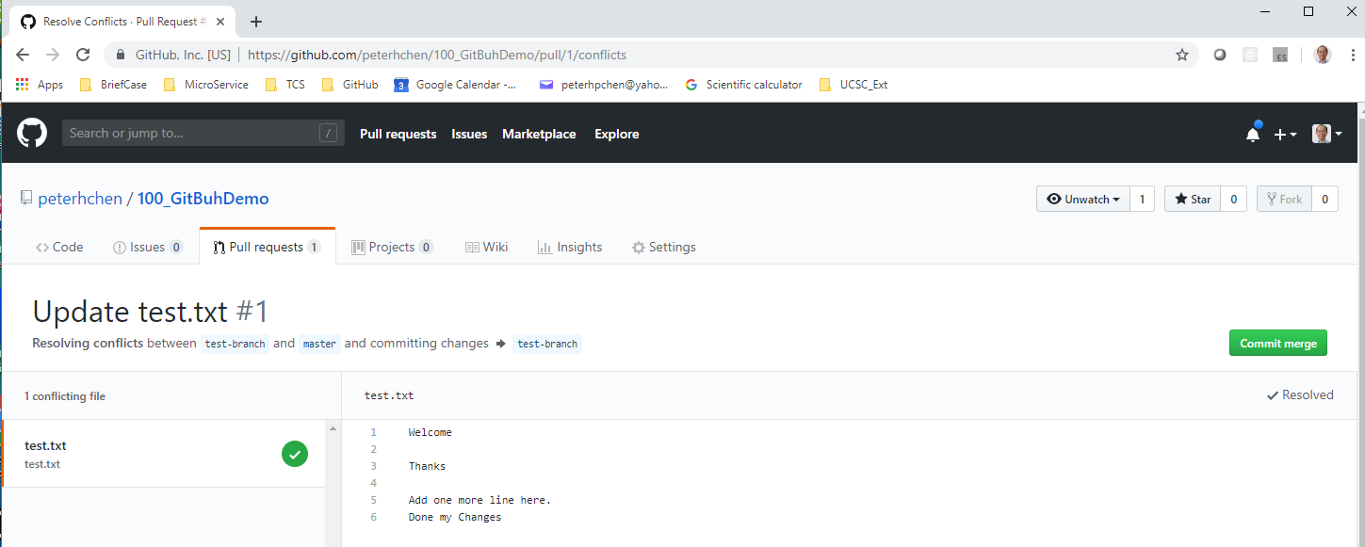
4.2 Pull Request/Merge
https://www.youtube.com/watch?v=OVQK2zzb6U8&list=PLsyeobzWxl7q2eaUkorLZExfd7qko9sZC&index=5
This is how we combine two files.
Now, we click “Commit merge”.
These two features are going to merge into the master branch.

Slide 20
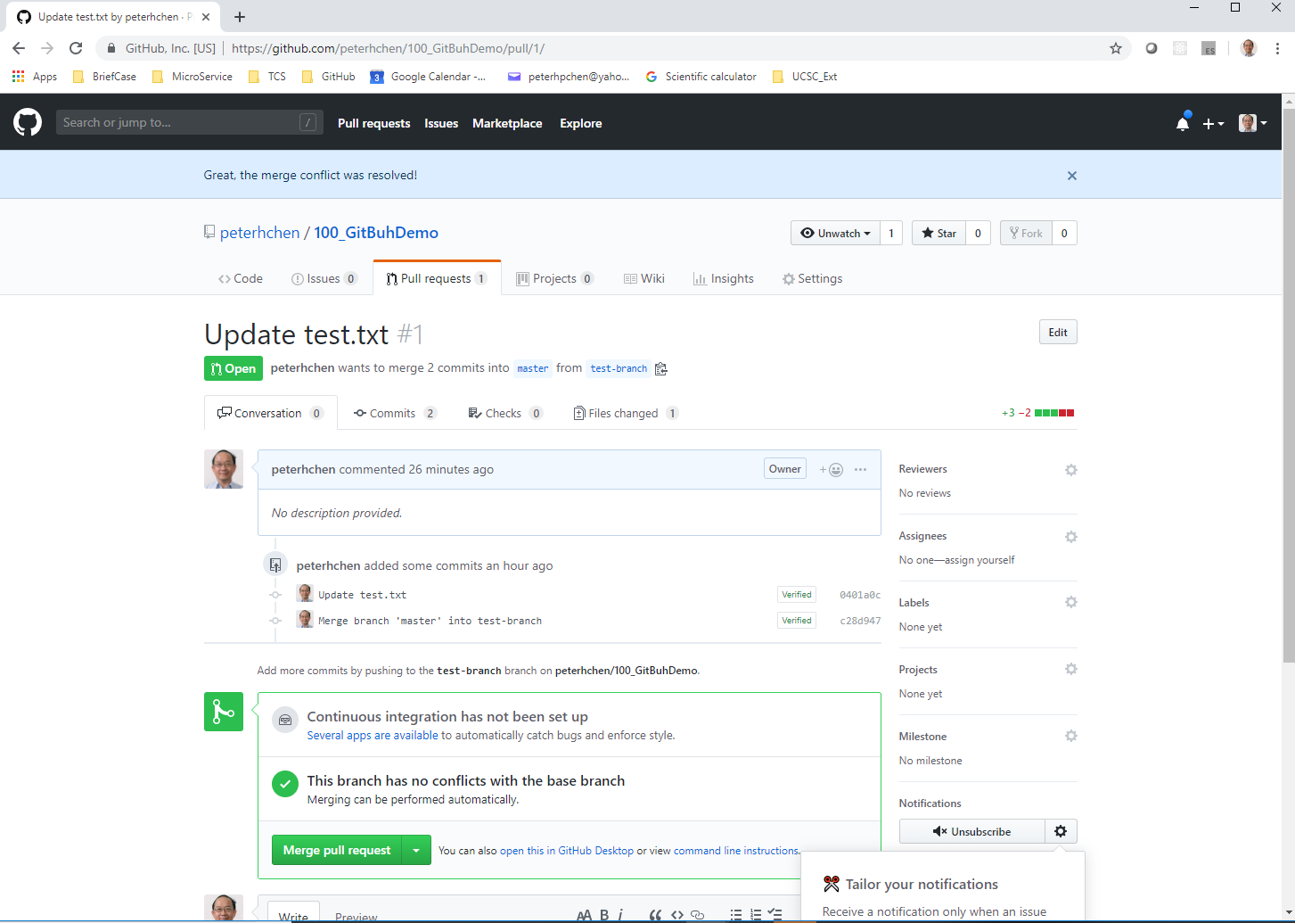
4.2 Pull Request/Merge
https://www.youtube.com/watch?v=OVQK2zzb6U8&list=PLsyeobzWxl7q2eaUkorLZExfd7qko9sZC&index=5
The message says “This branch (merged branch) has no conflicts with the base branch”.
We can click “merge pull request” button.

Slide 21
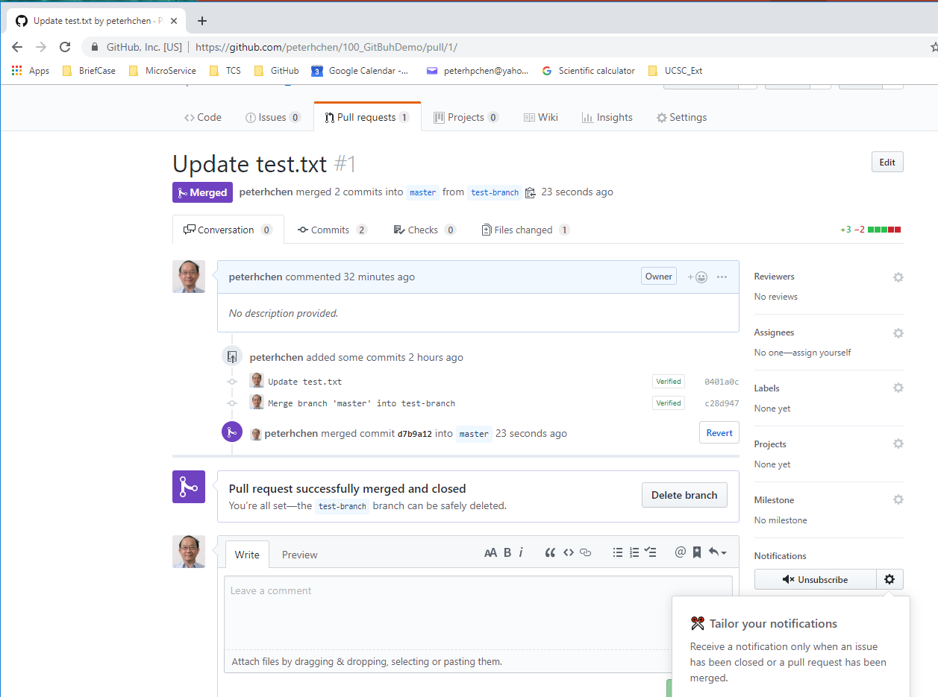
4.2 Pull Request/Merge
https://www.youtube.com/watch?v=OVQK2zzb6U8&list=PLsyeobzWxl7q2eaUkorLZExfd7qko9sZC&index=5
Merge is done. How to verify?

Slide 22
4.3 Verify

Slide 23
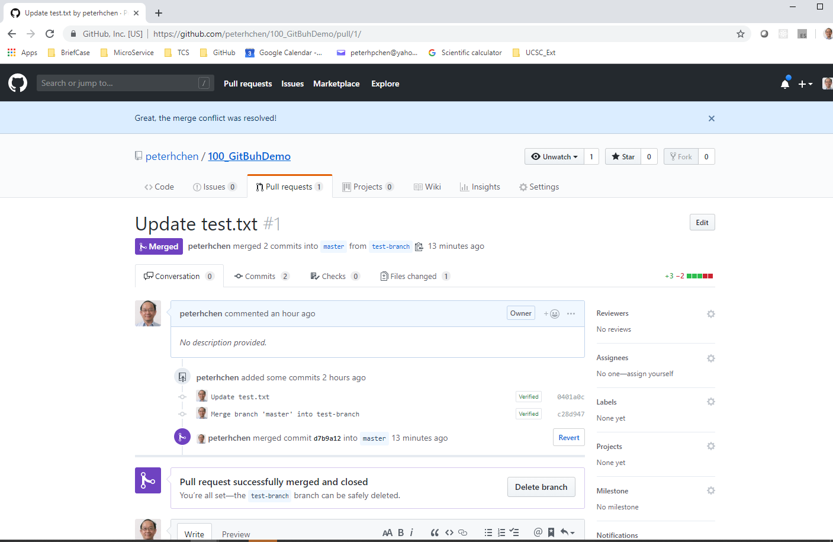
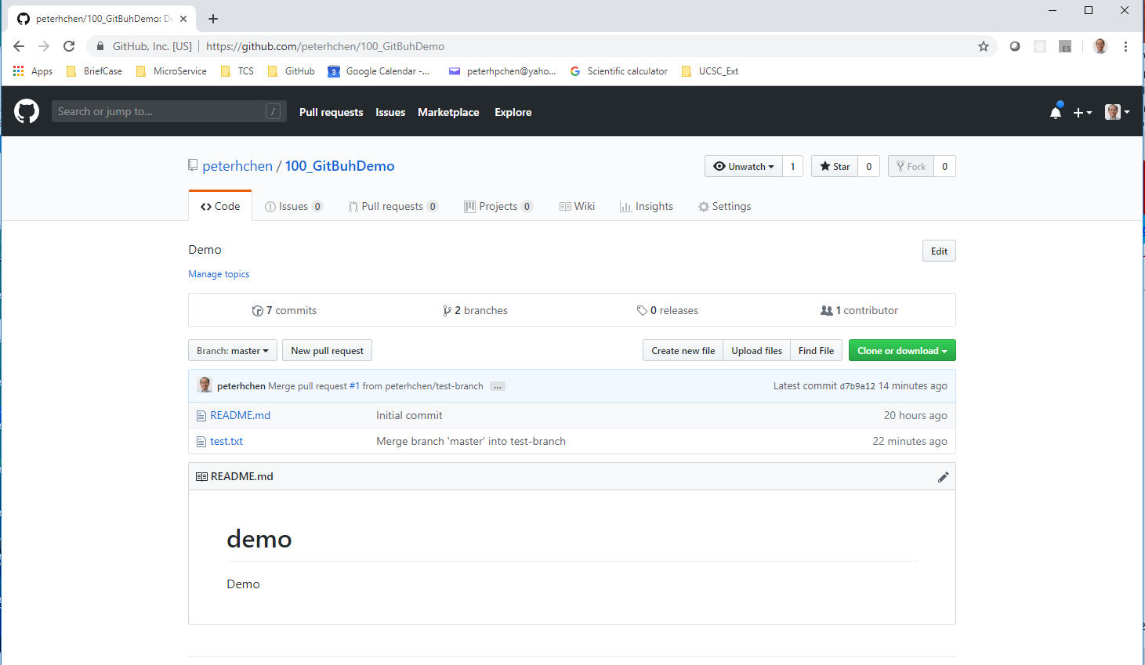
4.3 Verify
https://www.youtube.com/watch?v=OVQK2zzb6U8&list=PLsyeobzWxl7q2eaUkorLZExfd7qko9sZC&index=5
Click “100_GithubDemo”, we can see the “test.txt” file.

Slide 24
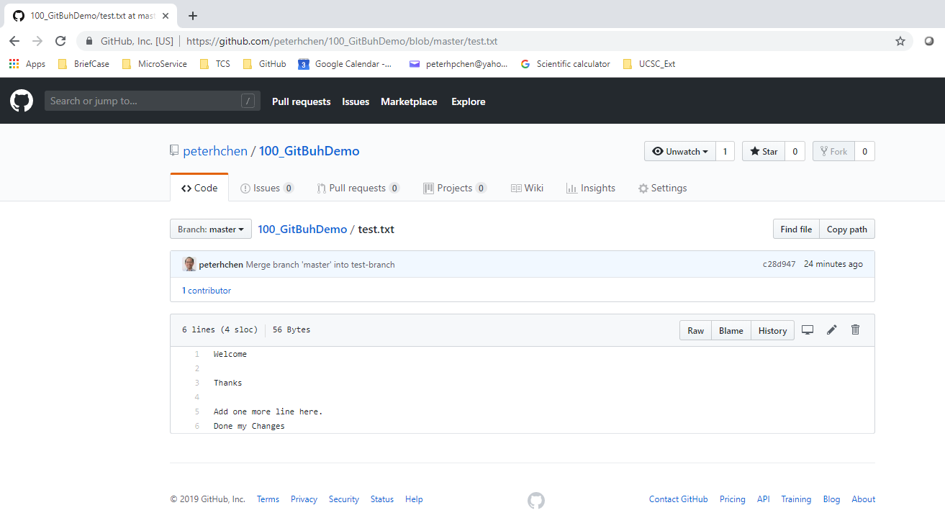
4.3 Verify
https://www.youtube.com/watch?v=OVQK2zzb6U8&list=PLsyeobzWxl7q2eaUkorLZExfd7qko9sZC&index=5
Both test-branch and master branch information are there.

Slide 25
4.3 Verify
https://www.youtube.com/watch?v=OVQK2zzb6U8&list=PLsyeobzWxl7q2eaUkorLZExfd7qko9sZC&index=5
You can have multiple people work on branches.
In the next section, we will discuss how to invite people to your project and work for branch.

Slide 26
End of Chapter

