Slide 1

5 GitHub Fork
Peter H. Chen

Slide 2
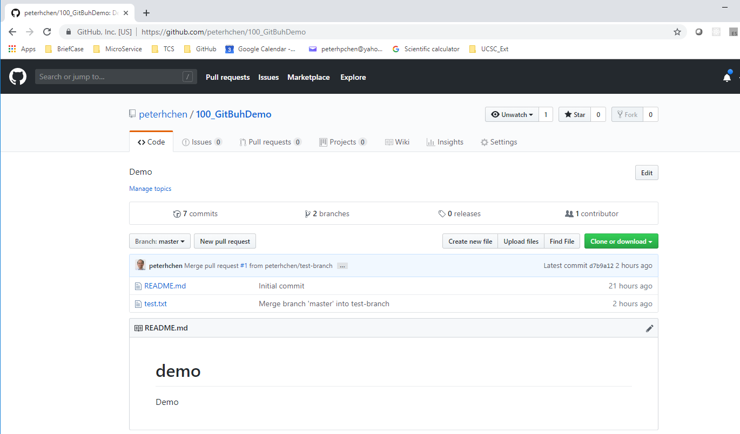
5 GitHub Fork
https://www.youtube.com/watch?v=l5NrYIa_aG4&list=PLsyeobzWxl7q2eaUkorLZExfd7qko9sZC&index=6
In the previous section, we discussed how to work with two branches.

Slide 3
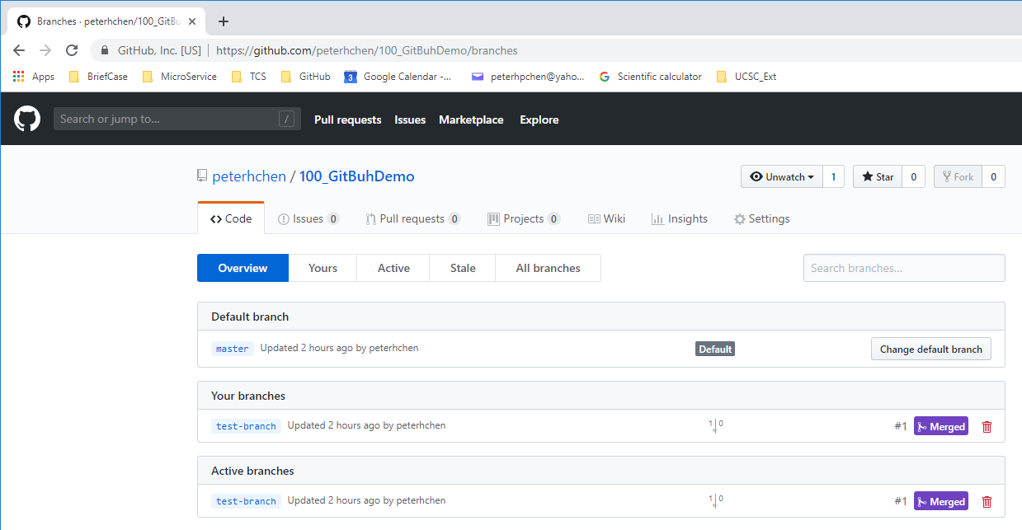
5 GitHub Fork
https://www.youtube.com/watch?v=l5NrYIa_aG4&list=PLsyeobzWxl7q2eaUkorLZExfd7qko9sZC&index=6
Click “2 branches”, we have two branches.
If you have multiple developers, we can create more branches for multiple developers.

Slide 4
5 GitHub Fork
https://www.youtube.com/watch?v=l5NrYIa_aG4&list=PLsyeobzWxl7q2eaUkorLZExfd7qko9sZC&index=6
What if someone who is not in your team but he wanted to join your team?
This is very common for open source project. There are people who want to contribute your project.
Click “code” tab. We have two files “README.md” and “test.txt”.
We will create a new file name “test2.txt” and get the “test2.txt” from open someone’s repository.

Slide 5
5 GitHub Fork
https://www.youtube.com/watch?v=l5NrYIa_aG4&list=PLsyeobzWxl7q2eaUkorLZExfd7qko9sZC&index=6
I have two GitHub accounts:
One is the project owner user is “peter.hp.chen@gmail.com”. The project name is “peterhchen/100_GitHubDemo”
The other one is for other user “pchen0723@mgail.com” with repository “pchen0723/test2” with file text2.txt. The test2.txt will be joined to project “peterhchen/100_GitHubDemo”.
Sign out the project “peterhchen/100_GitHubDemo”.
Sign in “pchen0723/test2”.
join
text2.txt
Peterhchen/100_GitHubDemo
Test.txt
README.md
pchen0723/test2
text2.txt

Slide 6
5.1 Join User Search Project

Slide 7
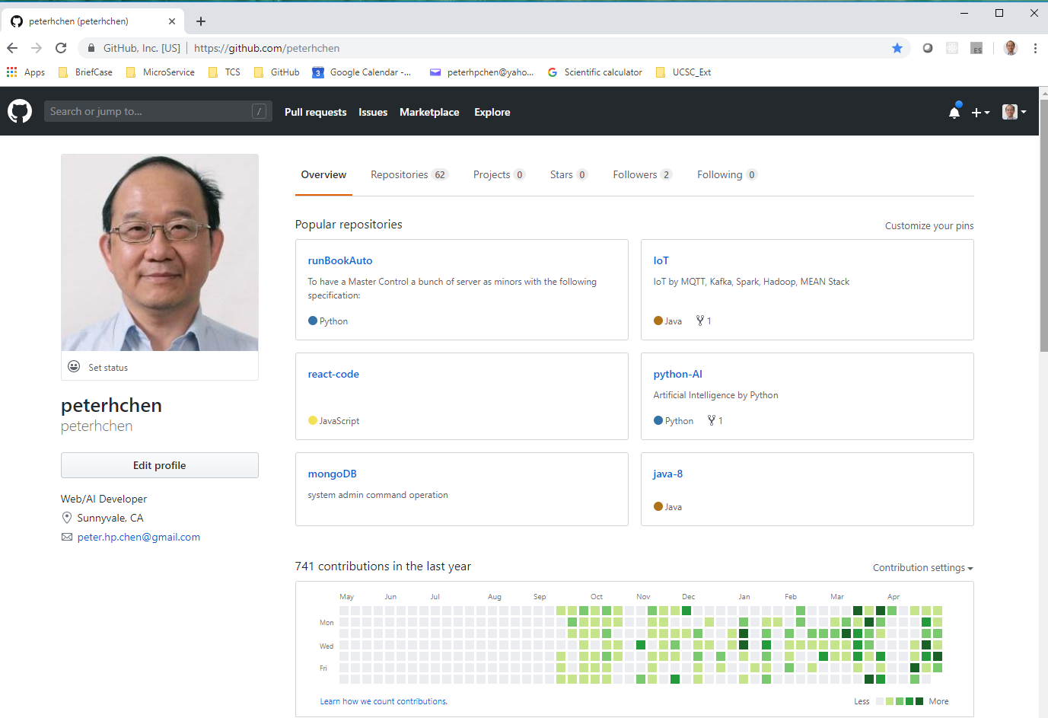
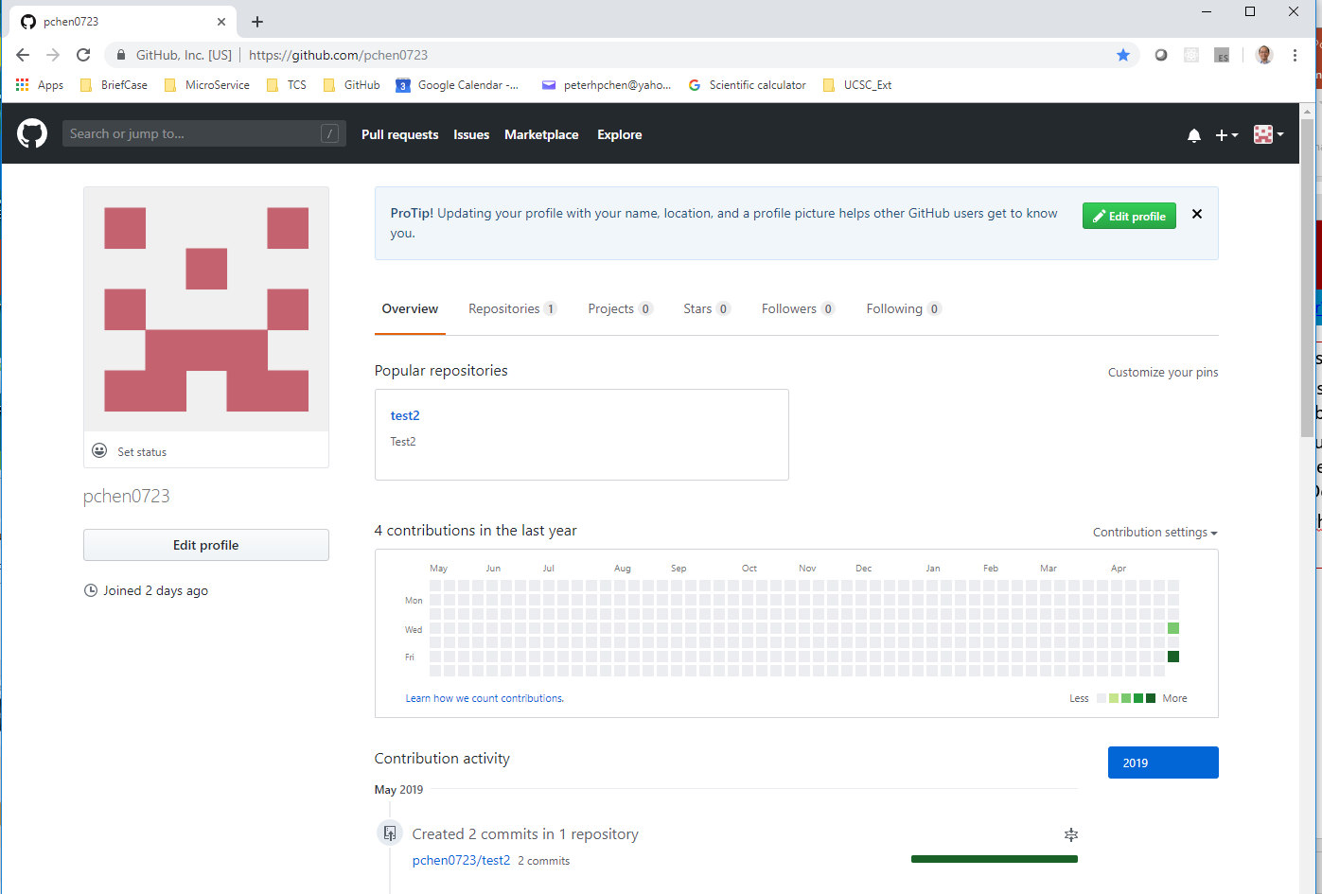
5.1 Join User Search Project
https://www.youtube.com/watch?v=l5NrYIa_aG4&list=PLsyeobzWxl7q2eaUkorLZExfd7qko9sZC&index=6
Sign out the project “peterhchen/100_GitHubDemo”.
The project account has my personal picture.
Sign in “pchen0723/test2”.
The “pchen0723” account has no picture.
join
text2.txt
Peterhchen/100_GitHubDemo
Test.txt
README.md
pchen0723/test2
text2.txt

Slide 8
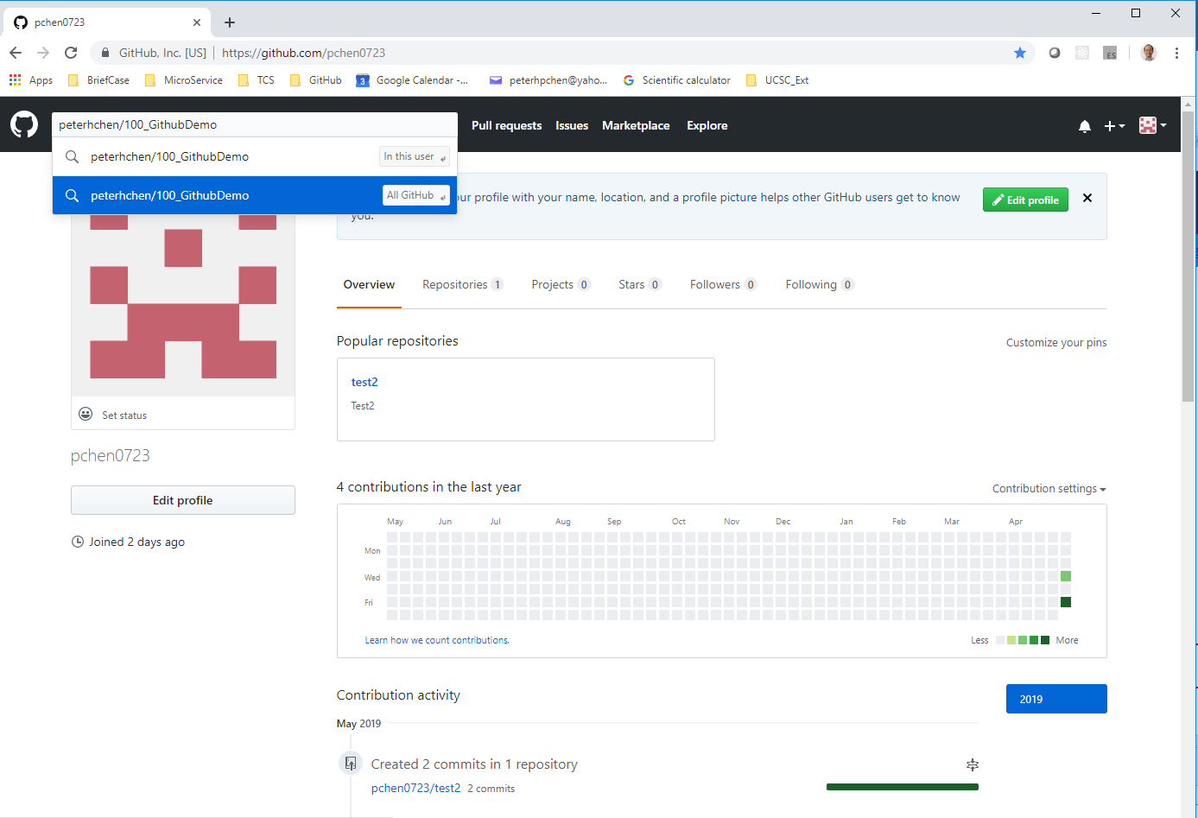
5.1 Join User Search Project
https://www.youtube.com/watch?v=l5NrYIa_aG4&list=PLsyeobzWxl7q2eaUkorLZExfd7qko9sZC&index=6
The “pchen0723” account has a test2 repository and test2.txt file.
In “pchen0723” account, search for project “petehchen/100_GitHubDemo” Project/repository.

Slide 9
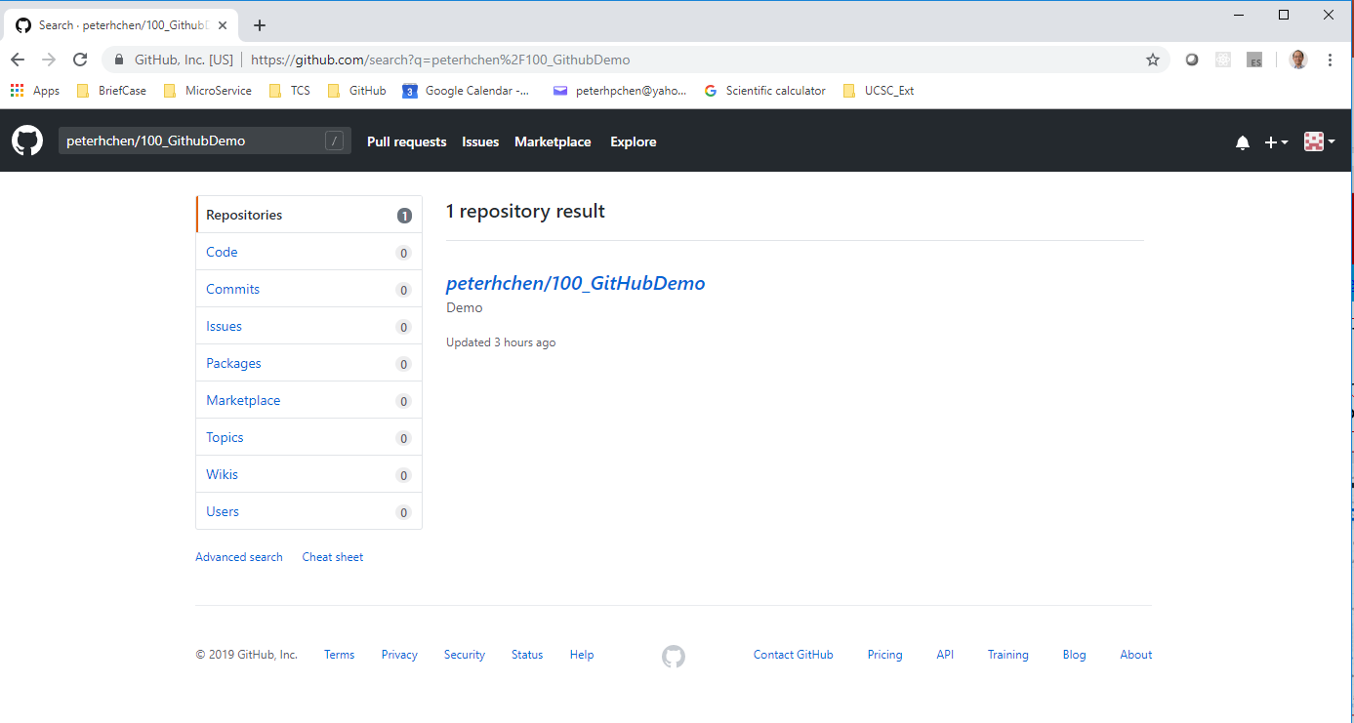
5.1 Join User Search Project
https://www.youtube.com/watch?v=l5NrYIa_aG4&list=PLsyeobzWxl7q2eaUkorLZExfd7qko9sZC&index=6
In the “pchen0723” account, we found the “peterhchen/100_GitHubDemo” project/repository.
This is one way.
We can get the link from project creator as well.

Slide 10
5.2 Add File of New User to Project

Slide 11
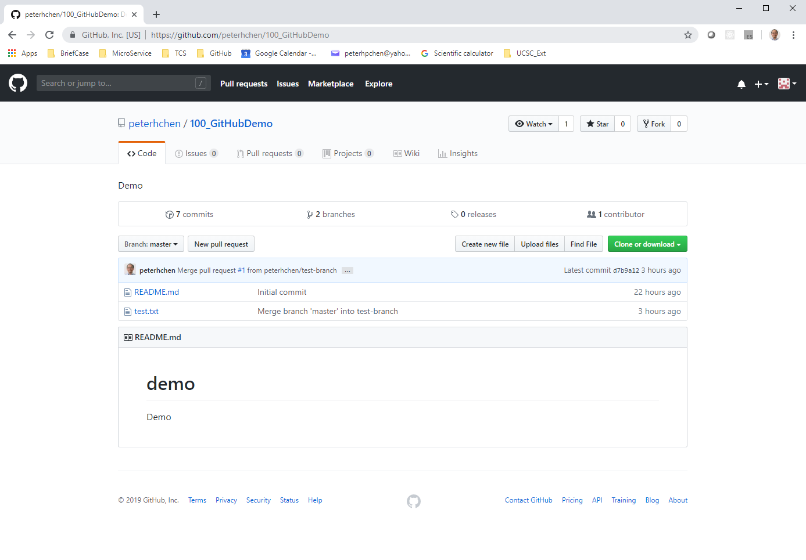
5.2 Add File of New User to Project
https://www.youtube.com/watch?v=l5NrYIa_aG4&list=PLsyeobzWxl7q2eaUkorLZExfd7qko9sZC&index=6
Click “peterhchen/100_GitHubDemo” project/repository.
The user “pchen0723” can view only “peterhchen” project/repository as follow but cannot modified the files.

Slide 12
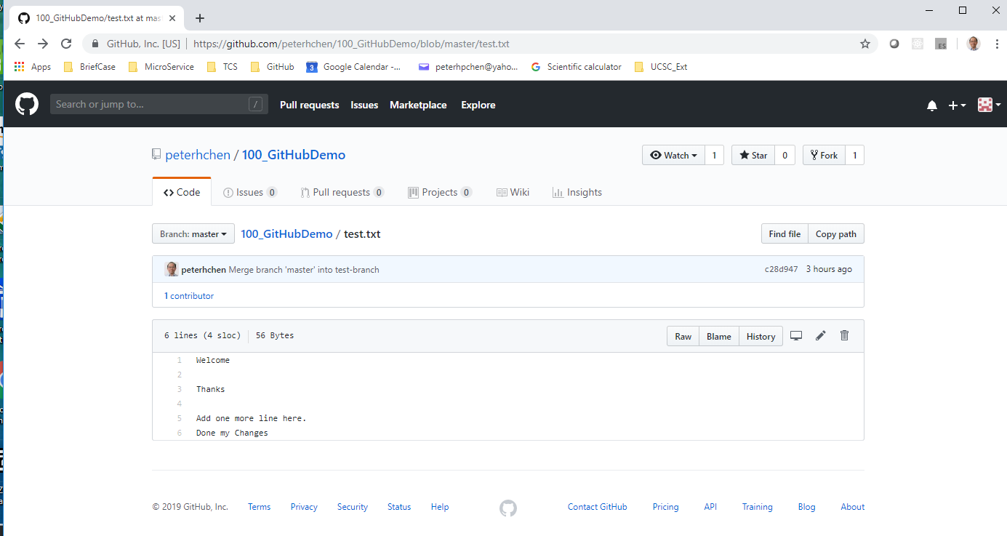
5.2 Add File of New User to Project
https://www.youtube.com/watch?v=l5NrYIa_aG4&list=PLsyeobzWxl7q2eaUkorLZExfd7qko9sZC&index=6
Click “test.txt” to view the file content only.

Slide 13
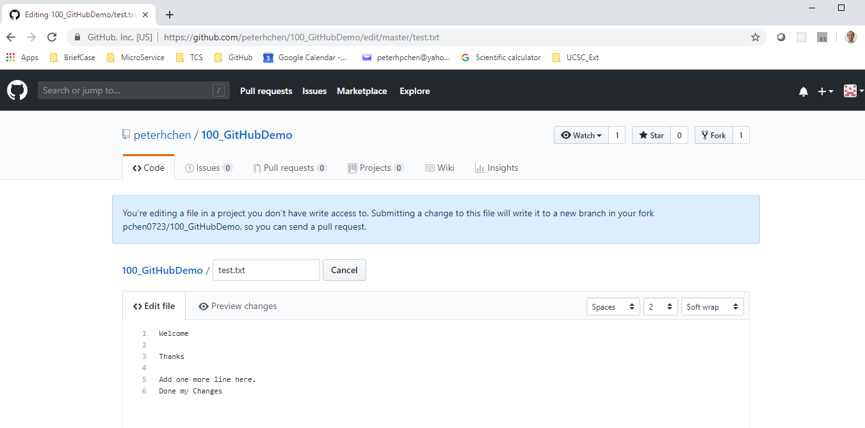
5.2 Add File of New User to Project
https://www.youtube.com/watch?v=l5NrYIa_aG4&list=PLsyeobzWxl7q2eaUkorLZExfd7qko9sZC&index=6
The user “pchen0723” does not have write access to user “peterhchen” project/repository and have error message as below.

Slide 14
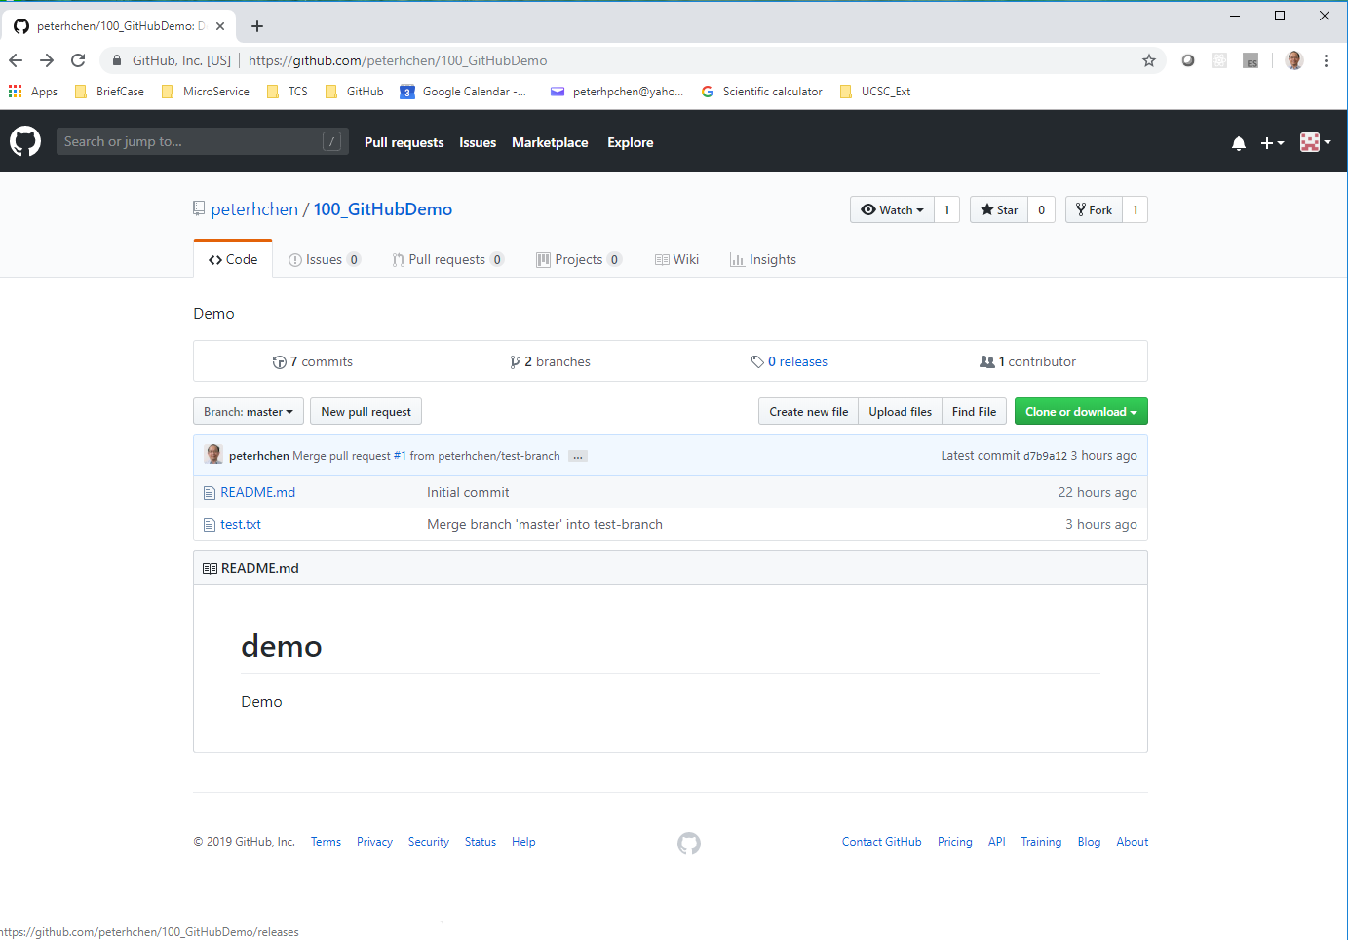
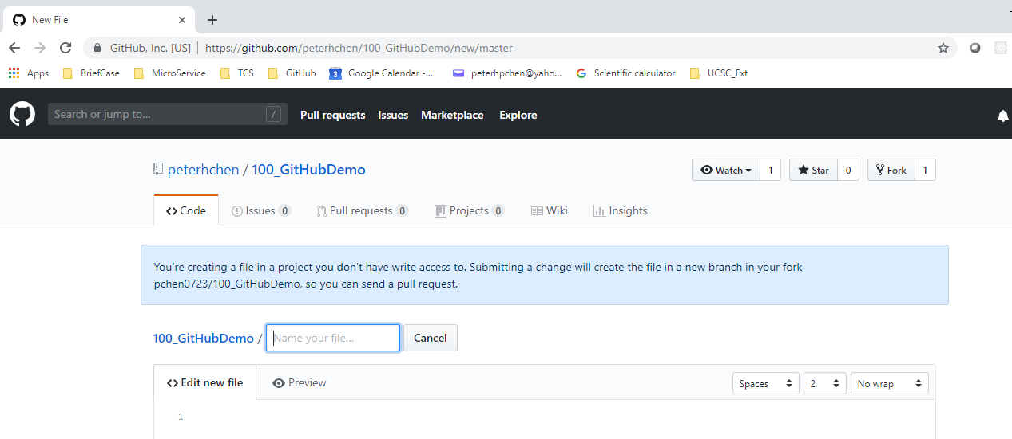
5.2 Add File of New User to Project
https://www.youtube.com/watch?v=l5NrYIa_aG4&list=PLsyeobzWxl7q2eaUkorLZExfd7qko9sZC&index=6
Click “Create new file”.
Look at the message “You’re creating a file in a project you don’t have write access to. Submitting a change will create the file in a new branch in your fork pchen0723/100_GitHubDemo, so you can send a pull request.”

Slide 15
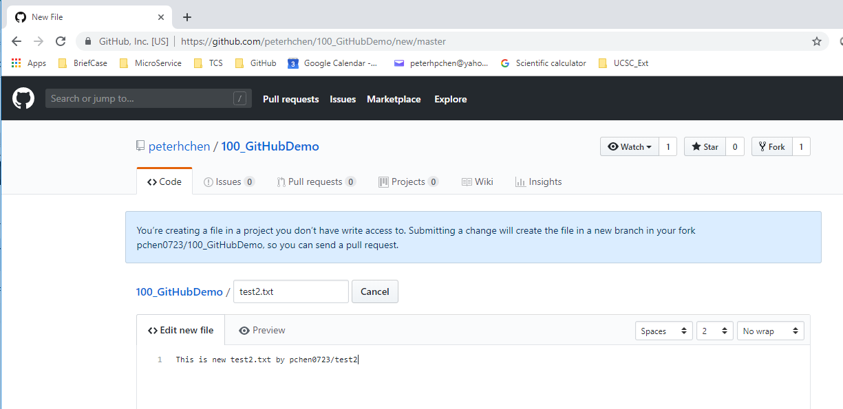
5.2 Add File of New User to Project
https://www.youtube.com/watch?v=l5NrYIa_aG4&list=PLsyeobzWxl7q2eaUkorLZExfd7qko9sZC&index=6
Enter file name test2.txt for project “100_GitHubDemo”.
The file content “This is new test2.txt by pchen0723/test2”

Slide 16
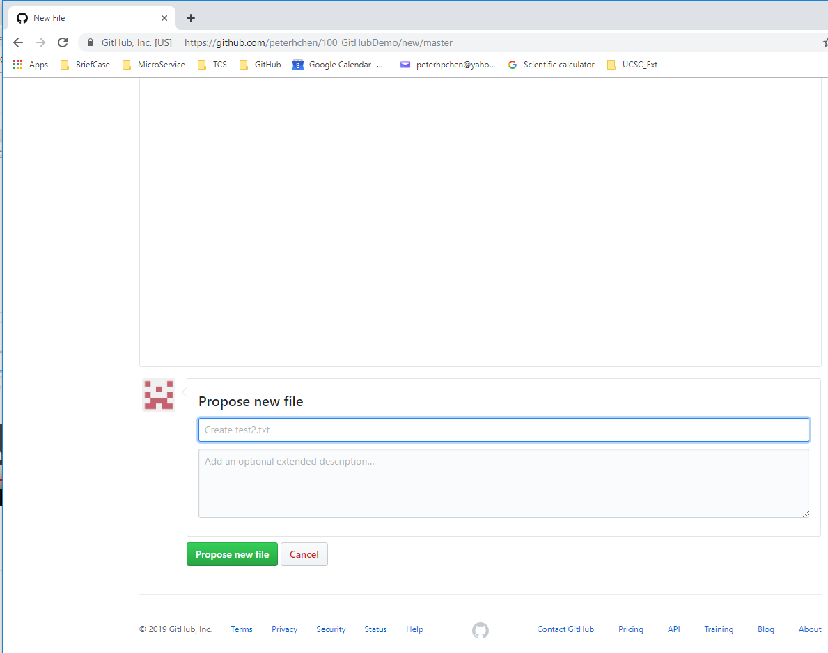
5.2 Add File of New User to Project
https://www.youtube.com/watch?v=l5NrYIa_aG4&list=PLsyeobzWxl7q2eaUkorLZExfd7qko9sZC&index=6
Scroll down and Click “Propose new File” button.

Slide 17
5.3 Create Pull Request

Slide 18
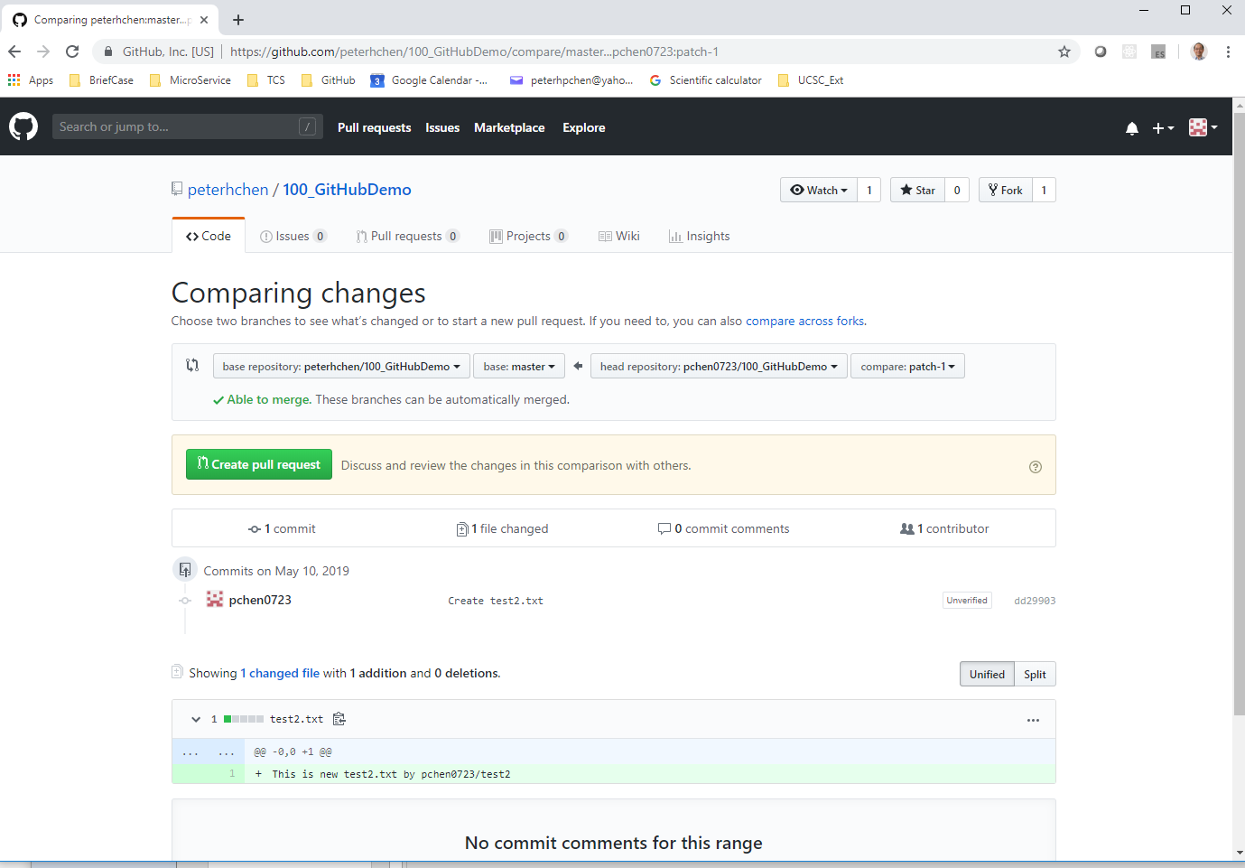
5.3 Create Pull Request
https://www.youtube.com/watch?v=l5NrYIa_aG4&list=PLsyeobzWxl7q2eaUkorLZExfd7qko9sZC&index=6
Verify the file name and file content. Click “Create pull request” button.

Slide 19
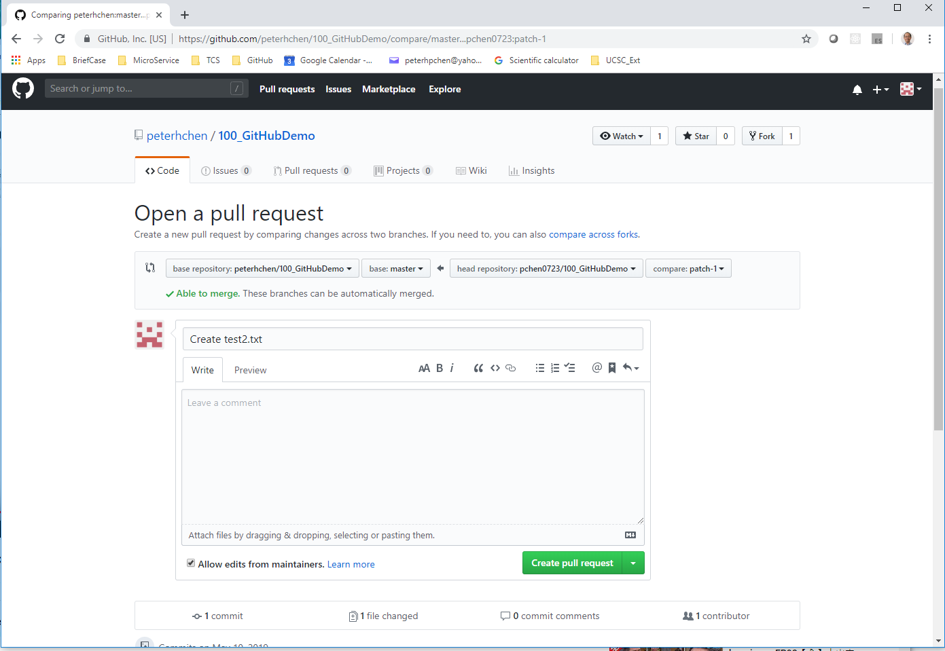
5.3 Create Pull Request
https://www.youtube.com/watch?v=l5NrYIa_aG4&list=PLsyeobzWxl7q2eaUkorLZExfd7qko9sZC&index=6
Check “Open a pull request”.
Check message say “Create test2.txt” and “Able to merge. These branches can be automatically merged.”
Click “Create pull request” button.

Slide 20
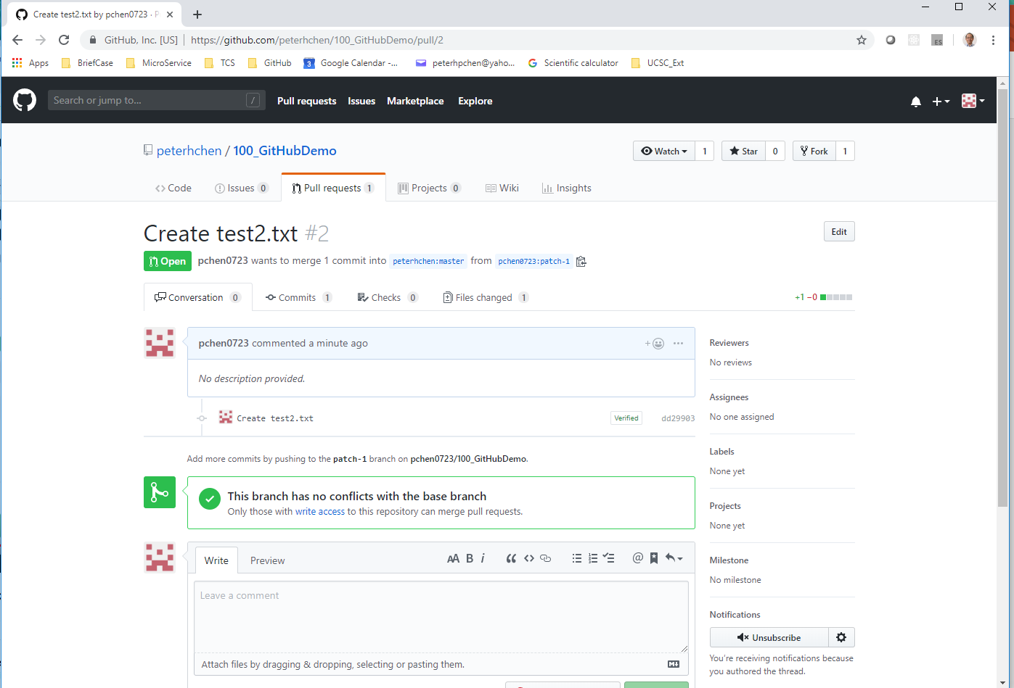
5.3 Create Pull Request
https://www.youtube.com/watch?v=l5NrYIa_aG4&list=PLsyeobzWxl7q2eaUkorLZExfd7qko9sZC&index=6
Check the create pull request message:
“pchen0723 wants to merge 1 comment into peterhchen.master from pchen0723/patch-1”
“The branch has no conflicts with the base branch”

Slide 21
5.4 Verify Project Repository

Slide 22
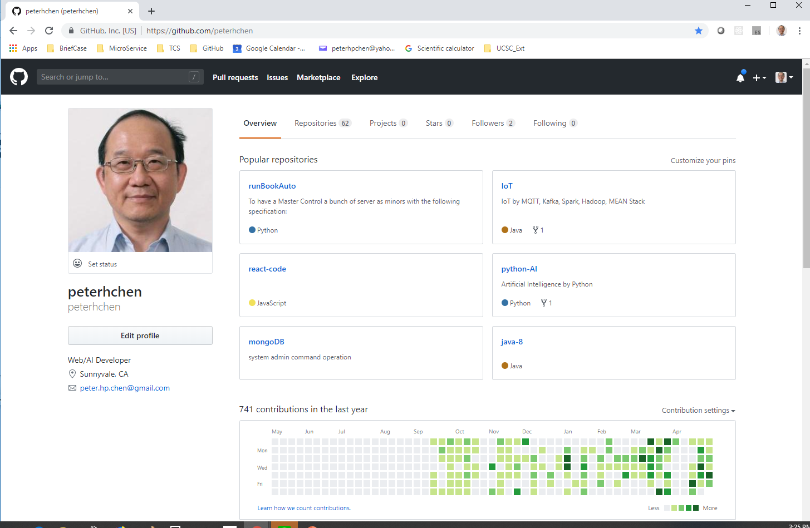
5.4 Verify Project Repository
https://www.youtube.com/watch?v=l5NrYIa_aG4&list=PLsyeobzWxl7q2eaUkorLZExfd7qko9sZC&index=6
Now, sign out the “pchen0723” account (without picture).
Sign in the “peterhchen” account (with picture).

Slide 23
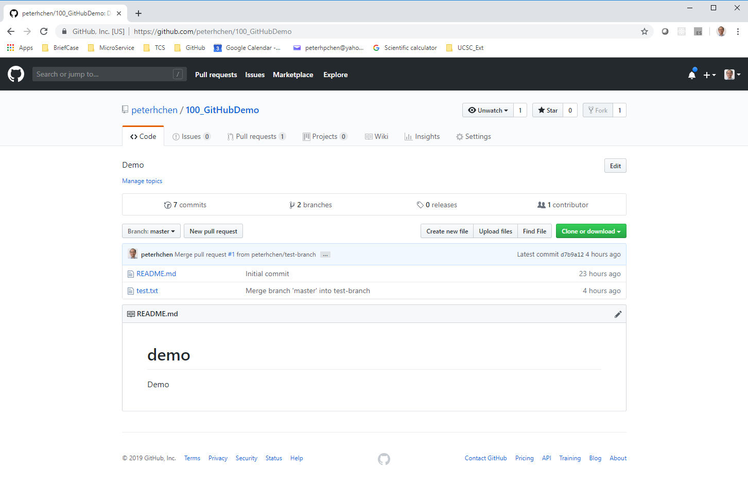
5.4 Verify Project Repository
https://www.youtube.com/watch?v=l5NrYIa_aG4&list=PLsyeobzWxl7q2eaUkorLZExfd7qko9sZC&index=6
In the “peterhchen” account (with picture), we see there is one pull request.

Slide 24
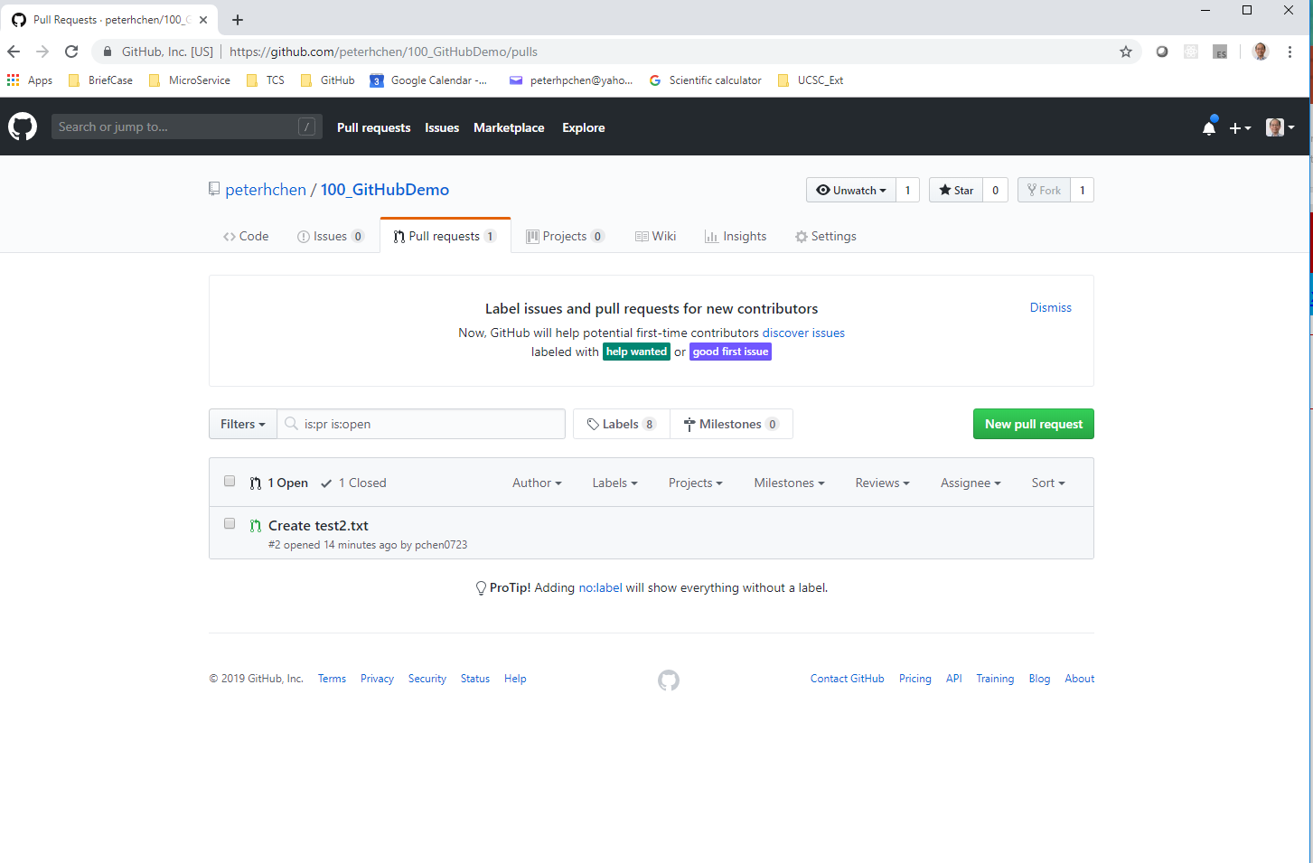
5.4 Verify Project Repository
https://www.youtube.com/watch?v=l5NrYIa_aG4&list=PLsyeobzWxl7q2eaUkorLZExfd7qko9sZC&index=6
Click the “pull request”. We see there is a request “Create test2.txt”

Slide 25
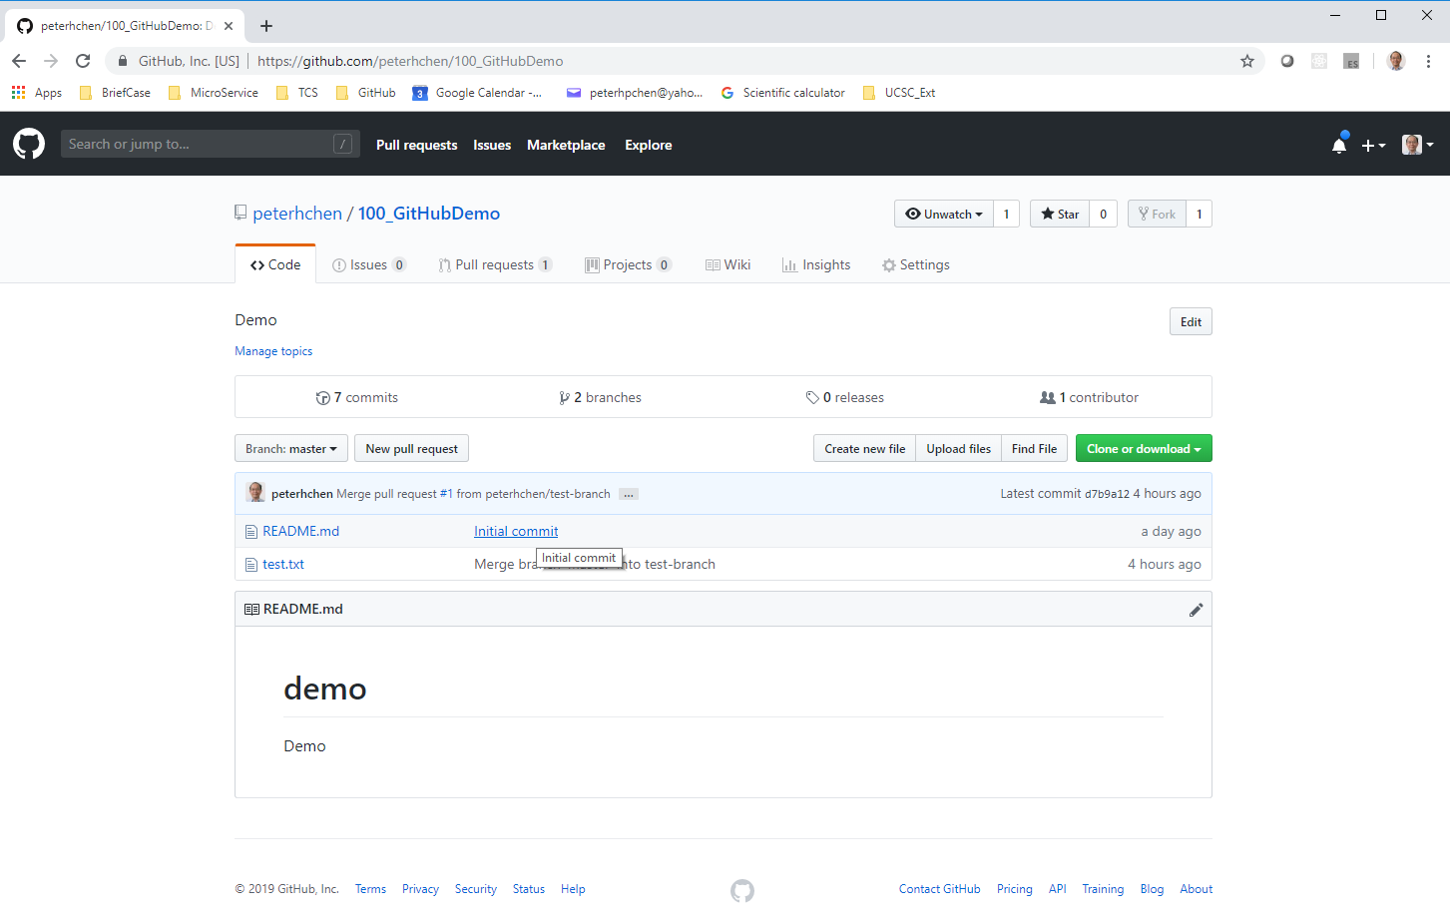
5.4 Verify Project Repository
https://www.youtube.com/watch?v=l5NrYIa_aG4&list=PLsyeobzWxl7q2eaUkorLZExfd7qko9sZC&index=6
Go to master branch. We do not find any “test2.txt”.
Of course, we do not merge the “test2.txt” into the master branch yet.

Slide 26
5.5 Merge Pull Request of test2.txt

Slide 27
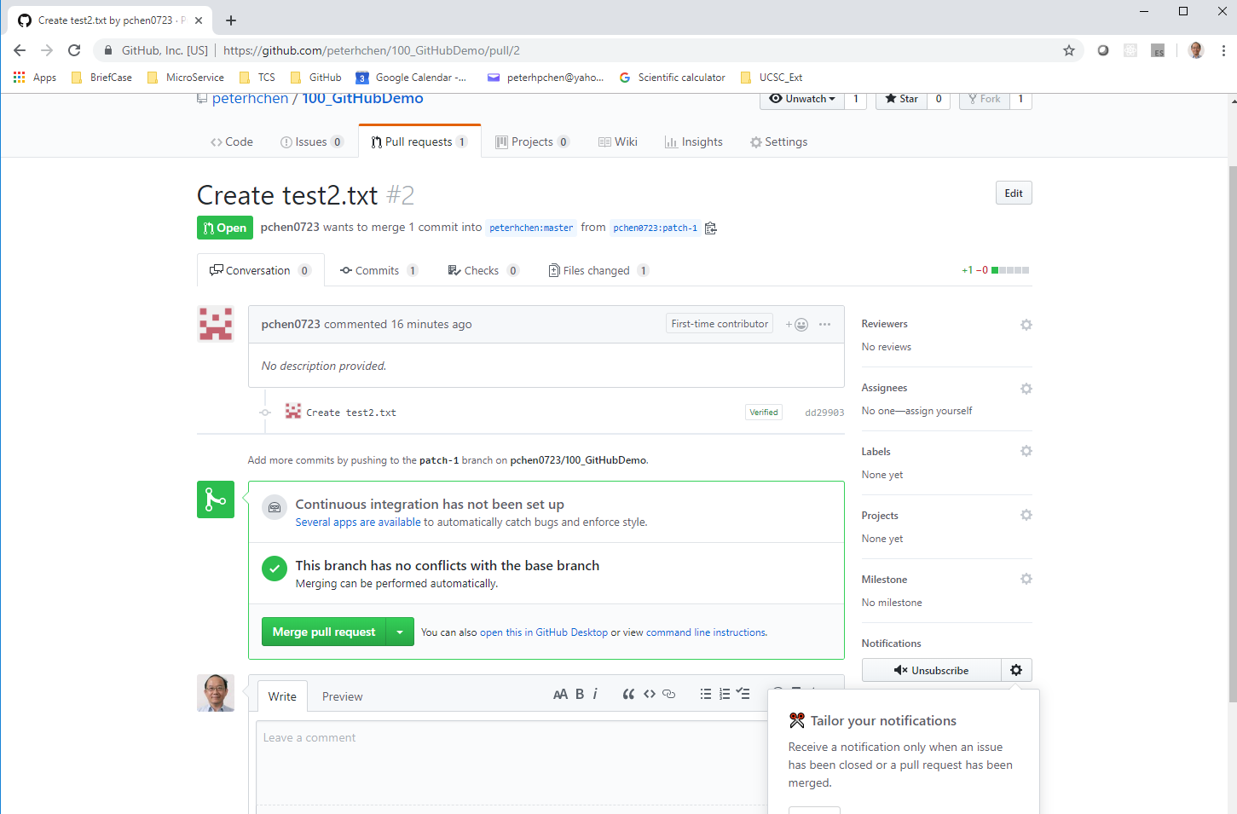
5.5 Merge Pull Request of test2.txt
https://www.youtube.com/watch?v=l5NrYIa_aG4&list=PLsyeobzWxl7q2eaUkorLZExfd7qko9sZC&index=6
Go back to request window again.
Click “Merge Pull Request”

Slide 28
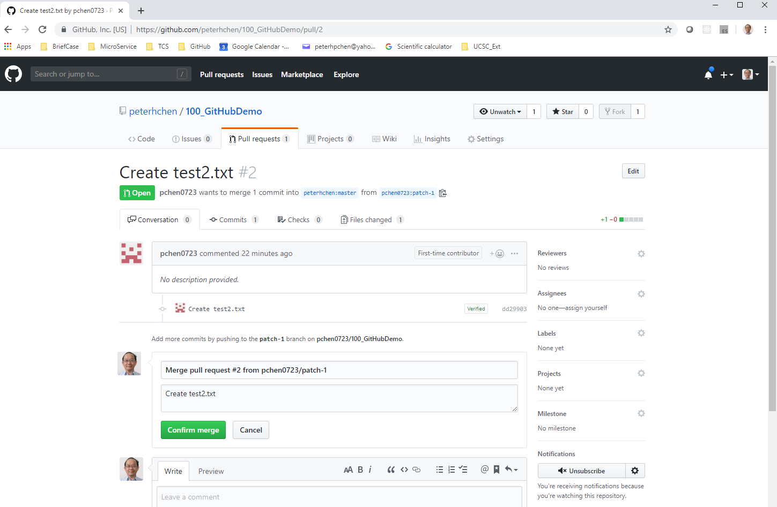
5.5 Merge Pull Request of test2.txt
https://www.youtube.com/watch?v=l5NrYIa_aG4&list=PLsyeobzWxl7q2eaUkorLZExfd7qko9sZC&index=6
Click “Confirm merge”.

Slide 29
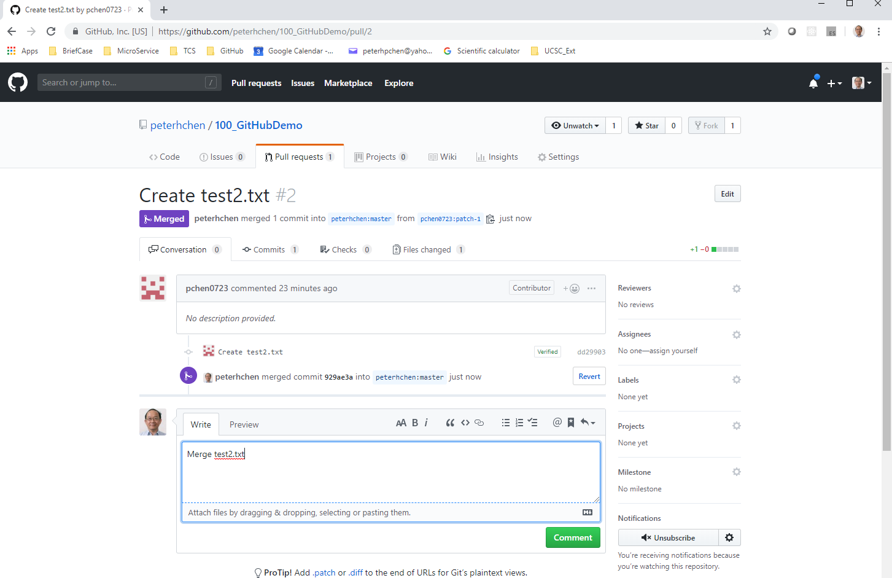
5.5 Merge Pull Request of test2.txt
https://www.youtube.com/watch?v=l5NrYIa_aG4&list=PLsyeobzWxl7q2eaUkorLZExfd7qko9sZC&index=6
Type in “Merge test2.txt”
Click “Commit”

Slide 30
5.6 Verify test2.txt in Master Branch

Slide 31
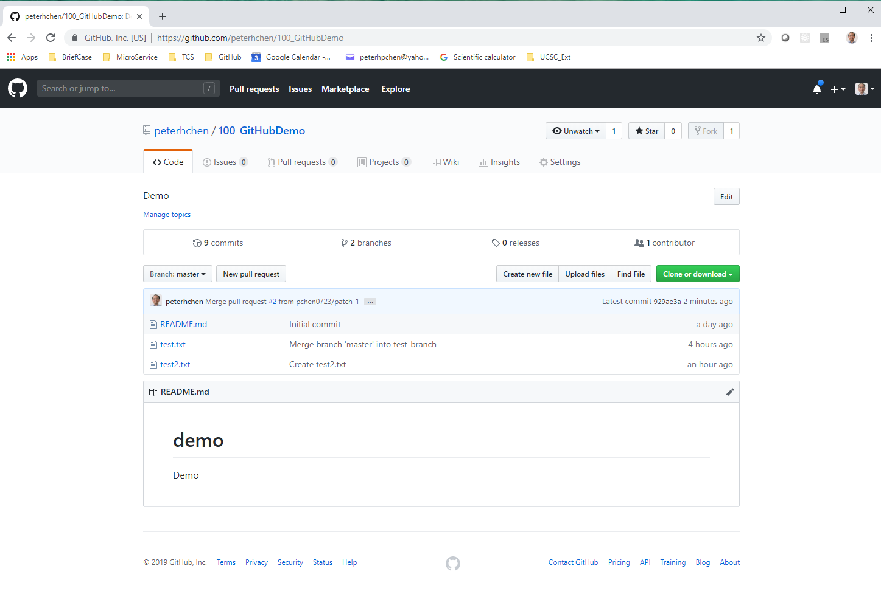
5.6 Verify test2.txt in Master Branch
https://www.youtube.com/watch?v=l5NrYIa_aG4&list=PLsyeobzWxl7q2eaUkorLZExfd7qko9sZC&index=6
Go to Master branch. Verify the test2.txt is inside the master branch.

Slide 32
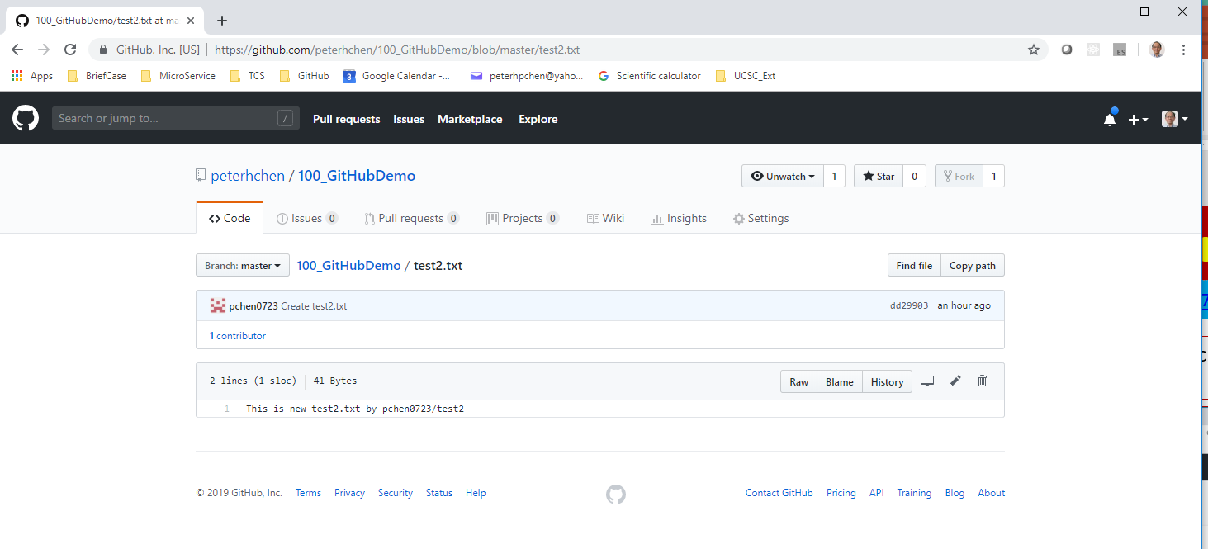
5.6 Verify test2.txt in Master Branch
https://www.youtube.com/watch?v=l5NrYIa_aG4&list=PLsyeobzWxl7q2eaUkorLZExfd7qko9sZC&index=6
Click test2.txt to verify the content.

Slide 33
5.6 Verify test2.txt in Master Branch
https://www.youtube.com/watch?v=l5NrYIa_aG4&list=PLsyeobzWxl7q2eaUkorLZExfd7qko9sZC&index=6
This is how someone join your project.
You can reject the pull request as well.

Slide 34
End of Chapter

