Slide 1

6 Upload File to GitHub by Eclipse
Peter H. Chen

Slide 2
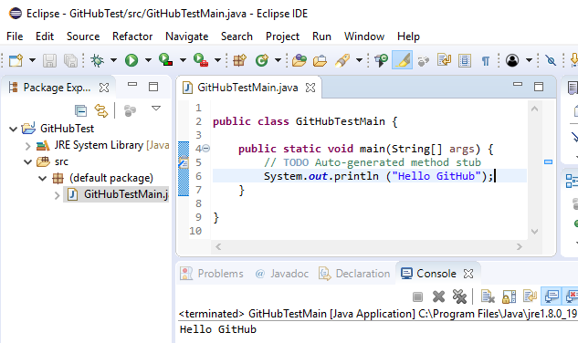
6 Upload File to GitHub by Eclipse
https://www.youtube.com/watch?v=Huwf0TgWrOw&list=PLsyeobzWxl7q2eaUkorLZExfd7qko9sZC&index=7
In this section, we discuss how to upload files into GitHub by Eclipse.
Create Java Project: GitHubTest, Class Name: GitHubTestMain.
We also can use command line to check into the GitHub Server.

Slide 3
6 Upload File to GitHub by Eclipse
https://www.youtube.com/watch?v=Huwf0TgWrOw&list=PLsyeobzWxl7q2eaUkorLZExfd7qko9sZC&index=7
We can use Eclipse, the easy way. We can use Eclipse to push our project to the GitHub.
We will push the Java project “GitHubTest” into the GitHub. The project contains one file GitHubTestMain.java. It does not matter how much codes you have.

Slide 4
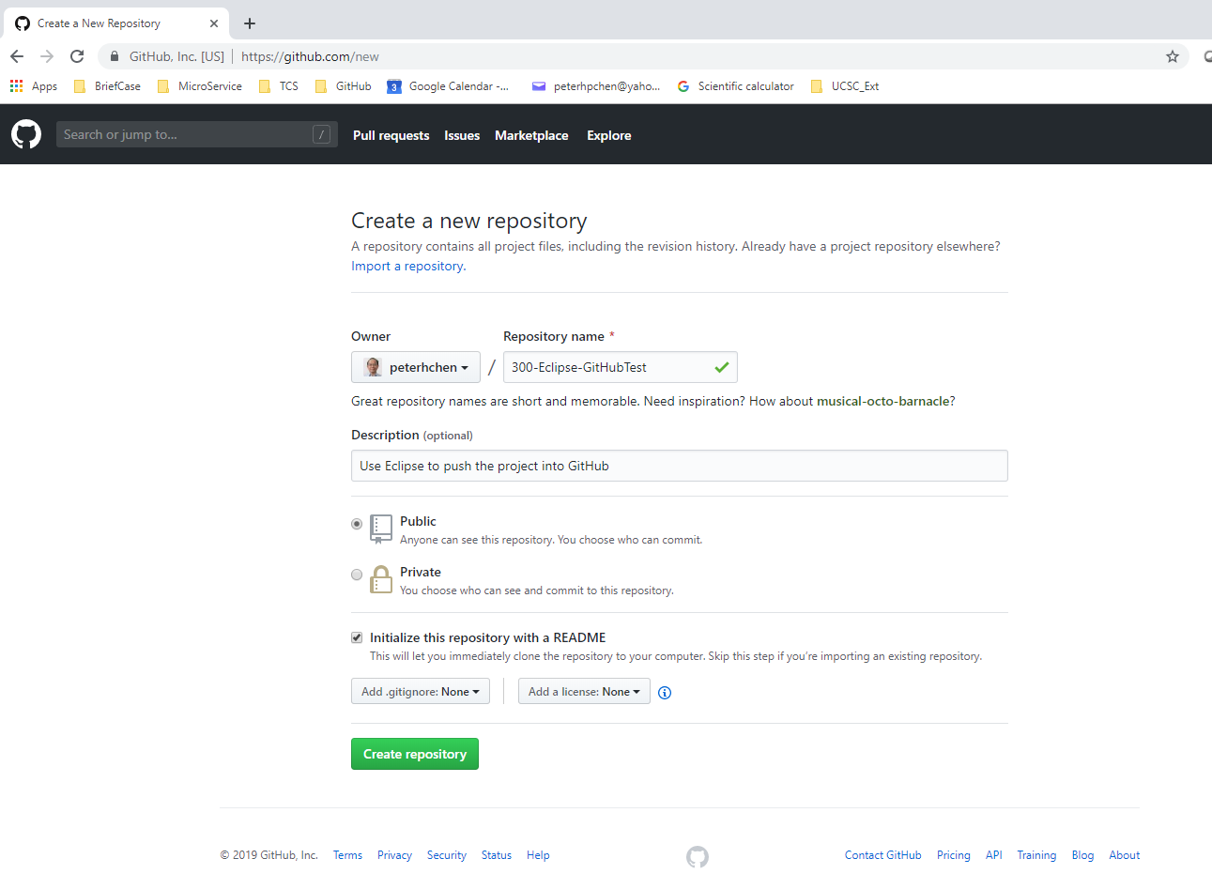
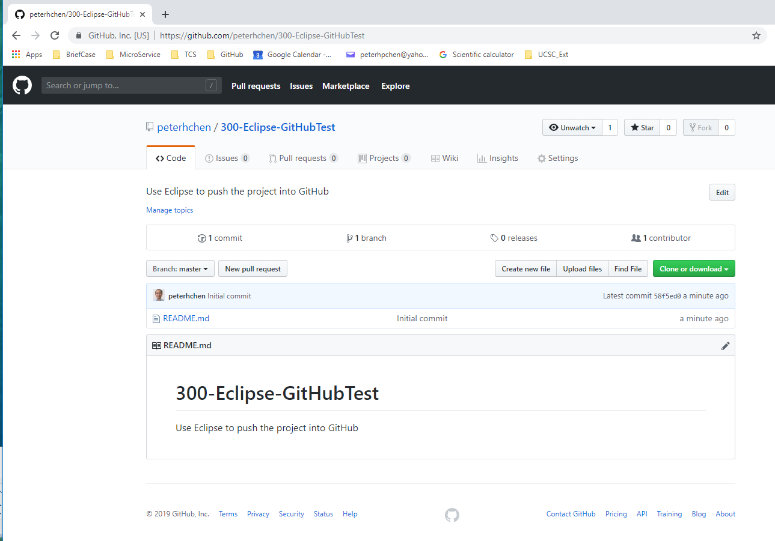
6 Upload File to GitHub by Eclipse
https://www.youtube.com/watch?v=Huwf0TgWrOw&list=PLsyeobzWxl7q2eaUkorLZExfd7qko9sZC&index=7
Create a new repository “300-Eclipse-GitHubTest” on GitHub.

Slide 5
6.1 Download EGit

Slide 6
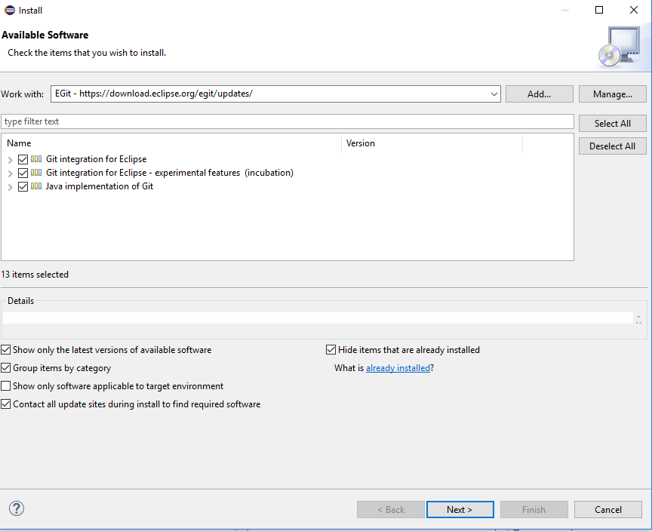
6.1 Download EGit
https://www.youtube.com/watch?v=Huwf0TgWrOw&list=PLsyeobzWxl7q2eaUkorLZExfd7qko9sZC&index=7
Install Eclipse: Eclipse > Help > Install New Software > Add > Name: Egit, URL: https://download.eclipse.org/egit/updates/.

Slide 7
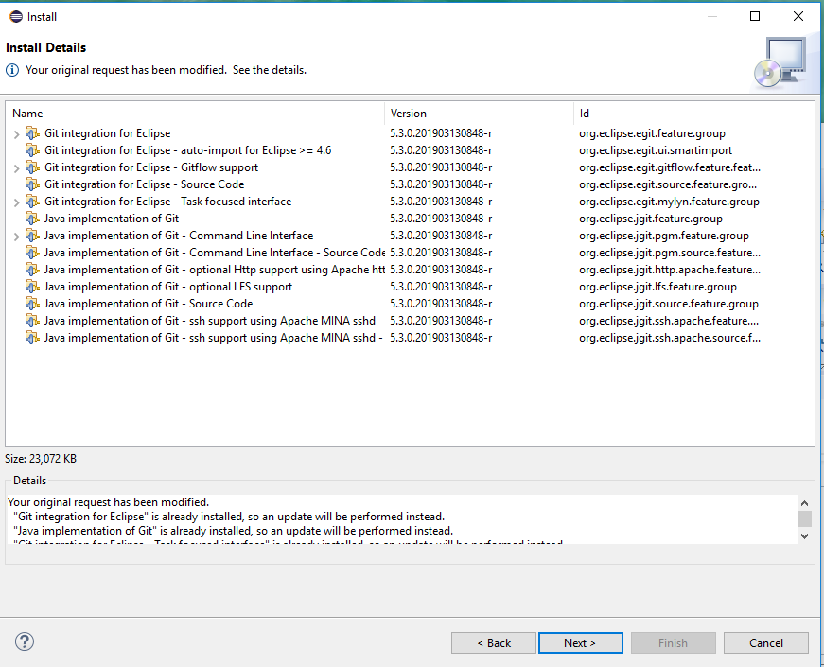
6.1 Download EGit
https://www.youtube.com/watch?v=Huwf0TgWrOw&list=PLsyeobzWxl7q2eaUkorLZExfd7qko9sZC&index=7
Click Next.

Slide 8
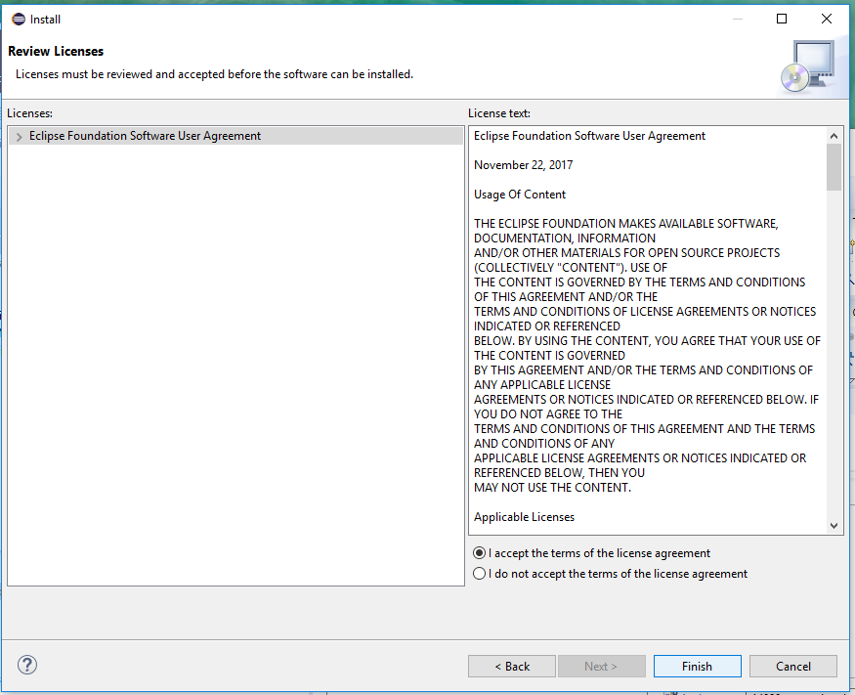
6.1 Download EGit
https://www.youtube.com/watch?v=Huwf0TgWrOw&list=PLsyeobzWxl7q2eaUkorLZExfd7qko9sZC&index=7
Click Finish and restart the Eclipse.

Slide 9
6.2 Create Local Repository

Slide 10
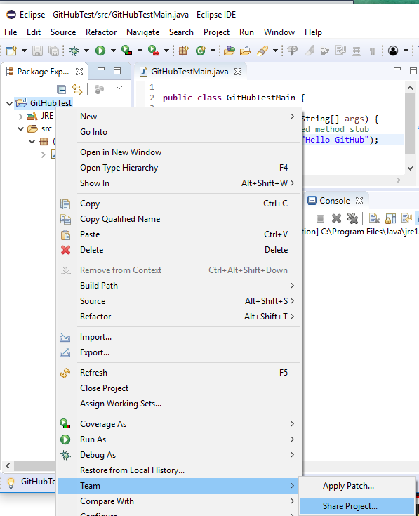
6.2 Create Local Repository
https://www.youtube.com/watch?v=Huwf0TgWrOw&list=PLsyeobzWxl7q2eaUkorLZExfd7qko9sZC&index=7
In the Eclipse, click Project Name: “GitHubTest” > Team > Share Project …
Put your project on the local repository. You need to install the git for your local repository.

Slide 11
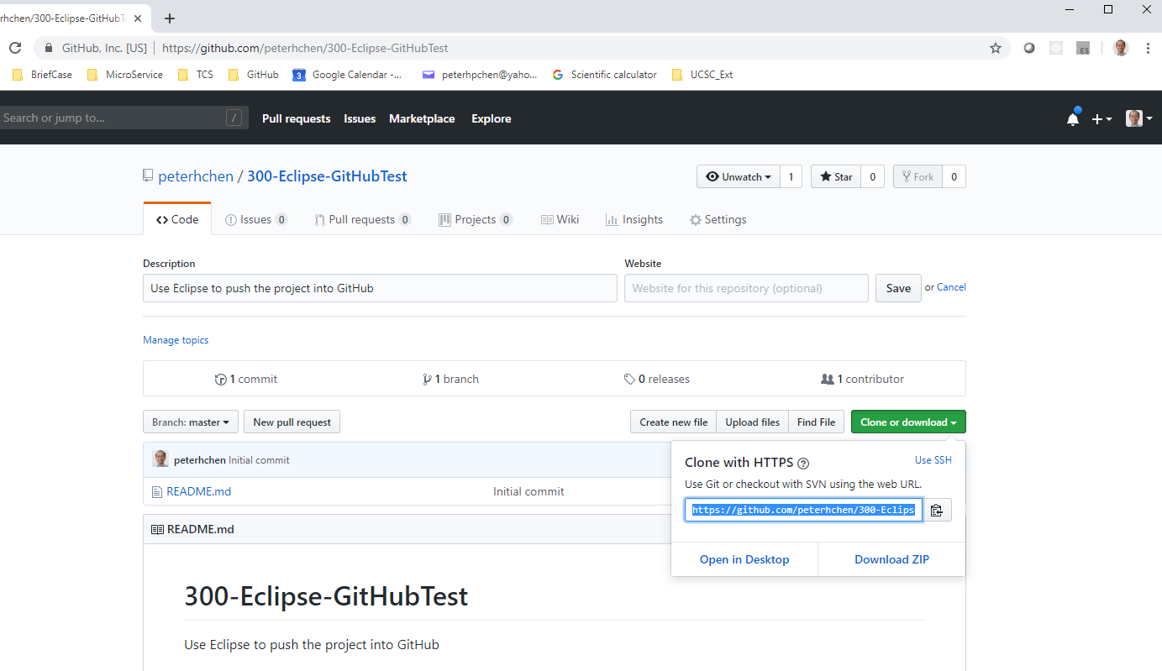
6.2 Create Local Repository
https://www.youtube.com/watch?v=Huwf0TgWrOw&list=PLsyeobzWxl7q2eaUkorLZExfd7qko9sZC&index=7
Get the link of repository “https://github.com/peterhchen/300-Eclipse-GitHubTest.git”

Slide 12
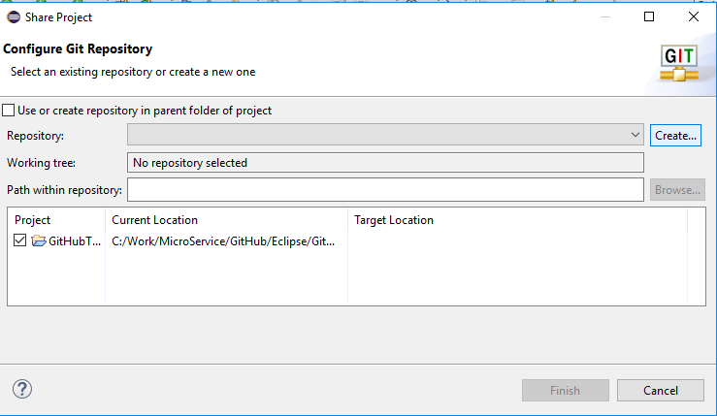
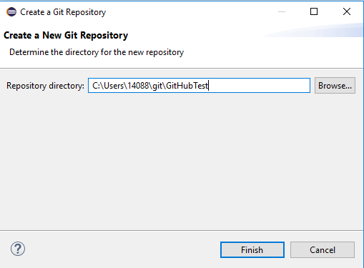
6.2 Create Local Repository
https://www.youtube.com/watch?v=Huwf0TgWrOw&list=PLsyeobzWxl7q2eaUkorLZExfd7qko9sZC&index=7
Click “Create…” to create local repository.
Give the name of local repository “GitHubTest”.

Slide 13
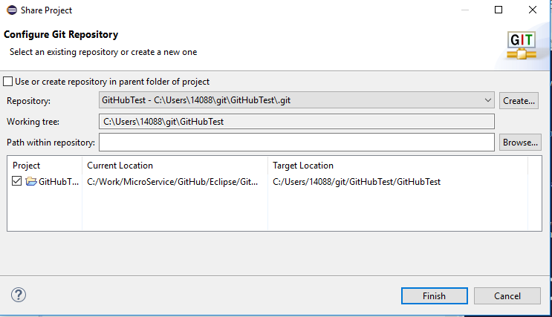
6.2 Create Local Repository
https://www.youtube.com/watch?v=Huwf0TgWrOw&list=PLsyeobzWxl7q2eaUkorLZExfd7qko9sZC&index=7
The local Git repository is “C:\Users\14088\git\GitHubTest\.git”.

Slide 14
6.3 Commit Project to Local Repository

Slide 15
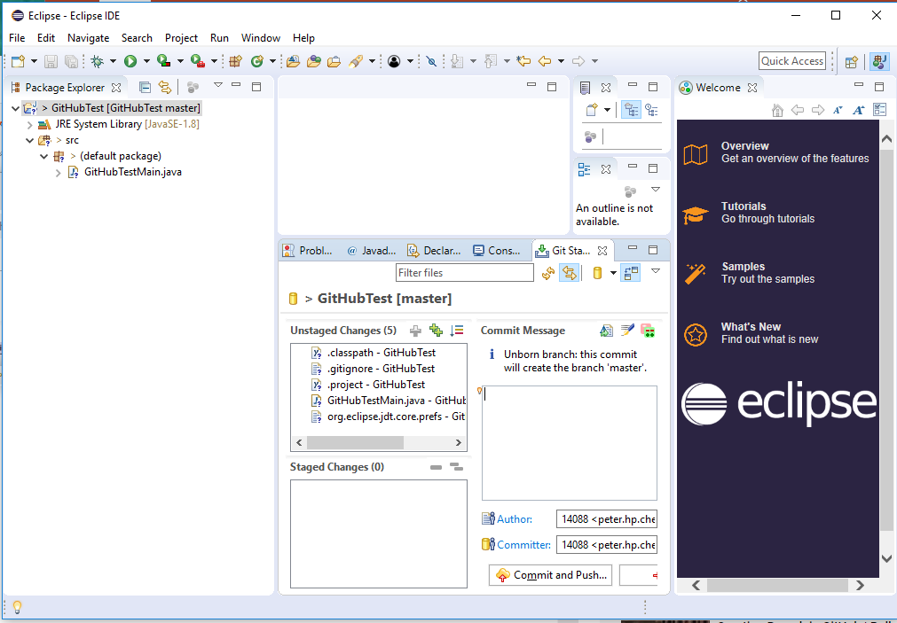
6.3 Commit Project to Local Repository
https://www.youtube.com/watch?v=Huwf0TgWrOw&list=PLsyeobzWxl7q2eaUkorLZExfd7qko9sZC&index=7
Select Project: GitHubTest > Team > Commit …

Slide 16
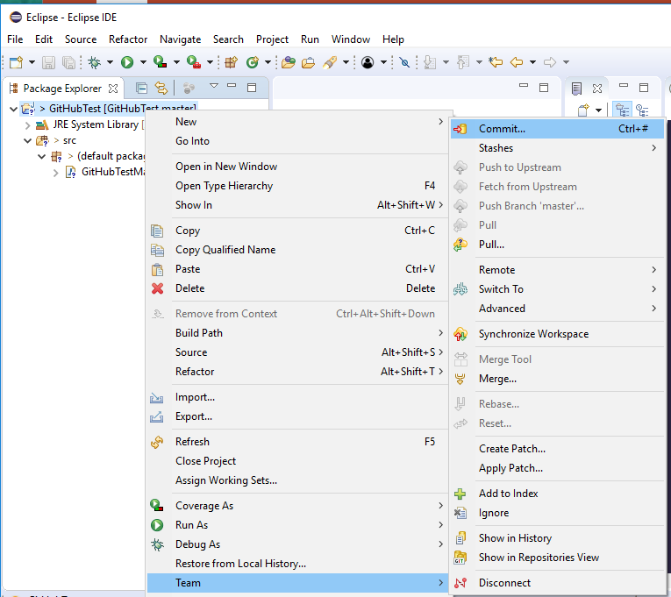
6.3 Commit Project to Local Repository
https://www.youtube.com/watch?v=Huwf0TgWrOw&list=PLsyeobzWxl7q2eaUkorLZExfd7qko9sZC&index=7
Select Project: GitHubTest > Team > Commit …

Slide 17
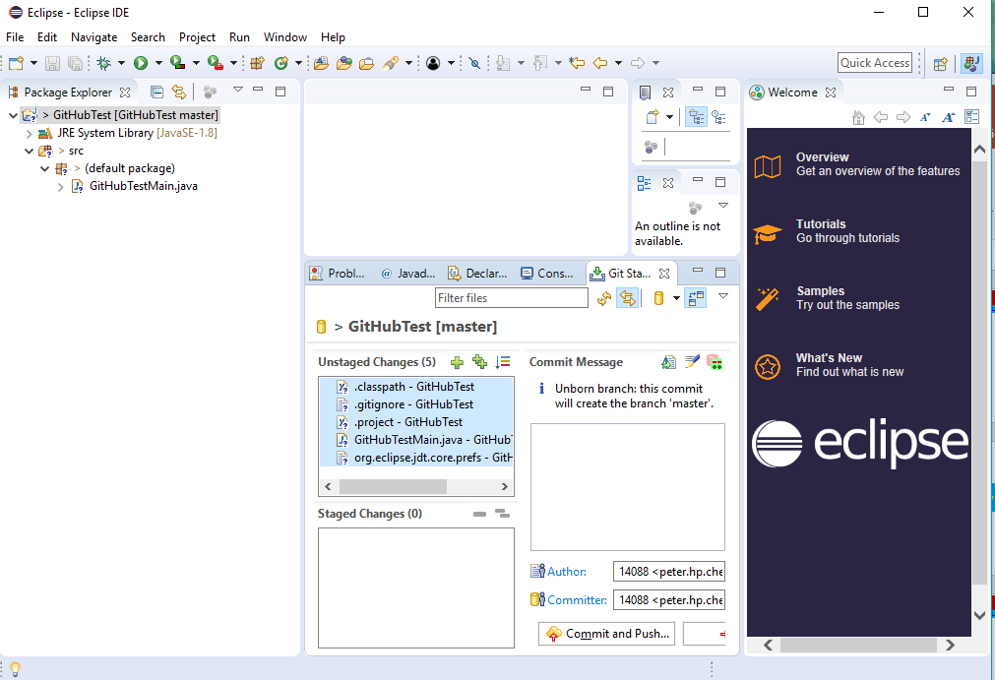
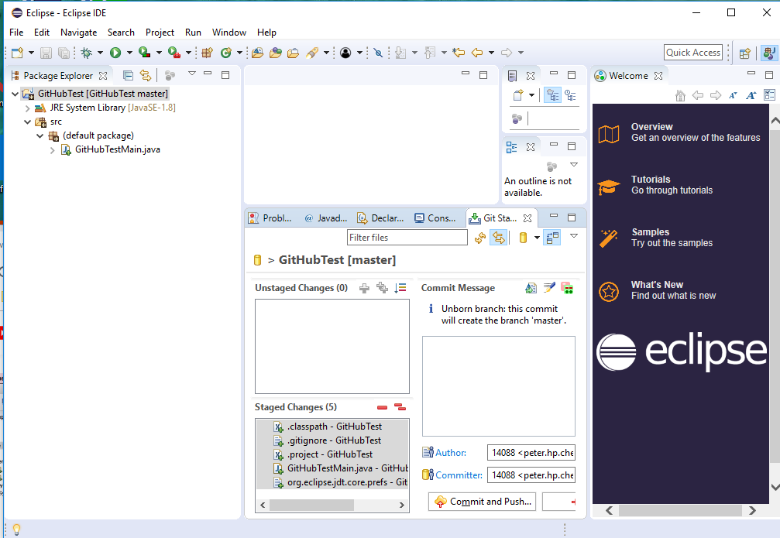
6.3 Commit Project to Local Repository
https://www.youtube.com/watch?v=Huwf0TgWrOw&list=PLsyeobzWxl7q2eaUkorLZExfd7qko9sZC&index=7
Select all the files to commit.
Drag-and-drop from “Unstaged Changes” into “Staged Changes” area.

Slide 18
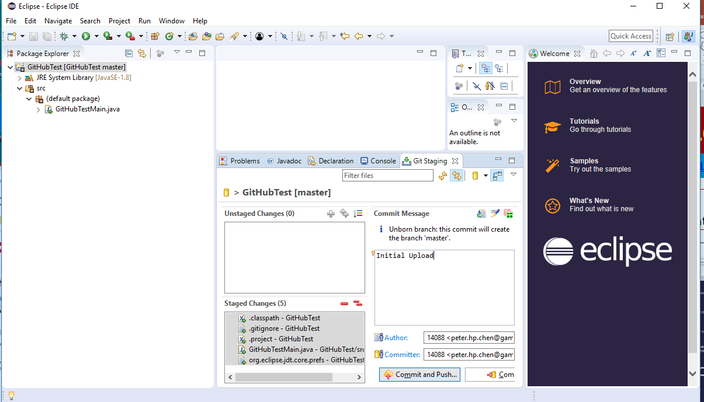
6.3 Commit Project to Local Repository
https://www.youtube.com/watch?v=Huwf0TgWrOw&list=PLsyeobzWxl7q2eaUkorLZExfd7qko9sZC&index=7
Type in log “Initial Uploaded”
Click “Commit and Push” button.

Slide 19
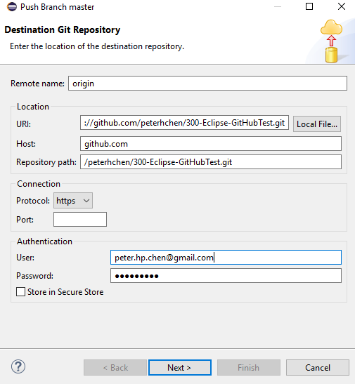
6.3 Commit Project to Local Repository
https://www.youtube.com/watch?v=Huwf0TgWrOw&list=PLsyeobzWxl7q2eaUkorLZExfd7qko9sZC&index=7
Copy the GitHub URI: https://github.com/peterhchen/300-Eclipse-GitHubTest.git
User name: peter.hp.chen@gamil.com, password: PCxxxx=xx

Slide 20
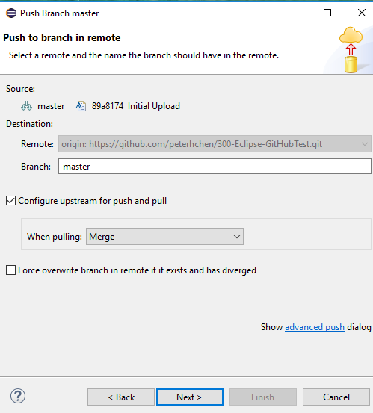
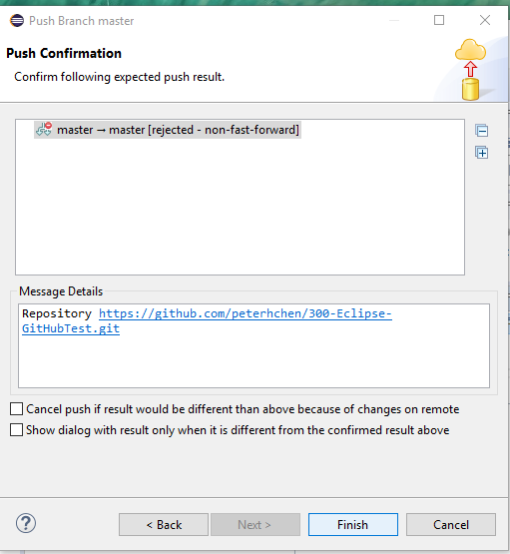
6.3 Commit Project to Local Repository
https://www.youtube.com/watch?v=Huwf0TgWrOw&list=PLsyeobzWxl7q2eaUkorLZExfd7qko9sZC&index=7
Branch: Master
There is an error message that does not allowed.

Slide 21
6.4 Command Line Check in

Slide 22
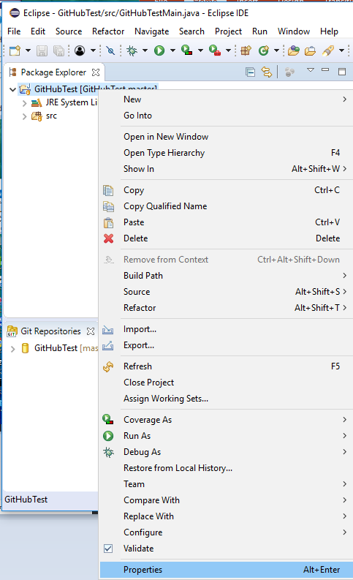
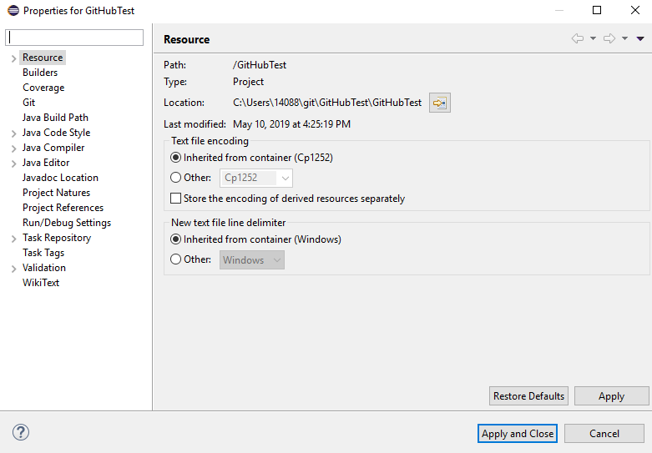
6.4 Command Line Check in
https://www.youtube.com/watch?v=Huwf0TgWrOw&list=PLsyeobzWxl7q2eaUkorLZExfd7qko9sZC&index=7
Since the Eclipse does not allow Push before Pull out, we use the command line instead.
First, we find out the project location.
Select project name: RMB > Properties.
The Project Location: C:\Users\14088\GitHubTest\GitHubTest

Slide 23
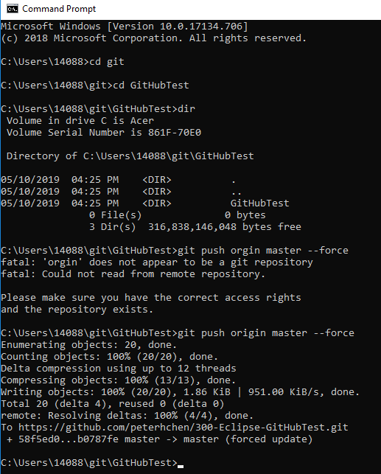
6.4 Command Line Check in
https://www.youtube.com/watch?v=Huwf0TgWrOw&list=PLsyeobzWxl7q2eaUkorLZExfd7qko9sZC&index=7
Change directory to C:\Users\14088\GitHubTest\GitHubTest
> git push origin master --force

Slide 24
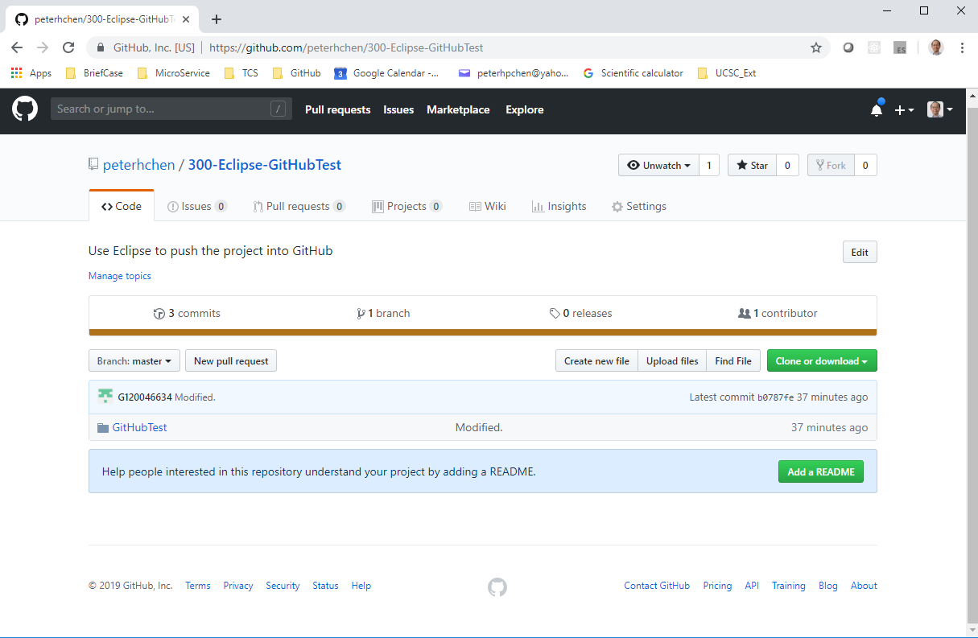
6.4 Command Line Check in
https://www.youtube.com/watch?v=Huwf0TgWrOw&list=PLsyeobzWxl7q2eaUkorLZExfd7qko9sZC&index=7
Check the GitHub Project Folder.

Slide 25
6.5 Got email from GitHub Team

Slide 26
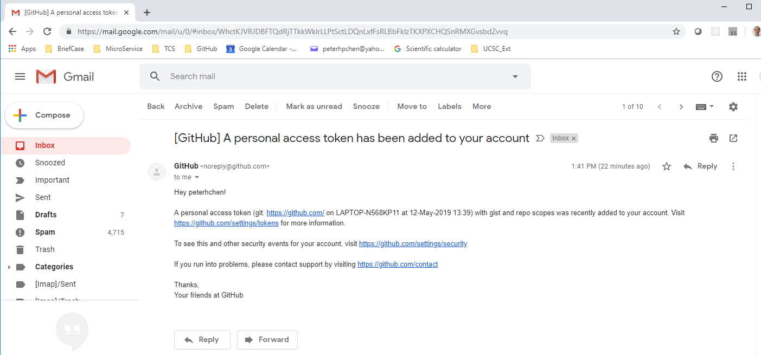
6.5 Got Email from GitHub Team
https://www.youtube.com/watch?v=Huwf0TgWrOw&list=PLsyeobzWxl7q2eaUkorLZExfd7qko9sZC&index=7
When you download or upload files by Eclipse, you will get an email from GitHub Team shows that you have token and can share the files to GitGub.

Slide 27
6.5 Use Eclipse and EGit

Slide 28
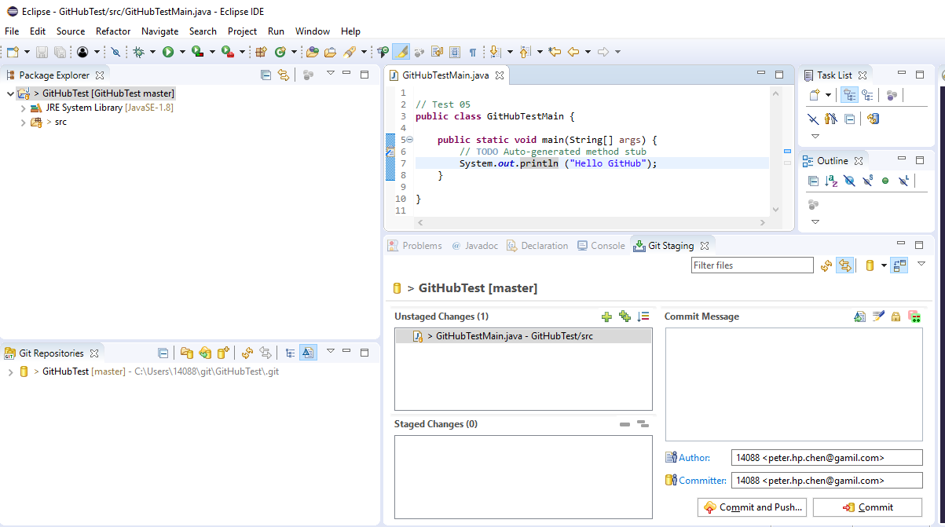
6.6 Use Eclipse and EGit
https://www.youtube.com/watch?v=Huwf0TgWrOw&list=PLsyeobzWxl7q2eaUkorLZExfd7qko9sZC&index=7
We can use the Eclipse and EGit to upload the project now.
Make “Test 05” modification as below.
Save File (Control+s).
The Unstaged Change will display the modified file(s).
1
2
Save File
3

Slide 29
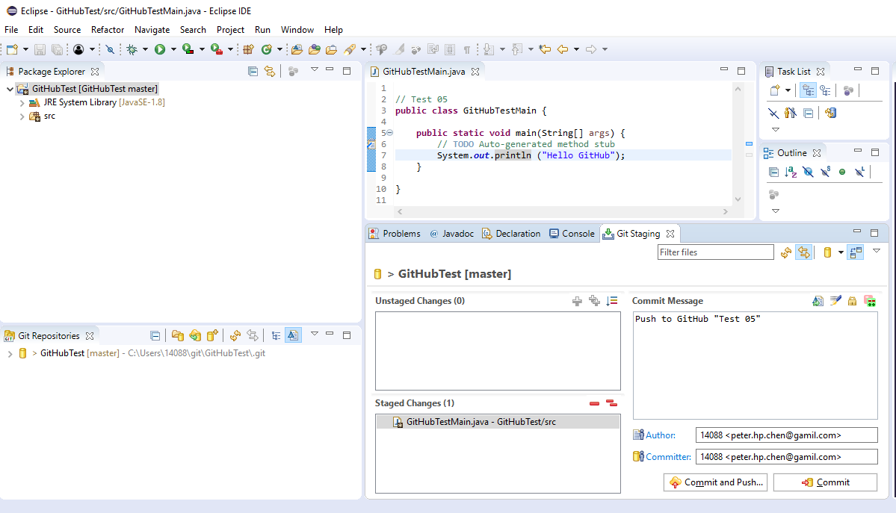
6.6 Use Eclipse and EGit
https://www.youtube.com/watch?v=Huwf0TgWrOw&list=PLsyeobzWxl7q2eaUkorLZExfd7qko9sZC&index=7
Push to the GitHub
Move the modified file from “Unsatged Changes” to “Staged Changes” (by Drag –and-drop or click + sign).
Write the Commit Message: Push to GitHub “Test 05”
Click button “Commit and Push …”
2
1
3

Slide 30
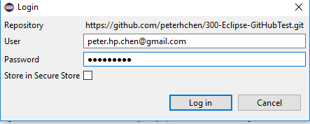
6.6 Use Eclipse and EGit
https://www.youtube.com/watch?v=Huwf0TgWrOw&list=PLsyeobzWxl7q2eaUkorLZExfd7qko9sZC&index=7
Fill in the
User: peter.hp.chen@gmail.com
Password: PCXXXX=XX
Click “Log in”

Slide 31
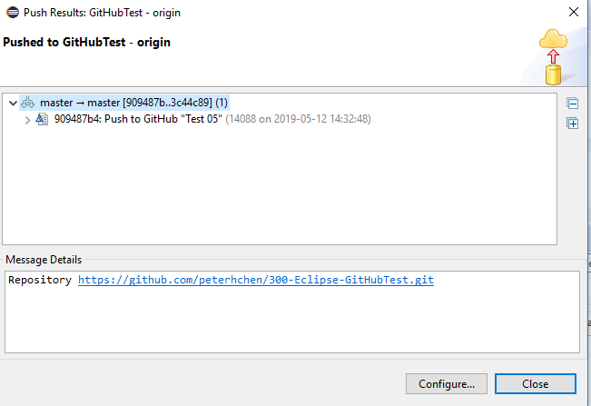
6.6 Use Eclipse and EGit
https://www.youtube.com/watch?v=Huwf0TgWrOw&list=PLsyeobzWxl7q2eaUkorLZExfd7qko9sZC&index=7
Display the successful message without error:
Master -> master [xxxxx…xxxxxx]
>….: Push to GitHub “Test 05”
Click “Close”

Slide 32
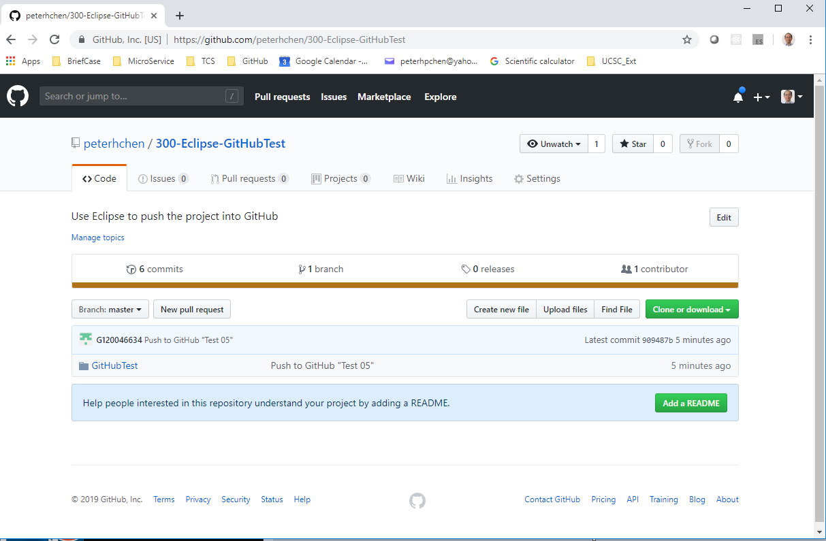
6.6 Use Eclipse and EGit
https://www.youtube.com/watch?v=Huwf0TgWrOw&list=PLsyeobzWxl7q2eaUkorLZExfd7qko9sZC&index=7
Click Repository: “300-Eclipse-GithubTest”
Click Project: “GitHubTest”

Slide 33
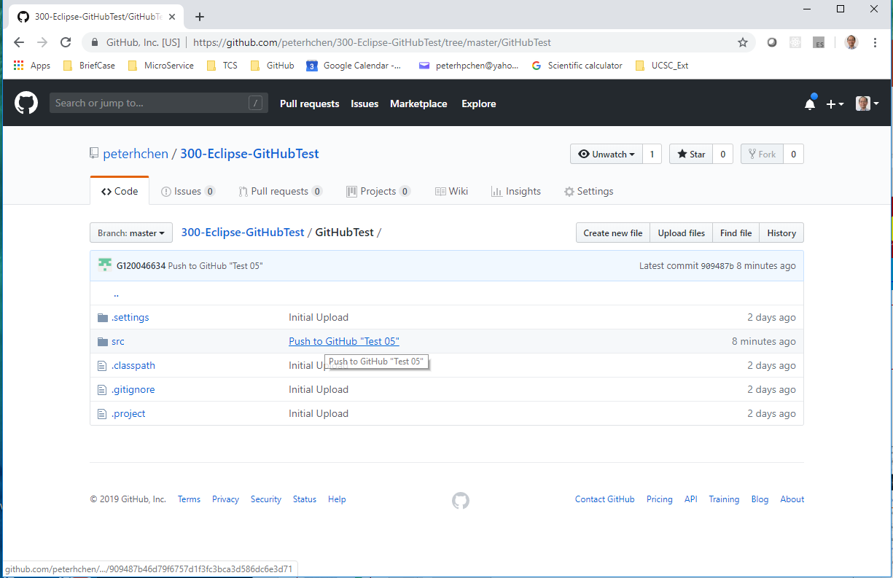
6.6 Use Eclipse and EGit
https://www.youtube.com/watch?v=Huwf0TgWrOw&list=PLsyeobzWxl7q2eaUkorLZExfd7qko9sZC&index=7
Click “src” folder

Slide 34
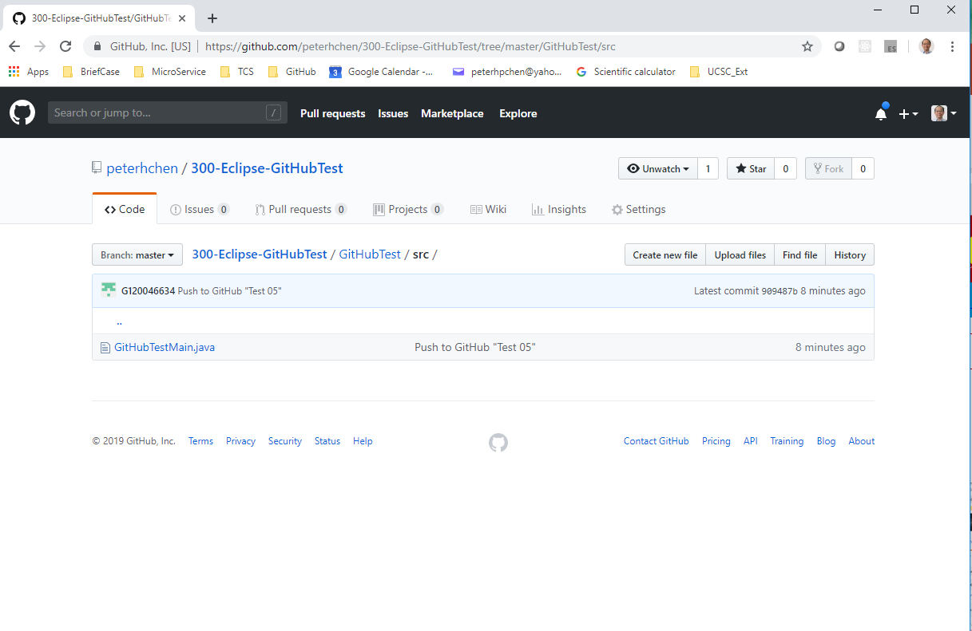
6.6 Use Eclipse and EGit
https://www.youtube.com/watch?v=Huwf0TgWrOw&list=PLsyeobzWxl7q2eaUkorLZExfd7qko9sZC&index=7
Click file “GitHubnTestMain.java”

Slide 35
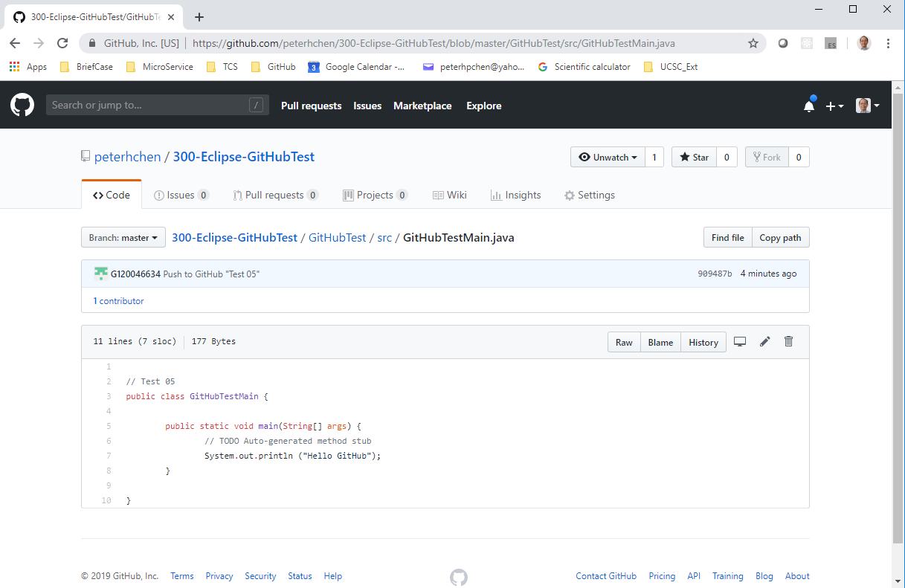
6.6 Use Eclipse and EGit
https://www.youtube.com/watch?v=Huwf0TgWrOw&list=PLsyeobzWxl7q2eaUkorLZExfd7qko9sZC&index=7
Check “Test 05” is there. This the modification we made in the local repository and uploaded to the remote repository.

Slide 36
End of Chapter

