Slide 1

2 GitHub Sign Up
Peter H. Chen

Slide 2
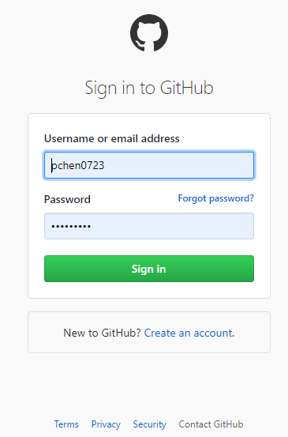
2 GitHub Signup
https://www.youtube.com/watch?v=WdncOs2FANQ&list=PLsyeobzWxl7q2eaUkorLZExfd7qko9sZC&index=2
Sign up for GitHub. We have GitLab and bitbucket.
GitLab for platform. Mostly used by the companies.
BitBucket from Atlassian, which includes the Jira as well. Mostly used by the companies as well. Small teams are free.

Slide 3
End of Chapter

