Slide 1

3 Create Repository
Peter H. Chen

Slide 2
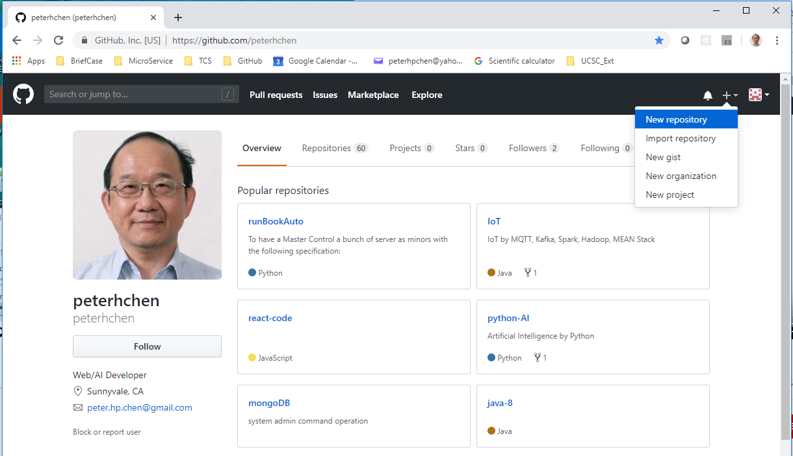
3 Create Repository
https://www.youtube.com/watch?v=WfhRyz3Wf4o&list=PLsyeobzWxl7q2eaUkorLZExfd7qko9sZC&index=4
New Repository.

Slide 3
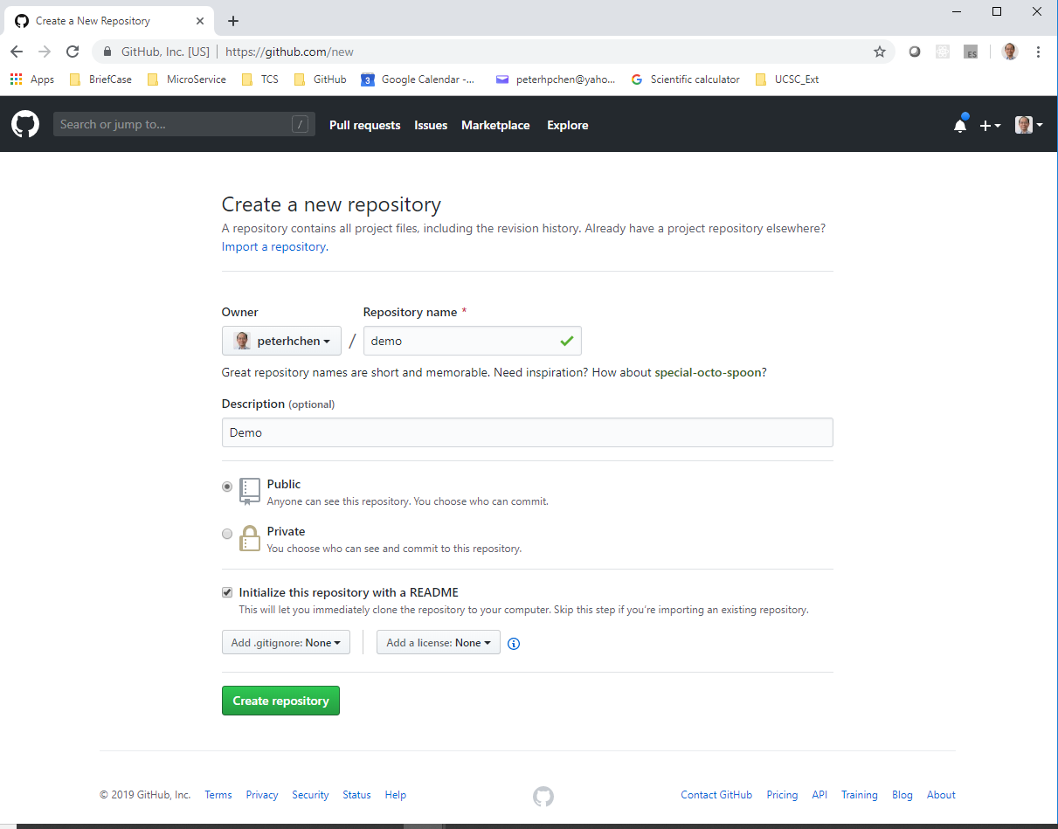
3 Create Repository
https://www.youtube.com/watch?v=WfhRyz3Wf4o&list=PLsyeobzWxl7q2eaUkorLZExfd7qko9sZC&index=4
Name, Description, and click “Create repository”.

Slide 4
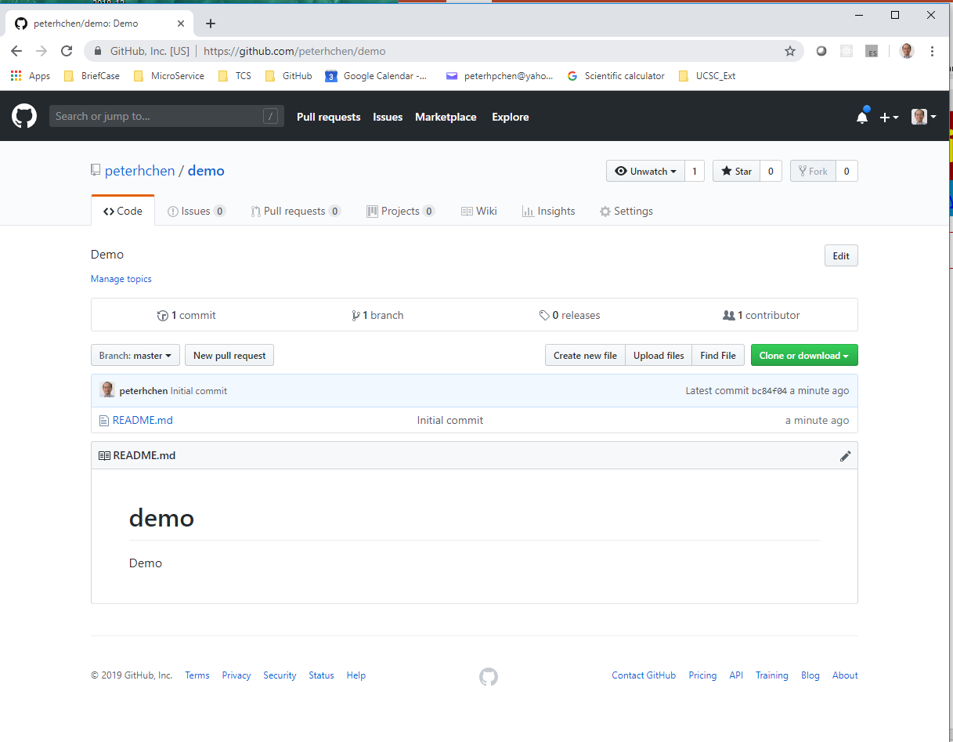
3 Create Repository
https://www.youtube.com/watch?v=WfhRyz3Wf4o&list=PLsyeobzWxl7q2eaUkorLZExfd7qko9sZC&index=4
You got a new repository. Click “Create new file”

Slide 5
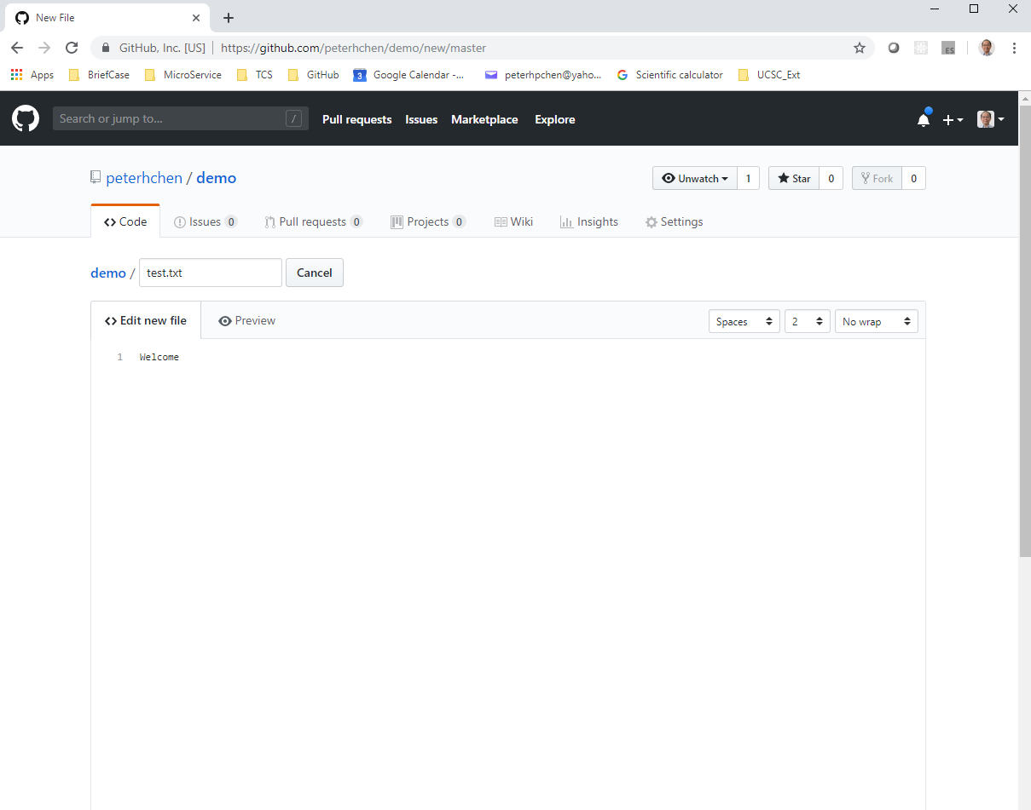
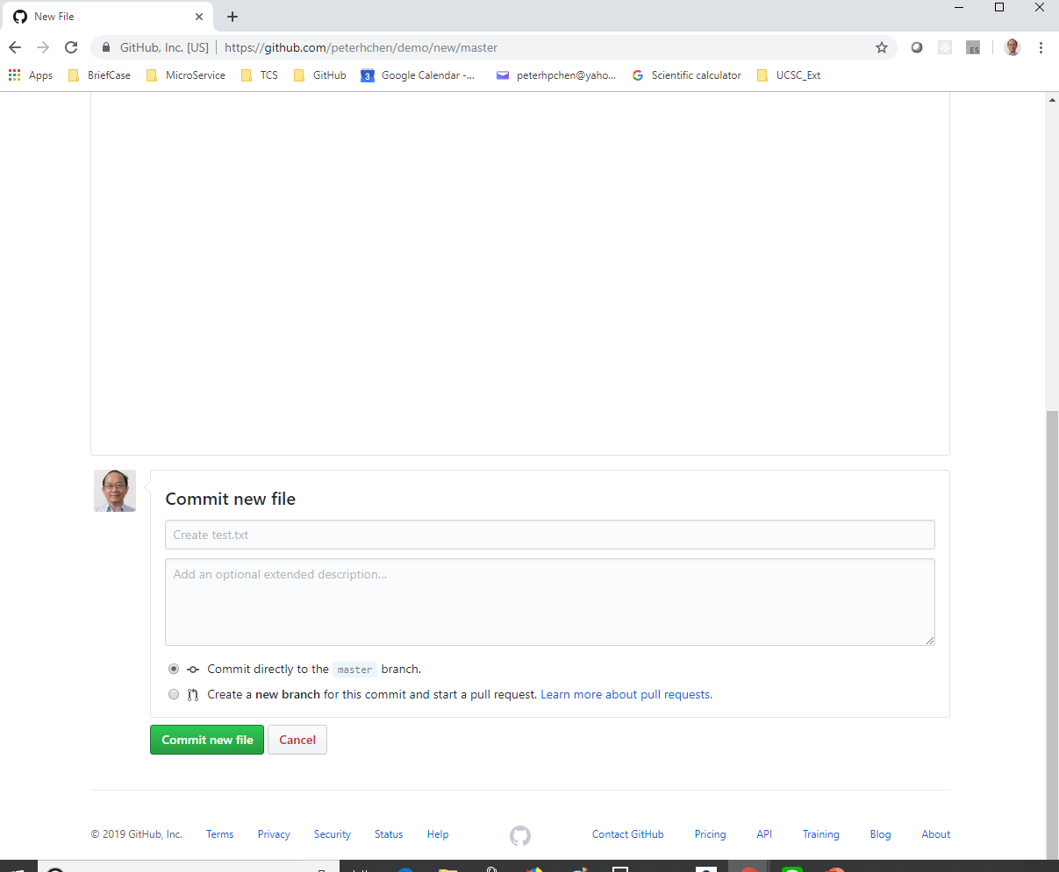
3 Create Repository
https://www.youtube.com/watch?v=WfhRyz3Wf4o&list=PLsyeobzWxl7q2eaUkorLZExfd7qko9sZC&index=4
Create “test.txt” and “Welcome” inside the file. Scroll down and “Commit new file”.

Slide 6
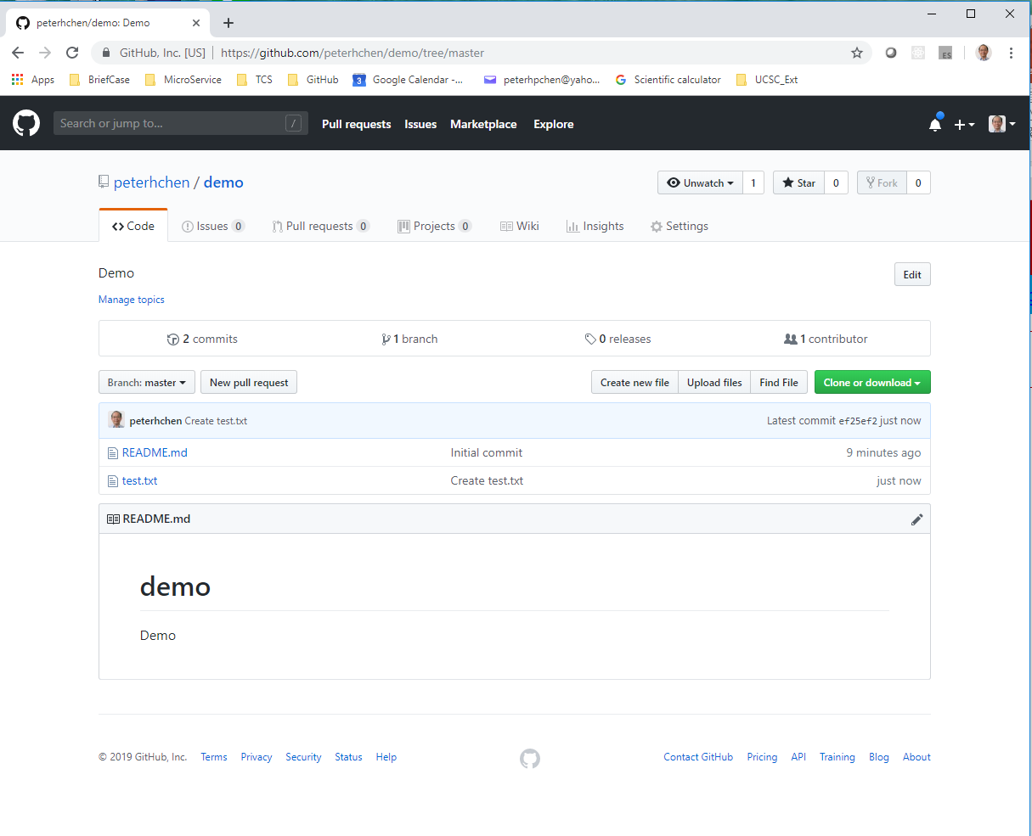
3 Create Repository
https://www.youtube.com/watch?v=WfhRyz3Wf4o&list=PLsyeobzWxl7q2eaUkorLZExfd7qko9sZC&index=4
We got “test.txt” file.

Slide 7
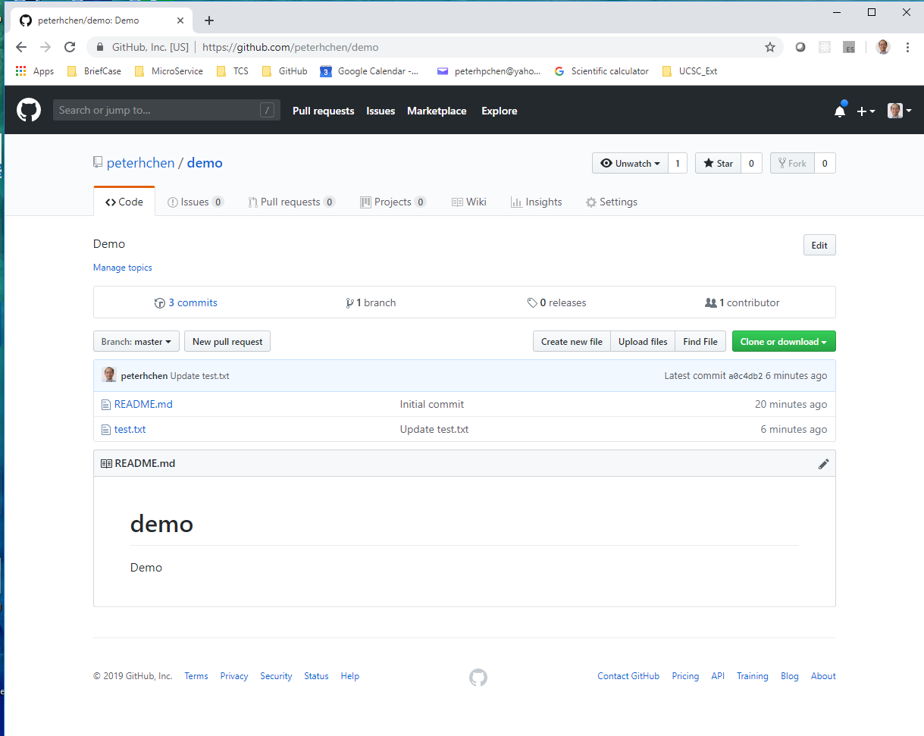
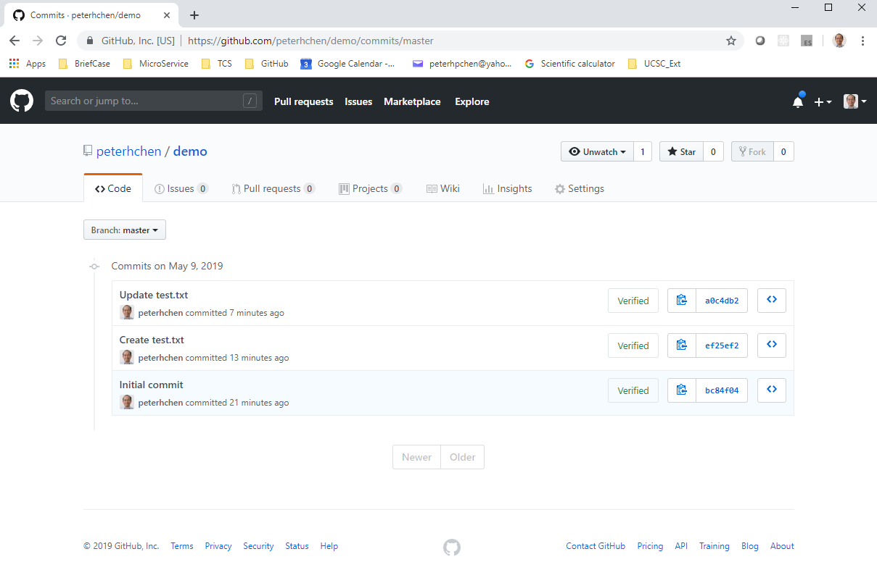
3 Create Repository
https://www.youtube.com/watch?v=WfhRyz3Wf4o&list=PLsyeobzWxl7q2eaUkorLZExfd7qko9sZC&index=4
Click “Commit” to view the previous commit modification.

Slide 8
End of Chapter

