Slide 1

1 Configure IntelliJ
Peter H. Chen

Slide 2
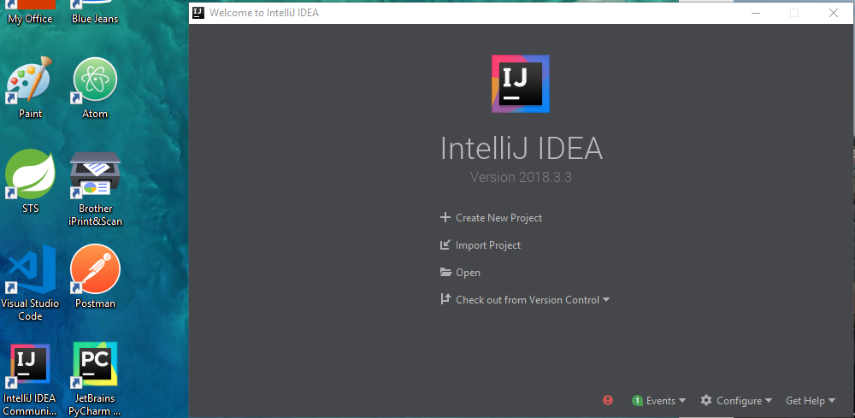
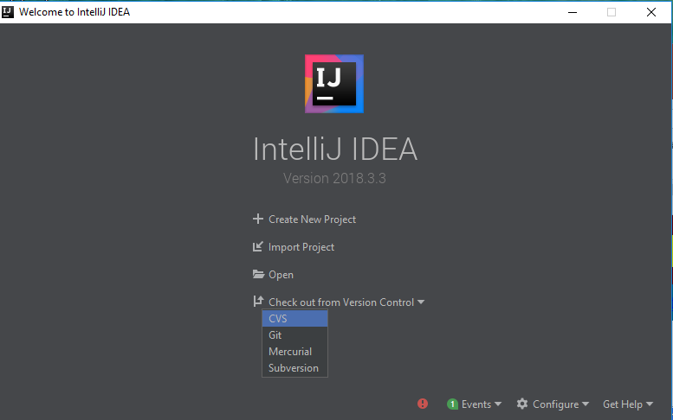
1 Configure IntelliJ
https://www.youtube.com/watch?v=c0efB_CKOYo&list=PLPZy-hmwOdEXdOtXdFzyx_XCnrF_oD2Ft&index=1
Start the IntelliJ, If you have any open project, close first, then restart the IntelliJ.
You can create a new project, import project with Gradle or Maven, open an existing project, and check out the project by CVS, Git, Mercurial, and Subversion.

Slide 3
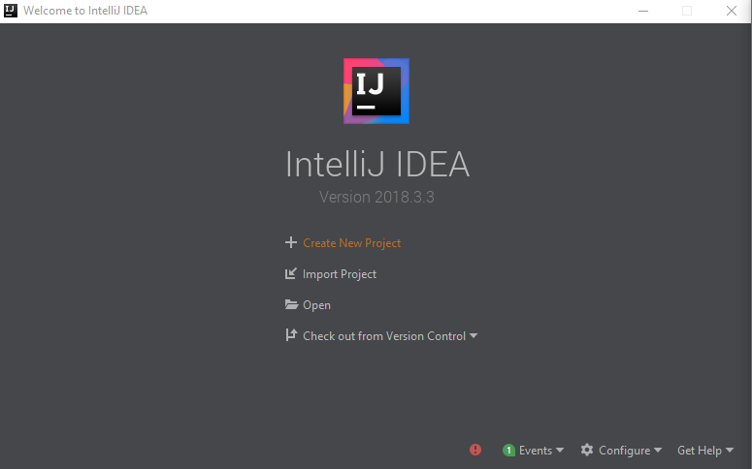
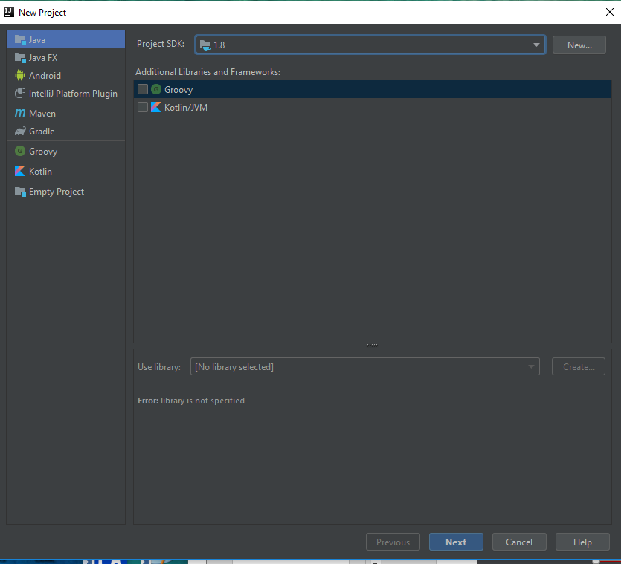
1 Configure IntelliJ
https://www.youtube.com/watch?v=c0efB_CKOYo&list=PLPZy-hmwOdEXdOtXdFzyx_XCnrF_oD2Ft&index=1
Create New Project.
The Java Project needs Project SDK 1.8 installed on your computer.

Slide 4
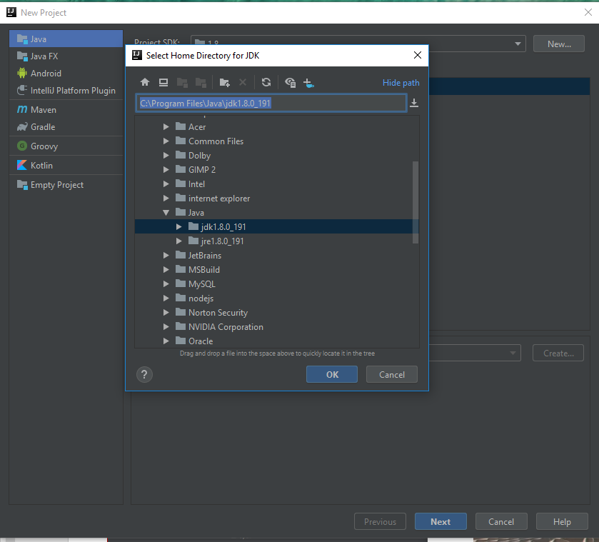
1 Configure IntelliJ
https://www.youtube.com/watch?v=c0efB_CKOYo&list=PLPZy-hmwOdEXdOtXdFzyx_XCnrF_oD2Ft&index=1
New and Select the JDK Library version. Click Next.

Slide 5
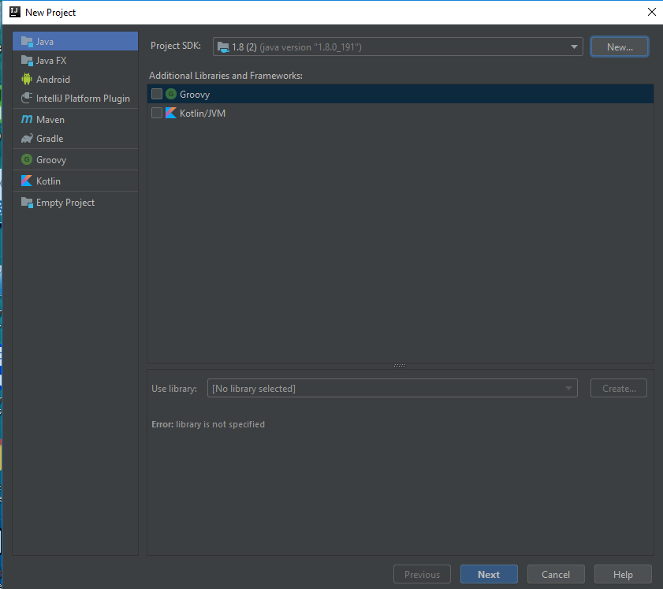
1 Configure IntelliJ
https://www.youtube.com/watch?v=c0efB_CKOYo&list=PLPZy-hmwOdEXdOtXdFzyx_XCnrF_oD2Ft&index=1
Keep default Groovy and click Next.

Slide 6
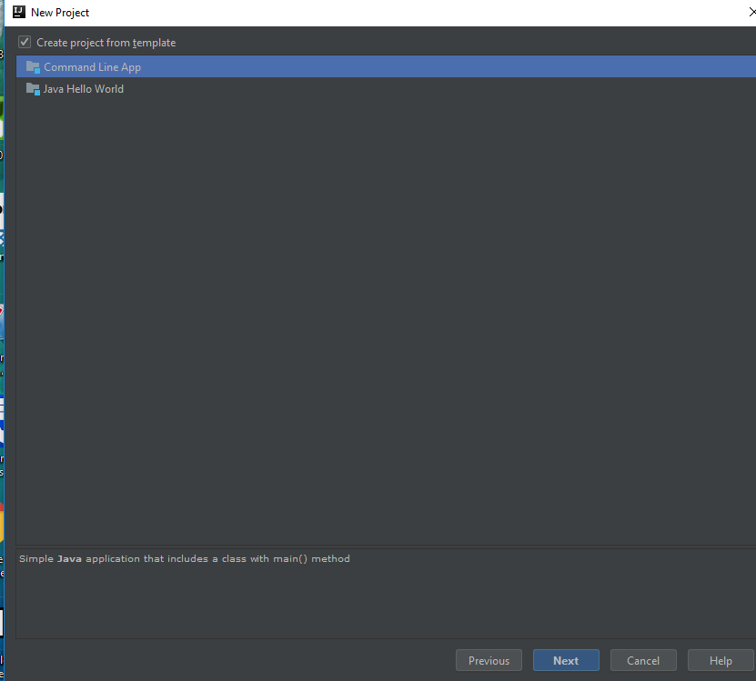
1 Configure IntelliJ
https://www.youtube.com/watch?v=c0efB_CKOYo&list=PLPZy-hmwOdEXdOtXdFzyx_XCnrF_oD2Ft&index=1
Select “Create project from template” and click Next.

Slide 7
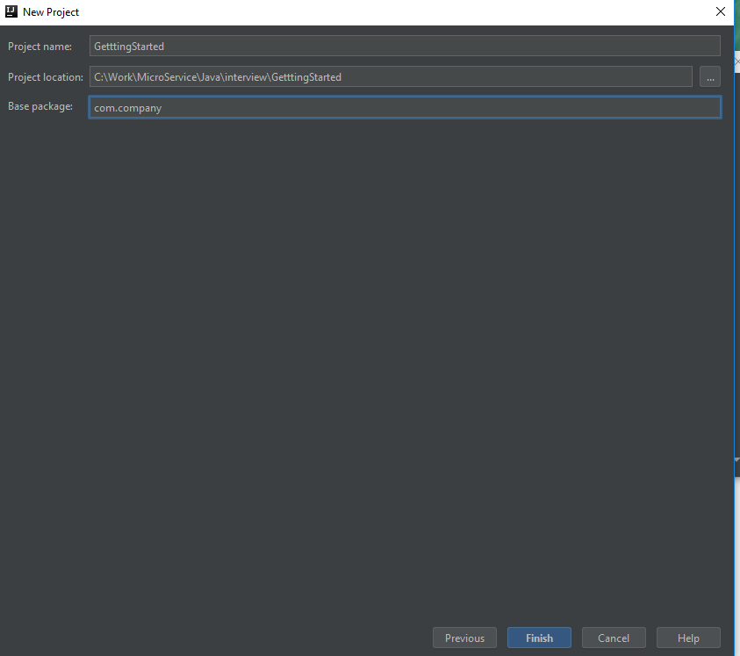
1 Configure IntelliJ
https://www.youtube.com/watch?v=c0efB_CKOYo&list=PLPZy-hmwOdEXdOtXdFzyx_XCnrF_oD2Ft&index=1
Enter the project name “GettingStarted” and click Finish.

Slide 8
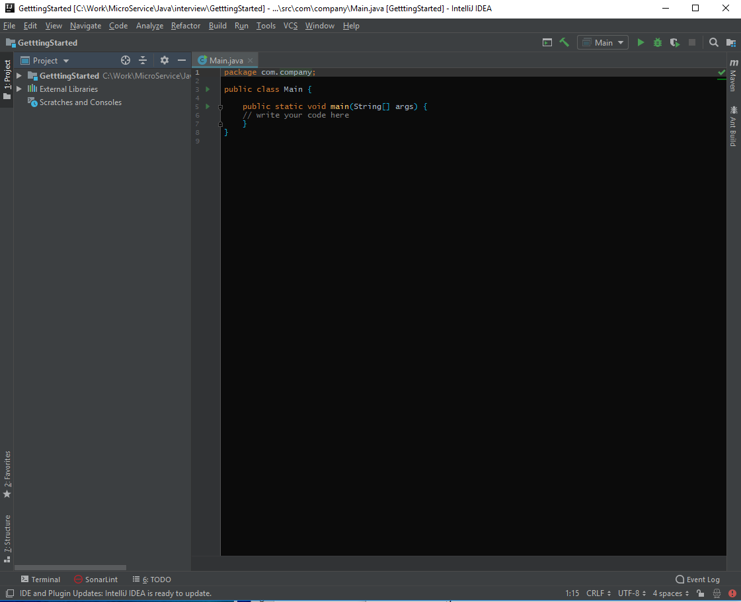
1 Configure IntelliJ
https://www.youtube.com/watch?v=c0efB_CKOYo&list=PLPZy-hmwOdEXdOtXdFzyx_XCnrF_oD2Ft&index=1
IntelliJ create a simple Java project template to start with.

Slide 9
1.1 IntelliJ Operation
Peter H. Chen

Slide 10
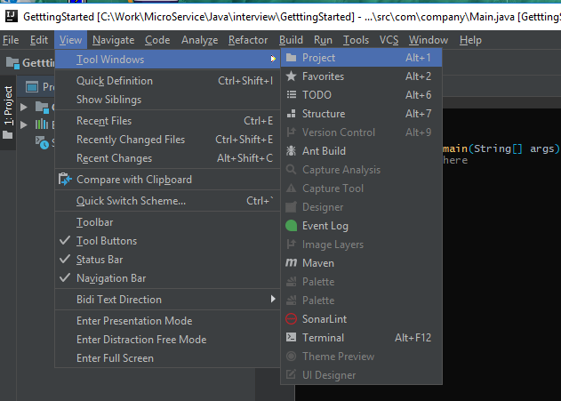
1.1 IntelliJ Operation
https://www.youtube.com/watch?v=c0efB_CKOYo&list=PLPZy-hmwOdEXdOtXdFzyx_XCnrF_oD2Ft&index=1
View > Tool Windows > Project: Turn on/off the Project Explorer.

Slide 11
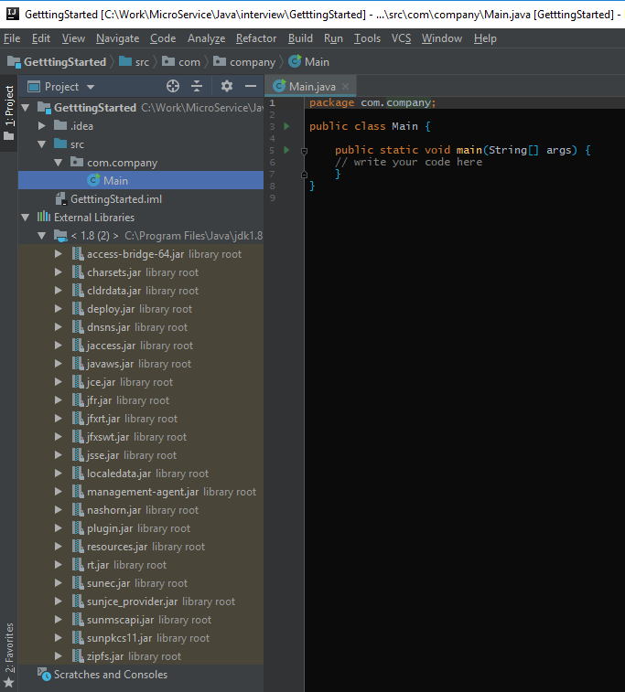
1.1 IntelliJ Operation
https://www.youtube.com/watch?v=c0efB_CKOYo&list=PLPZy-hmwOdEXdOtXdFzyx_XCnrF_oD2Ft&index=1
Check External Libraries: In this case, we have the SDK libraries.

Slide 12
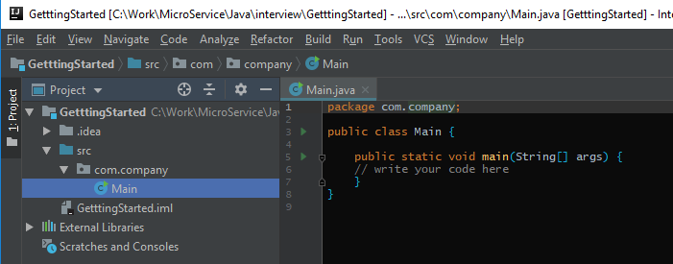
1.1 IntelliJ Operation
https://www.youtube.com/watch?v=c0efB_CKOYo&list=PLPZy-hmwOdEXdOtXdFzyx_XCnrF_oD2Ft&index=1
Browse your file by Project Explorer.

Slide 13
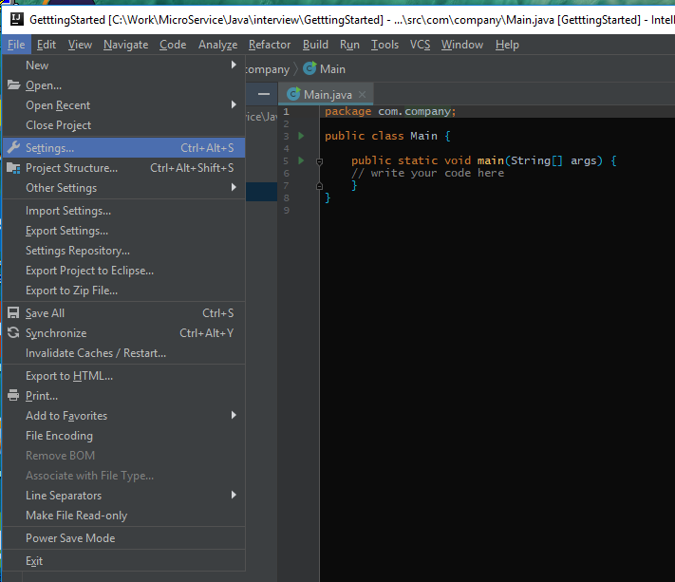
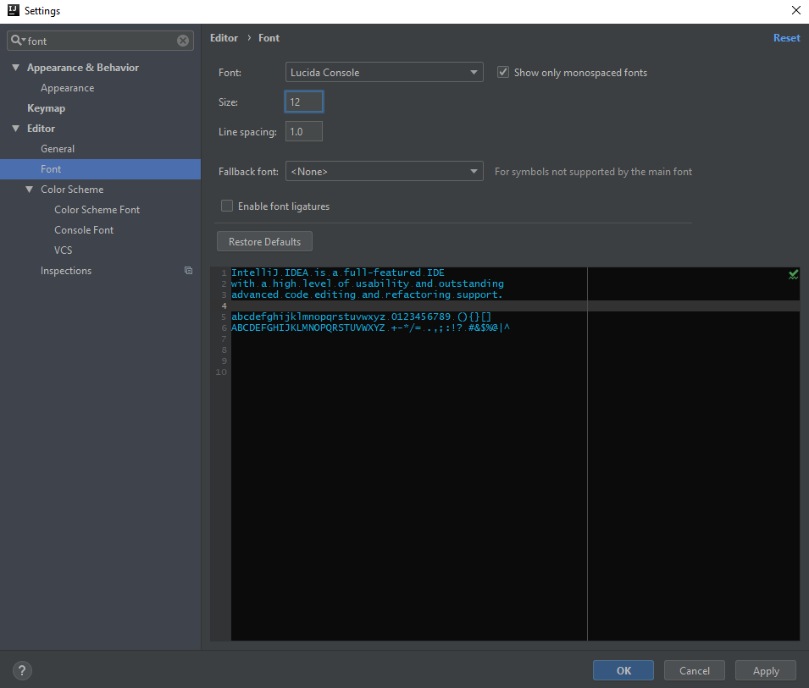
1.1 IntelliJ Operation
https://www.youtube.com/watch?v=c0efB_CKOYo&list=PLPZy-hmwOdEXdOtXdFzyx_XCnrF_oD2Ft&index=1
Setup the appearence: File > Settings …
Search “font” and change the font size, e.g., 12 to 16.

Slide 14
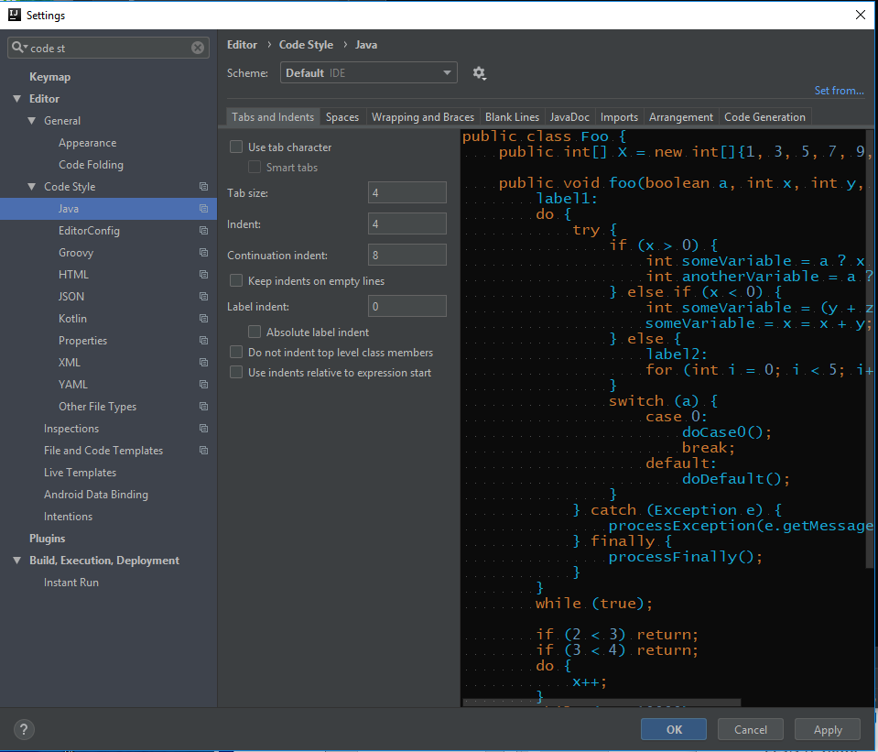
1.1 IntelliJ Operation
https://www.youtube.com/watch?v=c0efB_CKOYo&list=PLPZy-hmwOdEXdOtXdFzyx_XCnrF_oD2Ft&index=1
Search “code style”. Change the coding style, e.g., tab, space, and etc.

Slide 15
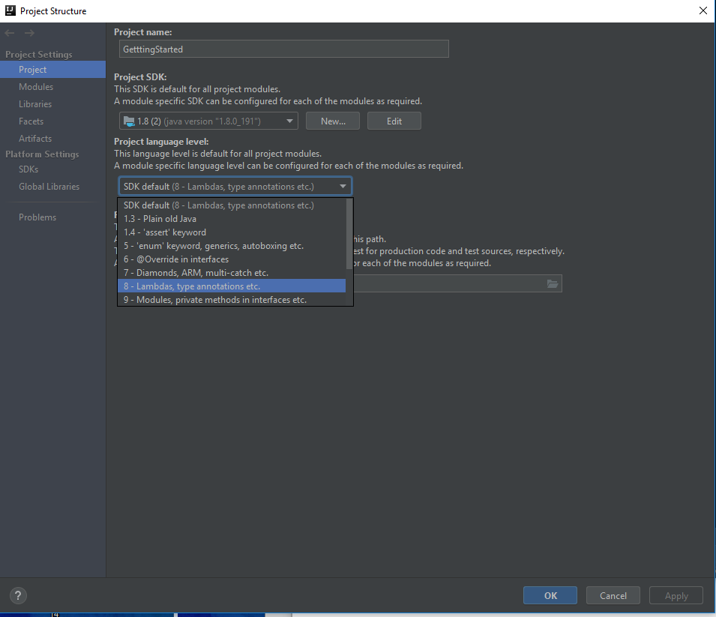
1.1 IntelliJ Operation
https://www.youtube.com/watch?v=c0efB_CKOYo&list=PLPZy-hmwOdEXdOtXdFzyx_XCnrF_oD2Ft&index=1
File > Project Structure. Default is Java 8. Your can select other version of Java.

Slide 16
1.2 Code Development
Peter H. Chen

Slide 17
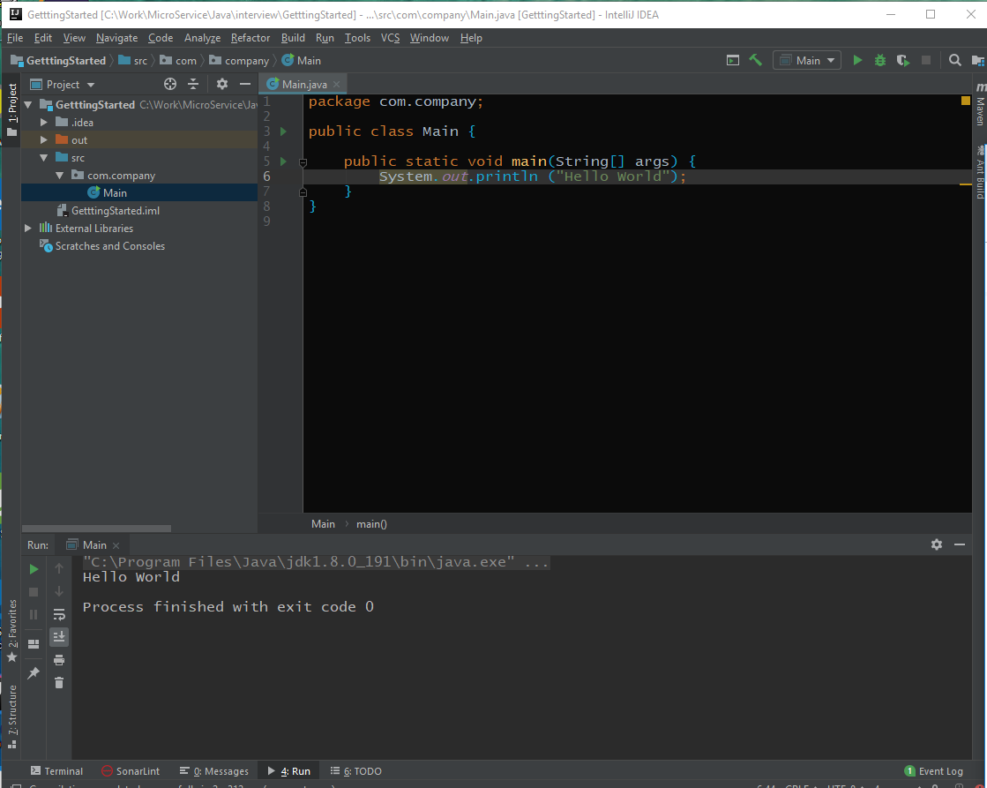
1.2 Code Development
https://www.youtube.com/watch?v=c0efB_CKOYo&list=PLPZy-hmwOdEXdOtXdFzyx_XCnrF_oD2Ft&index=1
Now, write some code and click “run”.

Slide 18
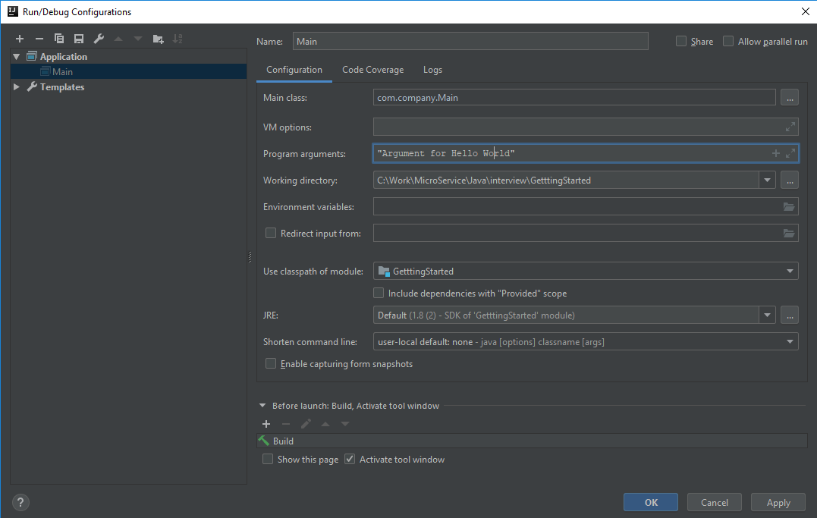
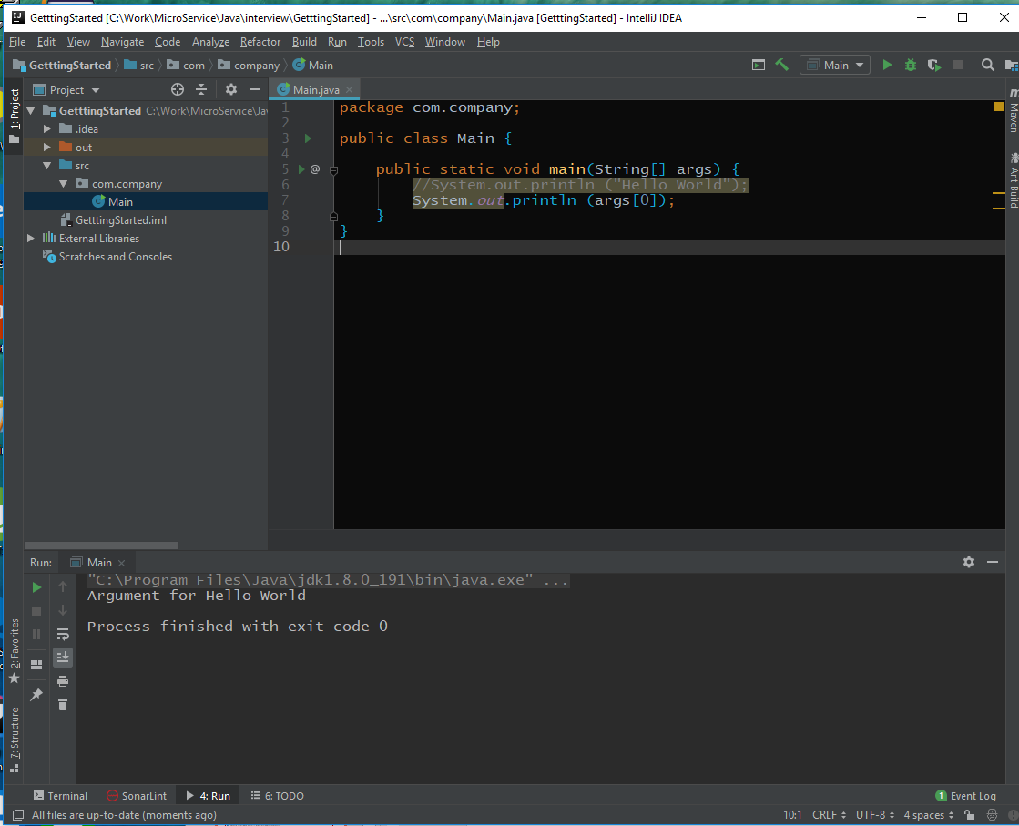
1.2 Code Development
https://www.youtube.com/watch?v=c0efB_CKOYo&list=PLPZy-hmwOdEXdOtXdFzyx_XCnrF_oD2Ft&index=1
Print args[0]: Run > Edit Configurations ...
Program Arguments: “Argument for Hello World”
Click Run

Slide 19
1.3 Debug
Peter H. Chen

Slide 20
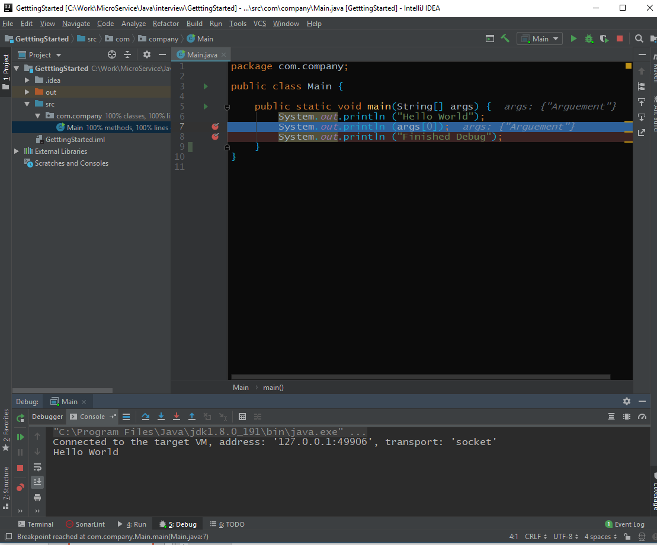
1.2 Code Development
https://www.youtube.com/watch?v=c0efB_CKOYo&list=PLPZy-hmwOdEXdOtXdFzyx_XCnrF_oD2Ft&index=1
Control+Fn+F8 set the breakpoint in the code.
Click “debug” to run and stop at break point.
Click Step over and click console to check the output display.

Slide 21
End of Chapter

