Slide 1

2 Override
Peter H. Chen

Slide 2
2 Override
https://www.tutorialspoint.com/java/index.htm
In the previous chapter, we talked about superclasses and subclasses.
If a class inherits a method from its superclass, then there is a chance to override the method provided that it is not marked final.
The benefit of overriding is: ability to define a behavior that's specific to the subclass type, which means a subclass can implement a parent class method based on its requirement.
In object-oriented terms, overriding means to override the functionality of an existing method.

Slide 3
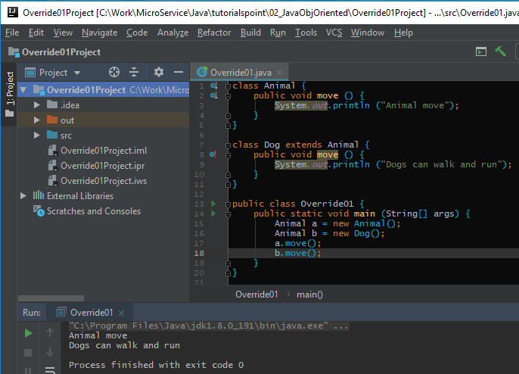
2 Override
https://www.tutorialspoint.com/java/index.htm
Example Override01.java.

Slide 4
End of Chapter

