Slide 1

5 Encapsulation
Peter H. Chen

Slide 2
5 Encapsulation
https://www.tutorialspoint.com/java/index.htm
Encapsulation is one of the four fundamental OOP concepts. The other three are inheritance, polymorphism, and abstraction.
Encapsulation in Java is a mechanism of wrapping the data (variables) and code acting on the data (methods) together as a single unit. In encapsulation, the variables of a class will be hidden from other classes, and can be accessed only through the methods of their current class. Therefore, it is also known as data hiding.
To achieve encapsulation in Java −
Declare the variables of a class as private.
Provide public setter and getter methods to modify and view the variables values.

Slide 3
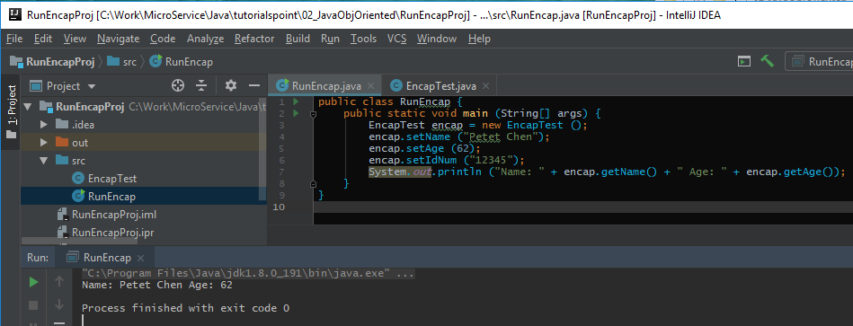
5 Encapsulation
https://www.tutorialspoint.com/java/index.htm
RunEncap.java:

Slide 4
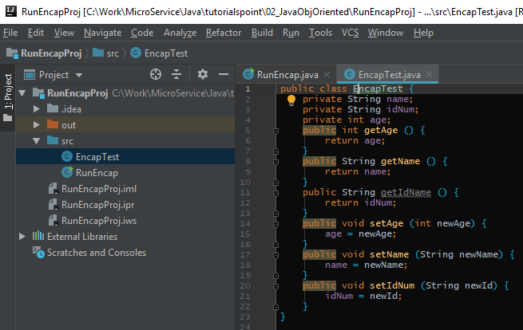
5 Encapsulation
https://www.tutorialspoint.com/java/index.htm
EncapTest.java:

Slide 5
End of Chapter

