Slide 1

1 Java Inheritance
Peter H. Chen

Slide 2
1 Java Inheritance
https://www.tutorialspoint.com/java/index.htm
Inheritance can be defined as the process where one class acquires the properties (methods and fields) of another.
With the use of inheritance the information is made manageable in a hierarchical order.
The class which inherits the properties of other is known as subclass (derived class, child class) and the class whose properties are inherited is known as superclass (base class, parent class).
extends Keyword
extends is the keyword used to inherit the properties of a class. Following is the syntax of extends keyword.
Syntax
class Super {
.....
.....
}
class Sub extends Super {
.....
.....
}

Slide 3
1.1 Keyword extends

Slide 4
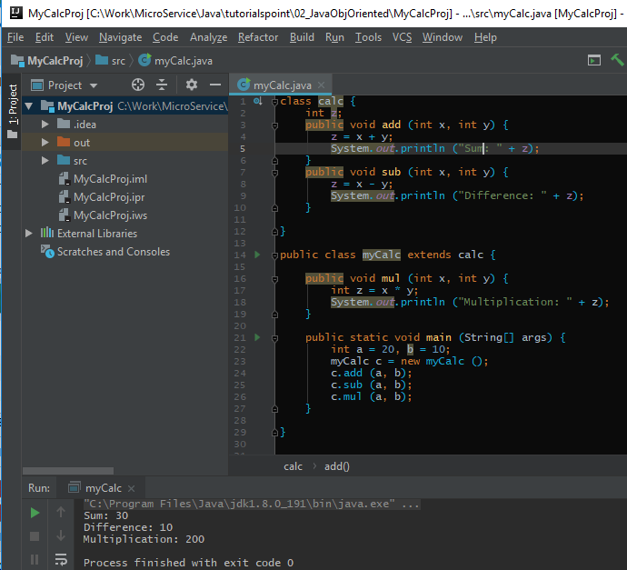
1.1 Keyword extend
https://www.tutorialspoint.com/java/index.htm
myCalc Example:

Slide 5
1.2 Keyword super

Slide 6
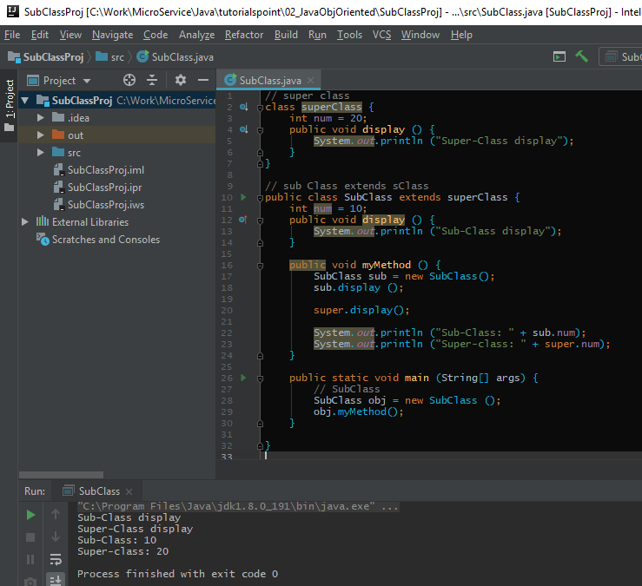
1.2 Keyword super
https://www.tutorialspoint.com/java/index.htm
Super Keyword:
The super keyword is similar to this keyword. Following are the scenarios where the super keyword is used.
It is used to differentiate the members of superclass from the members of subclass, if they have same names.
It is used to invoke the superclass constructor from subclass.

Slide 7
1.3 Superclass Constructor

Slide 8
1.3 Superclass Constructor
https://www.tutorialspoint.com/java/index.htm
Invoking Superclass Constructor (1)
If a class is inheriting the properties of another class, the subclass automatically acquires the default constructor of the superclass.
But if you want to call a parameterized constructor of the superclass, you need to use the super keyword as shown below.
super(values);

Slide 9
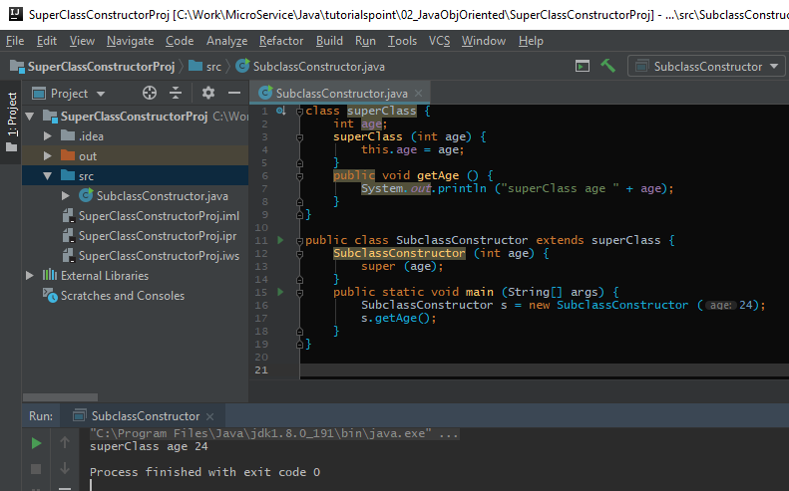
1.3 Superclass Constructor
https://www.tutorialspoint.com/java/index.htm
Invoking Superclass Constructor (2)

Slide 10
End of Chapter

