Slide 1

4 Abstraction
Peter H. Chen

Slide 2
4 Abstraction
https://www.tutorialspoint.com/java/index.htm
The abstraction is the manager’s ideas or management rather than engineer’s real work.
For example, the department manager is an abstraction function. The engineer under the manager implement the solid work which is not abstraction.
The abstraction is a process of hiding the implementation details from the user, only the functionality will be provided to the user.
In other words, the user will have the information on what the object does instead of how it does it.
In Java, abstraction is achieved using Abstract classes and interfaces.

Slide 3
4 Abstraction
https://www.tutorialspoint.com/java/index.htm
Abstract Class
A class which contains the abstract keyword in its declaration is known as abstract class.
Abstract classes may or may not contain abstract methods, i.e., methods without solid body (public void get(); ), just keep the method name like manger title without solid work.
If a class has at least one abstract method, then the class must be declared abstract. The manager job function is non-solid work. He may do solid work as well. Manager is abstract.
If a class is declared abstract, it cannot be instantiated.
To use an abstract class, you have to inherit it from another class, provide implementations to the abstract methods in it.
If you inherit an abstract class, you have to provide implementations to all the abstract methods in it.

Slide 4
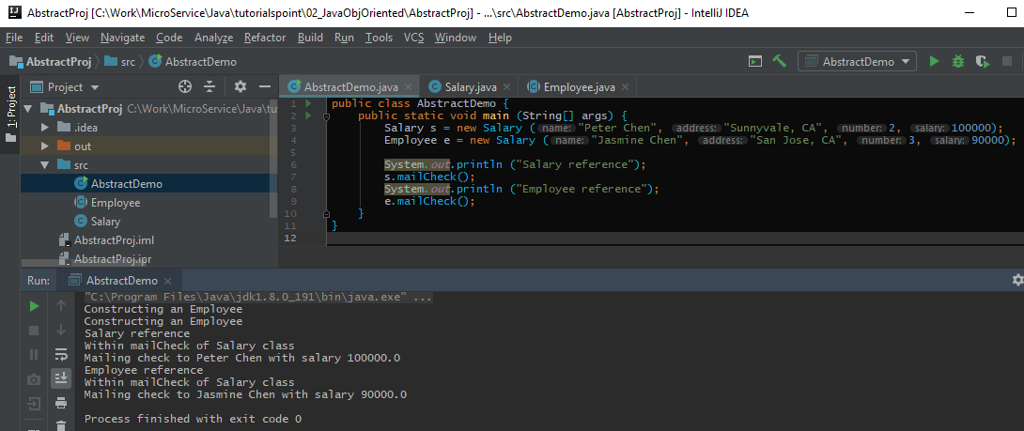
4 Abstraction
https://www.tutorialspoint.com/java/index.htm
AbstractDemo.java: You cannot instantiate the Employee since Employee is abstract class.

Slide 5
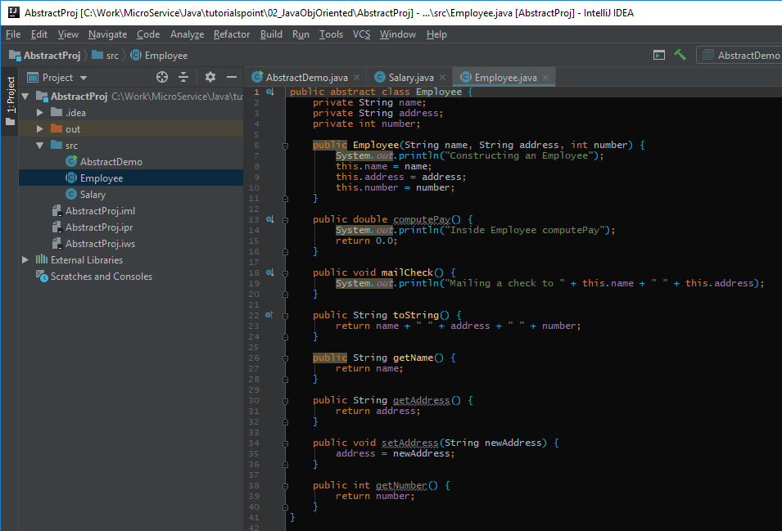
4 Abstraction
https://www.tutorialspoint.com/java/index.htm
Employee.java

Slide 6
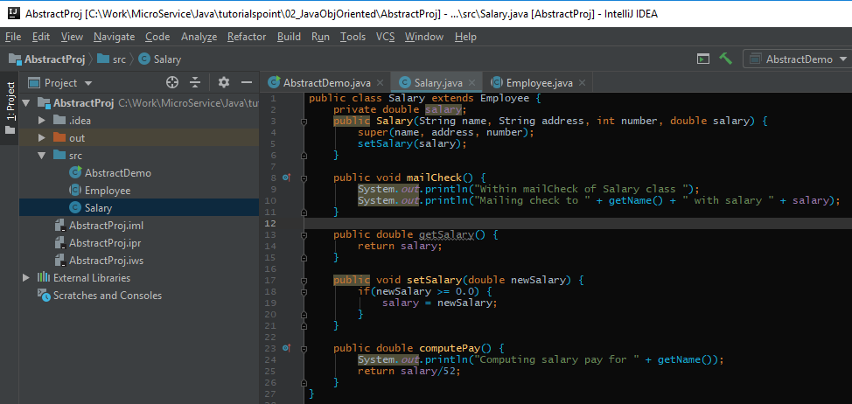
4 Abstraction
https://www.tutorialspoint.com/java/index.htm
salary.java

Slide 7
End of Chapter

