Slide 1

00.01 Eclipse Installation
Peter H. Chen

Slide 2
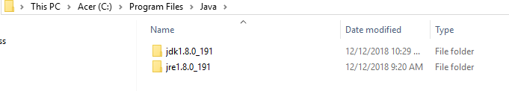
00.01 Eclipse Installation
https://www.youtube.com/watch?v=xqS31gwunp0&list=PLsyeobzWxl7rbjzQQQv8fCAlnBTDQJ2ps
This sections discusses how to install the Eclipse.
Eclipse IDE is for Java and Android development.
There are different IDE for Java Development. We have NetBeans, Eclipse, IntelliJ, and etc.
For industrial standards, everyone use Eclipse for web development.
If we talk about Android development, Eclipse provides some libraries that you can work on Android.
Google search for “Eclipse download”. Before you download, you have to make sure yout have JDK in your computer.
Go to: “C:\Program Files\Java”, you should have at least one jdk and jre. Make sure you have latest Java version 1.8.
Eclipse uses JDK to compile the Java code.

Slide 3
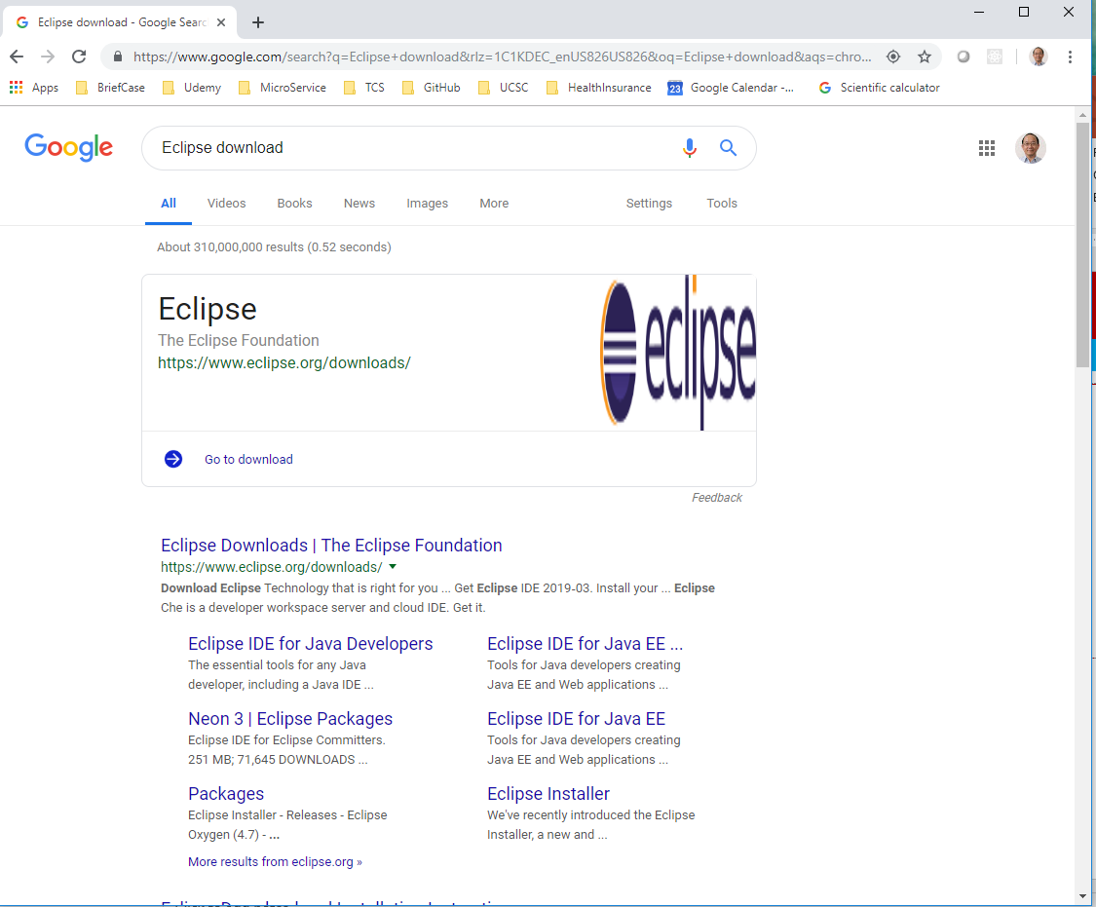
00.01 Eclipse Installation
https://www.youtube.com/watch?v=xqS31gwunp0&list=PLsyeobzWxl7rbjzQQQv8fCAlnBTDQJ2ps
Eclipse has different IDE for different perspective.
We have Eclipse for Java Developers, Java EE perspective, and etc.
Since we may download Eclipse for Java developer for different versions for web development, software development, version control, or Android development.
We may download Java EE.

Slide 4
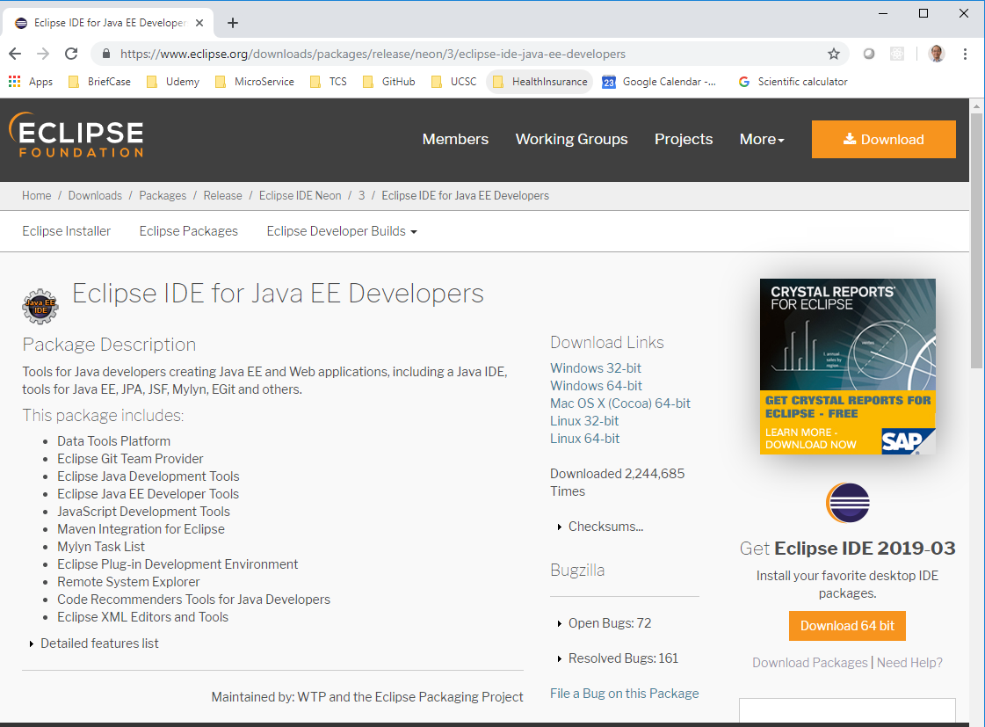
00.01 Eclipse Installation
https://www.youtube.com/watch?v=xqS31gwunp0&list=PLsyeobzWxl7rbjzQQQv8fCAlnBTDQJ2ps
As we can click on Java EE. They ask for different types of download link.
We are using the Windows 64 bits. Download and unzip.

Slide 5
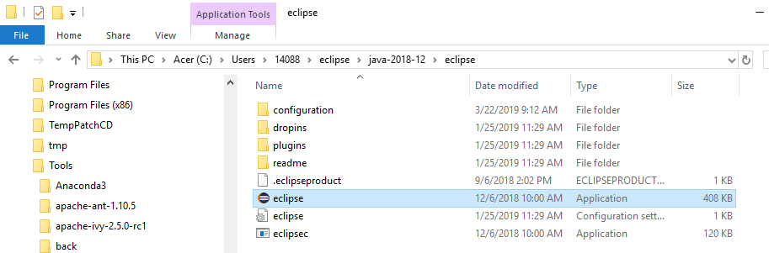
00.01 Eclipse Installation
https://www.youtube.com/watch?v=xqS31gwunp0&list=PLsyeobzWxl7rbjzQQQv8fCAlnBTDQJ2ps
You can find the Eclipse unzip folder.
In the folder, double click the Eclipse to start coding.
You don’t have to install the Eclipse.

Slide 6
End of Chapter

