Slide 1

00.02 Attach JavaDoc to IDE
Peter H. Chen

Slide 2
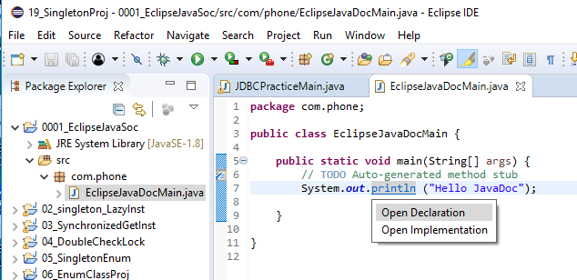
00.02 Attach JavaDoc to IDE
https://www.youtube.com/watch?v=jx9l72NBVC8&list=PLsyeobzWxl7rbjzQQQv8fCAlnBTDQJ2ps&index=2
Click Eclipse logo to start Eclipse.
File > New Project: 0001_EclipseJavaDoc
Select the Project, RMB (Right Mouse Button) and File > New Package: Com.phone
Select the Project, RMB and File > New Class: EclipseJavaDocMain.
Press Control key the select any method (as below) you want to know, e.g., System.out.println.

Slide 3
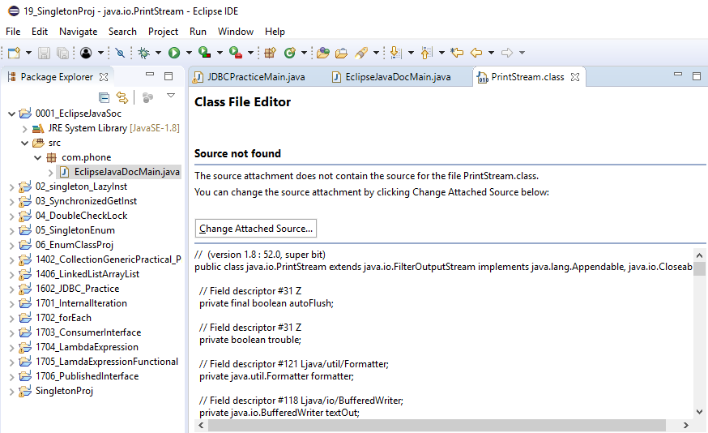
00.02 Attach JavaDoc to IDE
https://www.youtube.com/watch?v=jx9l72NBVC8&list=PLsyeobzWxl7rbjzQQQv8fCAlnBTDQJ2ps&index=2
It give you the error. It simply says, “No source code attached”.
How to attached the source?
Click the “Change Attached Source”

Slide 4
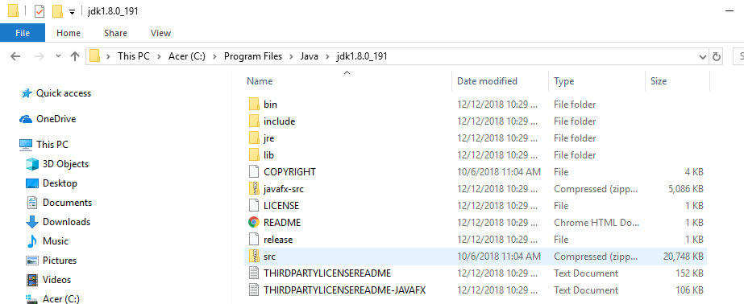
00.02 Attach JavaDoc to IDE
https://www.youtube.com/watch?v=jx9l72NBVC8&list=PLsyeobzWxl7rbjzQQQv8fCAlnBTDQJ2ps&index=2
We can look at the java install folder. There is compressed file folder called “src”.
Select the src and click OK. Now the JavaDoc is attached to Eclipse.

Slide 5
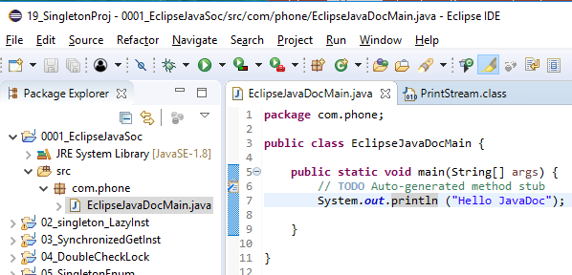
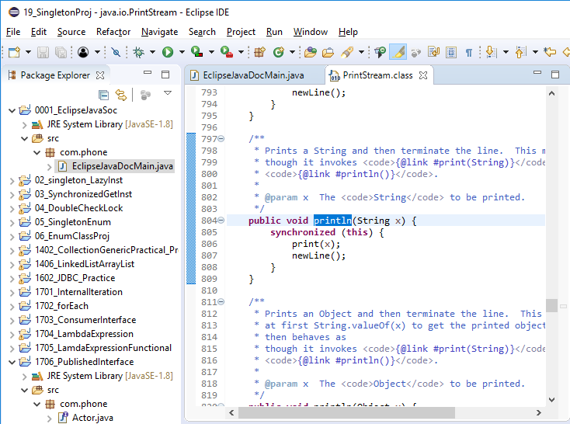
00.02 Attach JavaDoc to IDE
https://www.youtube.com/watch?v=jx9l72NBVC8&list=PLsyeobzWxl7rbjzQQQv8fCAlnBTDQJ2ps&index=2
We can look at the java install folder. There is compressed file folder called “src”.
Select the src and click OK. Now the JavaDoc is attached to Eclipse.
Press Control key and select any Java package (e.g. out), Interface (e.g., Consumer) or Core Java method (e.g., println). The JavaDoc is displayed.
Below, we select “println()”.

Slide 6
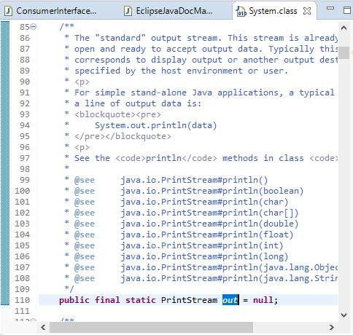
00.02 Attach JavaDoc to IDE
https://www.youtube.com/watch?v=jx9l72NBVC8&list=PLsyeobzWxl7rbjzQQQv8fCAlnBTDQJ2ps&index=2
Press Control and Select System package out.

Slide 7
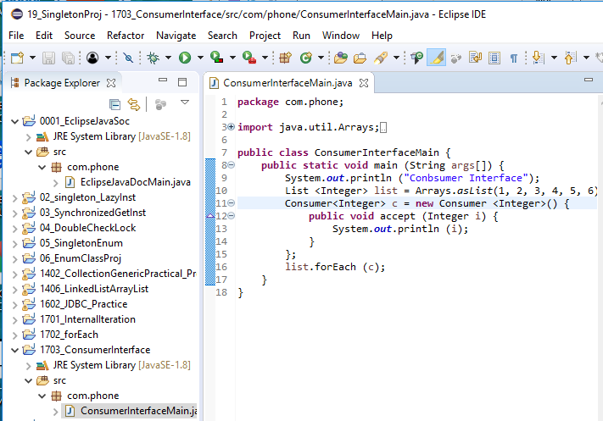
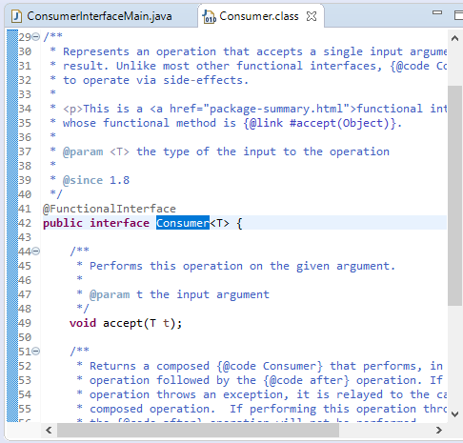
00.02 Attach JavaDoc to IDE
https://www.youtube.com/watch?v=jx9l72NBVC8&list=PLsyeobzWxl7rbjzQQQv8fCAlnBTDQJ2ps&index=2
Press Control and Select Interface Consumer.

Slide 8
End of Chapter

