Slide 1

14.02 Collection and Generic Practical
Peter H. Chen

Slide 2
14.02 Collection and Generic Practical
https://www.youtube.com/watch?v=HhrQqmp3hXI&list=PLsyeobzWxl7oZ-fxDYkOToURHhMuWD1BK&index=133
We discuss the Collection and Generic Practical in Java.
Java 1.2 have the Collections and Java 1.5 have the Generics
Since we are in Java 1.8, we have Collections and Generics.
Why we need the collections?
Collections provide you the dynamic type of arrays where you can add your elements, you can expand the size of array, and you can reduce the size of array. Those are the advantage of using collection.
Why we require the Generics? We add similar type elements inside the array. Why similar type? We can have array of objects.

Slide 3
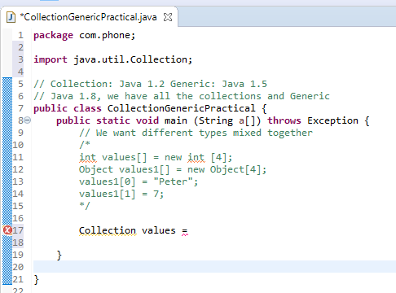
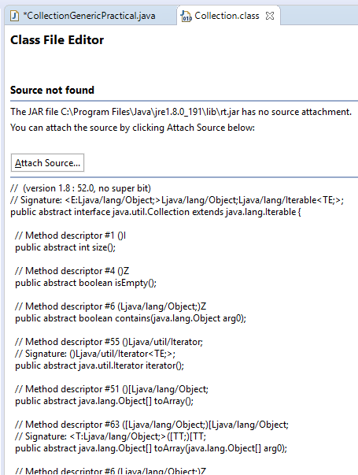
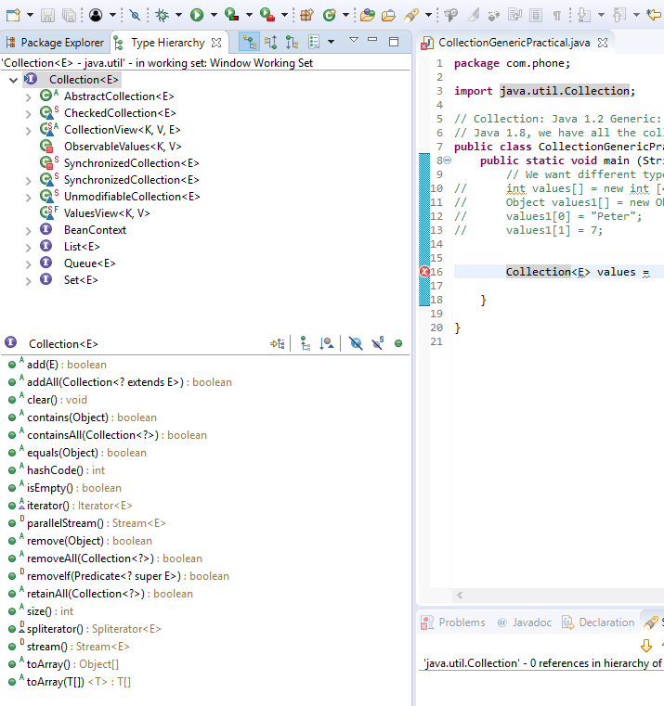
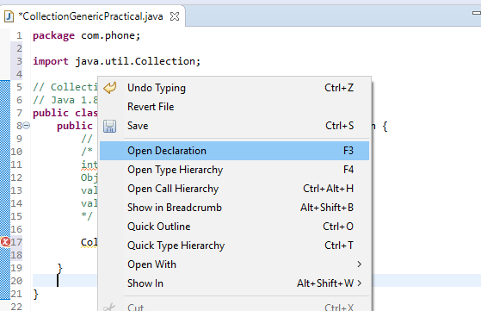
14.02 Collection and Generic Practical
https://www.youtube.com/watch?v=HhrQqmp3hXI&list=PLsyeobzWxl7oZ-fxDYkOToURHhMuWD1BK&index=133
Check the Collection Interface.

Slide 4
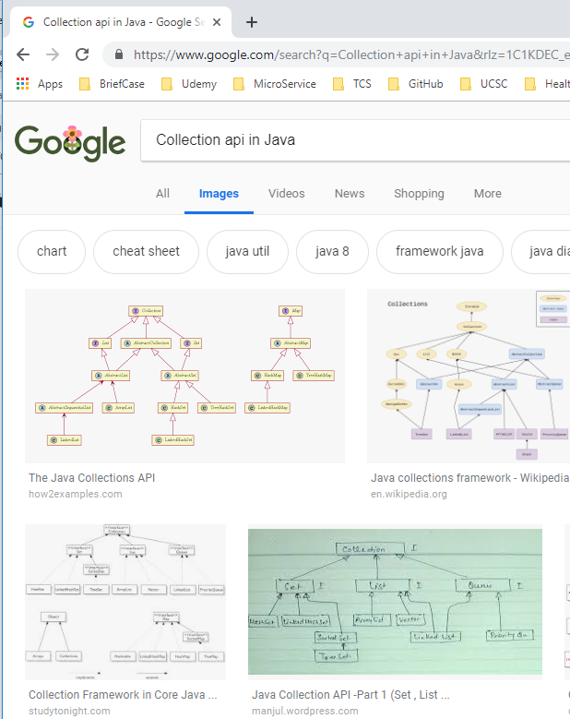
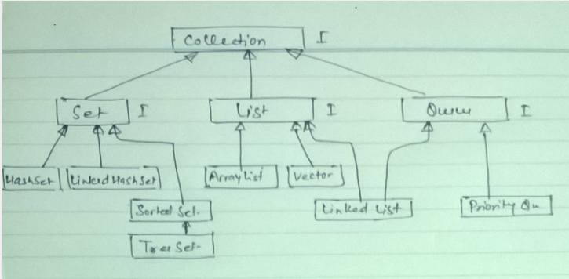
14.02 Collection and Generic Practical
https://www.youtube.com/watch?v=HhrQqmp3hXI&list=PLsyeobzWxl7oZ-fxDYkOToURHhMuWD1BK&index=133
Google “Collection API in Java”.

Slide 5
14.02 Collection and Generic Practical
https://www.youtube.com/watch?v=HhrQqmp3hXI&list=PLsyeobzWxl7oZ-fxDYkOToURHhMuWD1BK&index=133
Google “Collection API in Java”. The Collection Interface have Set, List, and Queue Interface.
Inside the List interface, we have ArrayList, Vector, and LinkedList.
Collection
I
Set
I
List
I
Queue
I
I: Interface
Implement
SortedSet
Dequeue
extends
ArrayList
PriorityQueue
HashSet
TreeSet
Vector
LinkedHashSet
LinkedList

Slide 6
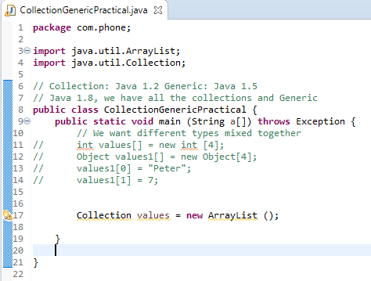
14.02 Collection and Generic Practical
https://www.youtube.com/watch?v=HhrQqmp3hXI&list=PLsyeobzWxl7oZ-fxDYkOToURHhMuWD1BK&index=133
In this example, we have Collection Interface and class ArrayList.
Once we got the object of ArrayList.

Slide 7
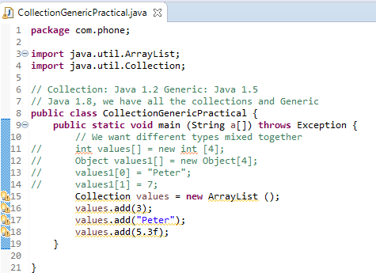
14.02 Collection and Generic Practical
https://www.youtube.com/watch?v=HhrQqmp3hXI&list=PLsyeobzWxl7oZ-fxDYkOToURHhMuWD1BK&index=133
Since our interface reference to values and ArrayList.
We can add some values of integer, string, or float.
We called this is a collection of objects.

Slide 8
14.02.01 Loop Objects by Iterator
Peter H. Chen

Slide 9
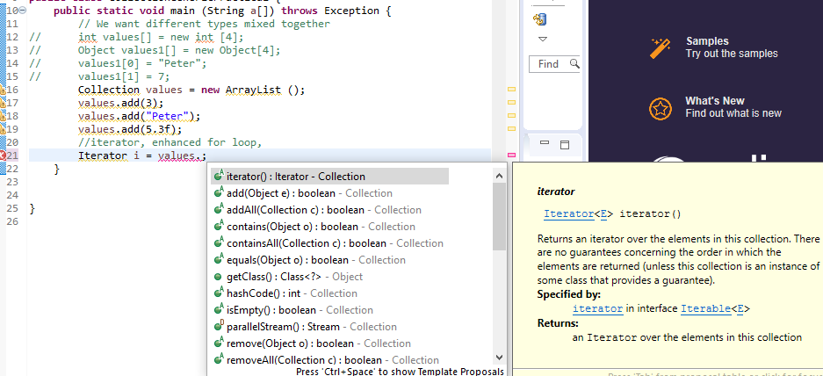
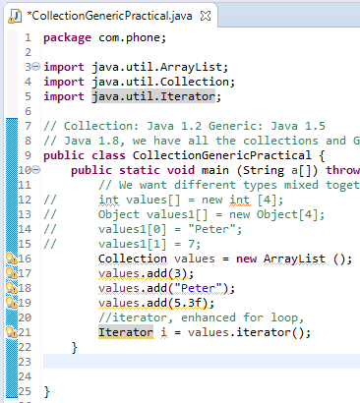
14.02.01 Loop Objects by Iterator
https://www.youtube.com/watch?v=HhrQqmp3hXI&list=PLsyeobzWxl7oZ-fxDYkOToURHhMuWD1BK&index=133
Now, how to fetch the values. You can type the values object and select the method iterator() in side the Iterator.

Slide 10
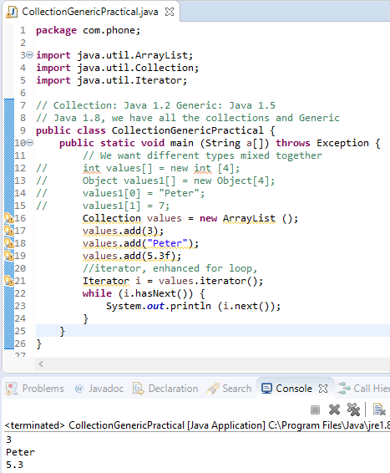
14.02.01 Loop Objects by Iterator
https://www.youtube.com/watch?v=HhrQqmp3hXI&list=PLsyeobzWxl7oZ-fxDYkOToURHhMuWD1BK&index=133
Use while (i.hasNext()) to loop all the elements and print with i.next().

Slide 11
14.02.02 Enhanced for Loop
Peter H. Chen

Slide 12
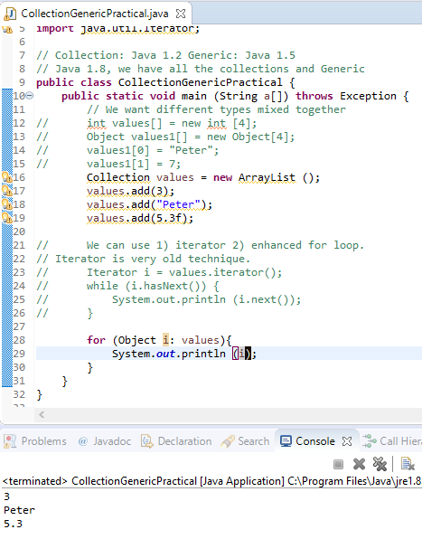
14.02.02 Enhanced for Loop
https://www.youtube.com/watch?v=HhrQqmp3hXI&list=PLsyeobzWxl7oZ-fxDYkOToURHhMuWD1BK&index=133
Iterator is a very old technique, we want to use new technique with Enhanced for Loop.
for (Obejct i: values) {
System.out.println (i);
}
i: is the Object in values Object. The i is one of the Object in the Object array.

Slide 13
14.02.02 Enhanced for Loop
https://www.youtube.com/watch?v=HhrQqmp3hXI&list=PLsyeobzWxl7oZ-fxDYkOToURHhMuWD1BK&index=133
Use while (i.hasNext()) to loop all the elements and print with i.next().

Slide 14
End of Chapter

