Slide 1

14.06 Linked List vs. Array List
Peter H. Chen

Slide 2
14.06 Linked List vs. Array List
https://www.youtube.com/watch?v=QWMyhFUtFHo
We discuss the difference of Linked List and Array List.
There some similarity of the implementation of Linked and Array List.
Both Linked List and Array List are the implementation of List Interface.
In Java, we talked about Collection of API. Then, we have a lot of interfaces.
For the Collection interface, we have List Interface, Set Interface, Map Interface, and etc.
The Linked List and Array List belong the same family but they still have differences.
If we want to implement Array List, we have fixed size of elements, for example, we can have five or six element, we cannot go beyond that.
If you want to create a dynamic array here, we normally use array list. We can expand the array and we can shrink array. We can do those stuff in array list.
Is it possible to the same stuff in Linked List? Same thing, we can add the element and we can remove the elements.
The differences is their implementation.

Slide 3
14.06 Linked List vs. Array List
https://www.youtube.com/watch?v=QWMyhFUtFHo
The major difference in Linked List and Array List is their implementation:
The LinkedList implementation is based on Doubled Linked List.
The ArrayList implementation is based on Dynamic Array.
LinkedList
vs
ArrayList
Based on
Based on
Double Linked List
Dynamic Array

Slide 4
14.06.1 Array List
Peter H. Chen

Slide 5
14.06.1 Array List
https://www.youtube.com/watch?v=QWMyhFUtFHo
How do you store the values in the dynamic array?
In dynamic array, the initial capacity is 10. We can add capacity 5.
What happened if we add the element in between? For example, we want to add 16 after 12 and between 21. The 16 will go to (index, value) = (4, 16), the other values will go to the next index number.
Every value you insert, you have to move the index below. It is time consuming.
ArrayList
Index
Value
Index
Value
0
5
0
5
Based on
1
7
1
7
2
8
2
8
Dynamic Array
3
12
3
12
4
21
4
16
5
2
5
21
6
3
6
2
7
3

Slide 6
14.06.1 Array List
https://www.youtube.com/watch?v=QWMyhFUtFHo
There are one more problem when you remove the element, for example, you remove (index, value) = (2, 8), all the index below 2 will be moved up.
Again, it will take some time. In data structure, the insert or remove operation in array list will affect the big O (n).
Index
Value
Index
Value
ArrayList
0
5
0
5
1
7
1
7
2
8
2
12
Based on
4
16
3
12
Dynamic Array
4
21
5
21
5
2
6
2
6
3
7
3

Slide 7
14.06.2 Linked List
Peter H. Chen

Slide 8
14.06.2 Linked List
https://www.youtube.com/watch?v=QWMyhFUtFHo
How about the LinkedList?
Each node contains data and previous node and next node. They linked together as below.
LinkedList
P
Previous Node
5
N
Next Node
P
N
Double Linked List
7
P
N
8
P
N
12
P
N

Slide 9
14.06.2 Linked List
https://www.youtube.com/watch?v=QWMyhFUtFHo
Add element 32. The add will not affect any performance. This is faster than ArrayList.
When you add or remove, the LinkedList is faster than ArrayList.
When you search the value, the LinkedList is slower than ArrayList.
5
P
N
7
P
N
32
LinkedList
P
Previous Node
P
N
N
Next Node
8
P
N
Double Linked List
12
P
N

Slide 10
14.06.3 Example
Peter H. Chen

Slide 11
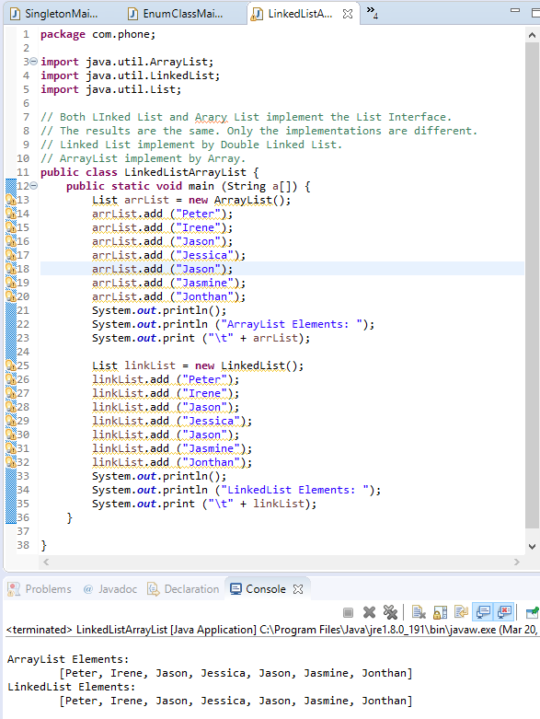
14.06.3 Example
https://www.tutorialspoint.com/java/java_list_interface.htm
Code Example:

Slide 12
End of Chapter

