Slide 1

17.03 Consumer Interface
Peter H. Chen

Slide 2
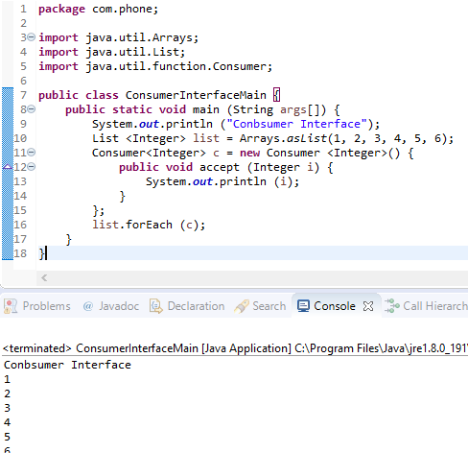
17.03 Consumer Interface
https://www.youtube.com/watch?v=_GLjsVdAhGw&list=PLsyeobzWxl7oZ-fxDYkOToURHhMuWD1BK&index=166
We discuss the forEach. How the argument inside the forEach ()?
The Consumer Interface is the parameter for forEach ().
It pass one object value one at a time from array to Consumer Interface.
The Consumer Interface has a accept method which requires you to implement.
The list will pass obj value to forEach (obj) one-by-one to Consumer Interface. If the value is 1, then the parameter in accept (parameter) will get 1.
The accept() here accepts a Consumer Interface.

Slide 3
End of Chapter

