Slide 1

14.02 Collection and Generic Practical
Peter H. Chen

Slide 2
14.02 Collection and Generic Practical
https://www.youtube.com/watch?v=HhrQqmp3hXI&list=PLsyeobzWxl7oZ-fxDYkOToURHhMuWD1BK&index=133
We discuss the Collection and Generic Practical in Java.
Java 1.0, Collection is not there.
Java 1.2 have the Collections and Java 1.5 have the Generics
Since we are in Java 1.8, we have all the features of Collections and Generics.
Why we need the collections?
Collections provide you the dynamic type of arrays where you can add your elements, you can expand the size of array, and you can reduce the size of array. Those are the advantage of using collection.

Slide 3
14.02 Collection and Generic Practical
https://www.youtube.com/watch?v=HhrQqmp3hXI&list=PLsyeobzWxl7oZ-fxDYkOToURHhMuWD1BK&index=133
For example,
int values [] = new int[4];
The size is fixed to 4. and data type is integer. We want the array is expandable.
Another example:
Object values1 [] = new Object[4];
values1[0] = “Peter”;
values1[1] = 7;
The Object here can be any type.
The Problem of two examples here are their array size is fixed. They can only hold 4 elements.
What if we want to increase size of array. That is not possible. That is why we go something like collection.

Slide 4
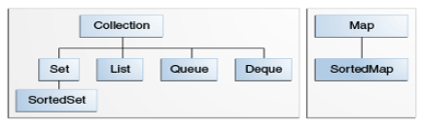
14.02 Collection and Generic Practical
https://www.youtube.com/watch?v=HhrQqmp3hXI&list=PLsyeobzWxl7oZ-fxDYkOToURHhMuWD1BK&index=133
What is collection? Collection is the interface in Java.
For example.
Collection values =
Search for “Lesson: Collection in Java”
https://docs.oracle.com/javase/tutorial/collections/intro/index.html

Slide 5
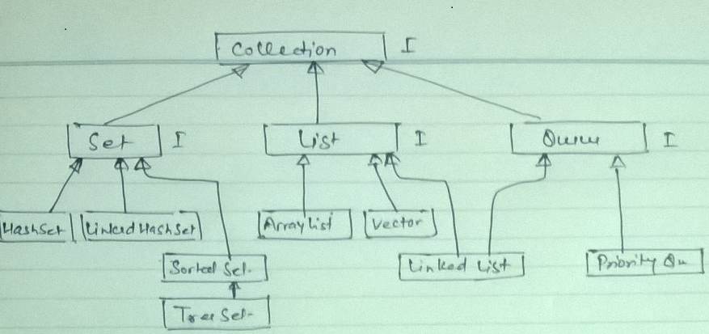
14.02 Collection and Generic Practical
https://www.youtube.com/watch?v=HhrQqmp3hXI&list=PLsyeobzWxl7oZ-fxDYkOToURHhMuWD1BK&index=133
Search for “Collection API in Java” images.

Slide 6
14.02 Collection and Generic Practical
https://www.youtube.com/watch?v=HhrQqmp3hXI&list=PLsyeobzWxl7oZ-fxDYkOToURHhMuWD1BK&index=133
In this example, we can have
import java.util.ArrayList;
import java.util.Collection;
…
Collection values = new ArrayList();
values.add (3);
values.add(“Peter”);
values.add(5.8f);
We can add elements of any type.
How to print the values?
There are two ways to fetch the value. The first way is using an iterator. The second way is use enhanced for loop.
Iterator is an interface:
Iterator i = values.iterator(); // We go the iterator object here.
// Once we got the object, we can use i.next() to loop through all the element.
System.out.println (i.next()); // print 3
System.out.println (i.next()); // print “Peter”
System.out.println (i.next()); // print 5.8

Slide 7
14.02 Collection and Generic Practical
https://www.youtube.com/watch?v=HhrQqmp3hXI&list=PLsyeobzWxl7oZ-fxDYkOToURHhMuWD1BK&index=133
Can we use while loop.
Collection values = new ArrayList();
values.add (3);
values.add(“Peter”);
values.add(5.8f);
Iterator i = values.Iterator ()
while (i.hasNext()) {
System.out.println (i.next());
}
We can use enhanced for loop here.
Collection values = new ArrayList();
values.add (3);
values.add(“Peter”);
values.add(5.8f);
for (Object i : values) {
System.out.println (i);
}

Slide 8
14.02 Collection and Generic Practical
https://www.youtube.com/watch?v=HhrQqmp3hXI&list=PLsyeobzWxl7oZ-fxDYkOToURHhMuWD1BK&index=133
Why we require the Generics? We add similar type elements inside the array. Why similar type? We can have array of objects.
If we want to have specific type of data.
The specific data type we specify by <> is called Generic. We can have any data type Integeer inside the <Integer>. This Generic is after Java 1.2.
Collection values<Integer> = new ArrayList<>();
We can put <Float> or any custom class, such as, class Student { …} and put student inside <> as follow:
Collection values <student> = new ArrayList<> ();
Collection values<Integer> = new ArrayList<>();
values.add (3);
values.add(77);
values.add(88);
for (Object i : values) {
System.out.println (i);
}

Slide 9
14.02 Collection and Generic Practical
https://www.youtube.com/watch?v=HhrQqmp3hXI&list=PLsyeobzWxl7oZ-fxDYkOToURHhMuWD1BK&index=133
We can remove element by
Collection values<Integer> = new ArrayList<>();
values.add (3);
values.add(77);
values.add(88);
values.remove(77);
for (Object i : values) {
System.out.println (i);
}

Slide 10
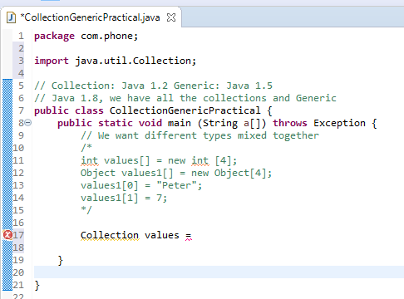
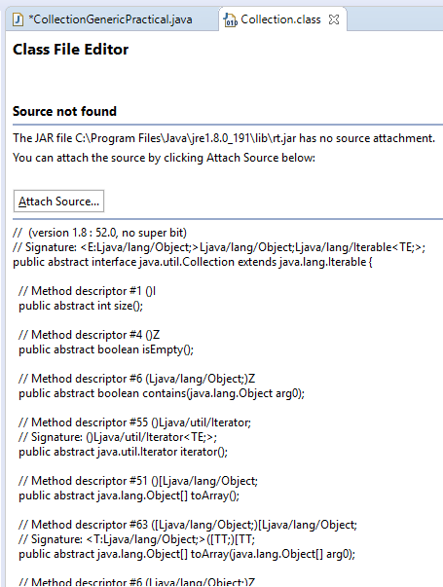
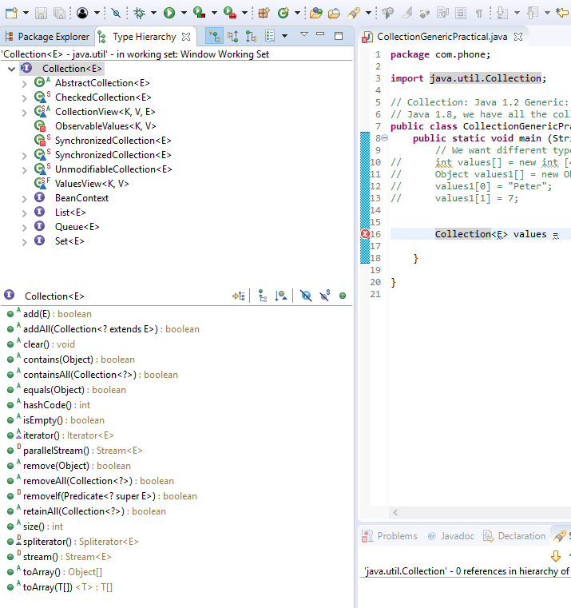
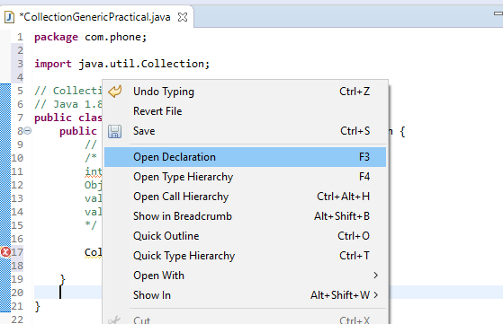
14.02 Collection and Generic Practical
https://www.youtube.com/watch?v=HhrQqmp3hXI&list=PLsyeobzWxl7oZ-fxDYkOToURHhMuWD1BK&index=133
Check the Collection Interface.

Slide 11
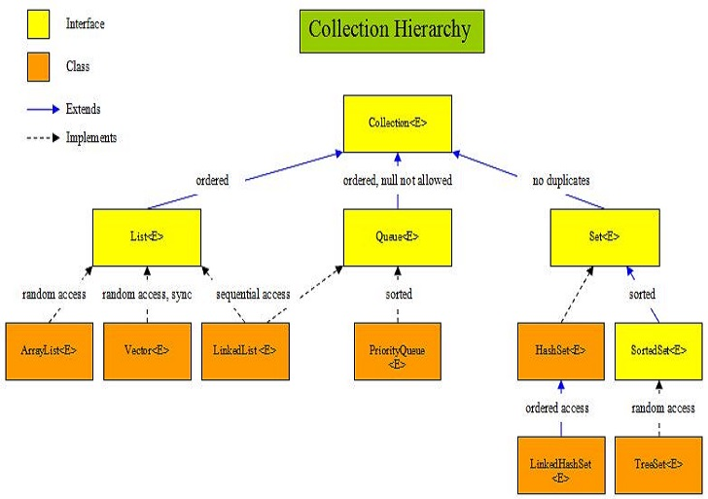
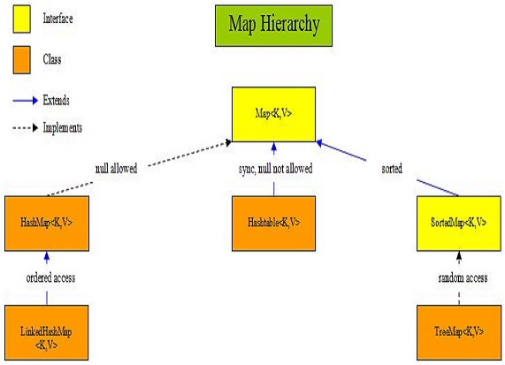
14.02 Collection and Generic Practical
https://www.youtube.com/watch?v=HhrQqmp3hXI&list=PLsyeobzWxl7oZ-fxDYkOToURHhMuWD1BK&index=133
Google “Collection API in Java” and “Map Interface in Java”.

Slide 12
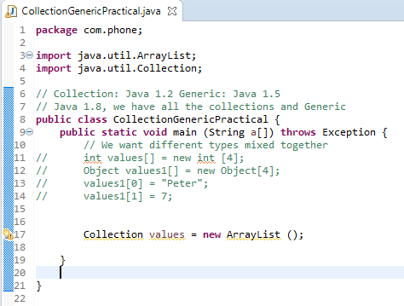
14.02 Collection and Generic Practical
https://www.youtube.com/watch?v=HhrQqmp3hXI&list=PLsyeobzWxl7oZ-fxDYkOToURHhMuWD1BK&index=133
In this example, we have Collection Interface and class ArrayList.
Once we got the object of ArrayList.

Slide 13
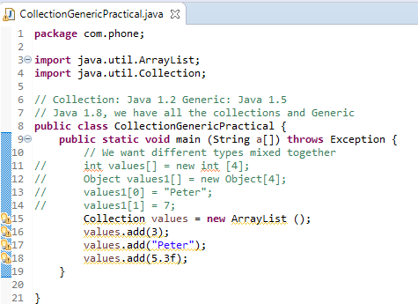
14.02 Collection and Generic Practical
https://www.youtube.com/watch?v=HhrQqmp3hXI&list=PLsyeobzWxl7oZ-fxDYkOToURHhMuWD1BK&index=133
Since our interface reference to values and ArrayList.
We can add some values of integer, string, or float.
We called this is a collection of objects.

Slide 14
14.02.01 Loop Objects by Iterator
Peter H. Chen

Slide 15
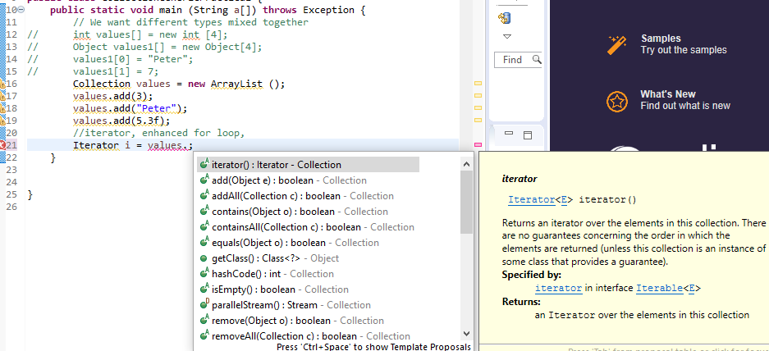
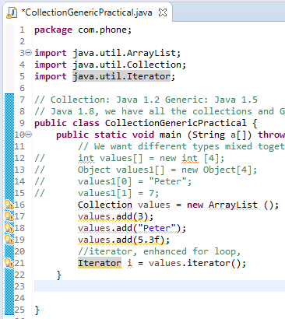
14.02.01 Loop Objects by Iterator
https://www.youtube.com/watch?v=HhrQqmp3hXI&list=PLsyeobzWxl7oZ-fxDYkOToURHhMuWD1BK&index=133
Now, how to fetch the values. You can type the values object and select the method iterator() in side the Iterator.

Slide 16
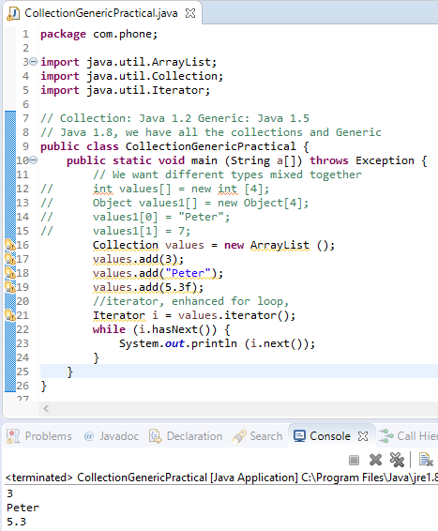
14.02.01 Loop Objects by Iterator
https://www.youtube.com/watch?v=HhrQqmp3hXI&list=PLsyeobzWxl7oZ-fxDYkOToURHhMuWD1BK&index=133
Use while (i.hasNext()) to loop all the elements and print with i.next().

Slide 17
14.02.02 Enhanced for Loop
Peter H. Chen

Slide 18
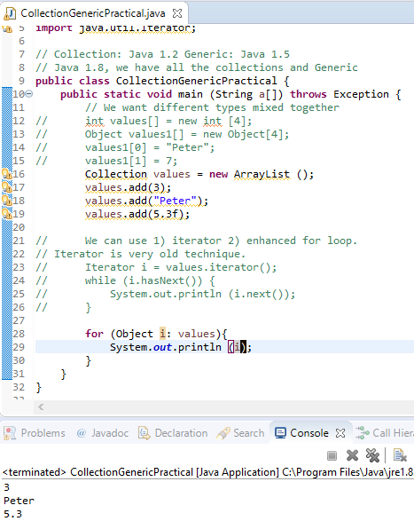
14.02.02 Enhanced for Loop
https://www.youtube.com/watch?v=HhrQqmp3hXI&list=PLsyeobzWxl7oZ-fxDYkOToURHhMuWD1BK&index=133
Iterator is a very old technique, we want to use new technique with Enhanced for Loop.
for (Obejct i: values) {
System.out.println (i);
}
i: is the Object in values Object. The i is one of the Object in the Object array.

Slide 19
14.02.03 Generic in Java
Peter H. Chen

Slide 20
14.02.03 Generic in Java
https://www.youtube.com/watch?v=XMvznsY02Mk&list=PLsyeobzWxl7oZ-fxDYkOToURHhMuWD1BK&index=134
This section talks about Generic:
public class GenericDemo {
public static void main (String [] args) {
}
}
In Java, if we want to work any variables, we have to declare first.
public class GenericDemo {
public static void main (String [] args) {
int value = 5; // We need to specify the type before the run time.
List values = new ArrayList(); // This values can have any type of value.
values.add(7);
values.add (“Peter”);
}
}

Slide 21
14.02.03 Generic in Java
https://www.youtube.com/watch?v=XMvznsY02Mk&list=PLsyeobzWxl7oZ-fxDYkOToURHhMuWD1BK&index=134
If you specify one type of data, such as, Integer
public class GenericDemo {
public static void main (String [] args) {
List <Integer> values = new ArrayList<>(); // Specify the Integer type.
values.add(7);
values.add (“Peter”); // You will get error in the compilation time.
}
}

Slide 22
End of Chapter

