Slide 1

17.06 Published Interface
Peter H. Chen

Slide 2
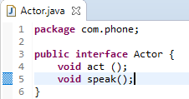
17.06 Published Interface
https://www.youtube.com/watch?v=akCAvlyHN2k&list=PLsyeobzWxl7oZ-fxDYkOToURHhMuWD1BK&index=169
Once the Interface is published, it should not be modified.
Let’s say, if we have an interface called Actor.
In the development stage, we can add method, such as, act() and speak(), for the interface.
Now, the Actor() interface has act() and speak() methods.

Slide 3
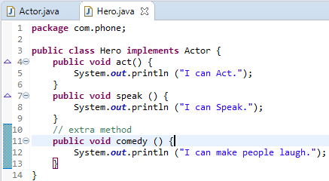
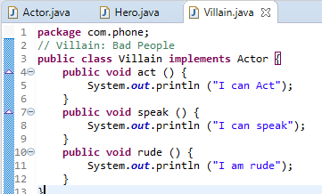
17.06 Published Interface
https://www.youtube.com/watch?v=akCAvlyHN2k&list=PLsyeobzWxl7oZ-fxDYkOToURHhMuWD1BK&index=169
Now, we create class Hero to implement the interface Actor().
Create a Villain Class which implements the interface Actor().

Slide 4
17.06 Published Interface
https://www.youtube.com/watch?v=akCAvlyHN2k&list=PLsyeobzWxl7oZ-fxDYkOToURHhMuWD1BK&index=169
Then, we published the interface Actor ().
We want to add dance () method inside the Interface Actor().
The dance() never implement in the class Hero() and class Villain().
Obviously, both classes will have error.
For another example, if Interface Actor add comedy() method, the class Hero is fine but the class Villain does not implement the comedy () method and will give you an error.
That is why after published the interface, you should never modify the interface.
Wait a second, in Java 1.7, you never modify the interface after published.
How about Java 1.8?
The problem is you declare the method and get the error for class who implement the interface. It we define the empty method here, it will be fine.
In Java 1.7, we should never modify the interface once they are published.

Slide 5
End of Chapter

